Slide 1
Chapter 9: NAT for IPv4
Routing and Switching Essentials 6.0 Planning Guide
Notes:
Cisco Networking Academy Program
Routing and Switching Essentials v6.0
Chapter 9: NAT for IPv4

Slide 2
Chapter 9 - Sections
9.1 NAT Operation
9.2 Configure NAT
9.3 Troubleshoot NAT
9.4 Něco navíc
Notes:
2
Cisco Networking Academy Program
Routing and Switching Essentials v6.0
Chapter 9: NAT for IPv4

Slide 3
9.1 NAT Operation
Notes:
9 – NAT for IPv4
9.1 – NAT Operation

Slide 4
IPv4 Private Address Space
Did you ever notice how all your labs were based on these addresses?
These are the IP addresses you will see assigned to company devices.
Notes:
9.1 – NAT Operation
9.1.1 – NAT Characteristics
9.1.1.1 – IPv4 Private Address Space

Slide 5
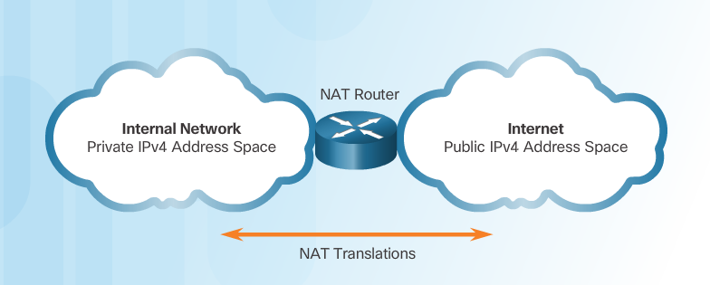
IPv4 Private Address Space (Cont.)
Private IP addresses cannot be routed over the Internet.
NAT is used to translate private IP addresses to public addresses that can be routed over the Internet.
One public IPv4 address can be used for thousands of devices that have private IP addresses.
Notes:
9.1 – NAT Operation
9.1.1 – NAT Characteristics
9.1.1.1 – IPv4 Private Address Space

Slide 6
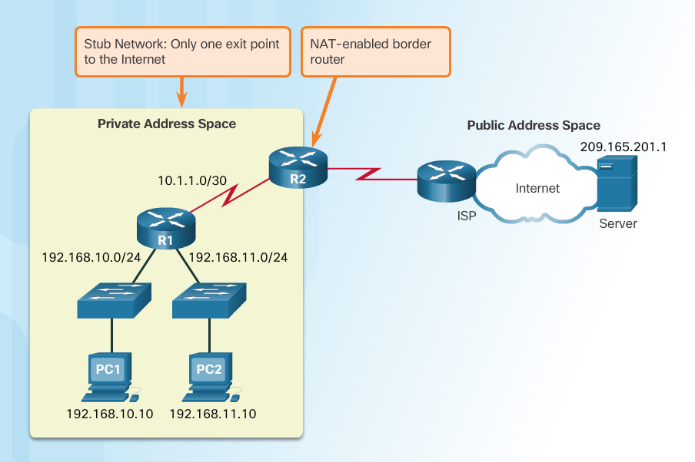
What is NAT?
Important Concept—NAT is enabled on one device (normally the border or edge router)
Notes:
9.1 – NAT Operation
9.1.1 – NAT Characteristics
9.1.1.2 – What is NAT?

Slide 7
What is NAT?
Private IP addresses cannot be routed over the Internet.
NAT is used to translate private IP addresses used inside a company to public addresses that can be routed over the Internet.
NAT hides internal IPv4 addresses from outside networks.
Companies use the same private IPv4 addresses so outside devices cannot tell one company’s 10.x.x.x network from another company’s 10.x.x.x network.
A NAT-enabled router can be configured with a public IPv4 address.
A NAT-enabled router can be configured with multiple public IPv4 addresses to be used in a pool or NAT pool for internal devices configured with private addresses.

Slide 8
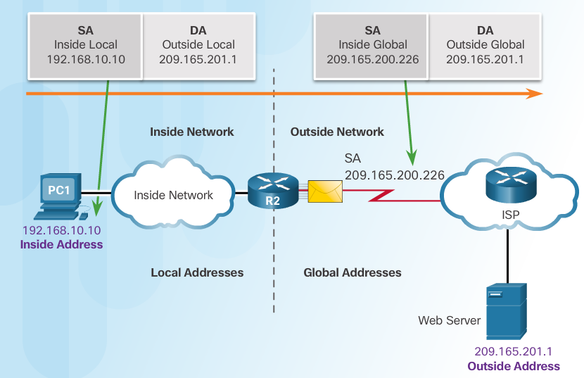
NAT Terminology
Four types of addresses: inside, outside, local, and global
Always consider the device that is having its private address translated to understand this concept.
Inside address – address of the company network device that is being translated by NAT
Outside address – IP address of the destination device
Local address – any address that appears on the inside portion of the network
Global address – any address that appears on the outside portion of the network
Notes:
9.1 – NAT Operation
9.1.1 – NAT Characteristics
9.1.1.3 –NAT Terminology

Slide 9
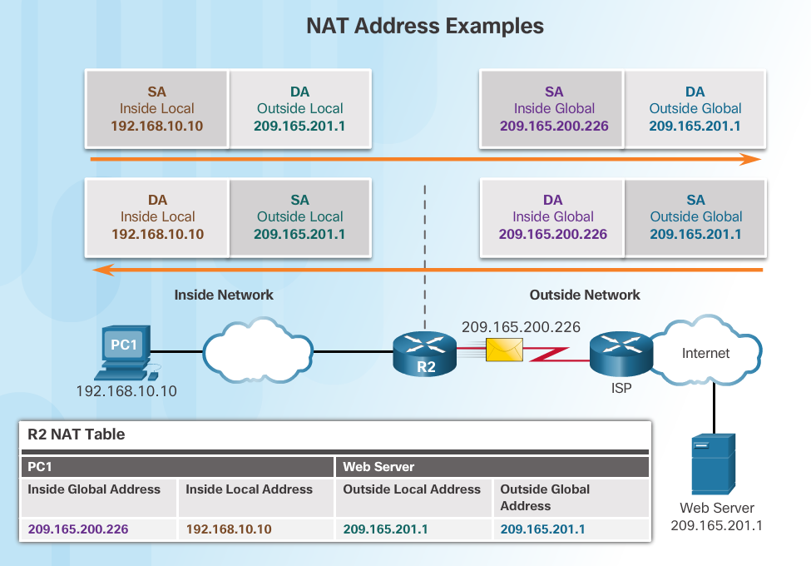
NAT Terminology (Cont.)
Notes:
9.1 – NAT Operation
9.1.1 – NAT Characteristics
9.1.1.4 –NAT Terminology (Cont.)

Slide 10
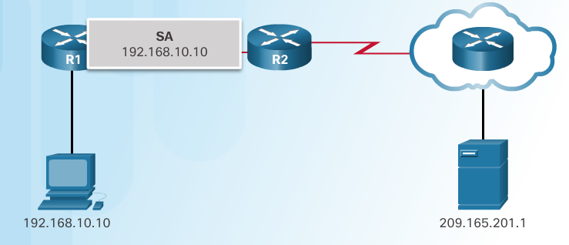
How NAT Works
1. The private (internal) IP address gets translated to a public IP address used to reach the external server.
Notes:
9.1 – NAT Operation
9.1.1 – NAT Characteristics
9.1.1.5 – How NAT Works

Slide 11
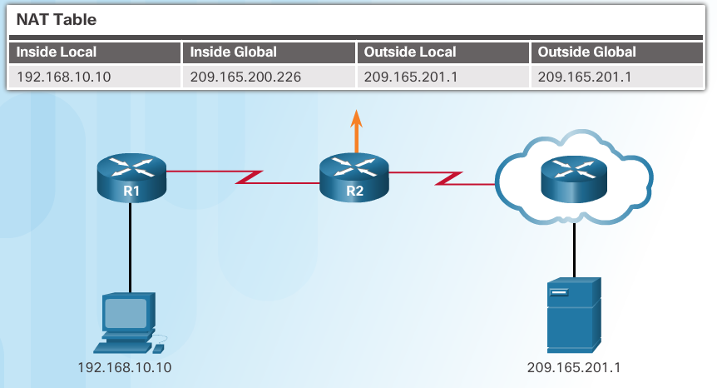
How NAT Works
1. The private (internal) IP address gets translated to a public IP address used to reach the external server.
Notes:
9.1 – NAT Operation
9.1.1 – NAT Characteristics
9.1.1.5 – How NAT Works

Slide 12
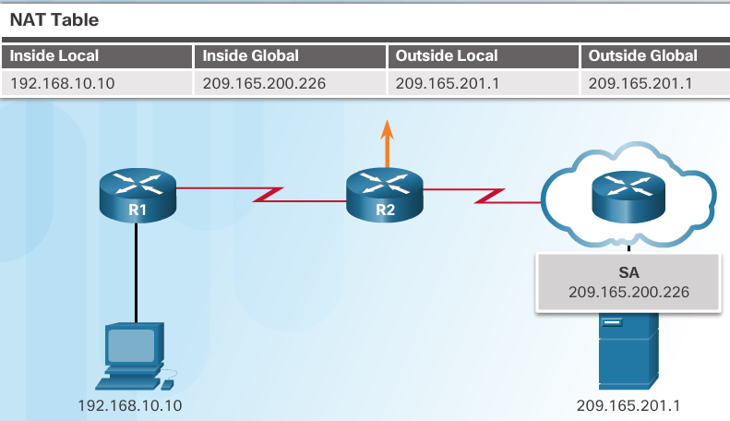
How NAT Works
1. The private (internal) IP address gets translated to a public IP address used to reach the external server.
Notes:
9.1 – NAT Operation
9.1.1 – NAT Characteristics
9.1.1.5 – How NAT Works

Slide 13
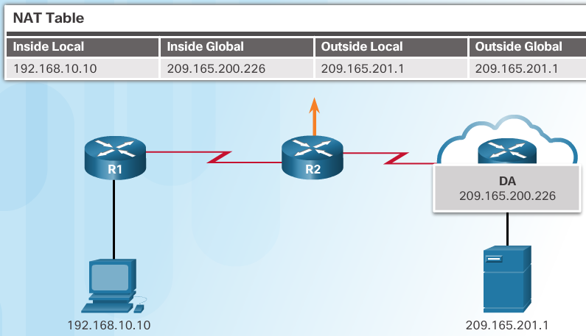
How NAT Works (Cont.)
2. The translated public address is used by the server to send the requested information to the device that actually has a private IP address assigned to it.
Notes:
9.1 – NAT Operation
9.1.1 – NAT Characteristics
9.1.1.5 – How NAT Works (Cont.)

Slide 14
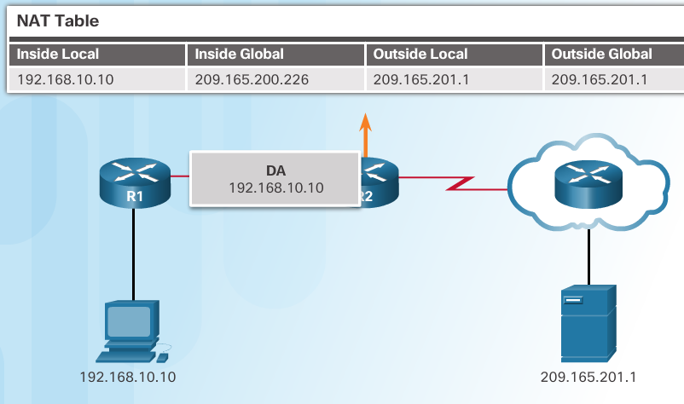
NAT Characteristics How NAT Works (Cont.)
3. The NAT-enabled router consults the routing table to see what private address requested the data.
Notes:
9.1 – NAT Operation
9.1.1 – NAT Characteristics
9.1.1.5 – How NAT Works (Cont.)

Slide 15
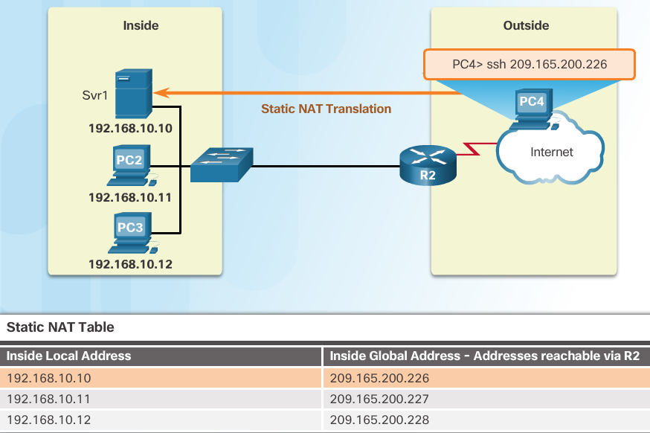
Static NAT
Static address translation (static NAT) assigns one public IP address to one private IP address
Commonly used for servers that need to be accessed by external devices or for devices that must be accessible by authorized personnel when offsite
One-to-one address mapping between local and global addresses
Notes:
9.1 – NAT Operation
9.1.2 – Types of NAT
9.1.2.1 – Static NAT

Slide 16
Static NAT
Notes:
9.1 – NAT Operation
9.1.2 – Types of NAT
9.1.2.1 – Static NAT

Slide 17
Dynamic NAT
Dynamic NAT assigns a public IP address from a pool of addresses to each packet that originates from a device that has a private IP address assigned when that packet is destined to a network outside the company.
Addresses are assigned on a first-come, first serve basis
The number of internal devices that can transmit outside the company is limited to the number of public IP addresses in the pool.
Notes:
9.1 – NAT Operation
9.1.2 – Types of NAT
9.1.2.2 – Dynamic NAT

Slide 18
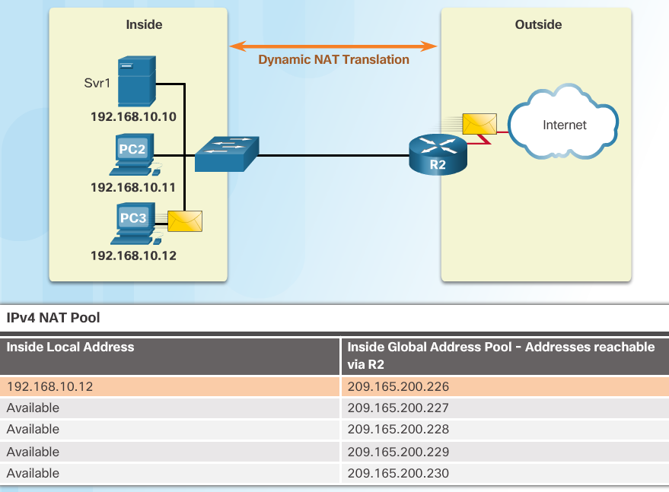
Dynamic NAT
Notes:
9.1 – NAT Operation
9.1.2 – Types of NAT
9.1.2.2 – Dynamic NAT

Slide 19
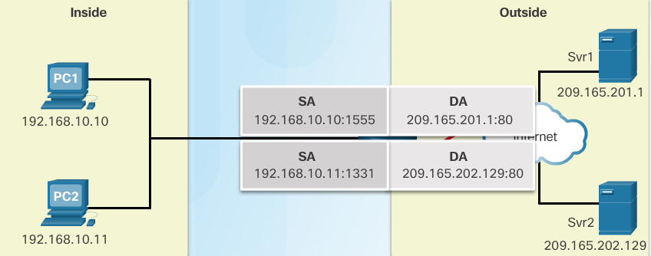
Port Address Translation (PAT)
PAT (otherwise known as NAT overload) can use one public IPv4 address to allow thousand of private IPv4 addresses to communicate with outside network devices.
Uses port numbers to track the session
Notes:
9.1 – NAT Operation
9.1.2 – Types of NAT
9.1.2.3 – Port Address Translation (PAT)

Slide 20
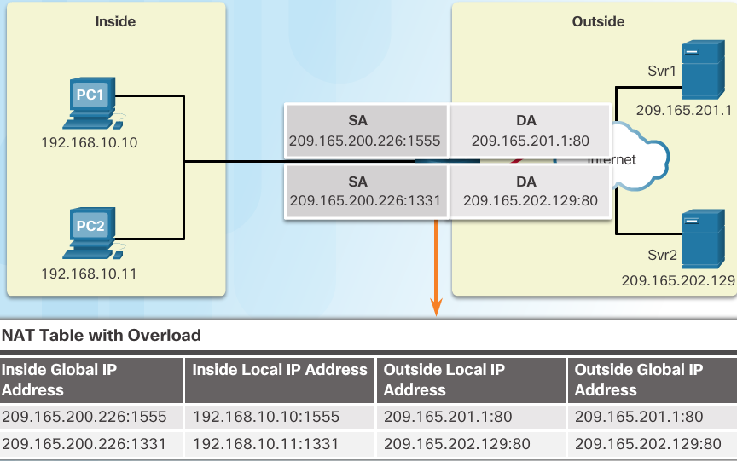
Port Address Translation (PAT)
Notes:
9.1 – NAT Operation
9.1.2 – Types of NAT
9.1.2.3 – Port Address Translation (PAT)

Slide 21
Next Available Port
PAT tries to preserve the original source port number.
If that port number is already use, PAT will assign the first available port number for the appropriate port group
0 - 511
512 - 1023
1024 - 65,535
When there are no more port numbers available, PAT moves to the next public IP address in the pool if there is one.
Notes:
9.1 – NAT Operation
9.1.2 – Types of NAT
9.1.2.4 – Next Available Port

Slide 22
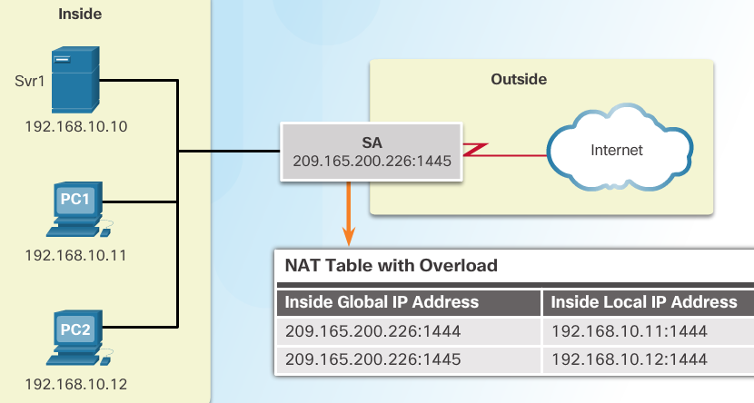
Next Available Port
1. Notice how traffic is from two different internal devices using the same port number.
2. Notice how PAT uses the same public address, but two different port numbers.
Notes:
9.1 – NAT Operation
9.1.2 – Types of NAT
9.1.2.4 – Next Available Port

Slide 23
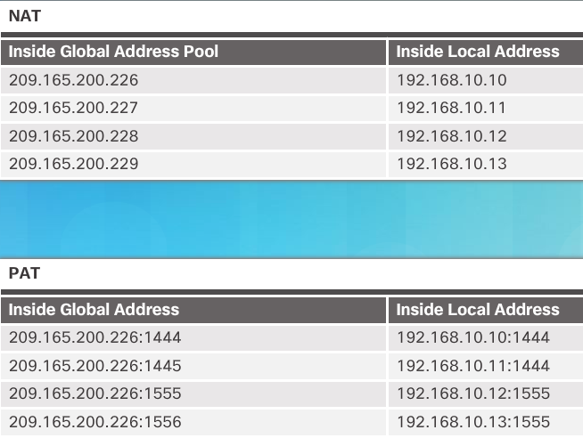
Comparing NAT and PAT
Static NAT translates address on a 1:1 basis
PAT uses port numbers so that one public address can be used for multiple privately addressed devices
PAT can still function with a protocol such as ICMP that does not use TCP or UDP
Notes:
9.1 – NAT Operation
9.1.2 – Types of NAT
9.1.2.5 – Comparing NAT and PAT

Slide 24
Types of NAT Packet Tracer – Investigating NAT Operation
Notes:
9.1 – NAT Operation
9.1.2 – Types of NAT
9.1.2.6 – Packet Tracer – Investigating NAT Operation

Slide 25
Advantages of NAT
Conserves the legally registered addressing scheme
Every company can use the private IP addresses
Increases the flexibility of connections to the public network
Multiple NAT pools, backup pools, and load-balancing across NAT pools
Provides consistency for internal network addressing schemes
Do not have to readdress the network if a new ISP or public IP address is assigned
Provides network security
Hides user private IPv4 addresses
Notes:
9.1 – NAT Operation
9.1.3 – NAT Advantages
9.1.3.1 – Advantages of NAT

Slide 26
Disadvantages of NAT
Performance is degraded.
The NAT-enabled border device must track and process each session destined for an external network.
End-to-end functionality is degraded.
Translation of each IPv4 address within the packet headers takes time.
End-to-end IP traceability is lost.
Some applications require end-to-end addressing and can‘t be used with NAT.
Static NAT mappings can sometimes be used.
Troubleshooting can be more challenging.
Tunneling becomes more complicated (náročnější).
Initiating TCP connections can be disrupted.
Notes:
9.1 – NAT Operation
9.1.3 – NAT Advantages
9.1.3.2 – Disadvantages of NAT

Slide 27
9.2 Configure NAT
Notes:
9 – NAT for IPv4
9.2 – Configure NAT

Slide 28
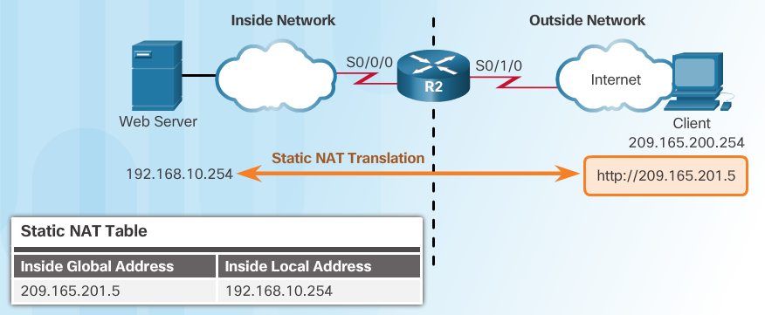
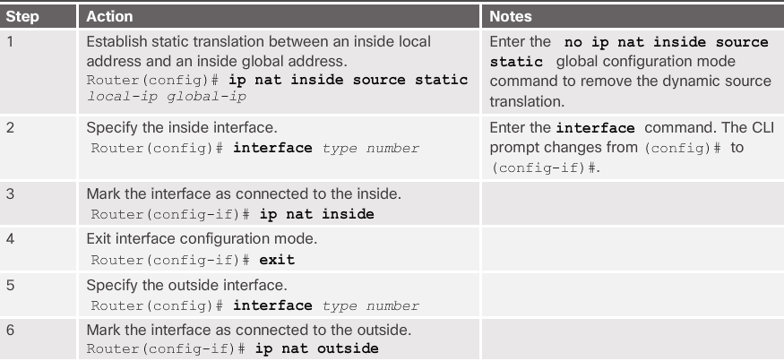
Configure Static NAT
Notes:
9.2 – Configure NAT
9.2.1 – Configuring Static NAT
9.2.1.1 – Configure Static NAT

Slide 29
Typická chyba!
Remember that any interface on the border router that is on the inside network must be configured with the ip nat inside command. This is a common mistake for those new to NAT.
Notes:
9.2 – Configure NAT
9.2.1 – Configuring Static NAT
9.2.1.1 – Configure Static NAT

Slide 30
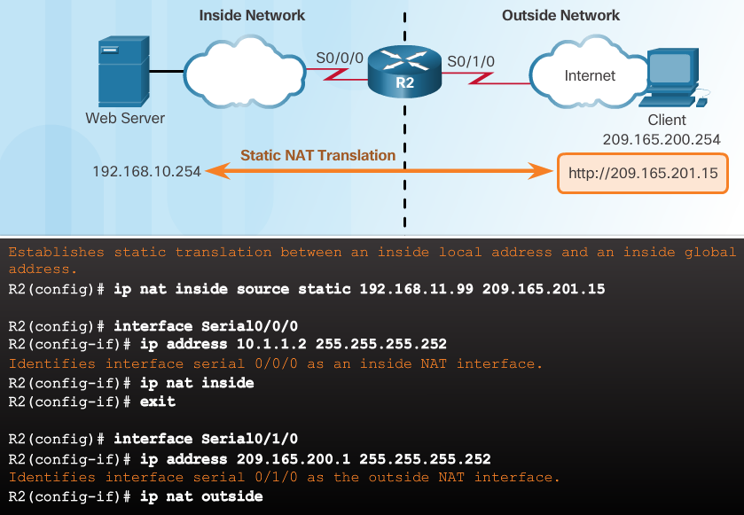
Static NAT
Notes:
9.2 – Configure NAT
9.2.1 – Configuring Static NAT
9.2.1.1 – Configure Static NAT

Slide 31
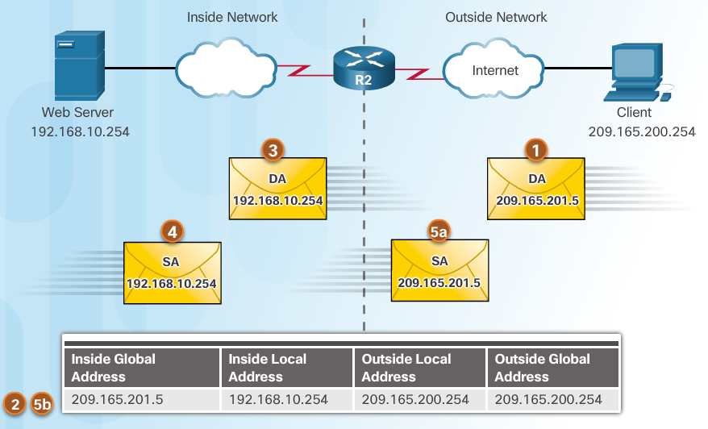
Configuring Static NAT Analyzing Static NAT
Client opens a web browser for a connection to a web server.
R2 receives the packet on the outside interface and checks the NAT table.
R2 replaces the inside global address with inside local address of 192.168.10.254 (the server’s address).
Web server responds to the client.
(a) R2 receives the packet from the server on the inside address. (b) R2 checks NAT table and translates the source address to the inside global address of 209165.201.5 and forwards the packet.
The client receives the packet.
Notes:
9.2 – Configure NAT
9.2.1 – Configuring Static NAT
9.2.1.2 – Analyzing Static NAT

Slide 32
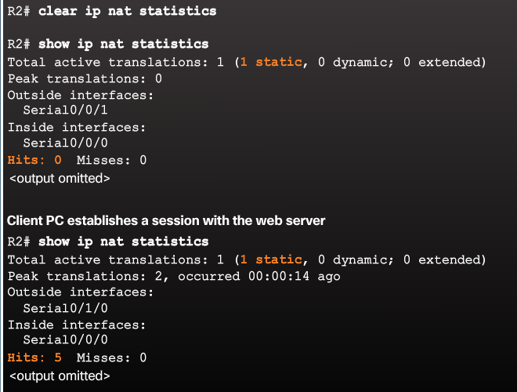
Configuring Static NAT Verifying Static NAT
A best practice is to clear statistics when verifying that NAT is working.
Important commands:
show ip nat translations
show ip nat statistics
Notes:
9.2 – Configure NAT
9.2.1 – Configuring Static NAT
9.2.1.3 – Verifying Static NAT

Slide 33
Configuring Static NAT Packet Tracer – Configuring Static NAT
Notes:
9.2 – Configure NAT
9.2.1 – Configuring Static NAT
9.2.1.4 – Packet Tracer – Configuring Static NAT

Slide 34
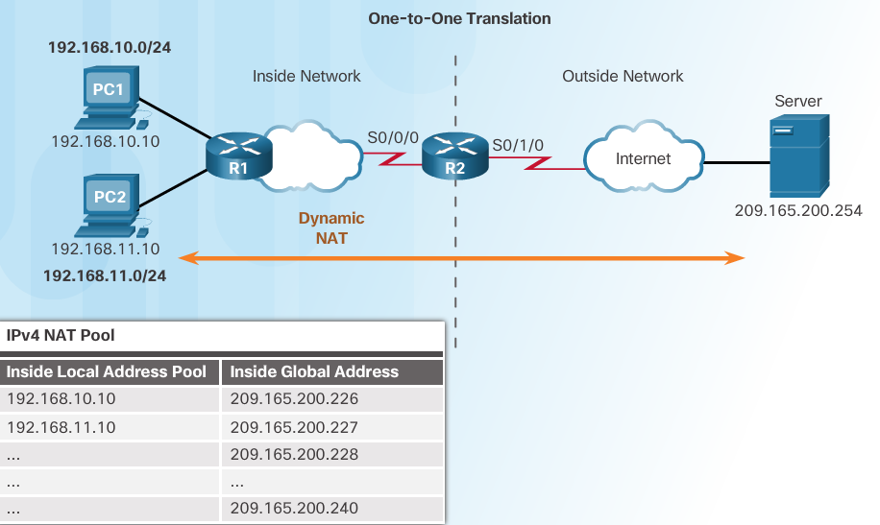
Configure Dynamic NAT Dynamic NAT Operation
Remember that dynamic NAT uses a pool of public IPv4 addresses.
Use the same concepts of inside and outside NAT interfaces as static NAT.
Notes:
9.2 – Configure NAT
9.2.2 – Configure Dynamic NAT
9.2.2.1 – Dynamic NAT Operation

Slide 35
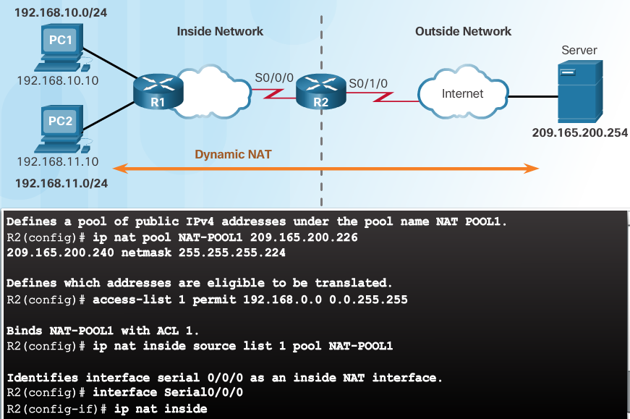
Dynamic NAT
Notes:
9.2 – Configure NAT
9.2.2 – Configure Dynamic NAT
9.2.2.2 – Configuring Dynamic NAT (Cont.)

Slide 36
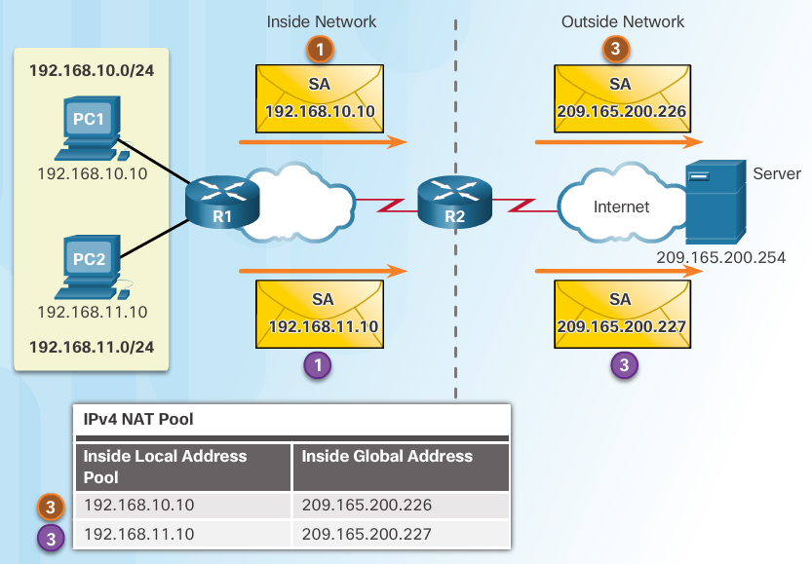
Analyzing Dynamic NAT
PC1 and PC2 open a web browser for a connection to a web server.
R2 receives the packets on the inside interface and checks if translation should be performed (via an ACL). R2 assigns a global address from the NAT pool and creates a NAT table entry for both packets.
R2 replaces the inside local source address on each packet with the translated inside global address from the pool.
Notes:
9.2 – Configure NAT
9.2.2 – Configure Dynamic NAT
9.2.2.3 – Analyzing Dynamic NAT

Slide 37
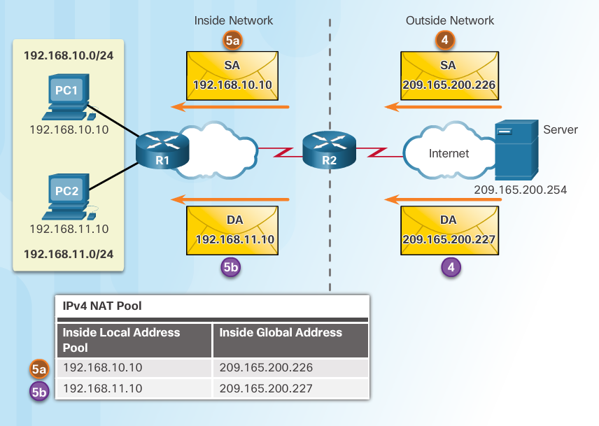
Analyzing Dynamic NAT
The server responds to PC1 using the destination address of 209.165.200.226 (the NAT-assigned address) and to PC2 using the destination address of 209.165.200.227.
(a and b) R2 looks up each received packet and forwards based on the private IP address found in the NAT table for each of the destination addresses.
Notes:
9.2 – Configure NAT
9.2.2 – Configure Dynamic NAT
9.2.2.3 – Analyzing Dynamic NAT (Cont.)

Slide 38
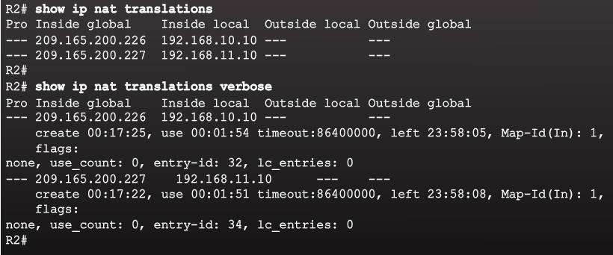
Verifying Dynamic NAT
Notes:
9.2 – Configure NAT
9.2.2 – Configure Dynamic NAT
9.2.2.4 – Verifying Dynamic NAT

Slide 39
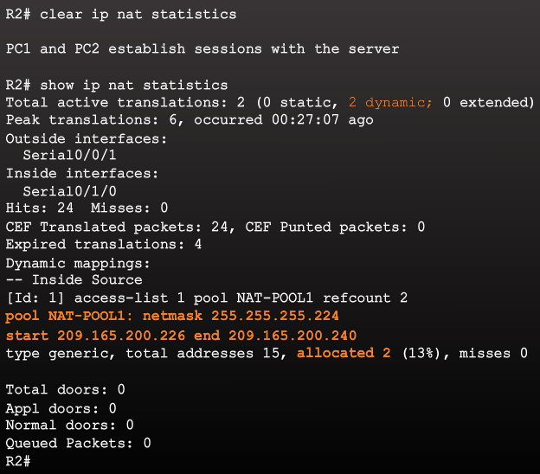
Verifying Dynamic NAT
Notes:
9.2 – Configure NAT
9.2.2 – Configure Dynamic NAT
9.2.2.4 – Verifying Dynamic NAT (Cont.)

Slide 40
Packet Tracer – Configuring Dynamic NAT
Notes:
9.2 – Configure NAT
9.2.2 – Configure Dynamic NAT
9.2.2.5 – Packet Tracer – Configuring Dynamic NAT

Slide 41
Configuring Dynamic and Static NAT
Notes:
9.2 – Configure NAT
9.2.2 – Configure Dynamic NAT
9.2.2.6 – Lab – Configuring Dynamic and Static NAT

Slide 42
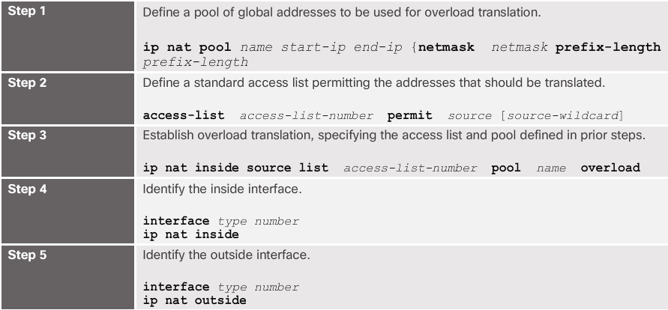
Configuring PAT: Address Pool
The pool contains the public addresses.
The ACL defines which private IP addresses gets translated.
The ip nat inside source list acl# pool name overload command ties Step 1 with Step 2.
The overload command is what allows the router to track port numbers (and do PAT instead of dynamic NAT).
Notes:
9.2 – Configure NAT
9.2.3 – Configure PAT
9.2.3.1 – Configuring PAT: Address Pool

Slide 43
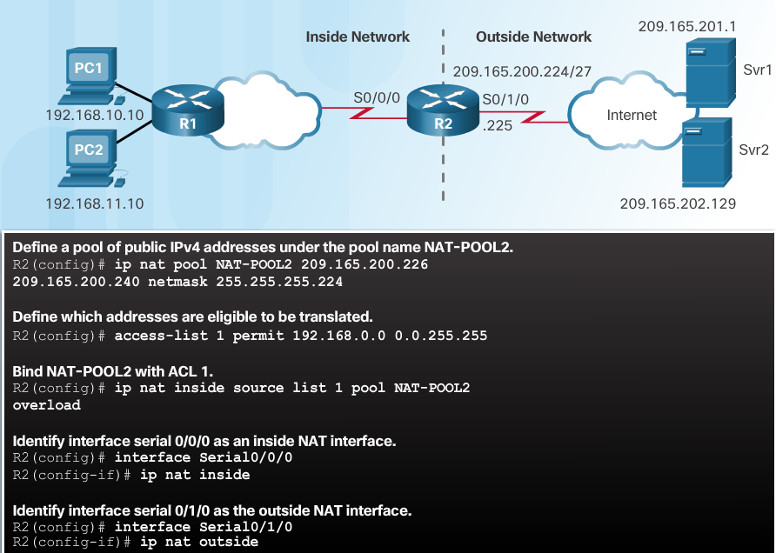
Configuring PAT: Address Pool
Notes:
9.2 – Configure NAT
9.2.3 – Configure PAT
9.2.3.1 – Configuring PAT: Address Pool (Cont.)

Slide 44
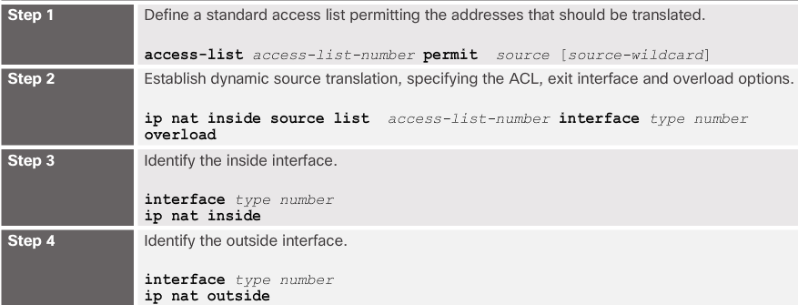
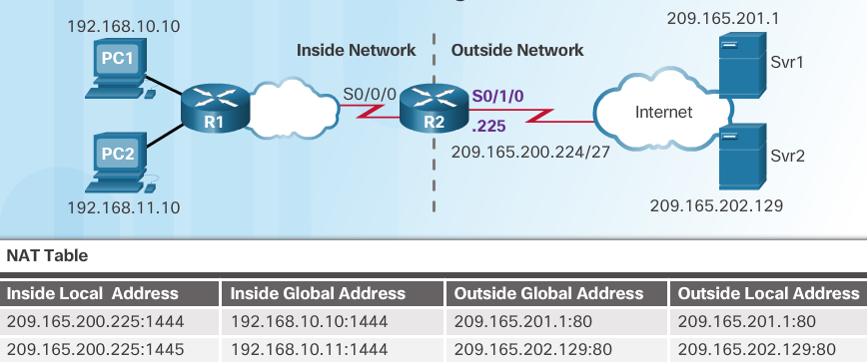
Configuring PAT: Single Address
When a public address is assigned to the external interface on the border router, that public address can be used for PAT and translate internal private IP addresses to the public IP address.
Still need an ACL to define which private IP addresses gets translated.
Instead of associating an ACL with a pool, the ACL is associated with an interface that has a public IP address assigned.
The overload command is always needed for PAT.
Notes:
9.2 – Configure NAT
9.2.3 – Configure PAT
9.2.3.2 – Configuring PAT: Single Address

Slide 45
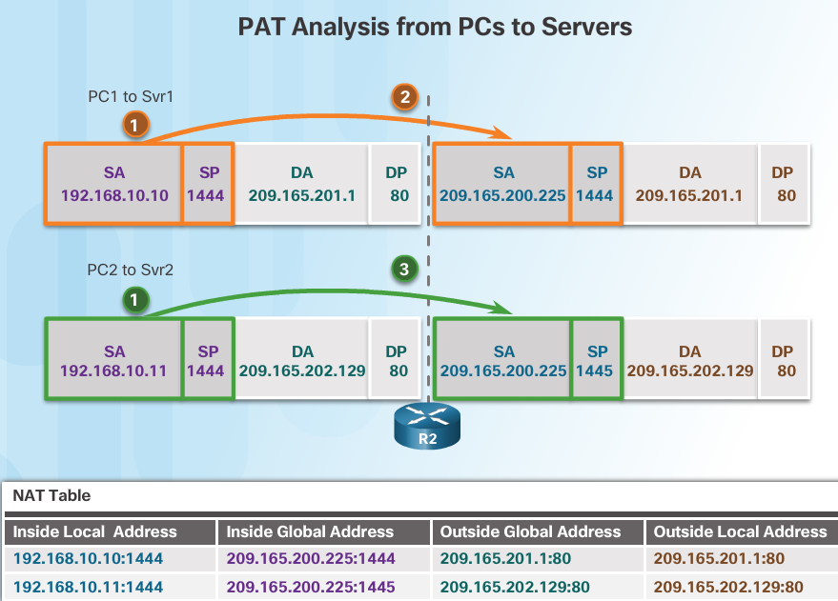
Analyzing PAT
PC1 and PC2 open a web browser for a connection to a web server.
R2 receives the packets on the inside interface and checks if translation should be performed (via an ACL). R2 assigns the IP address of the outside interface, adds a port number, and creates a NAT table entry for both packets.
R2 replaces the inside local source address on each packet with the translated inside global address.
Notes:
9.2 – Configure NAT
9.2.3 – Configure PAT
9.2.3.3 – Analyzing PAT

Slide 46
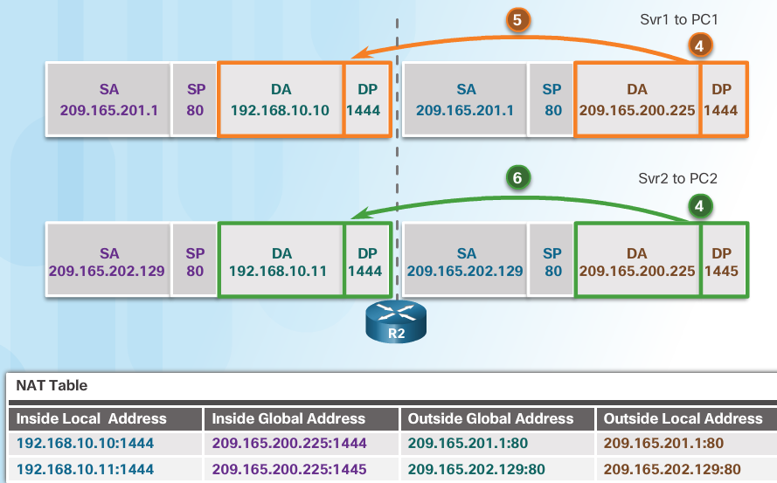
Analyzing PAT
Each server responds to PC1 and PC2 using the destination address of the public address assigned to the external interface on the border router.
R2 looks up the received packet and forwards to PC1 because that is the private IP address found in the NAT table for the destination address and port number.
R2 looks up the received packet and forwards to PC2 because that is the private IP address found in the NAT table for the destination address and port number.
Notes:
9.2 – Configure NAT
9.2.3 – Configure PAT
9.2.3.3 – Analyzing PAT (Cont.)

Slide 47
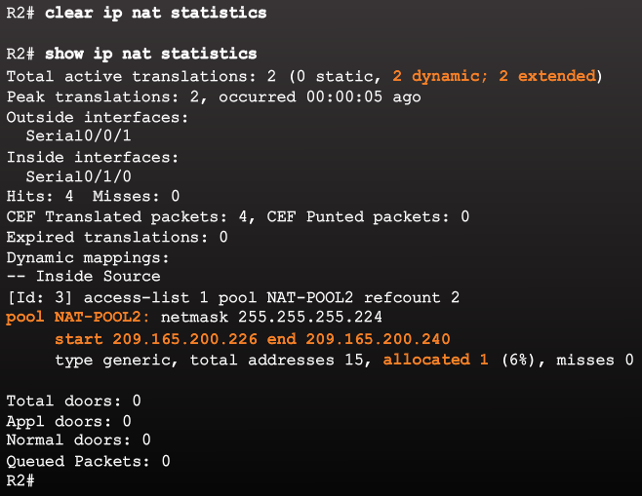
Configure PAT Verifying PAT
Notes:
9.2 – Configure NAT
9.2.3 – Configure PAT
9.2.3.4 – Verifying PAT

Slide 48
Packet Tracer – Implementing Static and Dynamic NAT
Notes:
9.2 – Configure NAT
9.2.3 – Configure PAT
9.2.3.6 – Packet Tracer – Implementing Static and Dynamic NAT

Slide 49
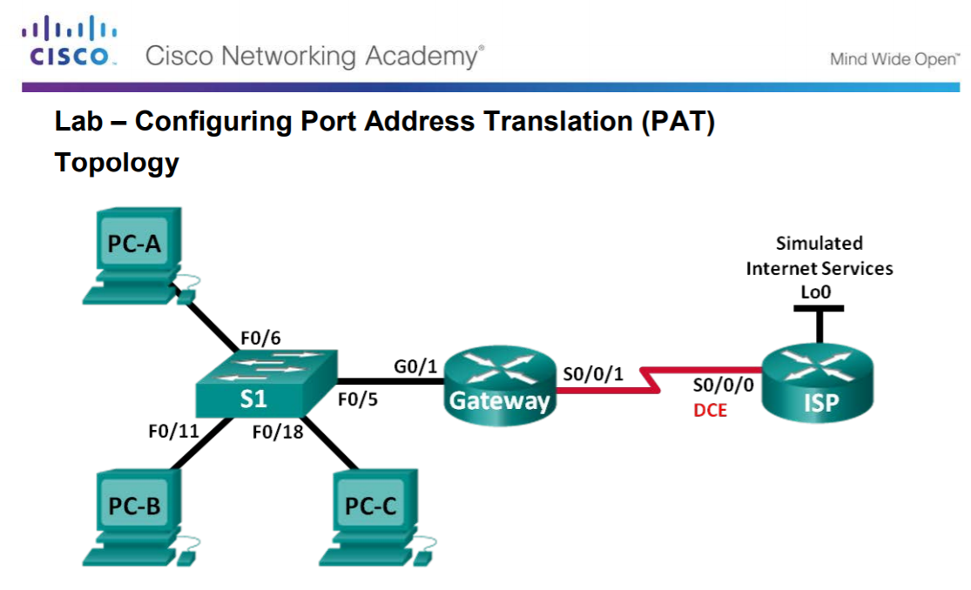
Configuring Port Address Translation (PAT)
Notes:
9.2 – Configure NAT
9.2.3 – Configure PAT
9.2.3.7 – Lab – Configuring Port Address Translation (PAT)

Slide 50
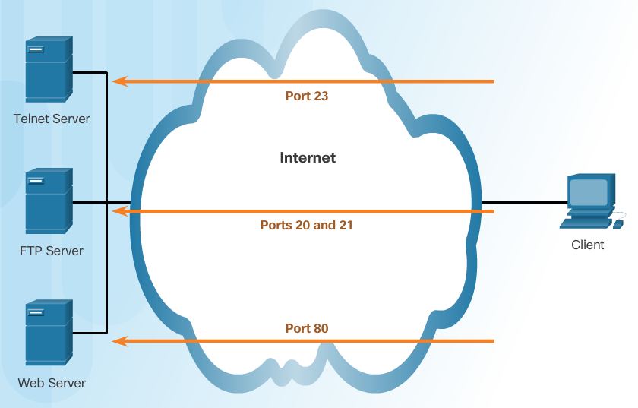
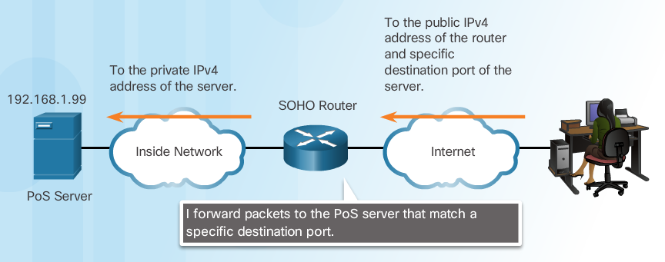
Port Forwarding
Port forwarding allows an external device to reach a device on a specific port number and the device is located on an internal (private) network.
Required for some peer-to-peer file-sharing programs and operations such as web serving and outgoing FTP
Solves the problem of NAT only allowing translations for traffic destined for external networks at the request of internal devices.
Notes:
9.2 – Configure NAT
9.2.4 – Configure Port Forwarding
9.2.4.1 – Port Forwarding

Slide 51
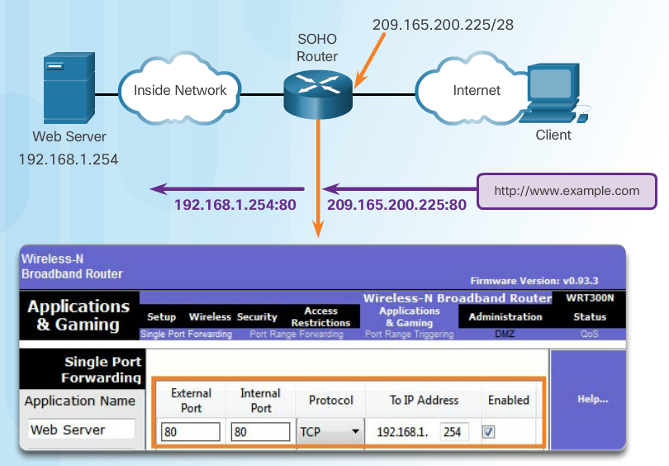
Wireless Router Example
Port forwarding can be enabled for specific applications
Must specify the inside local address that requests should be forwarded to
Notes:
9.2 – Configure NAT
9.2.4 – Configure Port Forwarding
9.2.4.2 – Wireless Router Example

Slide 52
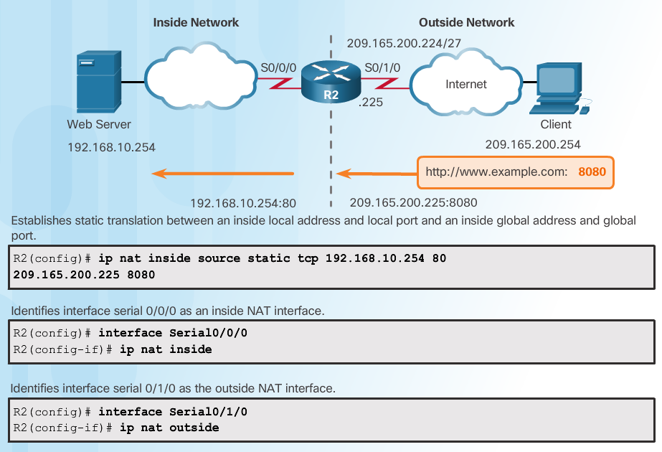
Configuring Port Forwarding with IOS
Notes:
9.2 – Configure NAT
9.2.4 – Configure Port Forwarding
9.2.4.3 – Configuring Port Forwarding with IOS

Slide 53
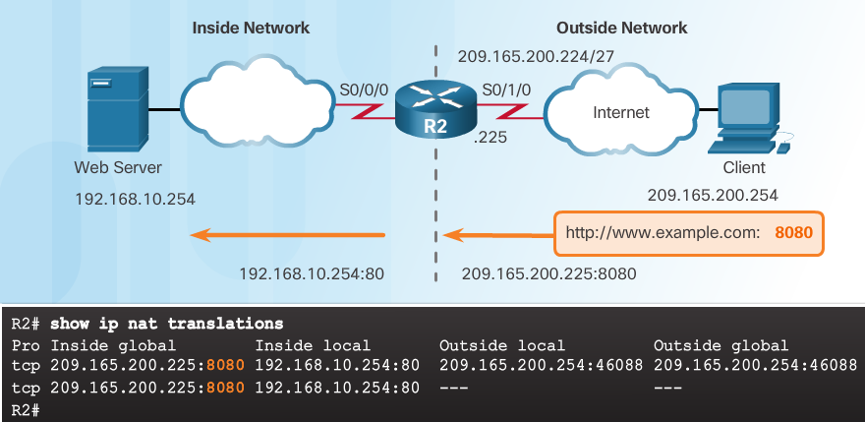
Kontrola
Notes:
9.2 – Configure NAT
9.2.4 – Configure Port Forwarding
9.2.4.3 – Configuring Port Forwarding with IOS (Cont.)

Slide 54
Packet Tracer – Configuring Port Forwarding on a Wireless Router
Notes:
9.2 – Configure NAT
9.2.4 – Configure Port Forwarding
9.2.4.4 – Packet Tracer – Configuring Port Forwarding on a Wireless Router

Slide 55
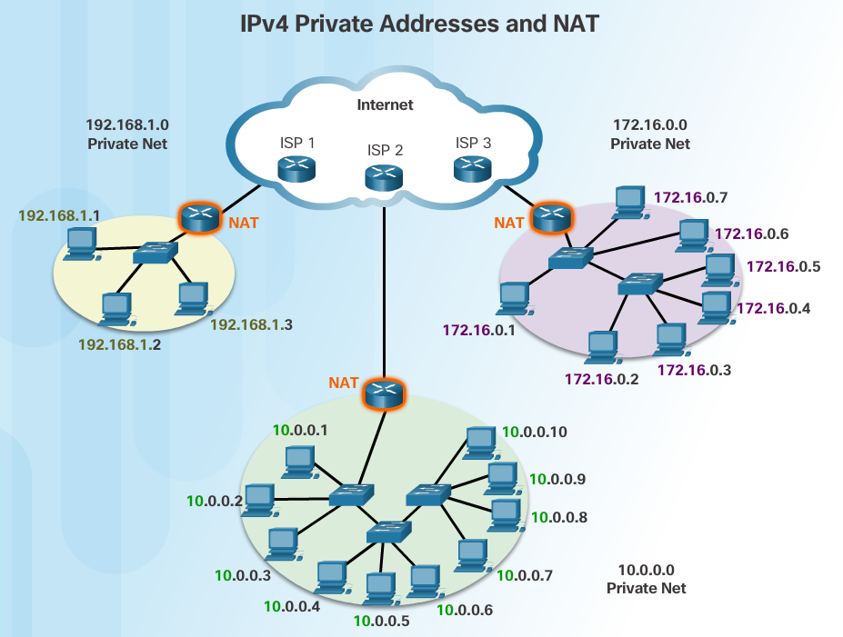
NAT for IPv6?
IPv6 was developed with the intention of making NAT for IPv4 unnecessary
IPv6 does have its own form of NAT
IPv6 has its own private address space
Notes:
9.2 – Configure NAT
9.2.5 – NAT and IPv6
9.2.5.1 – NAT for IPv6?

Slide 56
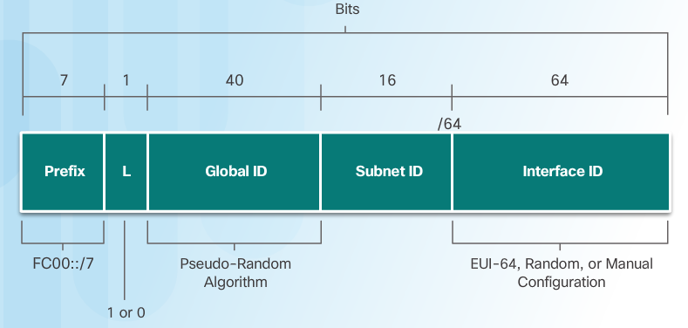
IPv6 Unique Local Addresses
IPv6 unique local addresses (ULAs) are similar to IPv4 private addresses
ULAs are to provide IPv6 address space for communications within a local site.
First 64 bits of a ULA
Prefix of FC00::/7 (FC00 to FDFF)
Next bit is a 1 if the prefix is locally assigned
Next 40 bits define a global ID
Next 16 bits is a subnet ID
Last 64 bits of a ULA is the interface ID or host portion of the address
Allows sites to be combined without address conflicts
Allows internal connectivity
Not routable on the Internet
Notes:
9.2 – Configure NAT
9.2.5 – NAT and IPv6
9.2.5.2 – IPv6 Unique Local Addresses

Slide 57
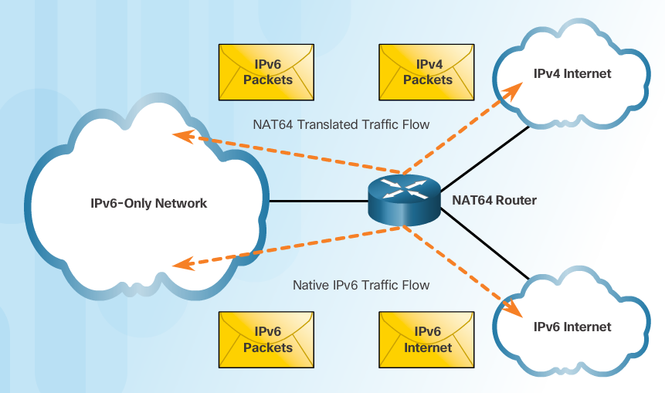
NAT for IPv6
Provide access between IPv6-only and IPv4-only networks (not translating private address to public addresses as NAT for IPv4 was)
Techniques available
Dual-stack – both devices run protocols for both IPv4 and IPv6
Tunneling – Encapsulate the IPv6 packet inside an IPv4 packet for transmission over an IPv4-only network
NAT for IPv6 (translation)
Should not be used as a long term strategy
The older Network Address Translation-Protocol Translation (NAT-PT)
NAT64
Notes:
9.2 – Configure NAT
9.2.5 – NAT and IPv6
9.2.5.3 – NAT for IPv6

Slide 58
9.3 Troubleshoot NAT
Notes:
9 – NAT for IPv4
9.3 – Troubleshoot NAT

Slide 59
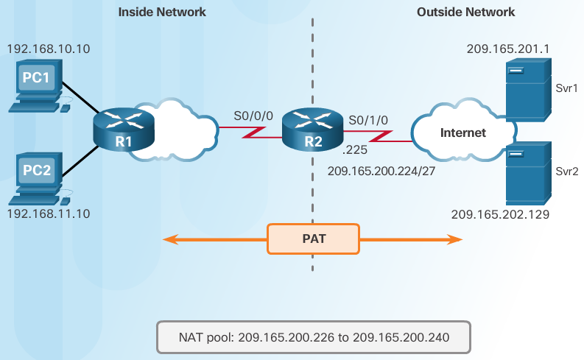
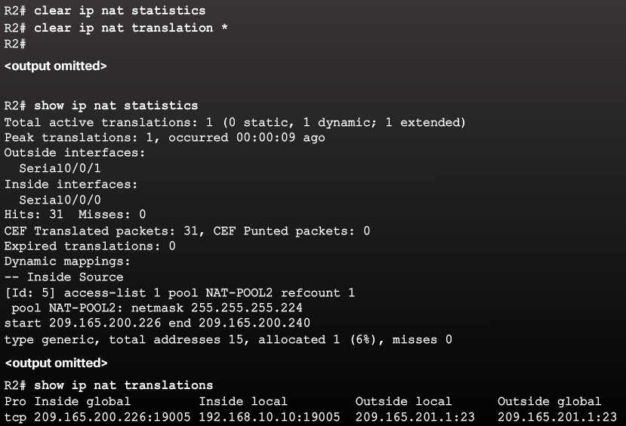
The show ip nat Commands
Determine what NAT is supposed to achieve and compare with configuration. This may reveal a problem with the configuration.
Verify translations using the show ip nat translations command.
Use the clear and debug commands to verify NAT.
Review what is happening to the packet and verify routing.
Notes:
9.3 – Troubleshoot NAT
9.3.1 – NAT Troubleshooting Commands
9.3.1.1 – The show ip nat Commands

Slide 60
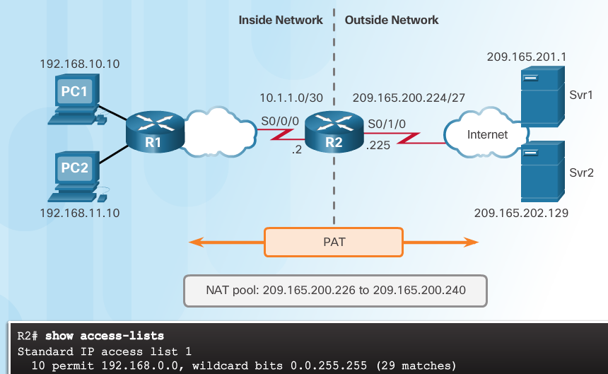
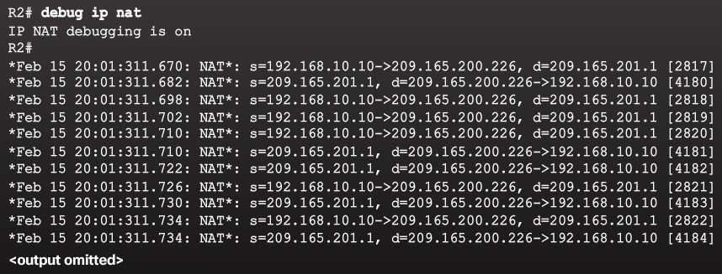
The debug ip nat Commands
Common commands
debug ip nat
debug ip nat detailed
Output symbols and values
* - The translation is occurring in the fast-switched path
s= - Source IPv4 address
a.b.c.d--->w.x.y.z – Source a.b.c.d is translated to w.x.y.z.
d= - Destination IPv4 address
[xxxx] - IPv4 identification number
Check the ACL to ensure the correct private addresses are designated.
Notes:
9.3 – Troubleshoot NAT
9.3.1 – NAT Troubleshooting Commands
9.3.1.2 – The debug ip nat Commands

Slide 61
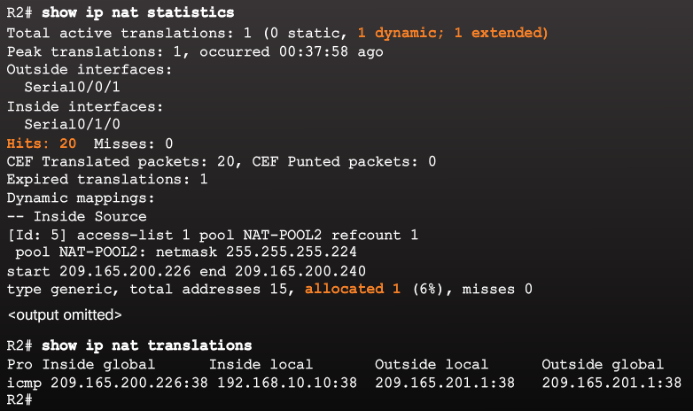
NAT Troubleshooting Scenario: překlady by měly vypadat takto:
Notes:
9.3 – Troubleshoot NAT
9.3.1 – NAT Troubleshooting Commands
9.3.1.3 – NAT Troubleshooting Scenario

Slide 62
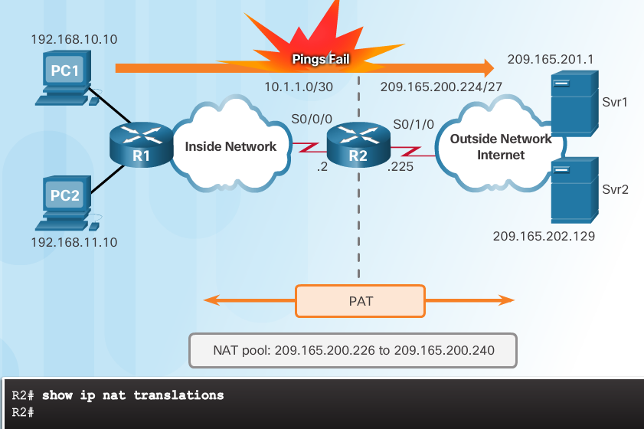
NAT Troubleshooting Scenario: interní počítač není schopen kontaktovat externí server, tabulka překladů vypadá takto: nic
Notes:
9.3 – Troubleshoot NAT
9.3.1 – NAT Troubleshooting Commands
9.3.1.3 – NAT Troubleshooting Scenario

Slide 63
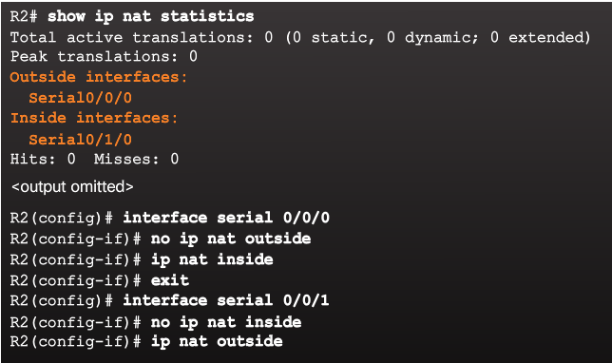
NAT Troubleshooting Scenario: můžete mít prohozeny rozhraní
Notes:
9.3 – Troubleshoot NAT
9.3.1 – NAT Troubleshooting Commands
9.3.1.3 – NAT Troubleshooting Scenario

Slide 64
NAT Troubleshooting Scenario: může být blbě ACL
Notes:
9.3 – Troubleshoot NAT
9.3.1 – NAT Troubleshooting Commands
9.3.1.3 – NAT Troubleshooting Scenario

Slide 65
NAT Troubleshooting Commands Packet Tracer – Verifying and Troubleshooting NAT Configurations
Notes:
9.3 – Troubleshoot NAT
9.3.1 – NAT Troubleshooting Commands
9.3.1.4 – Packet Tracer – Verifying and Troubleshooting NAT Configurations

Slide 66
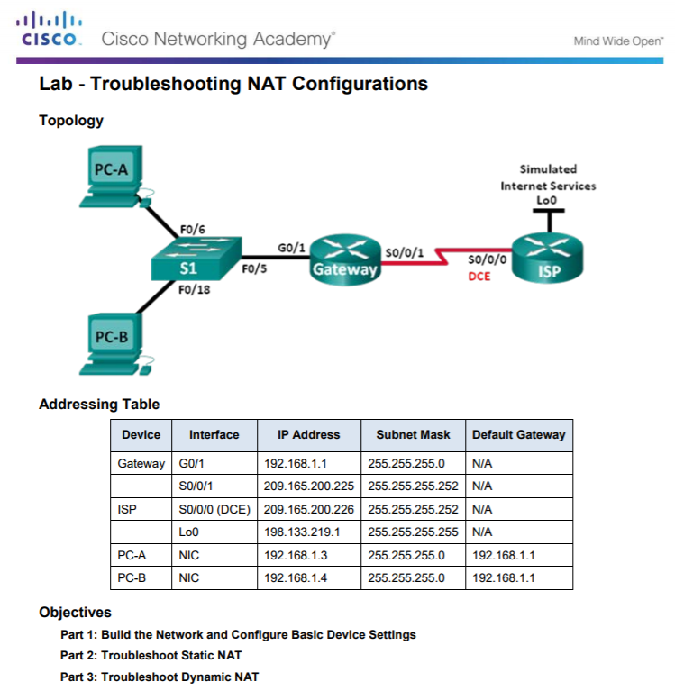
Troubleshooting NAT Configurations
Notes:
9.3 – Troubleshoot NAT
9.3.1 – NAT Troubleshooting Commands
9.3.1.5 – Lab – Troubleshooting NAT Configurations

Slide 67
Proxy a NAT

Slide 68
Typy proxy
CGI (Common Gateway Interface) Proxy – CGI proxy se používají hlavně pro přístup na webovou stránku, která je blokována firemními společnostmi, vzdělávací institucí atd. CGI proxy skryjí naši IP adresu a předávají webové stránky URL serveru proxy serveru, aby získali přístup na tyto stránky. Například stránky sociálních médií budou blokovány v různých korporátních společnostech, vzdělávací instituce CGI proxy nám pomáhají v přístupu na stránky.
Transparentní proxy – Transparentní proxy, který se představuje jako proxy server, ale nezakrývá aktuální IP adresu klienta. Klient proto neví, zda používají server proxy nebo ne. Pomáhá dostat se přes blok IP, ale uživatel nemá žádnou anonymitu.
Anonymous Proxy - Anonymní proxy server pomůže skrýt IP adresu klienta, ale představí jej jako proxy server. Pomůže vám určit anonymitu přes IP a poskytne nesprávnou IP adresu přístupovým webům.
High Anonymity Proxy – tento proxy server je nejbezpečnější a poskytuje uživateli úplnou anonymitu. Skrývá IP adresu klienta a sám funguje jako zařízení.

Slide 69
Co je proxy z bezpečnostního hlediska?
Proxy server je počítač, který funguje jako prostředník mezi internetem a uživatelským počítačem. Umožňuje počítači uživatele nepřímé připojení k jiným síťovým službám.
Proxy server se používá hlavně pro skrytí aktuální polohy uživatele a sdílení internetového připojení mezi více uživateli.
Když používáme proxy server, klientské počítače se nejprve připojí k proxy serveru a poté pošlou požadavek. Proxy server nejprve zkontroluje v keši, zda požadavek již neproveden dříve. Pokud nebyl, nový je požadavek odeslán na internet z proxy serveru.

Slide 70
Výhody proxy
Snižuje náklady na internet, protože může být sdílen s více klienty.
Může být použit v rámci VPN spojení, což vám pomůže skrýt aktuální polohu a pomoci zobrazit umístění podle našich preferencí.
Lze aplikovat filtr, čímž zlepšují bezpečnostní funkce.

Slide 71
Rozdíly forward proxy – reverse proxy

Slide 72
Pohled Microsoftu

Slide 73
Kam firewall

Slide 74
K čemu lze forward proxy použít
Content Filtering
eMail security
NAT’ing
Compliance Reporting

Slide 75
K čemu lze reverse proxy použít
Application Delivery including:
Load Balancing (TCP Multiplexing)
SSL Offload/Acceleration (SSL Multiplexing)
Caching
Compression
Content Switching/Redirection
Application Firewall
Server Obfuscation
Authentication
Single Sign On

Slide 76
Co blokuje jedna US firma na forward proxy
familypostcards2008.com (Storm Worm virus)
facebook.com
playboy.com
wikipedia.org

Slide 77
forward proxy software (server side)
PHP-Proxy
cgi-proxy
glype
Internet censorship wiki: List of Web Proxies

Slide 78
reverse proxy software for HTTP (server side)
apache mod_proxy (can also work as a forward proxy for HTTP)
nginx (used on hulu.com, spam sites, etc.)
HAProxy
lighthttpd
perlbal portfusion
pound
varnish cache

Slide 79
reverse proxy software for TCP (server side)
balance
delegate
pen
portfusion
python director

Slide 80
Rozdíl proxy a NAT
'Proxy' označuje aplikaci vrstvy 7 na referenčním modelu OSI. Překlad síťových adres (NAT) je podobný proxy, ale pracuje ve vrstvě 3.
V konfiguraci klienta vrstvy-3 NAT je konfigurace brány dostatečná. Pro klientskou konfiguraci proxy vrstvy 7 však musí být cílem paketů, které klient vygeneruje, vždy proxy server (vrstva-7), pak proxy server přečte každý paket a zjistí skutečný cíl.
Vzhledem k tomu, že NAT pracuje na vrstvě 3, je méně náročný na zdroje než proxy vrstvy 7, ale také méně flexibilní.
Srovnáme-li tyto dvě technologie, můžeme se setkat s terminologií známou jako „transparentní firewall“. Transparentní brána firewall znamená, že proxy používá výhody proxy vrstvy 7 bez znalosti klienta. Klient předpokládá, že brána je NAT ve vrstvě 3 a nemá žádnou představu o vnitřku paketu, ale prostřednictvím této metody se pakety vrstvy 3 odesílají pro účely vyšetřování do proxy serveru vrstvy 7.

Slide 81
Tor onion proxy software
Tor (zkratka pro Onion Router) je systém, který má umožnit online anonymitu. Klientský software Tor směruje internetový provoz prostřednictvím celosvětové sítě serverů dobrovolníků, aby se utajilo umístění uživatele nebo jeho použití od někoho, kdo provádí sledování sítě nebo analýzu provozu. Pomocí Tor je obtížnější sledovat činnost na internetu, včetně „návštěv na webových stránkách, online příspěvcích, okamžitých zprávách a dalších komunikačních formátech“, zpět uživateli. Jeho cílem je chránit osobní svobodu, soukromí a schopnost provádět důvěrné obchodní činnosti tím, že jejich internetové aktivity budou monitorovány.
„Cibulární směrování“ se vztahuje k vrstvené povaze šifrovací služby: Původní data jsou několikrát zašifrována a znovu odšifrována, poté posílána po sobě jdoucími Tor relé, z nichž každá dekóduje „vrstvu“ šifrování před předáním dat na další relé a nakonec cíl. Tím se snižuje možnost, že původní data budou při tranzitu odšifrována.

Slide 82
Problém s NAT
Velký problém je s NAT. Otázkou je, kde je umístěno proxy:
- uvnitř vnitřní sítě (v rámci lokální LAN);
- v rámci vnější sítě a z vnitřní sítě se je třeba k němu přihlašovat;
- dvě administrativní domény jsou spolu propojeny, každá má vlastní proxy.
.

Slide 83
Nejnepříjemnější je vnější proxy
Jeho privátní IP adresa je z privátní sítě (např. 10.1.1.100) a přichází k proxy v příkazu INVITE spolu s jeho SIP adresou (např. pepa@hp.cz).
Odpověď OK pak nenalezne příjemce. Možným řešením je použití transportního protokolu TCP anebo protokolu STUN.
A nejlepším řešením je NAT vůbec pokud možno nepoužívat – což je i jeden z argumentů pro přechod na IPv6.

Slide 84
Kdy STUN a kdy firewall?
STUN – Simple traversal of UDP through NATs

Slide 85
STUN (Simple/Session Traversal of UDP through NATs)
Dvojice adres „server-reflexivní“
Obvykle u ISP jako služba
STUN2 xoruje k adrese nonce
Klient je cloněn pouze nepříliš bezpečným NAT a je vystaven útokům
kohokoliv, kdo odchytá STUN provoz
Nezajišťuje symetrický NAT, kdy mezi unikátními IP adresami a porty
odesilatele a příjemce misí být unikátní i dvojice na NATu (jen pro ně).

Slide 86
TURN (Traversal Using Relay NAT)
Metoda náročná na šířku pásma
Server musí být blízko NATu a k dispozici po celou dobu komunikace
Zajišťuje symetrický NAT

Slide 87
TURN je součást migrace do IPv6

Slide 88
ICE (Interactive Connectivity Establishment)
Využívá STUN i TURN podle nastavené priority
Zprostředkovává je volanému prostřednictvím CDP
Po navázání spojení zastaví jejich použití
Microsoft Office Communications Server 2007 R2, A/V Edge Server
je rozšířen o STUN/TURN, blíže Mike Atkins v „Troubleshoot STUN with TURN
in Office Communications Server 2007 R2“ v http://blogs.technet.com z prosince 2010

Slide 89
Microsoft ICE z roku 2008 – 1. krok Klient posílá požadavek na STUN/TURN server
Klient STUN posílá TURN Allocation request na A/V Edge Server
Záznam: Microsoft Network Monitor 3.4

Slide 90
2. krok Odpověď STUN/TURN serveru

Slide 91
3. krok Výpočet MI a její odeslání na STUN/TURN server
Message-Integrity = MD5(username ":" realm ":" SASLPrep(password))
kde SASL (Simple Authentication and Security Layer) je obecná metoda ověřování v protokolech klient/server
SASLprep – reprezentace jmen a hesel pro SASL - viz RFC 4013

Slide 92
4. krok Server STUN/TURN odpovídá vzdálenému klientu
Server STUN/TURN odesílá paket Allocate Response, v ní hodnotu časovače, šířky pásma…
XORMappedAddress je počítána XORem z MagicCookie z 1. kroku

Slide 93
9.4 Chapter Summary
Notes:
9 – NAT for IPv4
9.4 – Summary

Slide 94
Conclusion Packet Tracer - Skills Integration Challenge
Notes:
9.4 – Summary
9.4.1 – Conclusion
9.4.1.2 – Packet Tracer - Skills Integration Challenge

Slide 95
Conclusion
Explain how NAT provides IPv4 address scalability in a small to medium-sized business network.
Configure NAT services on the edge router to provide IPv4 address scalability in a small to medium-sized business network.
Troubleshoot NAT issues in a small to medium-sized business network.
Notes:
9.4 – Summary
9.4.1 – Conclusion
9.4.1.3 – NAT for IPv4

Slide 98
https://www.mall.cz/porovnani?sectionId=EB036

