Slide 1


CRM conceptual background and analytics
Dalia Kriksciuniene, VU KNF

Slide 2
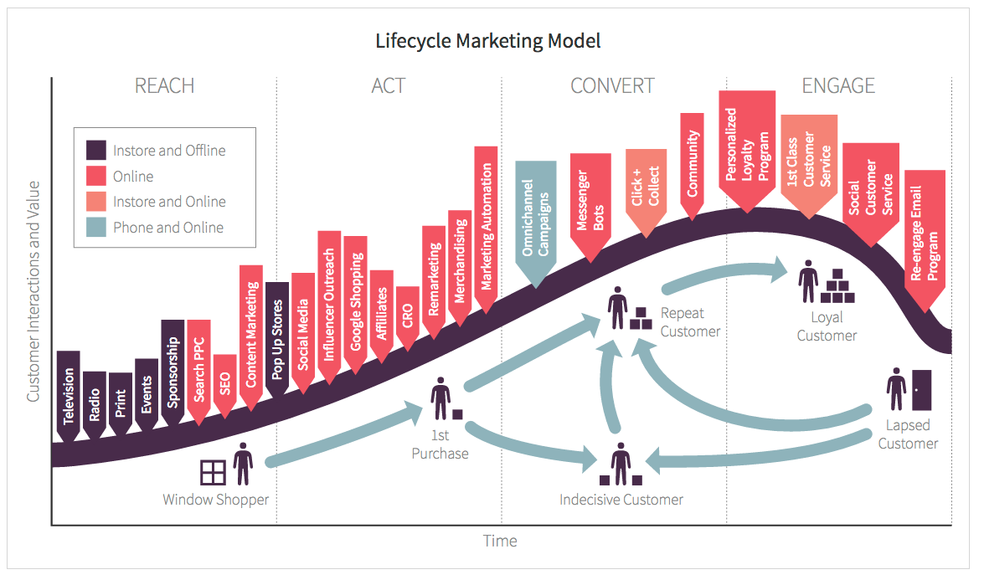
MARKETING process scope

Slide 3
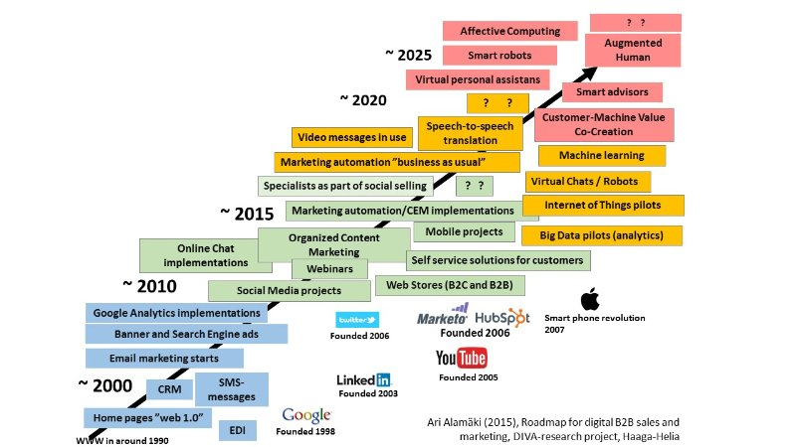
Marketing information management tasks- MARTECH landscape

Slide 4
Customer Relationship Management
Customer relationship management (CRM) is a broadly recognized, widely-implemented strategy for managing and nurturing a company’s interactions with clients and sales prospects
The overall goals are:
to find, attract, and win new clients,
nurture and retain those the company already has,
retain former clients back,
and to reduce the costs of marketing and client service (Pepper, Rodgers, 2004)

Slide 5
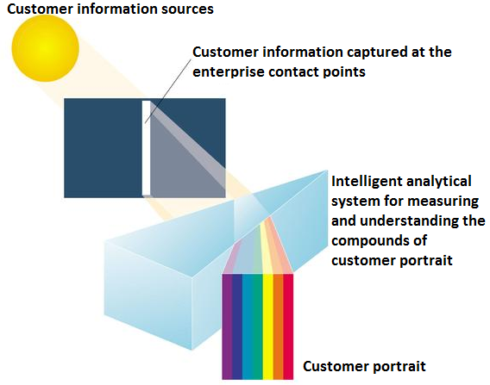
The spectrogram principle of the customer analysis
The success of the enterprise highly depends on the “prism” as analytical model which can convert “white light” of information to the swath of colours with different brightness: identify compounds of customer portrait by characteristics, their importance and effects to the financial results of the enterprise.

Slide 6
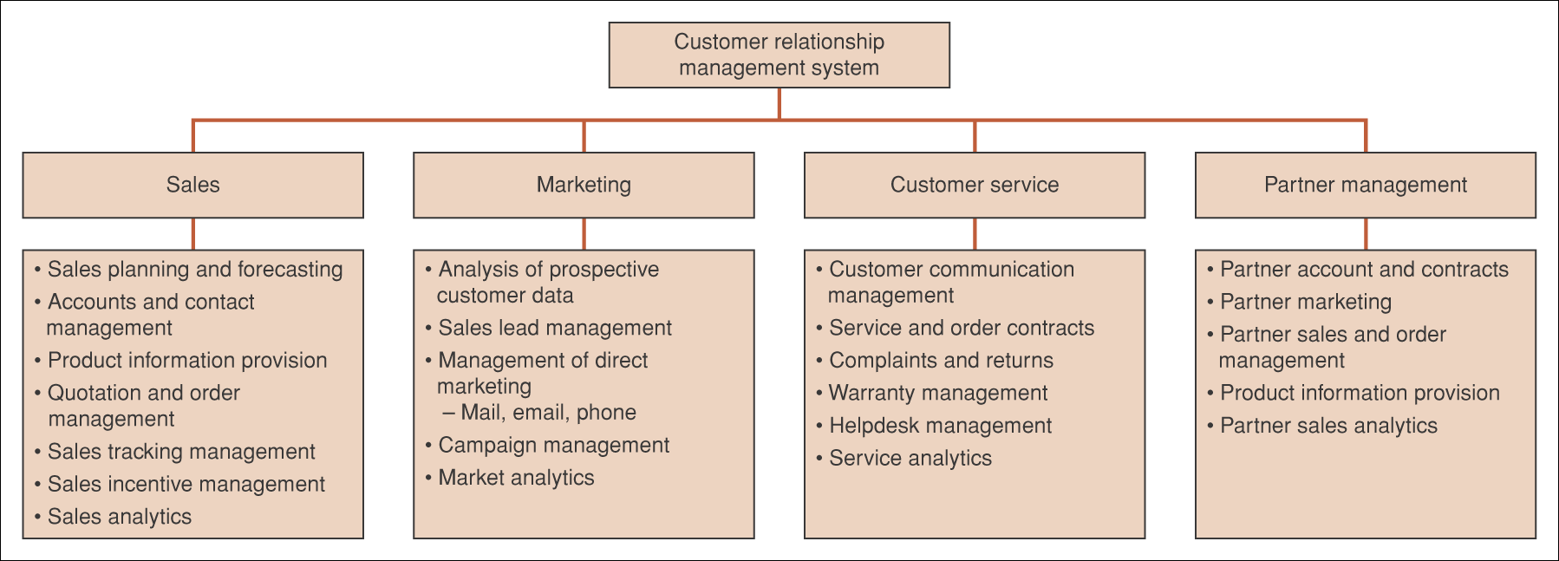
Components of CRM Systems
The software producers understand the structure of CRM differently
You can find CRM, which mean different goals: sales module, communication module, performance of sales personnel, distribution channel analysis, loyalty “point” systems, etc. (what type is Sugar CRM?, MS CRM ?, SAP CRM?)

Slide 7
Customer Relationship Management
(CRM) Systems – general understanding
Provide information on existing customers, their loyalty and churn
Identify and target new markets
Enhance customer’s satisfaction
Manage relationships with partner organizations
Marketing: cross-selling, upselling, bundling
Customer service
Partner relationship management
Internal marketing (making enterprise attractive for its workers for keeping their knowledge)

Slide 8
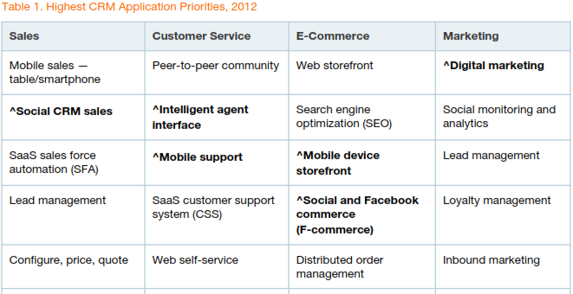
What’s hot: Gartner 2012 – did the forecasts come true ?

Slide 9
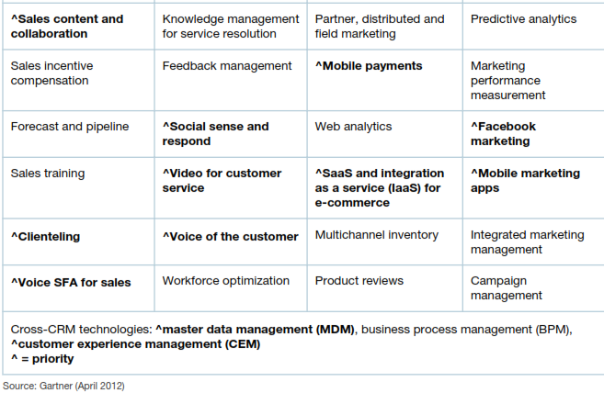
What’s hot from Gartner 2012

Slide 10
CRM- is a philosophy of management enterprise resources (4+1 main types).
Traditional parts of enterprise resource capital:
Financial
Human
Intangible
CRM explores new types of resource capital
Information
Customer capital, where share of each customer is explored (different approach is market share)
Knowledge & info
Material

Slide 11
Customer capital management goals
Get:
... Profitable customers
Keep:
... Profitable customers as long as possible
... Win them back from competitors
... Convert not-profitable customers to the profitable
Enhance:
... incentives to get additional products
.... Positive reference from existing customers to win new
... Customer service programs

Slide 12
CRM information needs
CRM goal | Information need | Capability of accounting systems to supply info
Profitable customers | New and old customers Profit per customer | No Profit calculation per unit
Keep profitable customers as long as possible | Communication history | Sales info is available Limited info about reaction to promotions
Win profitable customers back from competitors | Customers of the competitors Who were won back | No
Convert not-profitable customers to the profitable | Expenses per customer Sources for turnover | No
Provide incentives to get additional products | Know individual needs | No
Enhance positive reference | Opinion, referrals, impact | No
Enhance customer service programs | Effectiveness of programs | No

Slide 13
IDIC model for CRM
D. Peppers ir M. Rogers (2004)
IDIC model
Analytic:
Identification
Differentiation
Operational:
Interaction
Customization

Slide 14
Application of IDIC model
Identify customers- explore individual characteristics. Needs variables for identification: tel.no. address, email, psychographic characteristics, preferences, habits
Differentiate customers- searching for different characteristics which enable segmenting. Definition of similar segments helps to focus attention to best (most profitable) groups, and create scenarios evoking specific behaviors
Interact with customers- search for tools and technologies for creating perception of the enterprise to its customer in attractive way, get feedback, avoid information distortion due to attitudes (e.g. caused by resistance to spam)
Customize treatment- maximize profit due to meeting individual needs

Slide 15
Two tasks for managing CRM
OPERATIONAL CRM:
How to collect information about relationships
Surveys, registering calls, visual observation, loyalty cards, promotion responses
ANALYTICAL CRM:
Ho to evaluate and use information
Evaluation by creating meaningful CRM indicators
Reporting, statistical methods, analytic tools, intellectual computing

Slide 16
What is indicator?
Indicator is a common language among managers
Instead of evaluations “good”, “bad”, the numeric evaluations, rankings, graphical visualizations, etc. could be more effective
Indicator is a lever which we have to envisage, and use proper impulse of sufficient power to make impact on it.
Indicator reveals influences which affect enterprise. It is important to notice these influences, to know how they are created, what efforts are needed to make them serve to the enterprise needs.

Slide 17
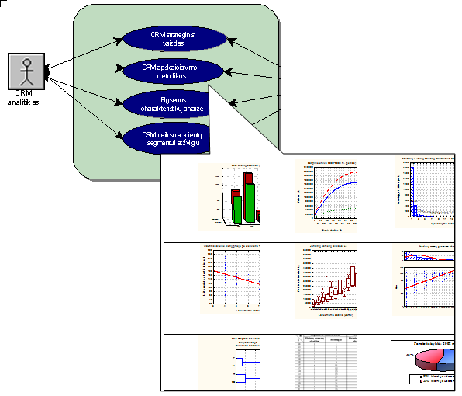
Integrated approach- CRM perspective

Slide 18
Problems of getting right data for analysis
Accounting information is limited, there is need for contact points, where customer information can be recorded (loyalty cards, personalized access points, transaction terminals, call centres, web pages or social networks)
The best descriptive is qualitative data, but it is collected in inconsistent way (surveys), or stated by subjective judgments, or classified by subjectively extracting characteristics of communication
Therefore our challenge is to apply the historical purchase data, utilize information from access points and capture qualitative data consistently

Slide 19
How to create indicators ?
Traditional commonly understood marketing indicators?
What is missing? What direction should be followed in order to enhance power of indicators?
How to understand gap?
Common rules for creating indicators : absolute (turnover, profit), relational (EBITDA), percental (impact of marketing for “bottom line” in accounting), complex interpretation (RFM), formulas (LTV), ranking (loyalty)
Analytical report types : summarization, queries, trends, anomalies, extremities.
Textual, numerical, color, graphical

Slide 20
Information for evaluation
CRM evaluation based on accounting information
Defining loyalty and its relationships to sales
Using non-financial information
Balanced scorecards
Internet technologies based indicators
Social network analytics

Slide 21
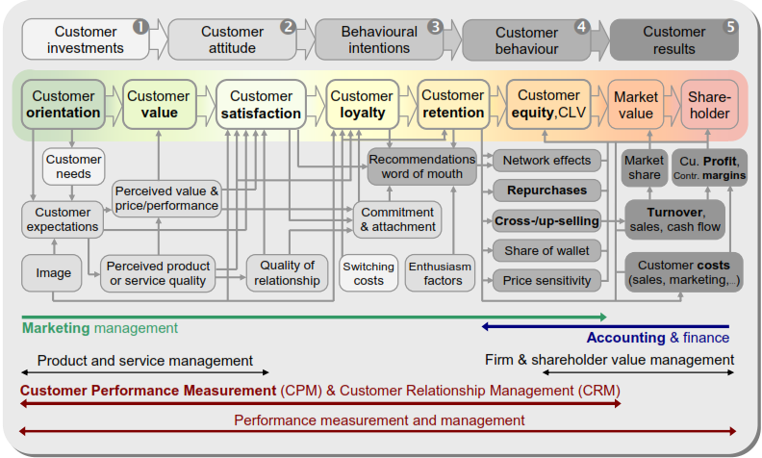
Gap of the indicators
Source: Zumstein, D.

Slide 22
How to fill the gaps to final indicator
Making qualitative indicators. Negative side- hard to transform to measurable
Creating lead indicators which are going to influence factual results in (lag indicators). Negative side- some relationships between them are missing or misleading
Proxy indicators try to created intermediate links leading to final values Proxy—Financial—Statistical
Creating indicators similar to financial philosophy : Return on Customer Investment (ROCI); Return on Relationship (ROR); – similar to ROI (return on investment in finance)
Longitudinal metrics – involve dynamics
Refining indicators by learning relationships philosophy

Slide 23
CRM variable types
Simple transactional variables – purchase value, frequency
Derived variables- CLTV- customer lifetime value
Survey-based: satisfaction, knowledge, preference
Event-based: churn, complaint
Expert-evaluation-based: loyalty
Compound variables – RFM
Proxy variables- compound-weighted-ranking based
Models: Pareto, Whale curve, custom designed models

Slide 24
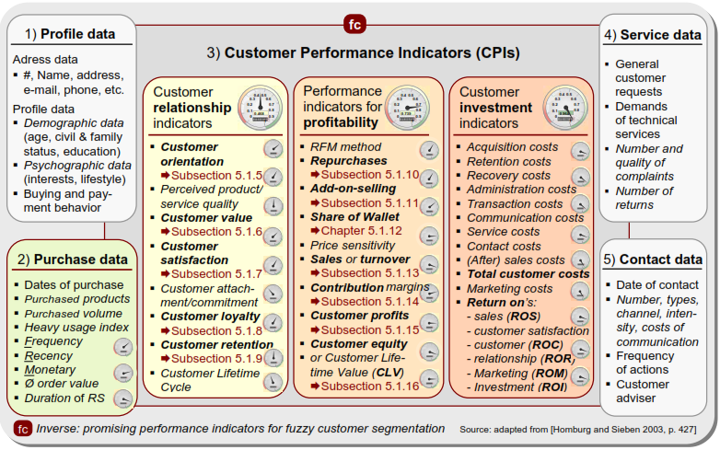
Promising variable types

Slide 25
CRM indicator and metric samples
Customer profitability metrics
Cross-sell change
Process and operation cost change
Credit usage level
Change of number of customers and their structure:
attrition,
churn rate,
Naming groups by character: “vintages”, “cohort”, “VIP”
satisfaction changes according to survey data

Slide 26
CRM indicator and metric samples
Value of customer
Evaluation in monetary terms by assumption that customer is the asset of enterprise
NPV-net present value
Potential value (IRR)
Current and potential value according to survey data
ROI – return on investment to customer
Cycles among purchases:
Cycle duration (shorten, lengthen, regularity)
Buyer trajectory – characteristics accumulated during purchase history

Slide 27
CRM indicator and metric samples
Evaluation of purchase structure:
Large purchase buyers
Petit purchase buyers
Frequent purchase return makers
Grouping, segmenting metrics:
Decile analysis (divide by 10% segments)
Pareto principle
Whale curve
Share of customer (e.g. VISA uses share of wallet)
Share of personal consumption, expenditures
Customer satisfaction

Slide 28
CRM indicator and metric samples
Life cycle value
Most valued customer segment- MVC
Relationship value
Relationship duration
Migration
Loyalty metrics
Specific behavior: “bought in past and will buy in future”
Attitude, brand preference
Tenure functions
Ranking according loyalty strength

Slide 29
Loyalty categories –their variety
Loyalty pyramid expresses levels of loyalties
No loyalty– first level of loyalty when it is simply absent The user freely searches for product by changing suppliers, not bonding to them. If he bought during promotion period, the sales of this loyalty group return back to previous level
False loyalty: customer does not feel any difference among products of suppliers, but he has no need to change them –behavior by inertia
Hidden loyalty- customer has preference to some product or supplier but not always keeps buying it
Real loyalty- the customer has clear preference and uses it even when there exists sufficient choice

Slide 30
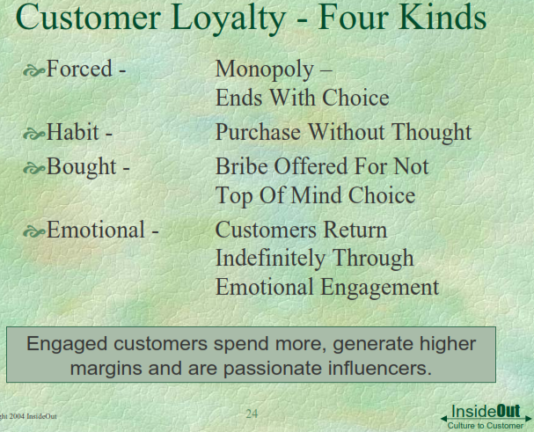
Loyalty categories –their variety

Slide 31
Compound variables – RFM
  Variable R (Recency) show the number of days since the last visit till the date set for analysis
  Variable F (Frequency) indicator is equal to the number of visits of the customer.
  The M (Monetary value) is equal to the total value of purchases during all the history of communication.
CRM task lays in defining RFM combination matrix for decisions. E.g. how we treat recent customer who comes often, pays much ? How do we treat if he comes rarely? Do we change opinion if he comes only during holiday time? If we waited for his holidays and he missed – did he chose competitor?

Slide 32
“Whale curve“ analytic visualization
Customers are sorted by descending order of their turnover (or profit) values, in order to compute thier cumulative percent values and to plot to Y axis.
In X axis you plot the cumulative percent of the number of customers (e.g. if the enterprise has 10 customers, each of them makes 10% of the enterprise customers, second line will show cumulative of 2 customers which make 20 cumulative percent, etc.
The Whale curve shows what percent of total number of customers in X axis are able to generate their part of the total enterprise turnover (profit) (plotted in % in Y axis).
The final point of curve means total turnover by all customers

Slide 33
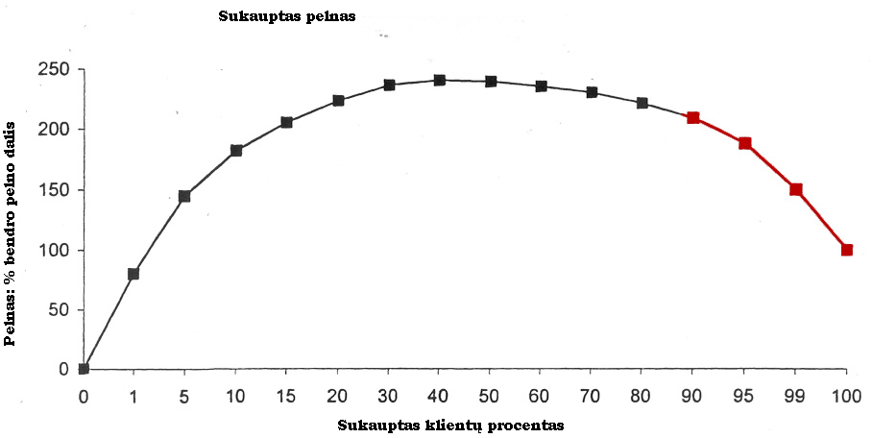
“Whale curve” of profit, red line denotes loss

Slide 34
Using “Whale curve”
Define visually the areas with same growth, split customers to segments accordingly
Ask questions by analyzing behaviors of segments: what we can do in order to convert “second best” customers to the “best”
How we can convert customers who bring “loss” to “profitable
Do we have different rules and personnel for segments?
We can split cumulative curve to “deciles” as well
Pareto “law” is visible in “Whale curve” at 20% in X axis

Slide 35
CRM for changing customer indicators
Cross sell- offering additional products, which are compatible to those already bought
Up-sell- improvements of the product already bought
Bundling- complex product /service/subscription
“Churn rate” measurement. No precise methods to define. The goal is to elaborate indicators which could make early prediction of churn
Mass customization- exploring customer choices, segmenting them and offering as most popular of them as standardized solutions for best-fit segments (improves costing, reduces waste and stock)
Using strategic games for capturing rules of behavior (e.g. putting advertisements to Second life game)

Slide 36
Proxy – creating cause-effect linked indicators
Indicator | Measure | Weight %.
Average income | Average of present and forecasted income | 20
Change of income | Annual change | 25
Relationship features | Duration of contract | 15
 | Tenure of history
Technologic involvement | System integration | 20
 | Reporting system
 | Tele-Web
 | Email
Parrnership value | Contact level | 10
 | Refferal Future value
Top 5 customers | Ranking by „proxy“ | Ranking by monetary value | Rank difference
A | 1 | 1 | 0
B | 2 | 22 | +20
C | 3 | 62 | +59
D | 4 | 4 | 0
E | 5 | 3 | -2

Slide 37
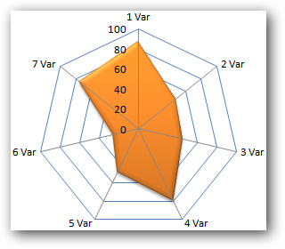
Customer portrait
Analytical aspects:
1 The percentage difference of each characteristics of the customer compared to the best value existing in the customer base of the enterprise.
2 customer portrait can be expressed as the area plot of the radar chart. Bigger normalized percentage values of each variable of the customer portrait form larger area plot, which can show, that the particular customer falls among the best customers of the enterprise.
3 possibility of tracking each customer over time by dynamics of each variable and the compound index as well.
Source:Kriksciuniene et al 2012

Slide 38
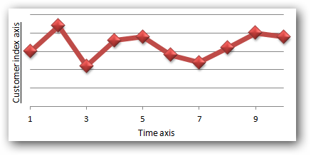
Customer index
Customer portrait index is computed as a mean value of all normalized variables included to the customer portrait
If we assume that each variable has different importance we include including weighting of the variables
Source:Kriksciuniene et al 2012

Slide 39
Web-page based indicators

Slide 40
Application of computerized solutions for CRM
www.sugarCRM.com –registers activities related to customers (contacts, commercial offers, negotiations, sales). Analytic tools. System is cloud based, customized
www.microstrategy.com system for intelligent analysis: aggregation of data, drill-down principle slice-and dice
Campain management- dynamic workflow based solution by microstrategy – provides wizard based, responsibility- based process management analytic support

Slide 41
CRM campaign research (Microstrategy)
Sales situation is evaluated
Loyalty level is evaluated
Problem is explored in detail (see the following example of wrongly selected promotion delivery channels (pre-campaign analysis)
Campaign is planned, the target group is selected by analytics
Post – campaign analysis

Slide 42
Example :microstrategy campaign analysis workflow

Slide 43
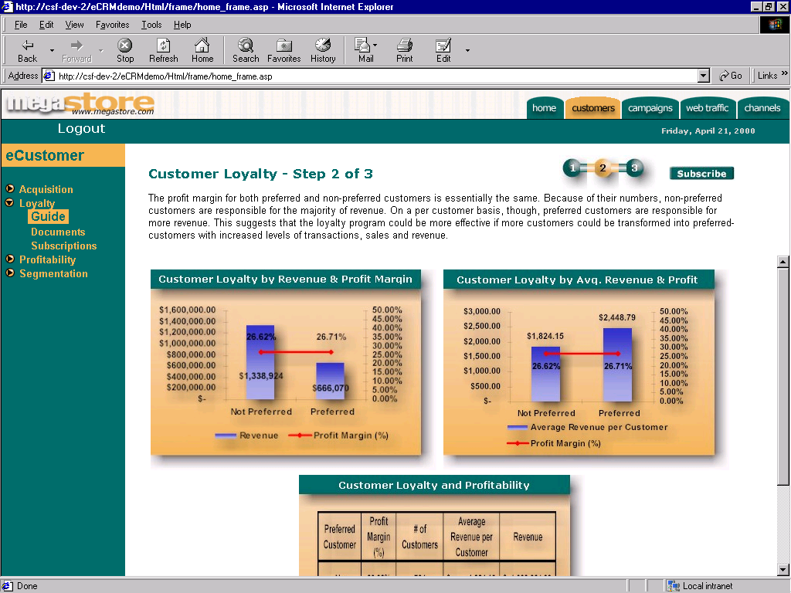
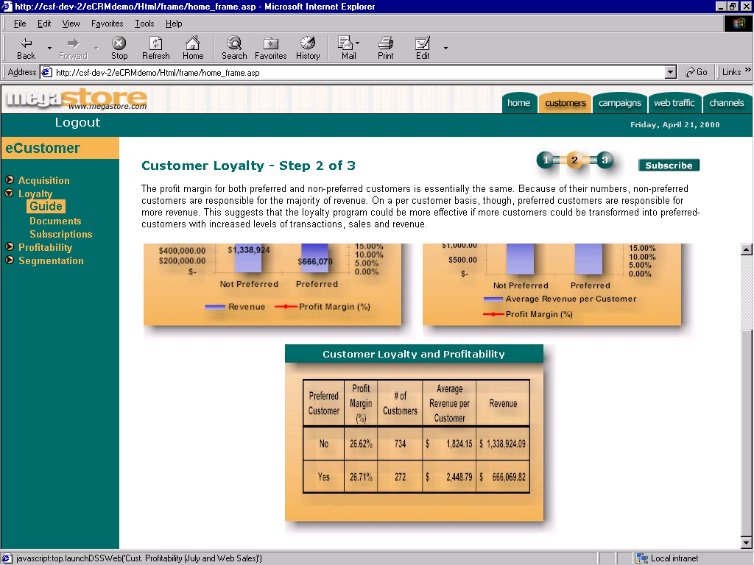
Notes:
Loyalty Guide
Step 2
Customer Profitability
This step gives the Director the opportunity to understand how the company’s customers affect overall performance indicators through their buying patterns.
The information in this report is again grouped by regular and preferred customers, and the Director finds the figures consistent with the information obtained in previous reports.
The Director can see that while profit margins are similar between loyalty cardholders and non-cardholders, average revenue per customer is much higher for cardholders. The loyalty cardholder is a better customer and the director will need to incorporate this into plans.
Also, the Director may conclude from the report that non-cardholding MegaStore customers may buy less profitable products or more products that are on sale.
The Director clicks on the Step 3 of the Loyalty Analysis Guide.

Slide 44
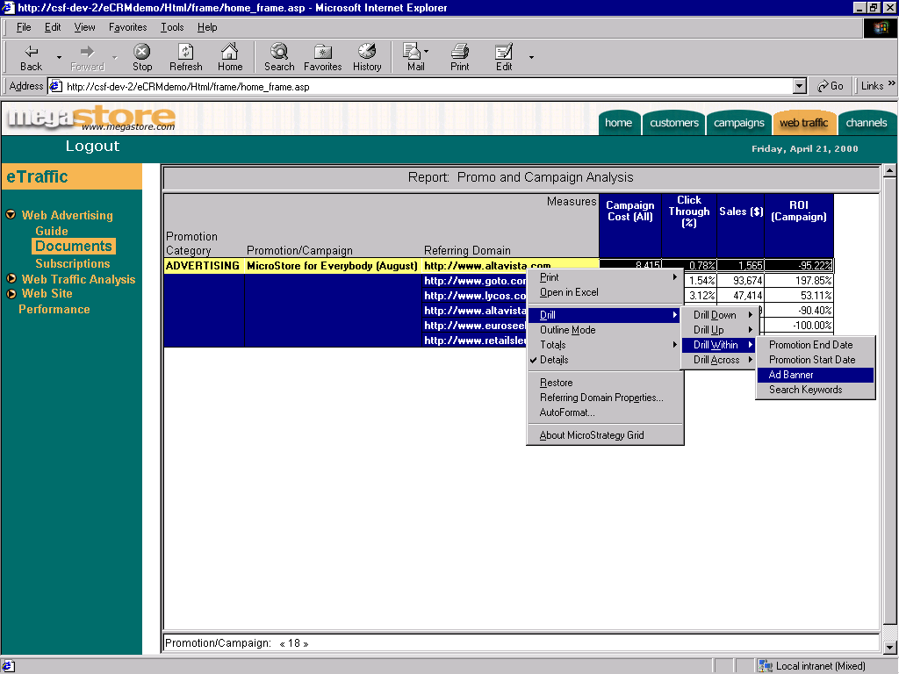
Notes:
At the referring domain level things look a little bit different. Now the Director can determine which domains didn’t work for the month of August. Two domains get the Director’s attention: euroseek.net with an ROI of -100% (which means that there was no profit at all), and altavista.com with an ROI of -95.22%. It is obvious that while some domains like gotto and lycos are working very well (with high ROI’s), the rest are negative, which is driving the average to be negative. This shows that the promotion itself is not the problem, but perhaps the site selection could be improved.
Having run 3 separate ads within this promotion, the Marketing Director is interested in finding out if any ads were more successful than others. The Director has a particular interest in altavista.com. Therefore, the Director selects that row of the report and drills within the same dimension to the Ad Banner level.

Slide 45
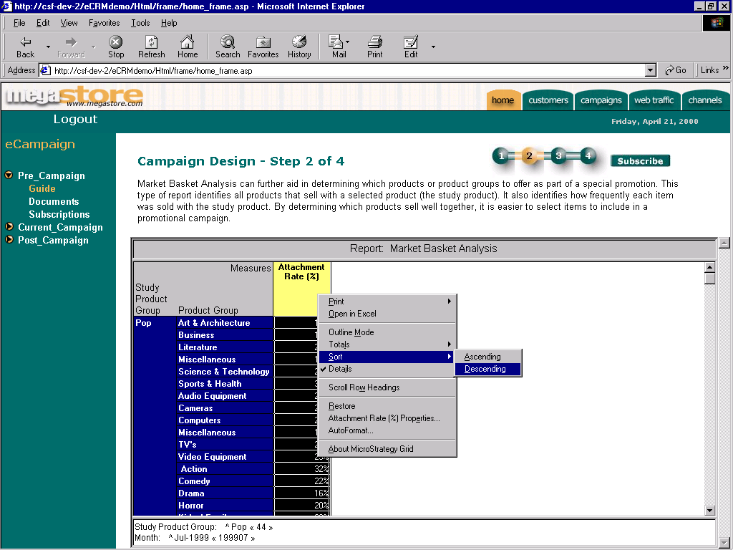
Notes:
In order to get a clearer picture of the products most commonly combined with Pop music, the Analyst sorts by attachment rate in descending order.
Note the strong analytic capabilities demonstrated by the calculation of attachment rate.

Slide 46
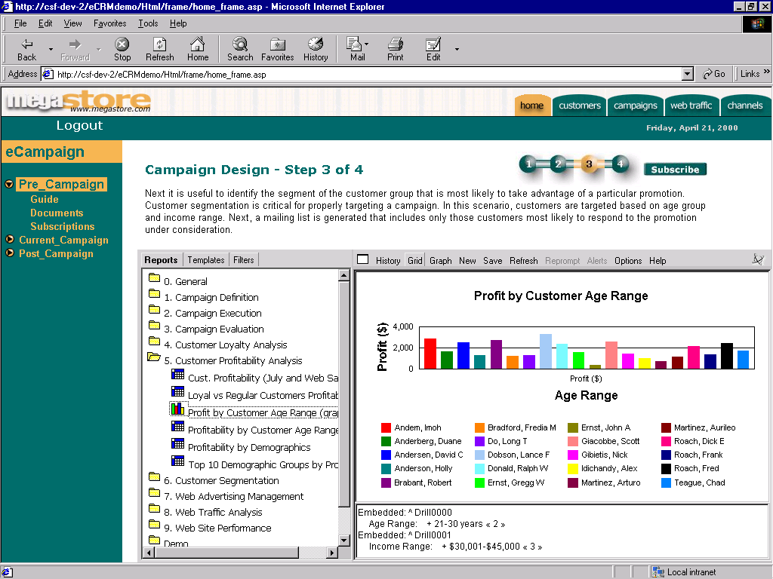
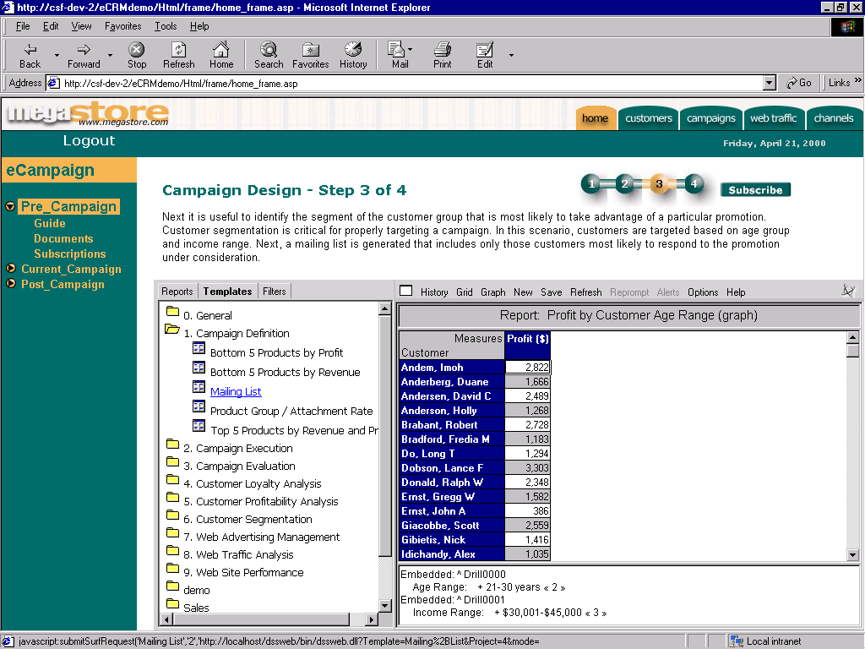
Notes:
Wanting a more precise look at the figures, the Analyst changes the report to grid format.
What the manager is looking at now is a list of customers that are between 21 and 30 years old and make between $30-$45K per year.
The analyst decides that the promotion should be sent to this group, and in order to do so, a mailing list is necessary with all the pertinent information.
With that in mind, the analyst clicks on the templates tab...

Slide 47
Specialized CRM systems and integrated solutions
  SAP
  Oracle
  Baan
  Microstrategy
Microsoft CRM
Microsoft NAV
Microsoft Ax Dyn
SAS
Remedy
Goldmine

Slide 48
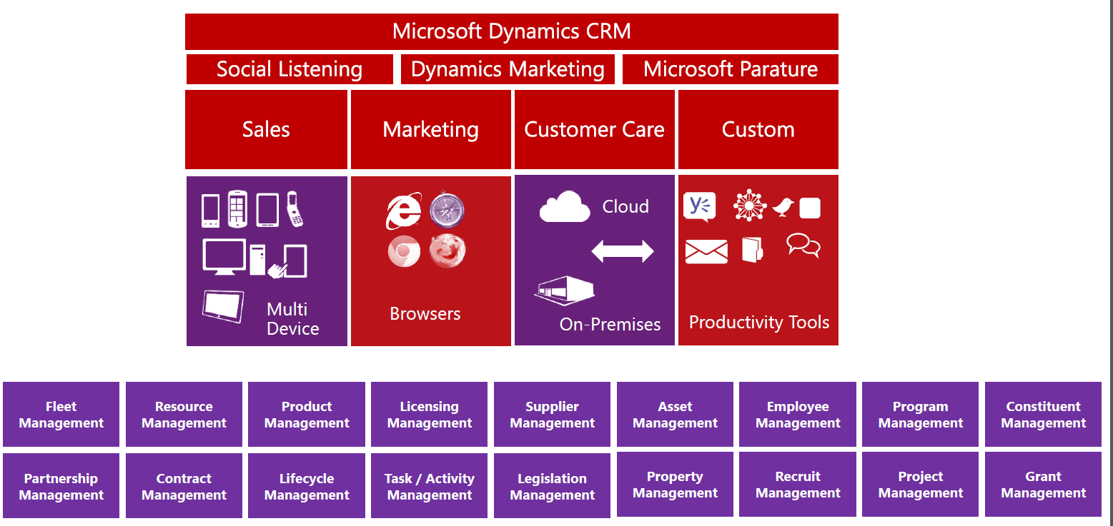
Microsoft CRM

Slide 49
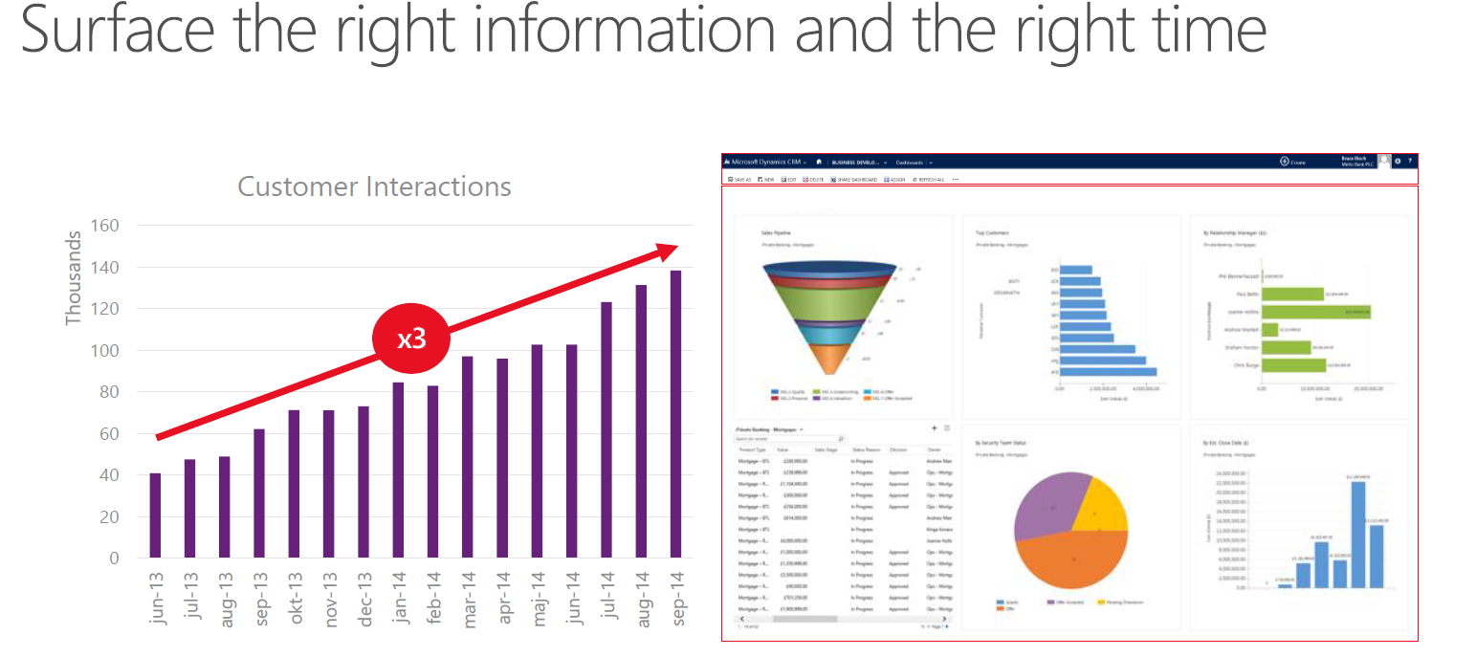
MS CRM

Slide 50
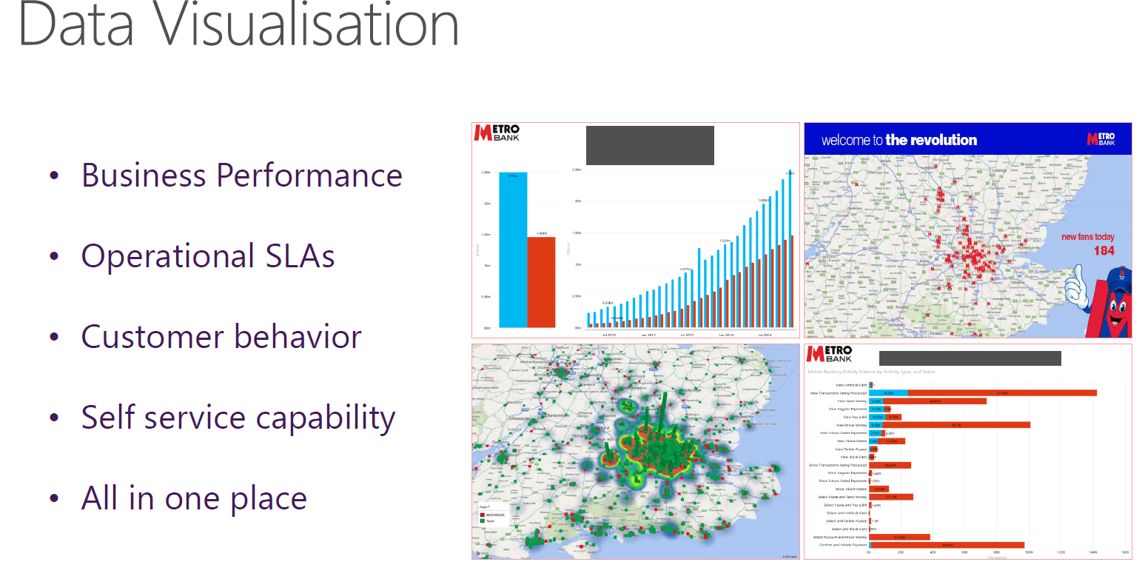
MS CRM

Slide 51
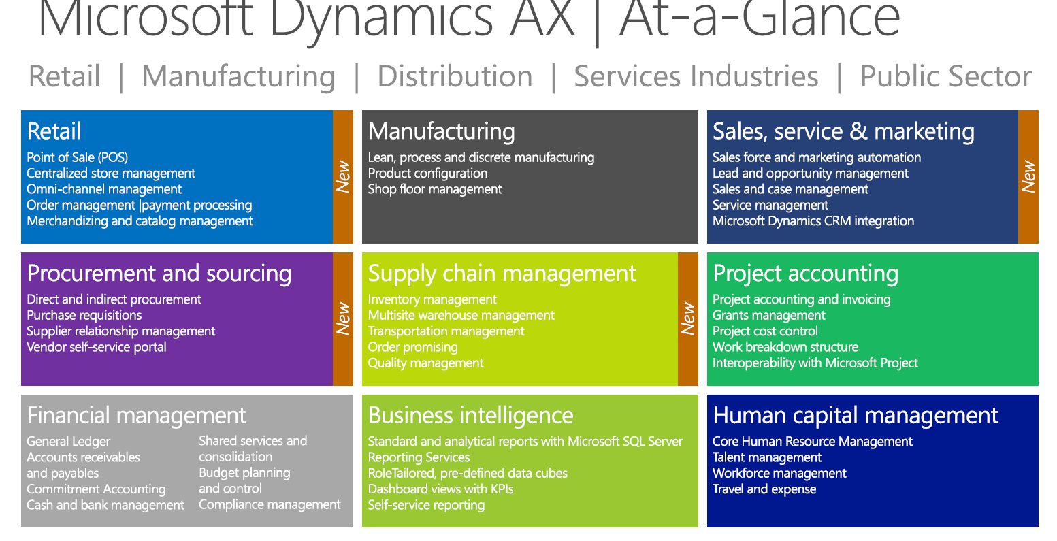
Microsoft AX Dynamics- marketing IS embedded

Slide 52
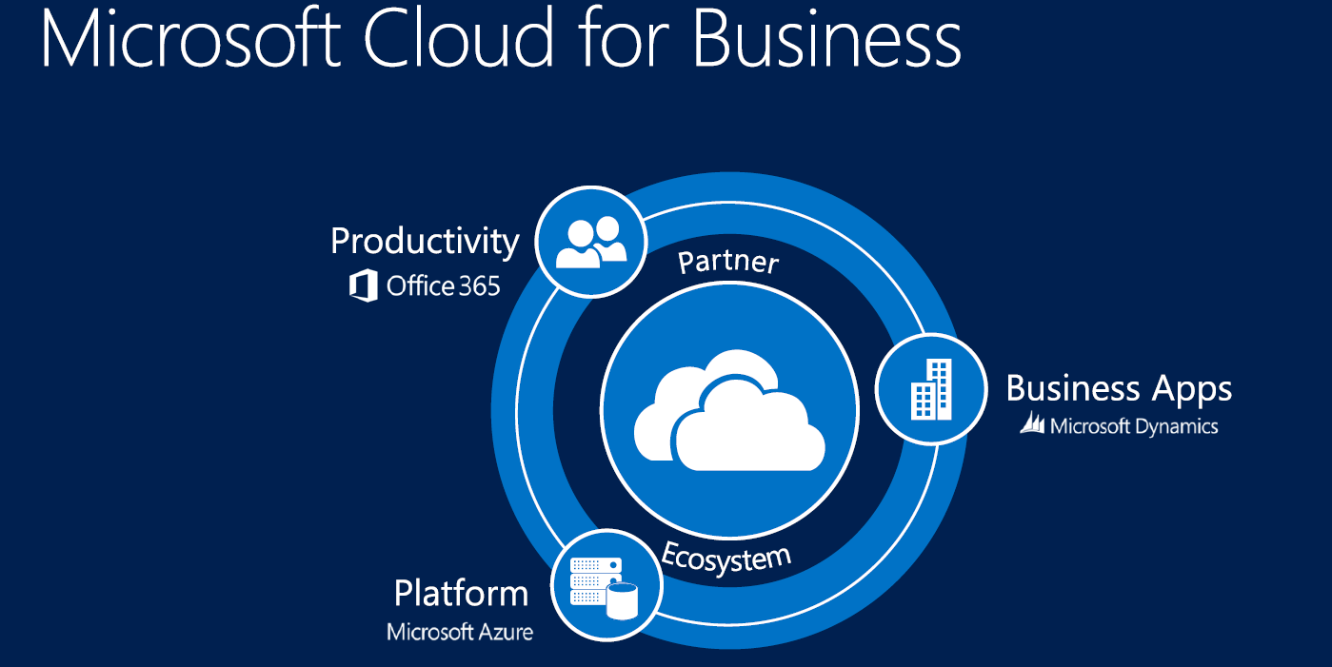
ERP in cloud (MS offer)

Slide 53
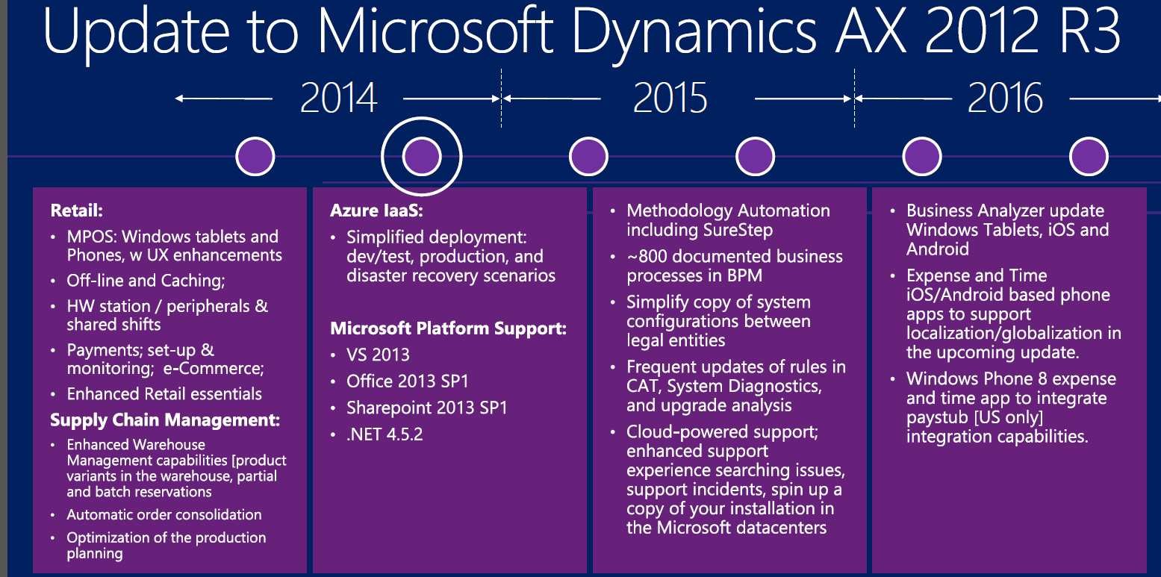
Industry trends for ERP (MS case)

Slide 54
MS key points for marketing applications
Marketing today starts at creating amazing brand experiences. This starts with the customer journey. Marketers have to deliver an engaging customer experience that is consistent, personalized and relevant across all channels. At the same time, marketers have to show impact on the business. They have to have an understanding how they contribute to revenue and pipeline, and they have to be able to provide detailed analytics of that contribution.
TALKING POINTS:
The most progressive companies focus on the customer journey AND embed analytics in their day-to-day operations to understand where and how marketing investments pay off
They plan and track all marketing assets and marketing programs and use customer insights to continuously improve their programs and to collaborate with sales.
Marketing is a data-driven science
Marketing is about using data to target audiences and create value. It’s about adding business value

Slide 55
MS key points for marketing applications
KEY TAKEAWAY
What does that mean? It means ENGAGING CUSTOMERS in a consistent way across channels to create amazing customer experiences. It means aligning marketing and sales to BUILD a better PIPELINE. And it means tracking your Marketing ROI to DEMONSTRATE IMPACT.
TALKING POINTS
You need to align the brand experience with the customer experience, and align your team around a single message.
You need to engage with customers, in the way that they want, at the time they want, with the content they need in order to drive conversion and revenue.
You need to be able to track your investments across channels and show your impact.
METRICS
Just to highlight a few metrics, it means an:
Increase qualified leads
Increase conversion rates
Decrease time-to-market
Prove ROMI
We all know marketers aren’t paid to plan – they’re paid to execute. With Dynamics Marketing, the plan is the campaign, allowing marketers to get all of the benefits of using a planning solution without wasting any time in the planning process. That means you can spend more time on the work that you love, and less time project managing.

Slide 56
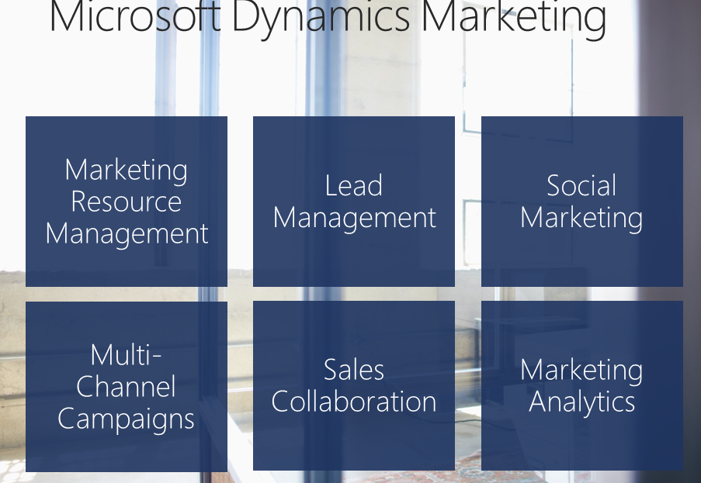
MS newest modules for marketing

Slide 57

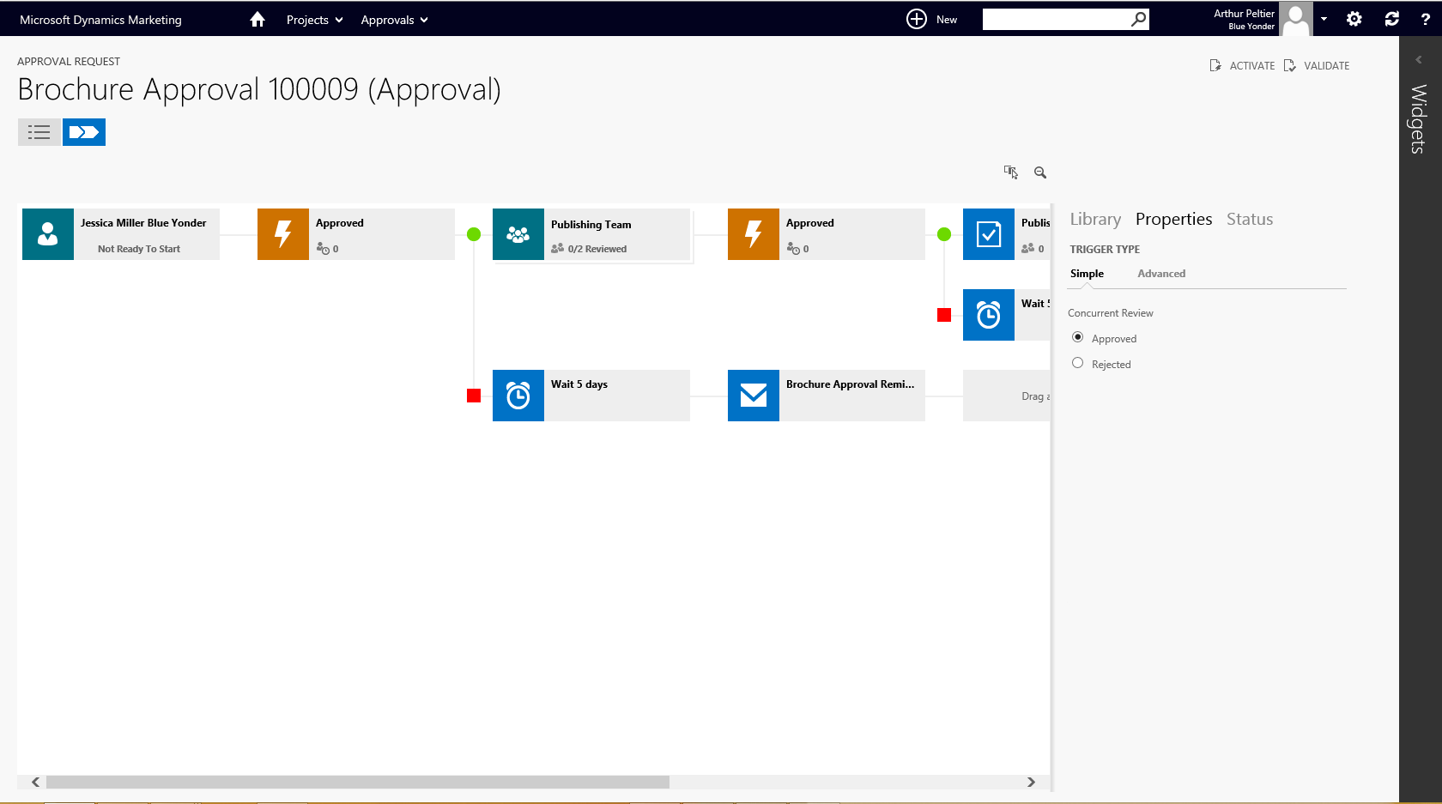
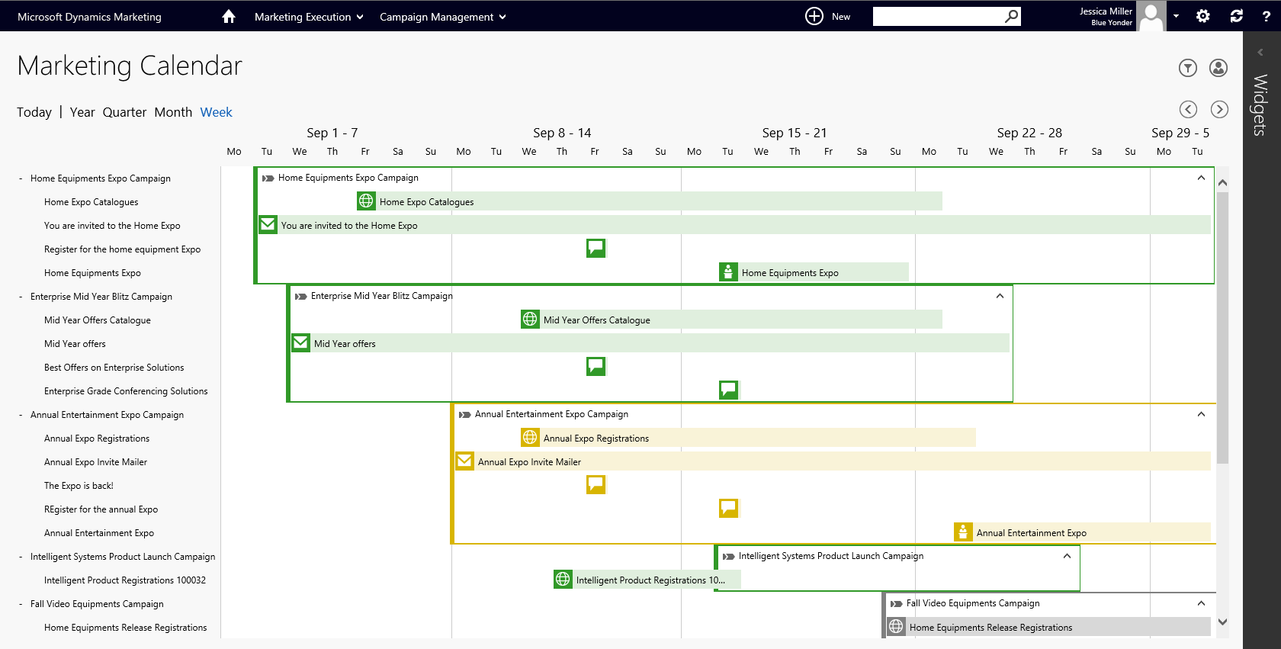
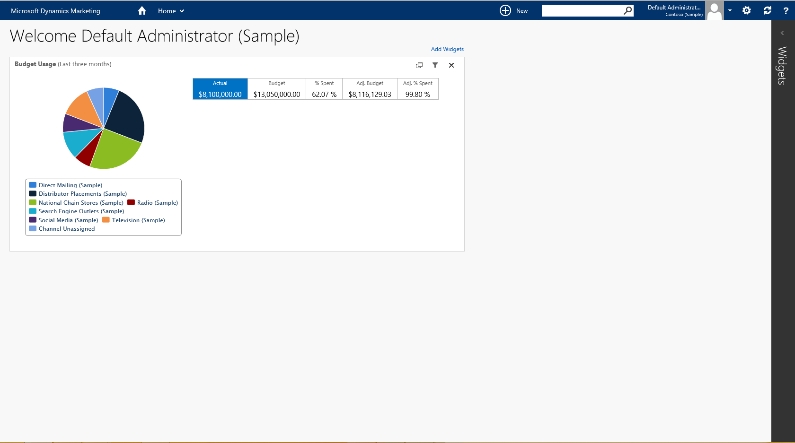
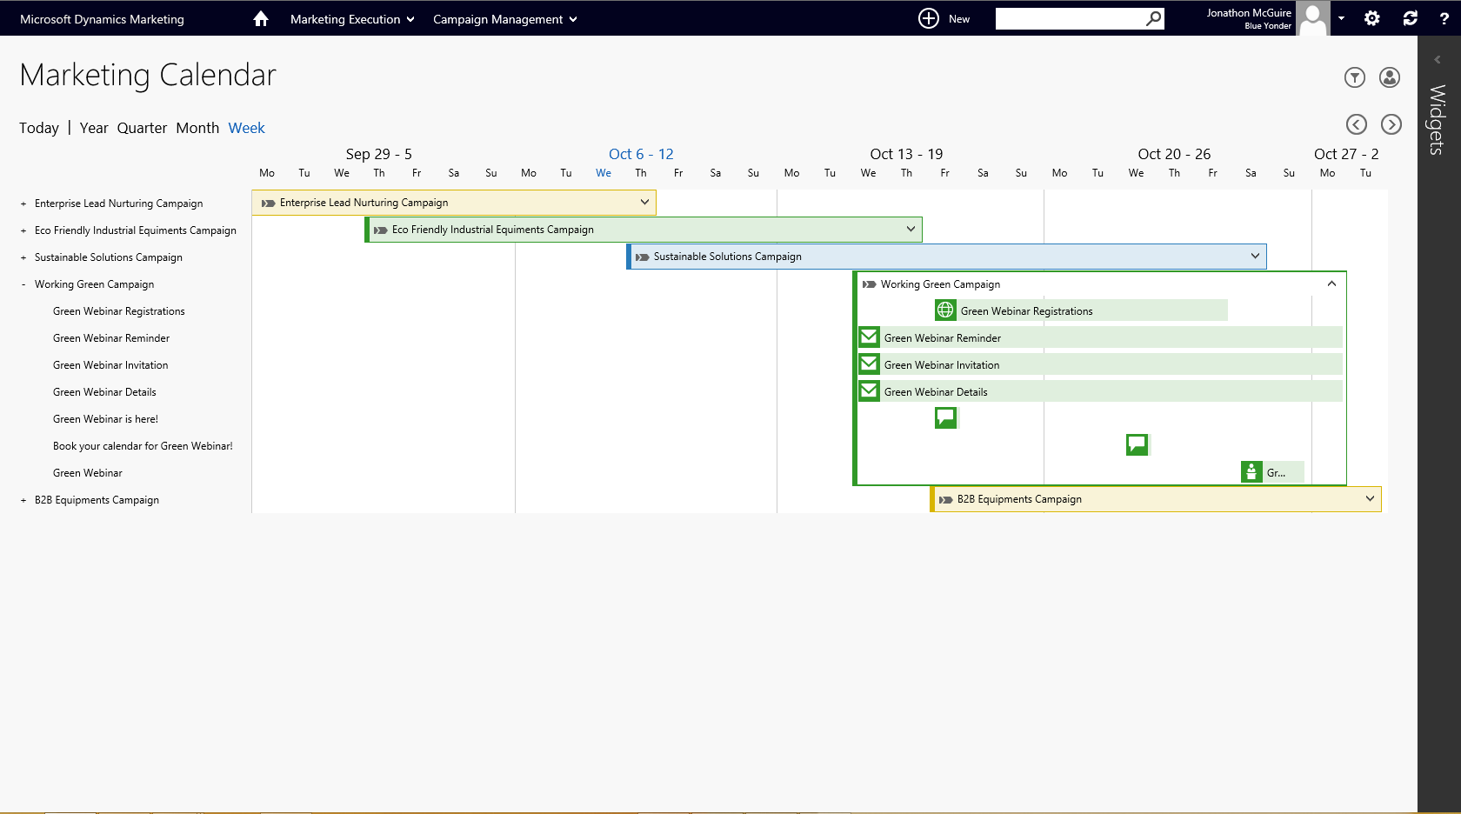
Marketing resource management
Marketing calendar
Align teams & plan around an integrated calendar for increased transparency & collaboration
Budgeting
Plan & manage marketing budget & spend across channels
Marketing workflow
Integrate extended marketing teams with automated processes & approvals
Digital asset management
Centrally manage digital assets with a powerful repository tied to campaigns & calendar
Budget Usage (last three months)
Notes:
KEY TAKEAWAY:
Integrate your marketing planning, budgeting and tracking across all channels, including email, digital, social and traditional. Scale your marketing with the ability to collaborate and manage processes and workflows across your team, other departments and agencies from a single platform.
TALKING POINTS:
No need for a separate application- all of your people, resources and assets are connected to the Campaign right from the start. Marketing gets the credit for every interaction.
By putting Planning at the center, each campaign starts with the right inputs and tracking codes to make sure that each interaction (web, email, etc) can be tracked to the right source for revenue attribution.
Without MRM, the marketer is constantly trying to interpret results after the fact
Most importantly, by aligning your team around the planning process, you can insure that you all contributing to the same, great customer experience. Scaling up resources with each campaign “sprint” is easier because you’re all on the same page.
We make managing marketing projects an easy and seamless part of the process, because marketers build out their campaigns and plans as a natural part of the design process. This means you have a great planning tool to coordinate your internal and external campaign stakeholders.

Slide 58
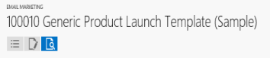
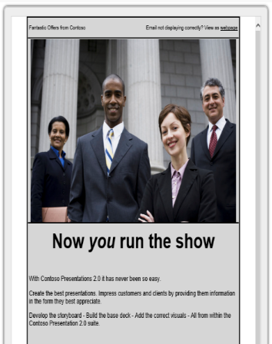
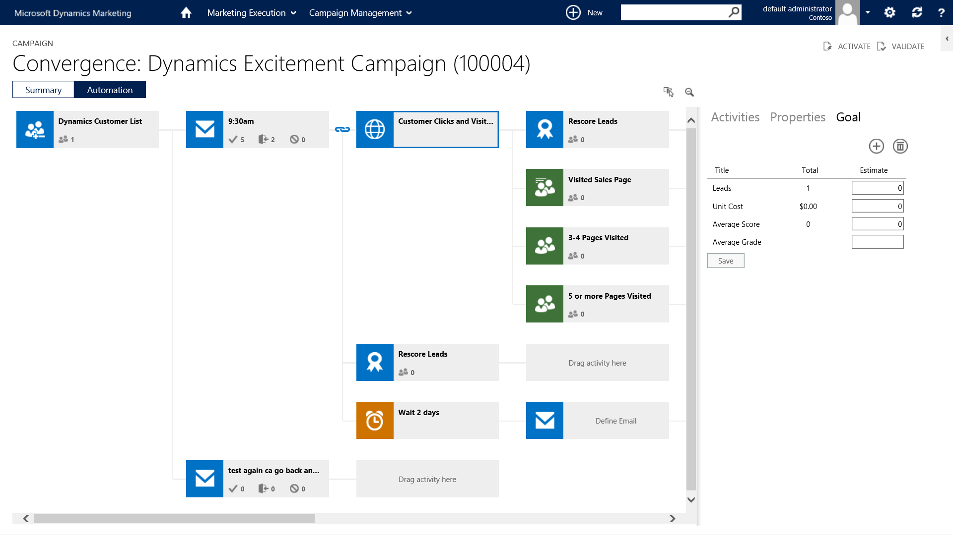
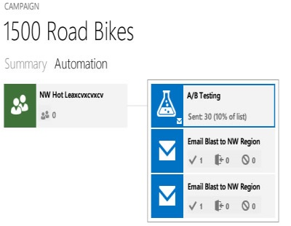
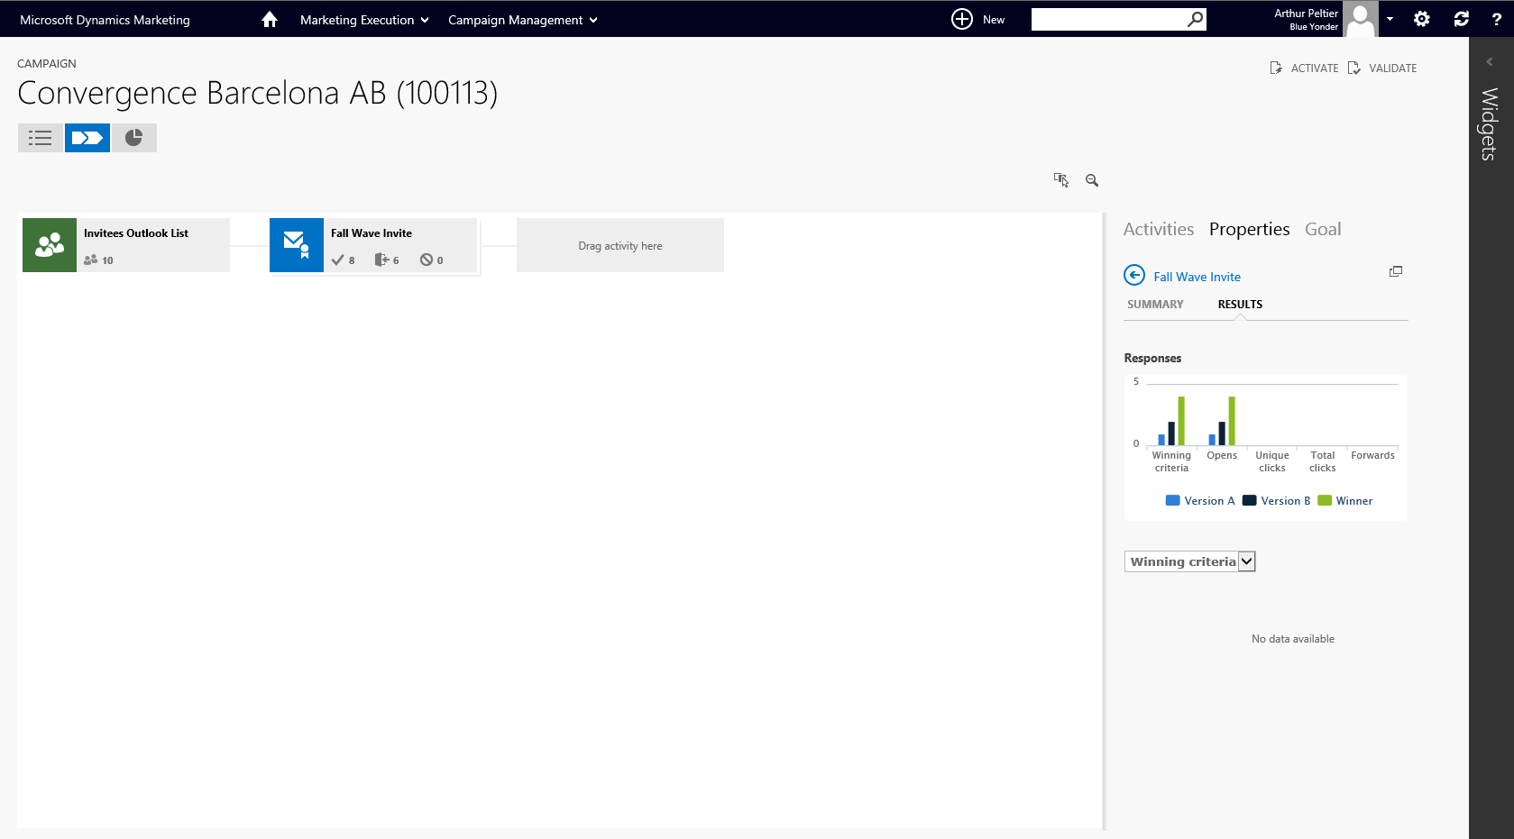
Multi-channel campaigns
Campaign design
Easily manage campaigns with drag & drop design across email, digital, social & traditional channels
Personalized engagement
Deliver one-to-one engagement with segmentation & targeting based on behavior & demographics
Email marketing
Easily design, test & launch contextual, personalized email marketing campaigns
A/B testing
Test marketing messaging & offers to optimize campaign performance
Notes:
KEY TAKEAWAY:
Engage customers with personalized, multichannel campaigns. Our visual campaign designer lets you drag and drop to create and manage campaigns in a single window—across email, social media, events, and direct mail. Streamline campaign creation, segment your customer and prospect base and test your campaign messaging and offers in order to improve conversion.
TALKING POINTS:
By setting up automated campaigns, the marketing manager can automate a complex selling process with multiple digital and traditional touchpoints and make sure that the customer experience is amazing- because they can map the right assets and content to the exact point in the customer lifecycle.
With the advanced email functionality embedded in the Campaign Automation Console, its easy to embed email campaigns and simplify the execution by aligning your marketing lists with your customer personas and your campaign flow. Event management is also integrated with our Campaign Management solution, so you can be sure that every single prospect interaction and conversion can be tracked for results.
Trigger based Campaigns can nurture your prospects through the customer journey, using all of your campaign assets to deliver exactly the right message to the right person at the right time. This means better customer experience, and improved conversion because you can tailor the experience to their needs.
Because Dynamics Marketing tracks engagement of the customer throughout the entire buying process (with anonymous and known contacts) both marketing and sales are empowered as a result. Marketers can design more segmented campaign flows based on engagement, and score those leads appropriately. Sales gets a view of the most actionable and engaged prospects.
Of course, because we have visual management reporting to see how many customers are at a given stage, we can quickly see if our campaign flow is working- real time.

Slide 59
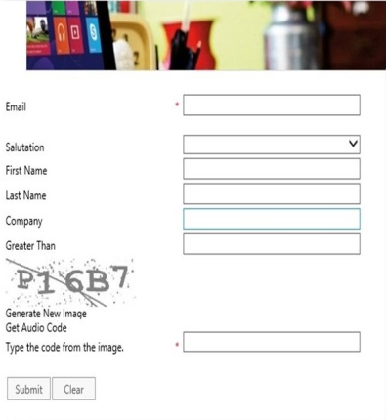
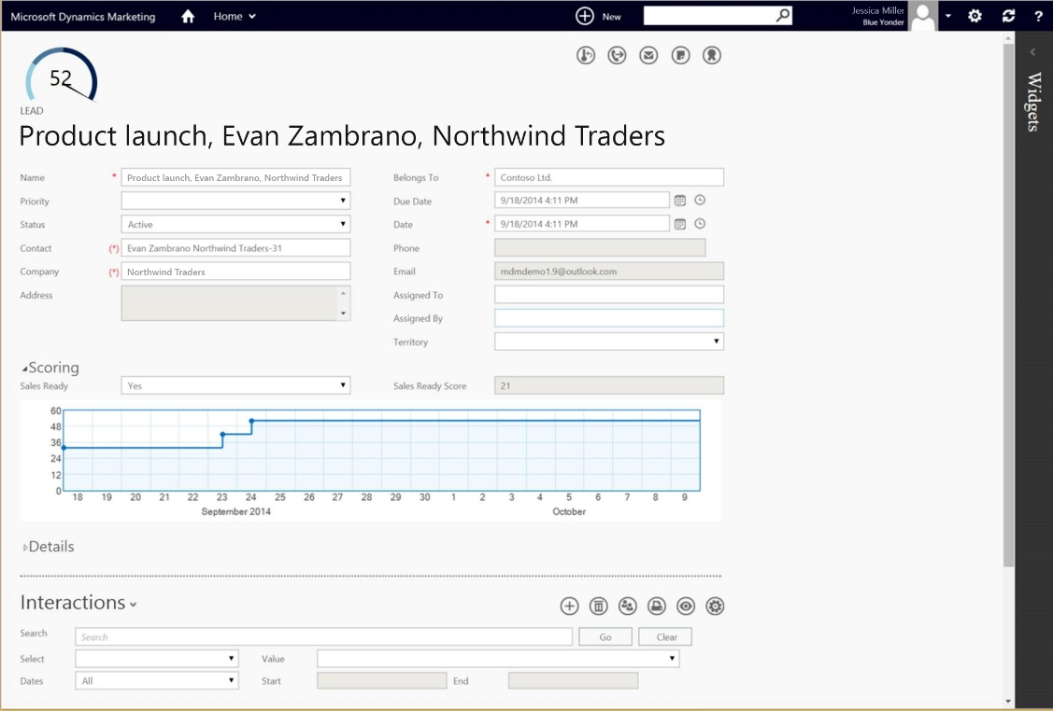
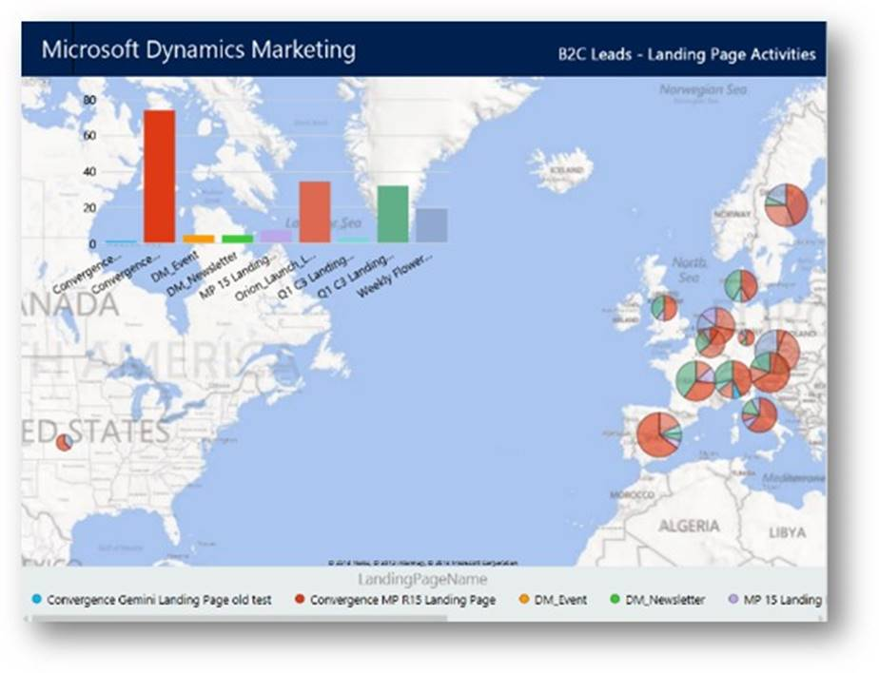
Lead management
Lead scoring
Determine sales-ready leads with flexible scoring based on behavior, demographics & time
Nurture campaigns
Foster prospect interest with multi-stage, trigger based nurture campaigns
Multiple scoring models
Accommodate different product & customer types with multiple lead scoring models
Lead imports
Enable leads from multiple sources with APIs for import from external lists
Notes:
KEY TAKEAWAY:
Generate more sales-ready leads with advanced segmentation and lead scoring. Foster prospect interest with multi-stage, trigger-based nurture programs that deliver relevant, personalized content and offers. Combine your sales and marketing funnel to better serve sales.
TALKING POINTS:
Dynamics Marketing is designed to help marketers drive more qualified leads to sales, with advanced segmentation and lead scoring rules to enable very precise qualification criteria. That means more sales ready leads.
Because we bring behavioral data right into our Lead scoring, that means we can score based on engagement and increase or decrease a lead score based on timing.
Customers rarely choose to interact on a single channel. The new world of marketing requires that we can not only execute multi-channel campaigns, but we need to build engagement across multiple channels Dynamics Marketing by nurturing customers using all the tools at our disposal.
Most important- that information is now visible on the lead, so when Sales receives a lead, they can quickly scan it and understand the next steps based on the customer behavior.

Slide 60
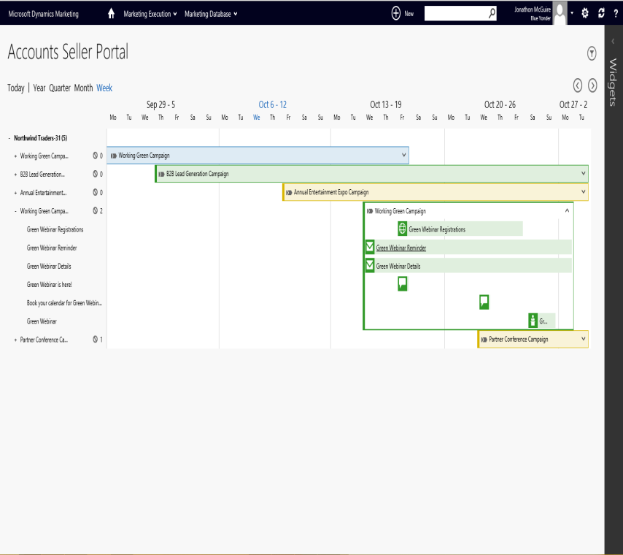
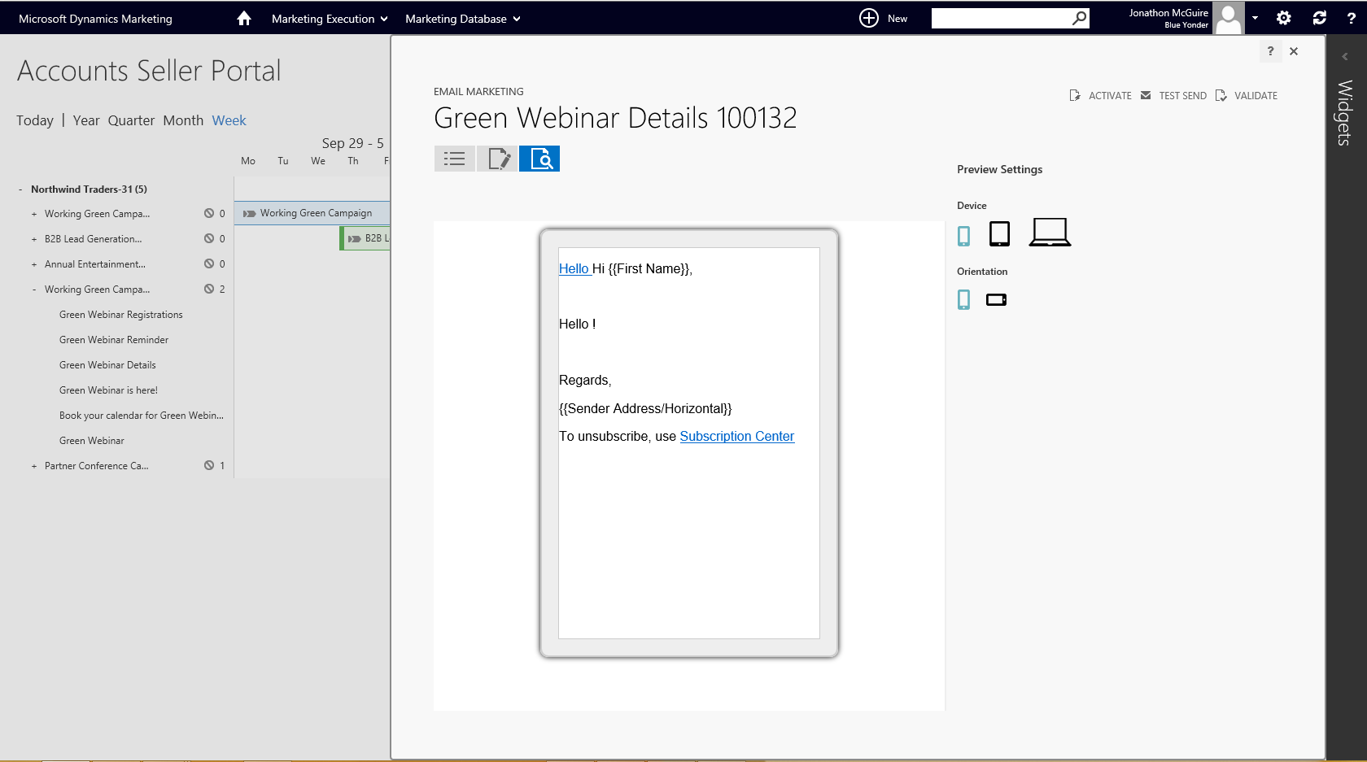
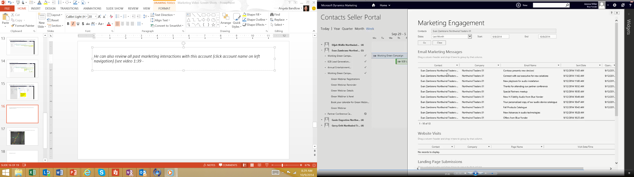
Sales collaboration
Marketing visibility
Empower sales teams with visibility into marketing calendar & campaigns
Outside-in view
Provide customer view of marketing activities & interactions vs CMO campaign view
Targeting input
Allow sales to provide input into campaign targeting for key accounts
Marketing alerts
Subscribe to alerts about customer behavior as part of an integrated campaign flow
Notes:
KEY TAKEAWAY:
The Sales Collaboration Panel is the most exciting new feature in the 2015 release. The Sales Collaboration Panel allows sales people to provide input to marketing campaigns and targeting. The Portal provides insight in all campaigns that are relevant for each customer and all interactions of each contact with marketing campaigns. A very cool feature is that sales people can exclude individual contacts from specific campaigns.
TALKING POINTS:
This is a new feature in Dynamics Marketing 2015
Strengthen your marketing and sales synergies by providing sales with visibility into the marketing calendar, along with how it impacts individual customers. Sales has the ability to provide input into campaigns and targeting. Both sales and marketing have visibility into the entire customer journey.

Slide 61
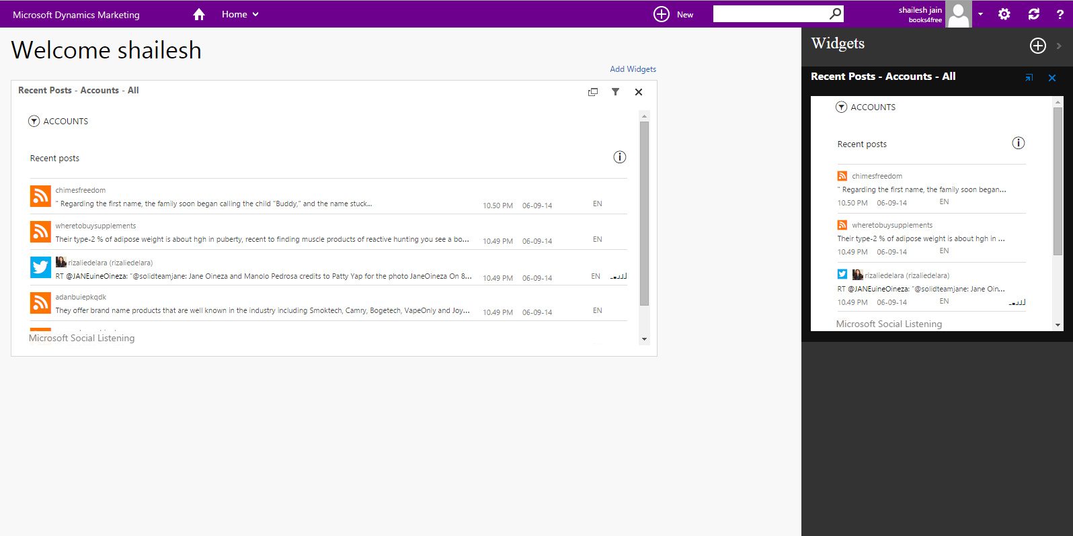
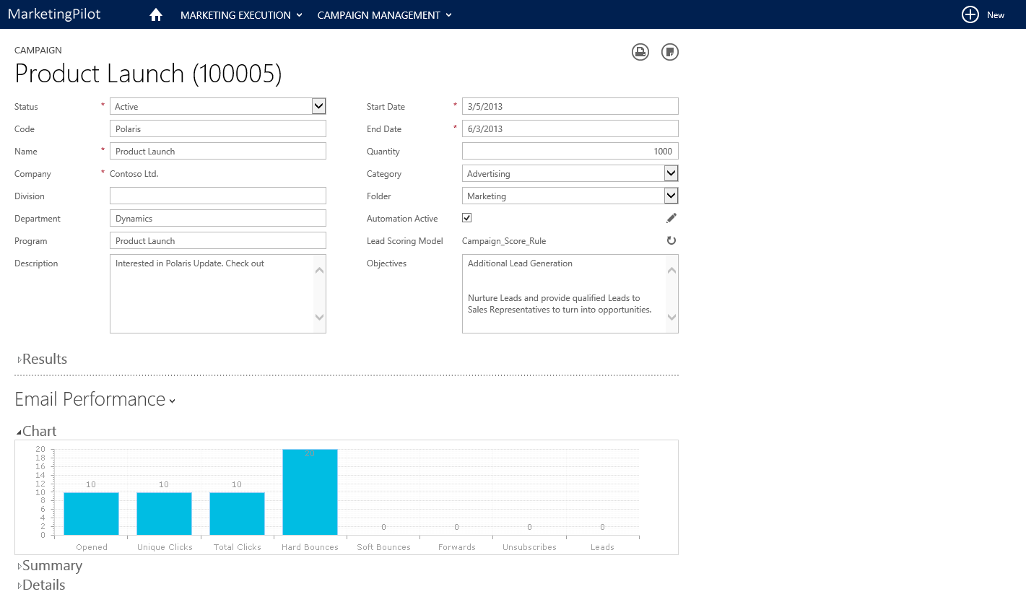
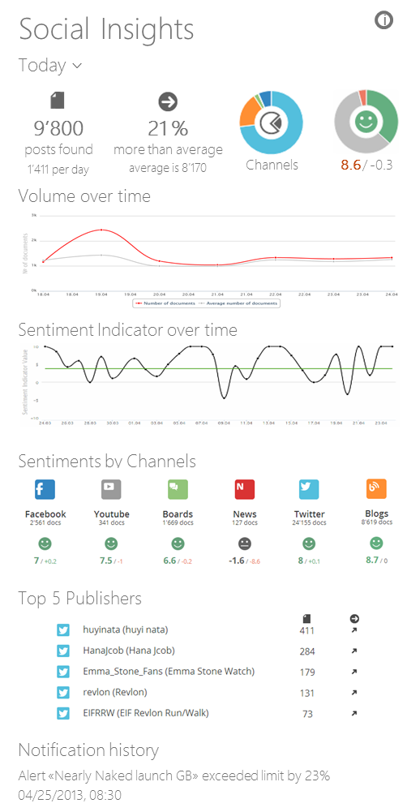
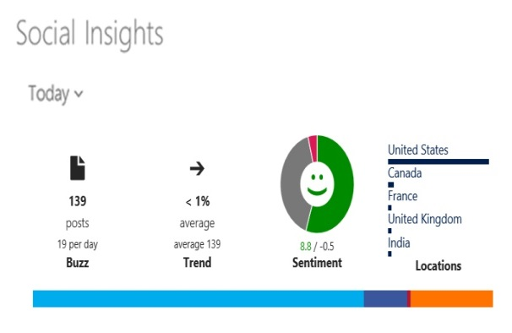
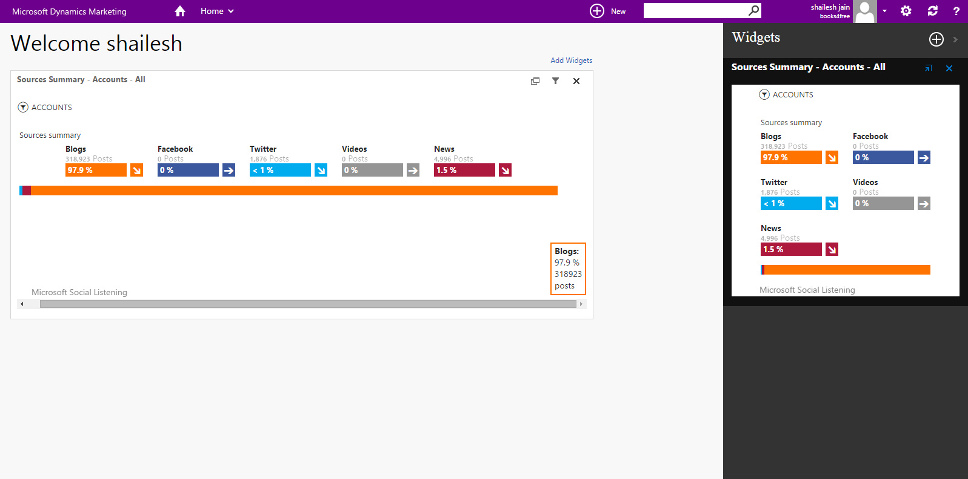
Social marketing
Social sentiment
Analyze sentiment with easy-to-read charts on the home page
Social amplification
Amplify campaign reach by posting directly to Facebook or Twitter
Collaboration
Collaborate across internal & external teams with Yammer, Skype & Lync
Social curation
Curate social messages to ensure compliance with brand standards
Notes:
KEY TAKEAWAY:
Enable your marketing organization to connect with customers and prospects with embedded, contextual social tools. See how your marketing campaign is performing by measuring impact across a number of social channels. Track your share of voice across the social web, including Twitter, Facebook, and YouTube. Monitor your global sentiment and brand presence.
TALKING POINTS:
Social sentiment comes from our Microsoft Social Listening product
Social Sentiment: Analyze sentiment with easy-to-read charts on your home page.
Social Amplification: Amplify campaign reach by posting directly to Facebook or Twitter.
Collaboration: Collaborate across internal and external teams with Yammer, Skype and Lync.
Curation: Curate social messages to ensure compliance with brand standards

Slide 62
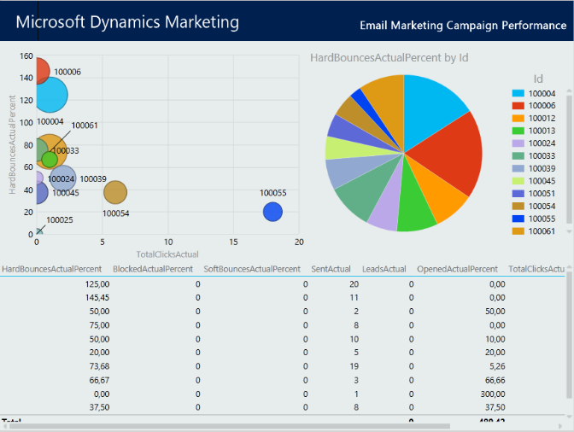
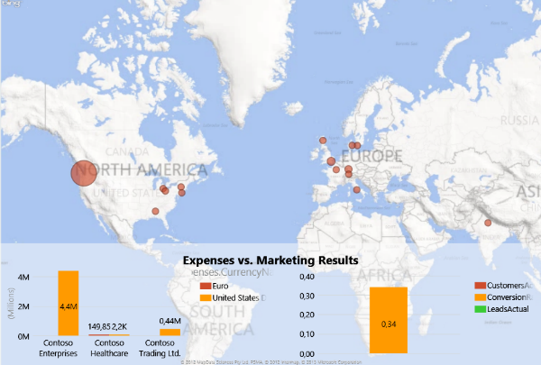
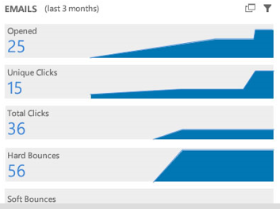
Marketing Analytics
Reporting
View campaign performance, financials & resource management with out-of-the-box reporting
Rich analytics
Analyze in depth campaign performance & marketing impact with powerful, flexible analytics
Time-based analysis
Understand trends & get a complete picture of marketing ROI with time-based analytics
Notes:
KEY TAKEAWAY:
Measure pipeline and revenue across every marketing investment to get a true view of your marketing ROI. Empower your marketers with access to sales and marketing data through visual dashboards. Get a clear overview of campaign results so you can quickly understand performance. Make reporting easy by giving marketers familiar tools - Excel and PowerBI for real-time reporting.
TALKING POINTS:
Using Power Query's OData, you can connect directly to your Dynamics CRM Online account, and join this to your marketing data for a complete view of your marketing and sales funnel. Explore and visualize your sales, customer and marketing data directly in Excel
Monitor the performance of your campaigns using familiar tools that all marketers can use and understand. Adjust your initiatives based on actual performance and see the results in a holistic view for continuous improvement
Create dashboards to monitor performance through all your channels. Share dashboards with the rest of your organization who can consume them anywhere at any time. Unlock new growth opportunities enabling visual data discovery for everyone in your sales pipeline and encourage collaboration
Through data visualizations now it is easier than ever to understand the value of each your segments. Because DM includes both cost (marketing investments) and revenue, you can understand return and investment on each of your channels and segments to maximize your return. Create KPIs to monitor customer value, churn and profitability.
It doesn't matter where all your data is coming from. Schedule refreshes to always have the latest view of your performance and make decisions that will produce results faster and more effectively. All of this while keeping your data secure and consistent.

Slide 63


Microsoft Social Listening
Social Listening
Social Analytics
Social CRM

Slide 64
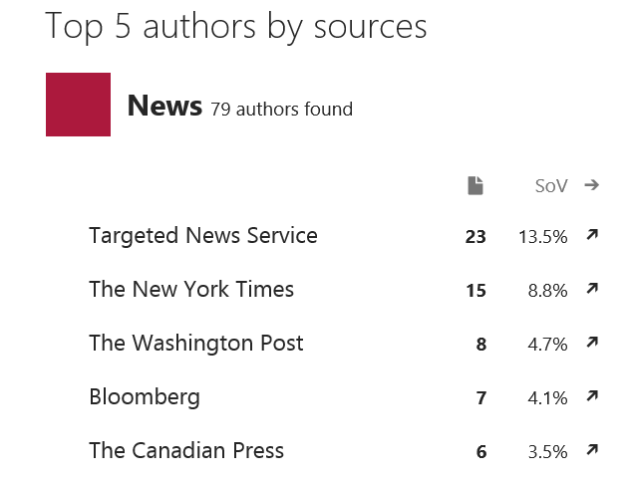



Social Listening
Powerful social listening
Listen to what people are saying globally across the social web in 19 languages.
Key influencers
Identify who is actively talking about your brand, products, or services.
Sophisticated alerts
Detect trends and listen for specific posts to keep you informed on the topics you care about.
Notes:
Key Points:
Microsoft Social Listening can listen in up to 19 languages and let’s you know which ones have the most posts around the topics you care about you.
Know key influencers - not just on your topics, but on the social web as a whole.
Trend alerts notifies you of market trends around your topics and post alerts notifies designated people when key words are mentioned.

Slide 65







Social Analytics
Global sentiment analysis
Gain a true understanding of your business, customers and topics that matter most.
Share of voice
Track and measure topics you care about across Facebook, Twitter, Blogs, Videos and news publications.
Advanced filtering
Flexible filters allow you to segment your data by source, sentiment, location, or author.
Notes:
Key Points:
Easy-to-read charts and graphs.
Sentiment monitoring is a tool which looks at posts and evaluates key words to assign value – words like “good or great” are given a positive sentiment. Words like “bad or terrible” are given a negative sentiment. This helps you identify whether there are positive, negative feelings about your product or brand and can be helpful for shaping messaging and sales conversations more effectively.
Share of Voice shows volume of discussion is coming happening on each source.
Advanced filtering allows you to view the social data the way you want to view it

Slide 66




Social CRM
Social for Sales
Watch for buying signals, monitor key developments and decision makers at your top accounts.
Social for Marketing
Manage your brand reputation, nurture influencers and measure campaign effectiveness.
Social for Service
See how happy your customers are and create alerts to identify any customer issues and trends early on.
Notes:
Key Points:
Some of the use cases around sales, marketing and service:
Sales
Social buying signals are an opportunity for sales to listen to social conversations and pick up on trends or signals.
Monitor developments at top accounts and use social signals to know if you need to check in.
Marketing
Marketer cares about protecting the brand. Important to know when the brand is damaged so they can fix.
Identify impact of different influencers and prioritize those who can deliver the greatest social impact.
Around campaigns, listen to social chatter, evaluate and adjust the campaign in real-time.
Service
Listen for when customer is complaining on the social web and proactively respond
Set up alerts to spot potential issues before they expand to damage the brand.

Slide 67

SAP integrated system: CRM module
Module is composed of various functional blocks.

Slide 68
Analytic scenarios
Analytic scenarios- multi purpose analysis
Customer analysis – value analysis per customer
Product analysis – observation of product, promotion optimization
Communication channels – analysis of regular and e-channels
Marketing analysis- allows to select new markets. Cross-sell scenario design
Sales analysis – extensive reports “win or lose” analysis for competitive evaluation
Customer oriented business management by differentiating approaches to customers

Slide 69

Structure of analytics scenario

Slide 70

“Best practice” application in SAP
The analytic scenarios idea is to evaluate them at all enterprises which implemented SAP solutions. Successful scenarios are standardized and implemented. Benchmark of scenario effectiveness is provided

Slide 71

CRM tasks related to social media analytics- new source for deriving value indicators
Development from Web1.0 to Web4.0

Slide 72

Social networks: nine most popular (2010)
72

Slide 73
The Web 2.0 characteristics:
Social Media, and Industry Disruptors
  The ability to tap into the collective intelligence of users
  Data is made available in new or never-intended ways
  Relies on user-generated and user-controlled content and data
  Lightweight programming techniques and tools let nearly anyone act as a Web site developer
  The virtual elimination of software-upgrade cycles makes everything a perpetual beta or work-in-progress and allows rapid prototyping

Slide 74

74

Slide 75

75

Slide 76
Online Social Networking: Basics and Examples
  New Business Models
  social network analysis (SNA software)
  The mapping and measuring of relationships and information flows among people, groups, organizations, computers, and other information- or knowledge-processing entities.
  The nodes in the network are the people and groups, whereas the links show relationships or flows between the nodes. SNAs provide both visual and mathematical analyses of relationships
76

Slide 77
Business and Enterprise Social Networks
social marketplace
The term is derived from the combination of social networking and marketplace. An online community that harnesses the power of one’s social networks for the introduction, buying, and selling of products, services, and resources, including one’s own creations. Also may refer to a structure that resembles a social network but is focused on individual members
77

Slide 78
Commercial Aspects of Web 2.0 and Social Networking Applications
  Consumers can provide feedback on the design of proposed or existing products etc.
  Word-of-mouth (viral marketing) is free advertising
  Increased Web site traffic brings more ad dollars
  Increased sales can come from techniques based on personal preferences such as collaborative filtering
78

Slide 79

CRM in virtual community

Slide 80
Web 2.0 data types
  Rating
  Tagging
  Forum content
  Blog
  E-newsletter
  Video materials
  Competitions
  Search engine analysis
  Shopping in social networks
  Feedback from customers: conversational marketing

Slide 81

Advertising using social networks, blogs
  Viral (Word-of-Mouth) Marketing done by bloggers
  Classified Ads, Job Listings, and Recruitment
  Special Advertising Campaigns
  Mobile Advertising
81

Slide 82
The Future: Web 3.0 And Web 4.0
Web 3.0: A term used to describe the future of the www. It consists of the creation of high-quality content and services produced by gifted individuals using Web 2.0 technology as an enabling platform
Semantic Web: An evolving extension of the Web in which Web content can be expressed not only in natural language, but also in a form that can be understood, interpreted, and used by intelligent computer software agents, permitting them to find, share, and integrate information more easily
Web 4.0: It is still an unknown entity. However, it is envisioned as being based on islands of intelligence and as being ubiquitous
82

Slide 83

Blog record preparation for analysis
83

Slide 84

Internet pages analysis: data preparation
84

Slide 85

Hot to use ontologies
By interlinking information from various sources, it is possible to define if “the person knows book author”
85

Slide 86

Links among individuals and their types
86

Slide 87

Internet query analytics
Grouping by topics
Defining group sizes
Detailed information of the query success
The suitable formats and algorithms for queries can be designed
87

Slide 88

Conversion analysis
User decision making process, affected by social networks:
Likes
Impressions
Friends impressions
Clicked
Share
Comments
Total fans
Young Ae Kim; Srivastava, J. (2007) Impact of Social Influence in E-Commerce Decision Making

Slide 89

Conversion analysis
The conversion rate (Z-axis) is affected by the likes (X-axis) and Clicks (Y-axis).
The correlation among the indicators for this case is 0,98. However each business case tend to be unique and should be explored by the enterprise in long term for its customer base

Slide 90

How it spreads when in need:
Katrina PeopleFinder
Hurricane 2005
1.1 M people were on search
Blogger initiative for search
PeopleFinder Information Format PFIF system was implemented during 24 hrs
90

Slide 91

Peoplefinder query sample
91

Slide 92
Project scope and data management problems
7,000 records on Sunday. 50,000 records on Monday evening
4000 volunteers
Total 640,000 records
ShelterFinder – other project where all shelters for people were registered
Katrina PeopleFinder project data was passed to Google and used together with American Red Cross and Microsoft for finding people
Project is now closed for preserving sensitive data
The processes can be transferred from non-profit to the commercial area for analysis of referral information
92

Slide 93
Literature
Berry, M.,J.A., Linoff, G.S. (2011), "Data Mining Techniques: For Marketing, Sales, and Customer Relationship Management", (3rd ed.), Indianapolis: Wiley Publishing, Inc.
(Electronic Version): StatSoft, Inc. (2012). Electronic Statistics Textbook. Tulsa, OK: StatSoft. WEB: http://www.statsoft.com/textbook/
(Printed Version): Hill, T. & Lewicki, P. (2007). STATISTICS: Methods and Applications. StatSoft, Tulsa, OK.
Sugar CRM Implementation http://www.optimuscrm.com/index.php?lang=en
Statsoft: the creators of Statistica http://www.statsoft.com
Viscovery Somine http://www.viscovery.net/

