Slide 1

PV181 Laboratory of security and applied cryptography
Asymmetric cryptography
Marek Sýs, Zdeněk Říha

Slide 2
Public vs private key cryptography
Private (symmetric)
  both parties share secret (private)
  Pros: fast encryption
  Cons: key distribution requires secure channel
Public (asymmetric)
  one key is public
  Pros - key distribution – insecure channel is OK
  Cons - slow encryption
Practice - private + public:
  public used to establish key for private key system

Slide 3
Asymmetric cryptography
Two related keys – created by one party
  different inverse operations (encryption - decryption, signing – signature verification)
Properties - hard to compute private from public key
  based on hard mathematical problems
Hard problems and cryptosystems:
  Integer factorization – RSA, Rabin, …
  Discrete logarithm problem (DLP): ElGamal, EC, DSA, …
  Others (DH, decoding,…) – Diffie-Helman, McElliece,…

Slide 4
Asymmetric cryptosystem
Public key of Bob
Private key of Bob
encryption
decryption
Alice
Bob
message
Encrypted
message
Decrypted
original
message
Adapted Source: Network and
Internetwork Security (Stallings)

Slide 5
Asymmetric cryptosystem
Bob generates both keys:
  Public is sent to Alice
  Private is kept secret
Alice encrypt message with her public key and send it to Bob
Bob decrypt message using his private key

Slide 6
Digital signature
Asymmetric cryptography
  Private key – signature generation (usually only hash of data is signed not data itself)
  Public key – verification procedure
Data integrity + data origin + non-repudiation:
Non-repudiation - correct signatures can be generated only by those having the private key
The digital signature itself does not give any guarantees with respect to signing time.

Slide 7
Digital signature scheme
Public key of Alice
Private key of Alice
Bob
Signature
algorithm
Verification
algorithm
Alice
message
signed
message
verified
message
Source: Network and
Internetwork Security (Stallings)

Slide 8
Digital signature
Alice generates key pair
  Public key is published (sent to Bob) for verification of signature
Alice sign a document using her private key
Bob use public key to verify the digital signature

Slide 9
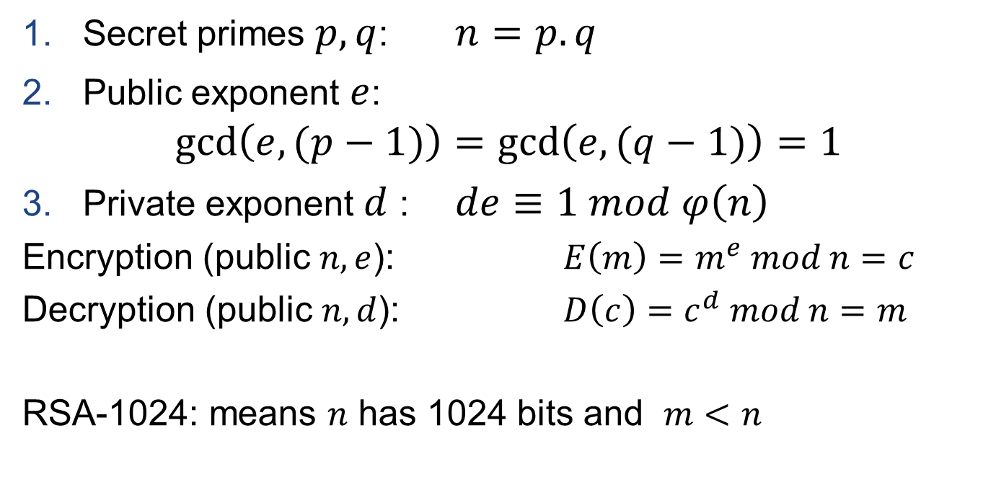
RSA: matematics
Secret primes $p,q$: $n=p.q$
Public exponent $e$:
$\gcd\left(e,(p−1)\right)=\gcd\left(e,(q−1)\right)=1$
Private exponent $d$ : $de≡1 mod φ\left(n\right)$
Encryption (public $n,e$): $E\left(m\right)=m^{e} mod n=c$
Decryption (public $n,d$): $D\left(c\right)=c^{d} mod n=m$
RSA-1024: means $n$ has 1024 bits and $m<n$

Slide 10
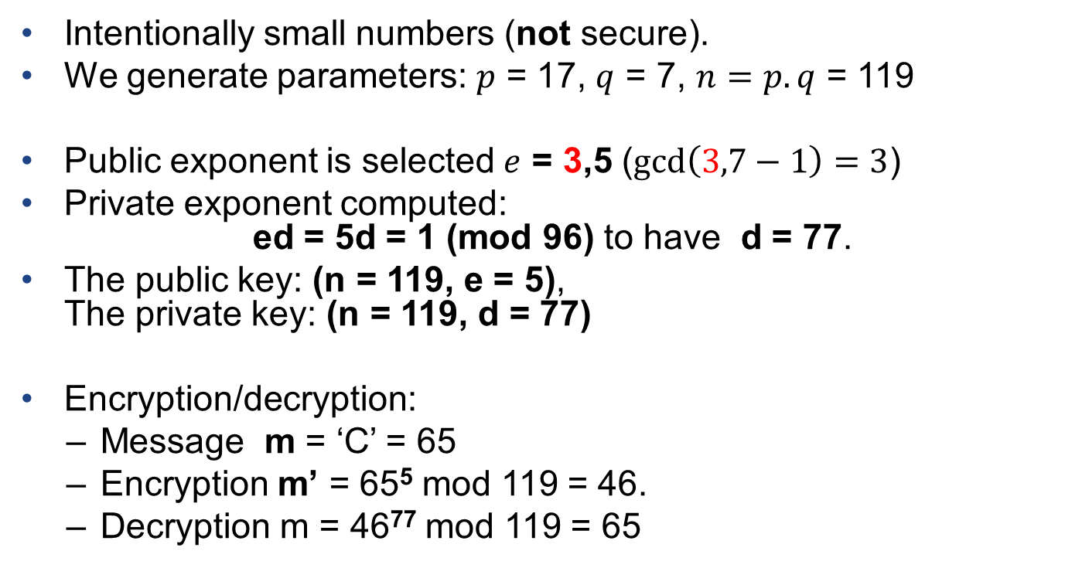
RSA example

Slide 11
RSA Padding example (PKCS#1 v1.5)
Document
  “00 01 02 03 04 05 06 07 07 06 05 04 03 02 01”
Hash of the document (sha-1)
  “b3 39 90 4c d2 a0 10 e6 19 37 eb e5 b5 83 37 8c 5d 10 51 95”
Padded hash
  “00 01 ff ff ff ff ff ff ff ff ff ff ff ff ff ff ff ff ff ff ff ff ff ff ff ff ff ff 00 30 21 30 09 06 05 2b 0e 03 02 1a 05 00 04 14 b3 39 90 4c d2 a0 10 e6 19 37 eb e5 b5 83 37 8c 5d 10 51 95”

Slide 12
RSA in practice: Padding
μ(M) = 6b bb … bb ba || Hash(M) || 3x cc
where x = 3 for SHA-1, 1 for RIPEMD-160
  ANSI X9.31
μ(M) = 00 01 ff … ff 00 || HashAlgID || Hash(M)
  PKCS #1 v1.5
μ(M) = 00 || H || G(H) ⊕ [salt || 00 … 00]
where H = Hash(salt, M), salt is random, and G is a mask generation function
  Probabilistic Signature Scheme (PSS)

Slide 13
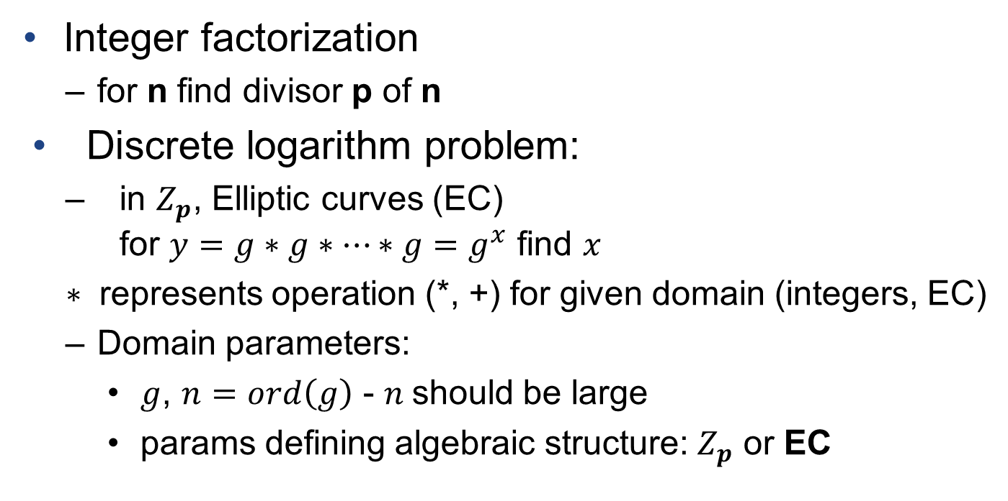
Hard problems

Slide 14
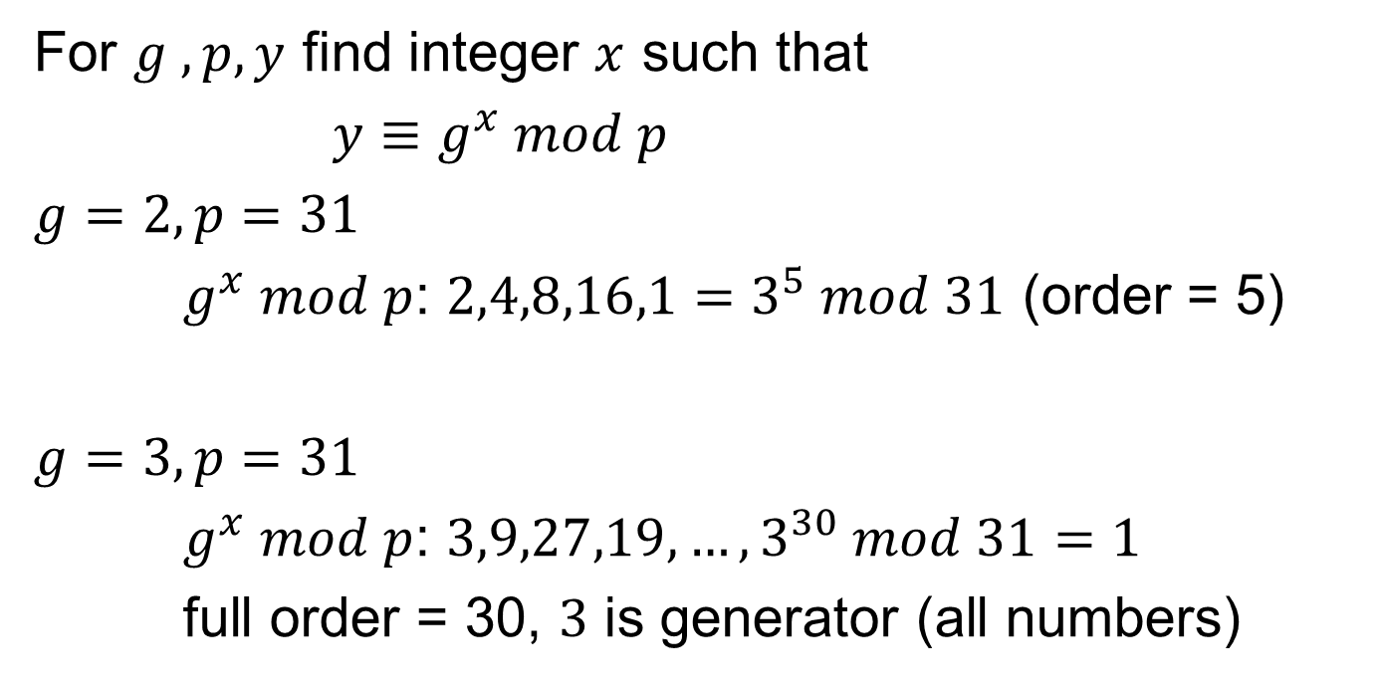
DLP for integers

Slide 15
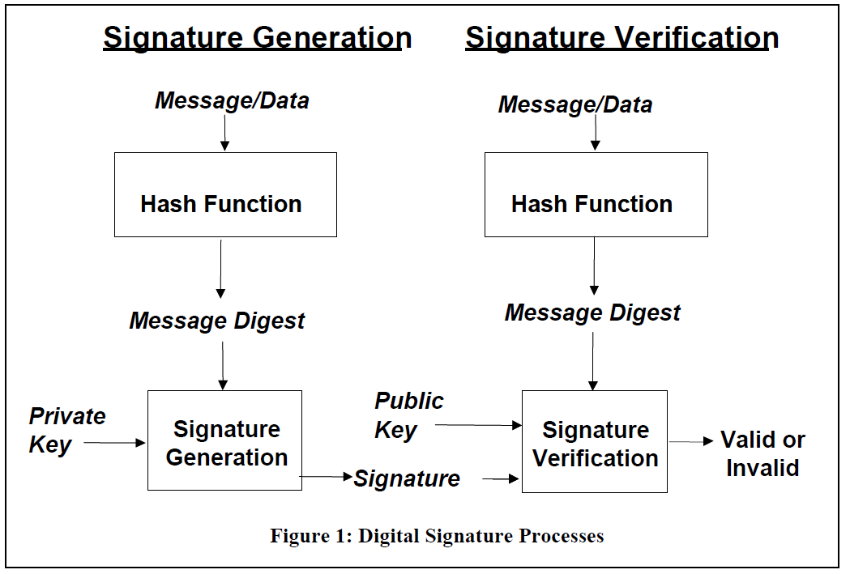
Digital Signature Standard (DSS)

Slide 16
Digital Signature Standard (DSS)
Signing:
  Hash H(m) of message m is computed
  H(m) is signed (E(H(m))) with private key
Verification:
  Public key is applied to E(H(m)) to get H(m) of original m
  m’ (obtained along with signature) is hashed to H(m’)
  if H(m) is equal to H(m’) signature is verified

Slide 17
Digital Signature Algorithm (DSA)
Proposed in 1991 by NIST
In 1994 the selection procedure for Digital Signature Standard (DSS) was concluded – DSA (Digital Signature Algorithm) was selected.
Modified version of ElGamal algorithm, based on discrete logarithm in Z_{p}.
Became FIPS standard FIPS 186 in 1993.
Slightly modified in 1996 as FIPS 186-1.
Extended in 2000 as FIPS 186-2.
Updated in 2009 as FIPS 186-3 (new key sizes).
Now NIST FIPS 186-3 supports RSA & DSA & ECDSA.

Slide 18
DSS
Selection of Parameter Sizes and Hash Functions
Domain Parameter Generation
- only for DSA, ECDSA
Signature Generation
Signature Verification and Validation

Slide 19
DSA: mathematics
Key generation – domain parameters
  Decide on a key length L and N, e.g. (1024,160).
    N must be less than or equal to the hash output length
  Choose an N-bit prime q. [“order of g w.r.t p”]
  Choose an L-bit prime modulus p such that p–1 is a multiple of q.
  Choose g, a number whose multiplicative order modulo p is q, e.g. g = h^{(p–1)/q} mod p for some arbitrary h (1 < h < p-1). [“generator”]
  Domain parameters (p, q, g) may be shared between different users of the DSA system.

Slide 20
DSA: mathematics II
Key generation
  Choose random x, such that 0 < x < q.
  Calculate y = g^{x} mod p.
Private key: x.
Public key: y & (p, q, g).

Slide 21
DSA: mathematics III
Signature generation
  Generate a random per-message value k such that 0 < k < q.
  Calculate r = (g^{k} mod p) mod q
  Calculate s = (k⁻¹(H(m) + x*r)) mod q
  The signature is (r, s).
Signature verification
  w = (s)⁻¹ mod q
  u1 = (H(m)*w) mod q
  u2 = (r*w) mod q
  v = ((g^{u1}*y^{u2}) mod p) mod q
  The signature is valid if v = r
For DSA (1024,160) the signature size will be 2x160 bits.

Slide 22
DSA: Padding
Decide on lengths L and N, e.g. (1024,160).
  N must be less than or equal to the hash output length
    E.g. for (1024,160) sha-1 is typically used,
    sha-256 would be ok as well and only first 160 bits would be used
  s = (k⁻¹(H(m) + x*r)) mod q
“It is recommended that the security strength of the (L, N) pair and the security strength of the hash function used for the generation of digital signatures be the same unless an agreement has been made between participating entities to use a stronger hash function. When the length of the output of the hash function is greater than N (i.e., the bit length of q), then the leftmost N bits of the hash function output block shall be used in any calculation using the hash function output during the generation or verification of a digital signature. A hash function that provides a lower security strength than the (L, N) pair ordinarily should not be used, since this would reduce the security strength of the digital signature process to a level no greater than that provided by the hash function.” [FIPS 186-3]

Slide 23
Elliptic curve DSA (ECDSA)
Elliptic curves invented by Koblitz & Miller in 1985.
ECDSA proposed in 1992 by Vanstone
Became ISO standard (ISO 14888-3) in 1998
Became ANSI standard (ANSI X9.62) in 1999
ECDSA is a version of DSA based on elliptic curves.

Slide 24
ECDSA: Elliptic curve domain parameters
(field,a,b,G,n,h)
  Finite field
    p for F_{p}
    m, bases (trinomial, pentanomial) for F₂^{m}
  Coefficients a, b: y² = x³ + ax +b
  Group generator: G
  Order of the G: n
  Optional cofactor: h
    (h = number of elements in field / order n)
  The base point G generates a cyclic subgroup of order n in the field.

Slide 25
ECDSA: Keys
Generating key pair
  Select a random integer d from [1,n − 1]
  Compute P = d*G;
Private key: d
Public key: P
For 256-bit curve
  the private key d will be approx. 256-bit long
  the public key P is a point on the curve – will be approx 512-bit long

Slide 26
ECDSA: Signatures
Generate signature
  Select a random integer k from [1,n − 1]
  (x₁,y₁) = k*G
  Calculate r = x₁ (mod n)
  Calculate s = k⁻¹(M + r*d) (mod n)
  Signature is (r,s).
Signature verification
  Calculate w = s⁻¹ (mod n)
  Calculate u₁ = z*w (mod n) & u₂ = r*w (mod n)
  Calculate (x₁,y₁) = u₁*G + u₂*P
  The signature is valid if r = x₁ (mod n).
For 256-bit curve the signature length will be approx. 512 bits

Slide 27
ECDSA: Padding
Rules are same as for DSA
“It is recommended that the security strength associated with the bit length of n and the security strength of the hash function be the same unless an agreement has been made between participating entities to use a stronger hash function. When the length of the output of the hash function is greater than the bit length of n, then the leftmost n bits of the hash function output block shall be used in any calculation using the hash function output during the generation or verification of a digital signature. A hash function that provides a lower security strength than the security strength associated with the bit length of n ordinarily should not be used, since this would reduce the security strength of the digital signature process to a level no greater than that provided by the hash function.” [FIPS 186-3]

Slide 28
Digital certificate

Slide 29
Digital certificate
used to prove ownership of the public key
binds public key to identity (identity, email,… )
Public key certificate is signed by trusted third party – Certification Authority (CA)
two models: centralized and decentralized

Slide 30
Trust models
Public key infrastructure (PKI)
  centralized – hierarchy of CA’s
  cert signed by party
  used in web browsers
  standard X.509
Web of trust
  decentralized model
  signed by many parties
  used in PGP, GPG
  standard OpenPGP

Slide 31
Public key Infrastructure (PKI)
set of roles and procedures:
  issue, maintain, administer, revoke, suspend, reinstate, and renew digital certificates
  create and manage a public key repository
PKI:
CA – stores, issues, signs certs
RA – verifies identity
Central directory– cert requests issued and revoked,
Management system
Cert policy

Slide 32
X.509 PKI certificate
Certification Authority – trusted third party
Certificate revocation lists (CRL) – certificates no longer be trusted (compromised key, CA,…)
RFC5280 – defines format and semantics of certs and CRLs
X.509 versions 1,2,3

Slide 33
X.509 PKI certificate content
Serial Number: unique ID of cert
Subject: ID of entity
Signature algorithm:
Signature:
Issuer: verifier of info and issued cert
Valid–From: date cert is first valid from
Valid–To: expiry date
Key-Usage: purpose of PK (signature, cert signing, …)
Public Key:
Thumbprint algorithm: to compute hash of PK cert
Thumbprint (fingerprint): hash of abbreviated PK cert

Slide 34
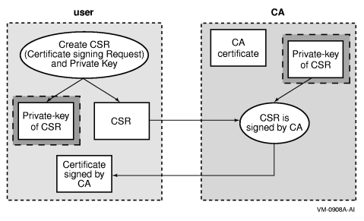
Certificate issuing

Slide 35
Certificate issuing
User:
  creates key pair
  public + info is used to create - certification signing request
  CSR(cert. s. request) is sent to CA
CA
  cert is created = CSR is signed by private key of CA
  Cert is sent to user

Slide 36
Certificate verification
Checking single cert:
current date against validity period
current validity of CA public key
signature of CA on cert
check whether certificate is revoked
  CRL or OCSP
policies

Slide 37
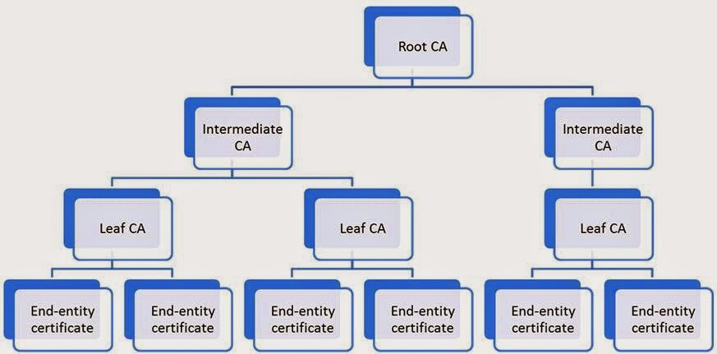
Certificates hierarchy
root CA (trust anchor) - self-signed certificate
Intermediate CA’s
End entity – user certificate

Slide 38
Certificates hierarchy
root CA (trust anchor) - self-signed certificate
Intermediate CA’s
End entity – user certificate
Tree structure
  root = root CA
  nodes = intermediate CA’s
  leaves = end user certificates

Slide 39
Chain of trust
Trust transfer – to lower CA’s
Root cert, intermediate certs, end-user cert.
Chain:
  end-user cert – signed by CA1
  CA1 cert – signed by CA2…
  root CA cert – signed by itself
Server – sends all certs up to root cert to browser

Slide 40
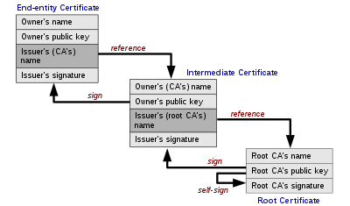
Chain of trust

Slide 41
Chain of trust - text
Cert = Owner’s name, Owner PK, Issuer’s name, issuer signature
End entity cert
– issuer reference to 2.cert owner’s name
Intermediate cert
– issuer reference to 3.root cert owner’s name
Root cert

Slide 42
Certificate path validation
Input: cert path, trust anchor
Path validation:
Check all certs if still valid
Check revocation status of certs
Check issuer = of previous cert subject
Check policy constraints
…

Slide 43
Revocation
Reasons for revocation
  key compromise (most common), CA compromise, affiliation change,…
Two states:
  revoked – irreversibly for compromised private key
  hold – unsure user about key compromising, can be reinstalled
Checked using:
  CRL – list of revoked certs
  Online Certificate Status Protocol – on demand

Slide 44
CRL
Issued by CA:
Certificate Revocation List (CRL):
  list of revoked certificates of end-users
Authority Revocation list
  List of revoked cert of CA’s
Issuer name
Date list created
Date next CRL scheduled
Entries = serial number + revocation date of cert

