Slide 1

PV181 Laboratory of security and applied cryptography
CryptoAPI
Danil Leksin, Marek Sýs, Zdeněk Říha

Slide 2
CAPI
CryptoAPI (Cryptographic Application Programming Interface, Microsoft
Cryptography API, MS-CAPI or simply CAPI) is an application programming interface
included with Microsoft Windows operating systems that provides services to enable
developers to secure Windows-based applications using cryptography. It is a set of
dynamically linked libraries that provides an abstraction layer which isolates programmers
from the code used to encrypt the data. (CryptoAPI supports both public-key and
Symmetric key cryptography)
CAPI provides:
1. Secure data storing
2. Ability to transfer data
3. Validation from 3rd party users
4. Work with cryptographic standards
5. Extension
CAPI functionality groups:
Basic cryptographic functions:
  encoding / decoding
  hash function
  initializing CSP, working with context
  key generation
  key exchanging
Functions for working with certificates
High-level functions
Low-level functions

Slide 3
CAPI and terminology
Work with: CSPs + keys
Key containers
  store keys (symmetric, private or public)
  associated to CSP
Context - session between CAPI and client App
Session key – volatile objects never leave CSP
  import, export functions
Key BLOB - contain an encrypted private key

Slide 4
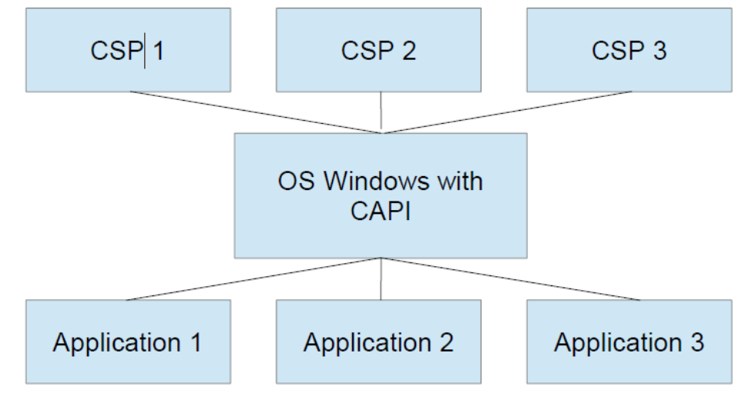
CAPI, CSP and APS

Slide 5
CSP
CSP (Cryptography Service Provider) - is a software library that implements
the Microsoft CryptoAPI (CAPI). CSPs implement encoding and decoding
functions, which computer application programs may use.
CSP provides:
– implementation of the standard interface
– work with encode / decode keys
– inability to interference from third parties
2 function groups for working with CSP:
– initialization of the context and getting CSP parameters
– Key generation and function for work with them
– encode / decode functions
– Hash functions

Slide 6
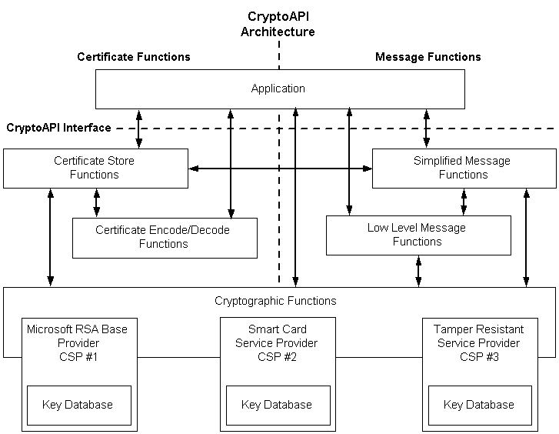
App and CSP
Source

Slide 7
CNG
Cryptography API: Next Generation(CNG)
  since Vista
Two modes: kernel, user (same API)
  user mode – CNG provided in Bcrypt.dll
  kernel mode - Ksecdd.sys
Functions: key funcs, crypto primitives
Crypto agility:
  easy to add functions

Slide 8
CAPI vs CNG
CAPI
  algs (numeric constants) defined in wincrypt.h
  hard to add new algorithm
CNG
  Key storage containers
  algs are strings
  new CSP can be created – no need to sign it by MS
  possible to query CNG for supported algs
  Newer algs – NSA Suite B and several others

Slide 9
CAPI programming
Call CryptAcquireContext function (returns handle)
work with handle – potentially other objects should be created (e.g. hash objects)
BOOL CryptAcquireContext(
HCRYPTPROV *phProv, // pointer to a handle of a CSP
LPCSTR szContainer, // key container name
LPCSTR szProvider, // name of the CSP
DWORD dwProvType, // type of provider to acquire
DWORD dwFlags // Flags)
See manual with examples:
https://docs.microsoft.com/en-us/windows/win32/seccrypto/cryptography-portal

Slide 10
CNG programming
Most of the CNG APIs require a provider or an object
Created by a provider.
Opening the Algorithm Provider
Getting or Setting Algorithm Properties
Creating or Importing a Key
Performing Cryptographic Operations
Closing the Algorithm Provider

Slide 11
CNG example
BCryptOpenAlgorithmProvider(&hAlg...)
BCryptGetProperty(hAlg, BCRYPT_BLOCK_LENGTH, &dwBlockSize...)
//allocate buffer, rounding up to next block size
BCryptGetProperty(hAlg, BCRYPT_OBJECT_LENGTH, &cbKeyObjectLen...)
//allocate buffer for key object
BCryptGenerateSymmetricKey(hAlg, &hKey...)
BCryptEncrypt(hKey,...) //data is now encrypted
BCryptDestroyKey(hKey)
BCryptCloseAlgorithmProvider(hAlg, 0) //deallocate buffers

Slide 12
Enumerate CSPs
cmd (source):
  certutil -csplist
  certutil -csptest
Registry Editor:
  Computer\HKEY_LOCAL_MACHINE\SOFTWARE\Microsoft\Cryptography\Defaults\Provider
C++:
  CAPI
  CNG

Slide 13
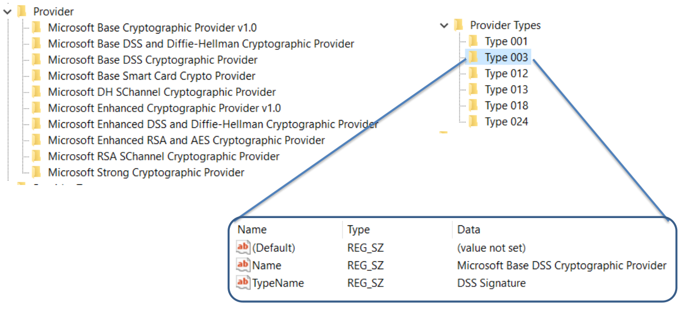
CSP on current machine
HKEY_LOCAL_MACHINE\SOFTWARE\Microsoft\Cryptography\Defaults\Provider\

