Slide 1
Service Dominant Logic and asymmetric information
PA194
© Leonard Walletzký

Slide 2
In previous lessons
Asymmetric information
Information gap
Filling the information gap
Role of IT in filling the gap
Role of government on information market

Slide 3



Mention - Use
Forms of relationship
value co-creation
value proposition
information sharing
Provider
Mention
Client
Mention/Use
Forms of ownership
C is owner of T or
C needs an added
value on T
Forms of responsibility
P is responsible for
the actions with T
Use
Target

Slide 4
Problem of moral hazard
a tendency to take undue risks because the costs are not borne by the party taking the risk
The customer is able to affect an event he is insured against, but the seller has no power to monitor or affect this event.
ERP supplier has limited information about customers IT security
Provider has limited information about the basement of the real client´s problem
Double moral hazard
Client does not know if the provider is able to operate on the particular target

Slide 5
Double moral hazard
Illusion of value proposition
Provider is not able to see the basis of target
Client is not able to see the benefits of the cooperation
Both are motivated to share information and knowledge
Value proposition can not be set up

Slide 6
Value
Value proposition is hidden
is hidden by the hill
Hierarchy of barriers hiding the target
have to be overcame step by step
leads to process of value estimation
Value can not be proposed
It can be only estimated
is used to find value proposition
there is not a target, only target area
target area is the space of all sub-targets, corresponding with particular value estimation

Slide 7
Value estimation
modified by the value co-creation process
motivated by the decreasing of the level of information asymmetry of both parties
the process is about particularize of value estimations
till the moment of founding the value proposition

Slide 8
Value proposition
can be found in the moment client and provider can see the target
share the same point of view
both can see the utility level
and share as well
both partners agree with concrete mutual criteria of success
variables to test
no of customers
profitability
target values
number of customers rise of 30%
profitability rises more than 10%

Slide 9
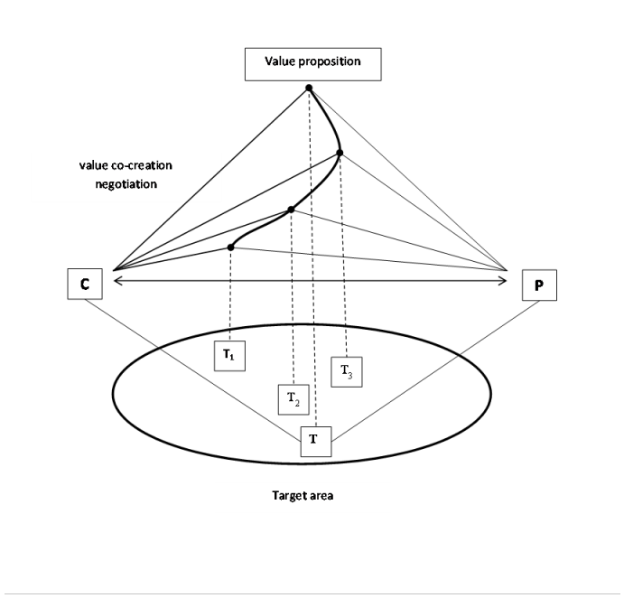
Value proposition

Slide 10
Costs of value estimation
must be shared and paid
problem is complex
must be understood and explored
provider must be paid for using his sources to do it
Client is paying for the analysis of the target area

Slide 11
Management of Service company
A lot of new methodologies inpired by services
New business models
Switch from Business model Canvas to Lean Canvas

Slide 12
Business model Canvas

Slide 13
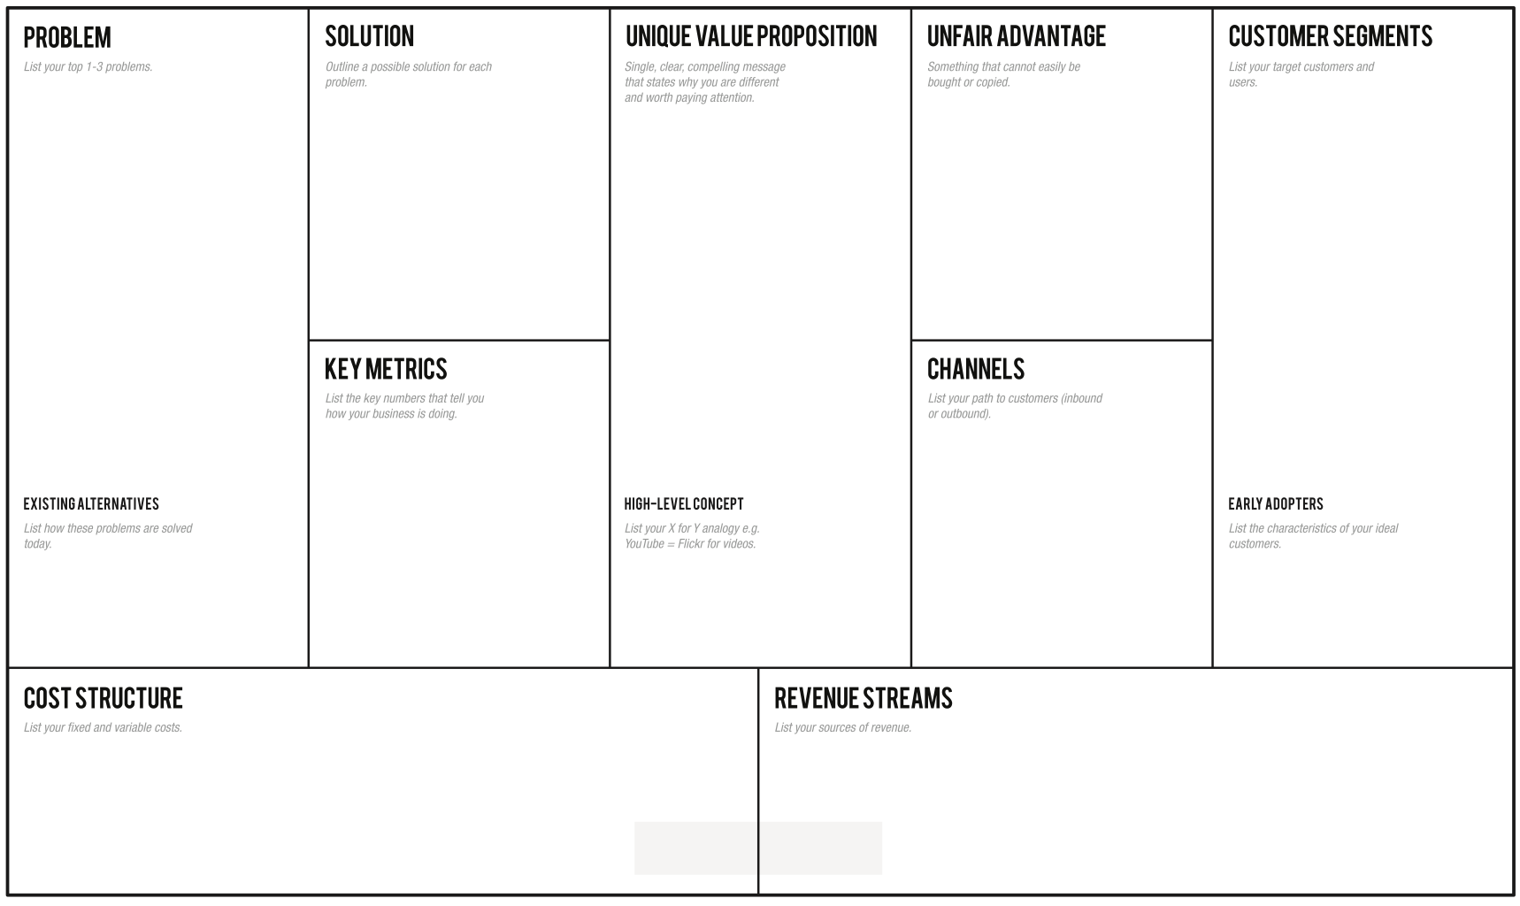
Lean Canvas

Slide 14
Service Practices, Outcomes and Institutionalization
A service interaction has always an outcome.
An interaction can reach a value co-creation point, and each party gains benefit from the service interaction.
Sometimes, the service interaction acts the context, in terms of environment, society, or nation.

Slide 15
Value co-creation and value co-creation processes.
In the Service Science perspective, value co-creation is a holistic view.
Mainly, it refers to the process of resource integration, where customer resources are integrated with different resources provided from various sources (market, private and public)
and are used for value creation with all involved parties

Slide 17
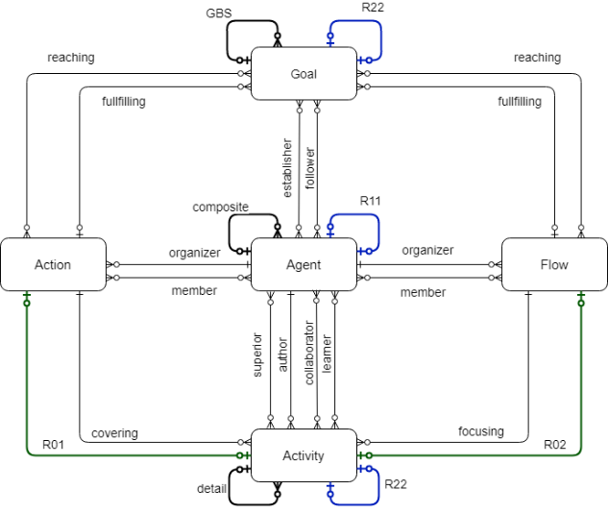
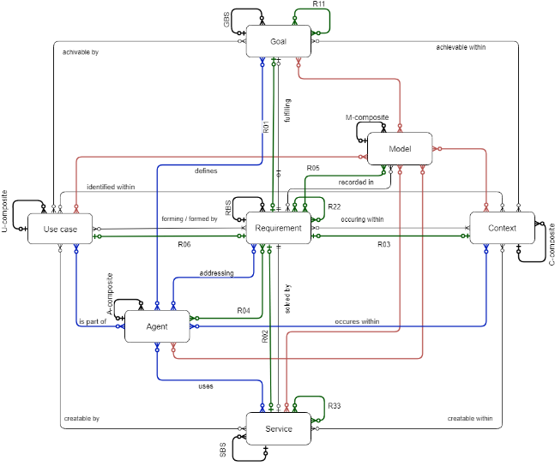
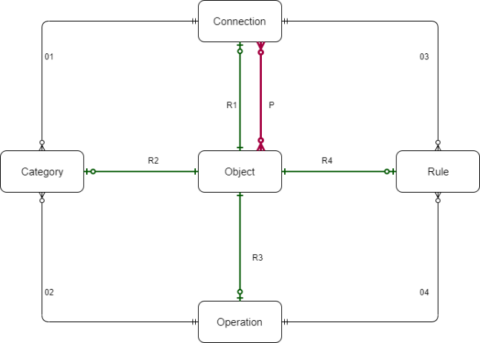
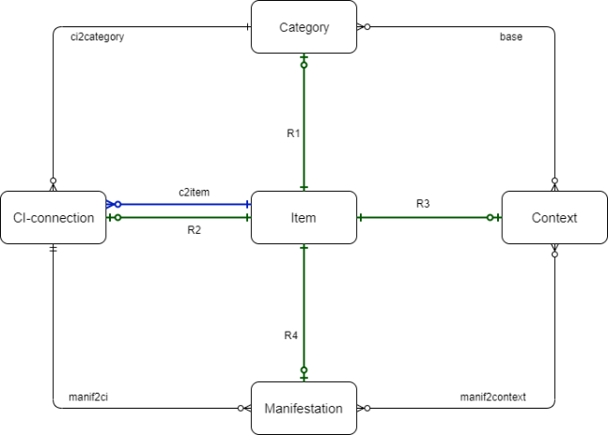
Model of 4-diamonds
See
Recognize
Organize
Do
Diamond of Attention Focusing
Diamond of Cognitive Elements
Diamond of Agent- Team Organization
Diamond of Predictive Behaviour
Stanicek, Z: SSME Manuscript, http://is.muni.cz/el/1433/jaro2013/PV202/um/SSMEstar_manuscript.pdf (2009)
WALLETZKY, L., L. CARRUBBO a M. GE, 2019. Exploring complex service design: Understanding the Diamonds of Context. In: Naples Forum on Service. 2019 Salerno.
WALLETZKÝ, L., L. CARUBBO a M. GE, 2019. Modelling Service Design and Complexity for Multi-contextual Applications in Smart Cities. In: 23rd International Conference on System Theory, Control and Computing. Bucharest: ICSTCC, s. 101-106.

Slide 18
Smart Service Canvas
Actors
Resources
Institutional arrangement
Co-creation
Goals
What goal is fulfilled by a service?
Are there any sub-goals that need to be taken into the account? Are they part of the main goal GBS ?
Who is the establisher of the goal? Who is the follower?
Requirements
What requirements are important for service design?
What goals are they born from?
Are all requirements in the same context?
Agents
What groups of stakeholders are involved into service?
Are there any special groups of agents that must be mentioned?
What is their role in the GBS/ Actions/ Flows?
Value co-creation
How the value is co-created?
How does each agent contribute on the value co-creation?
How the service is linked to other services?
What is its role in the value co-creation chain?
Contexts
In what contexts is the service able to provide a value? Which context is the main one?
Are there any contexts influenced by the service? How?
Is the service sustainable in all contexts?
Endowment
What resources are necessary to create and maintain the service?
What are the necessary inputs from other services?
Use-cases
Are there any practical applications of the similar service?
How they are designed?
What aspects can we use?
Value proposition
How is the value proposition formulated?
Who are addressing and addressed agents?
How is their response evaluated?
Actions
What necessary actions must be done to create/ maintain/ cooperate on the service?
Are there any actions that take part in other context? And how?
Flows
What flows are affected/newly defined by the service?
In what contexts do they appear and how?
Activities
What activities do the actions and flow contain?
What roles do they play in other contexts?
Measures (KPI)
What are defined indicators to monitor quality and the level of value provided?
How is the innovation level monitored?
Are the effects of the service monitored in all contexts?

Slide 19



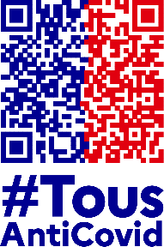

Case study
Target 60%
Sources:
(data updated to 2021 Jan)
https://immuni.italia.it
https://erouska.cz
https://coronawarn.de
https://tousanticovid.fr
https://radarcovid.es
https://www.nhs.uk/nhs
QR Check-in,
Local Area Alert,
Contact tracing,
Anonymous
Contact tracing,
Anonymous
Contact tracing,
Anonymous
Contact tracing,
Anonymous
Contact tracing,
Anonymous
Contact tracing,
Anonymous
Main concerns:
25.2M
20.9M
16.1M
12.7M
n. of Downloads:
1,5M
4,6M
27%
33%
19%
31%
% on the total:
15%
9.9%

Slide 20
Case study
The application of immuni (ITALY)
First, the value of current application is analyzed
Second, the design of „an ideal application“ is suggested with the examples of the value

Slide 21


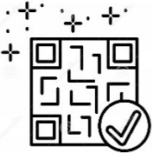











Case study
Public App store
(for free)
1. Few downloads can tackle the final aim
WHERE IS VALUE?
2. Not using the App (even if installed) reduces the solution’s validity
3. Not ‘engaged’ people doesn’t help enough
Local Area Alert (not in Italy)
3
QR check-in (not in Italy)
1
Risky contacts
(tested positive person)
Warning with notifications
2
Data privacy guaranted
Population reached (activated)
Automatic tracking (contact tracing)
Call for competent local support
Anonymous
users
16.1
27%
Infection trends monitoring
(in Millions)
(on the total)

Slide 22
Goals
Requirements
Agents
Value co-creation
To monitor a spread of covid-19.
To prevent covid-19 infection.
To help people to get oriented.
To protect non-infected people​
To enable normal life
To inform about the contacts ​
To provide information about current situation ​
Inhabitants
Medical institutions
Sanitary stations
PARTIALLY-CHECKED
PARTIALLY-CHECKED
MISSED
CHECKED
Contexts
Endowment
Use-cases
Value proposition
Medical – the key is to prevent the congestion of hospitals
Social – people need to understand why the must be isolated
Information about test results
  Are All Covid -19 applications
To be informed about the possible infection
To know what to do
PARTIALLY-CHECKED
PARTIALLY-CHECKED
PARTIALLY-CHECKED
CHECKED
Actions
Flows
Activities
Measures (MPI)
Send warning – this actions happens if the user is infected. The users who were in contact with him/her will be warned. ​
To monitor surrounding ​
To receive positive test information ​
Detect all close devices ​
Send information to sanitary station ​
Receive information about positive contacts​
No of installations ​
No. of informed users ​
PARTIALLY-CHECKED
PARTIALLY-CHECKED
PARTIALLY-CHECKED
PARTIALLY-CHECKED

Slide 23
Goals
Requirements
Agents
Value co-creation
To monitor a spread of covid-19.
To prevent covid-19 infection.
To help people to get oriented.
To protect non-infected people​
To enable normal life
To inform about the contacts ​
To provide information about current situation ​
Inhabitants
Medical institutions
Sanitary stations
The interaction based on information sharing (the confirmation about healthy status)​
The control on the vaccination and testing
To link to register of tests and vaccination​
Business entities – will use the app to confirm the person health status
CHECKED
PARTIALLY-CHECKED
PARTIALLY-CHECKED
MISSED
CHECKED
CHECKED
CHECKED
Contexts
Endowment
Use-cases
Value proposition
Medical – the key is to prevent the congestion of hospitals
Social – people need to understand why the must be isolated
Information about test results
  Are All Covid -19 applications
To be informed about the possible infection
To know what to do
Information about the vaccinations
Control of private data
Economic – to enable economy to run
To get proper date and place for tests and vaccination​
CHECKED
PARTIALLY-CHECKED
PARTIALLY-CHECKED
CHECKED
PARTIALLY-CHECKED
CHECKED
CHECKED
Actions
Flows
Activities
Measures (MPI)
Send warning – this actions happens if the user is infected. The users who were in contact with him/her will be warned. ​
To monitor surrounding ​
To receive positive test information ​
Detect all close devices ​
Send information to sanitary station ​
Receive information about positive contacts​
No of installations ​
No. of informed users ​
To monitor the validity of test and vaccination
No. of tests linked with app​
No of vaccinations linked with app​
No. of questions​
Get the status – get the current health status from register​
Connect to register – connect to the register of test and vaccination​
Get the information about new test or vaccination
PARTIALLY-CHECKED
PARTIALLY-CHECKED
PARTIALLY-CHECKED
PARTIALLY-CHECKED
CHECKED
CHECKED
CHECKED
CHECKED

Slide 24
Conclusion
Information asymmetry and its role in service system
Value estimation
Smart City services are complex services that integrate various activities developed with the participation of various stakeholders evolving in various contexts.
Their contexts must be analyzed, understood, integrated, and managed collectively.
It is important to explore further how to integrate various aspects of value, such as value-in-use, value-in-context, and value-in-experience in the design of the services within their environment.

