Slide 1
Predict future sales
Kaggle competition
https://www.kaggle.com/c/competitive-data-science-predict-future-sales/data

Slide 2
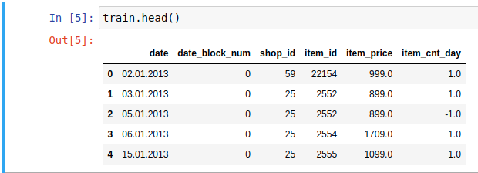
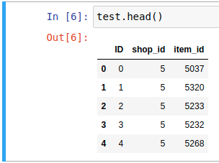
Goal
Predict total number of sales for every product and store in the next month
given daily sales data provided by company 1C Company
Time series dataset, time period-33 months

Slide 3
Data
Sales
Items
Categories

Slide 4
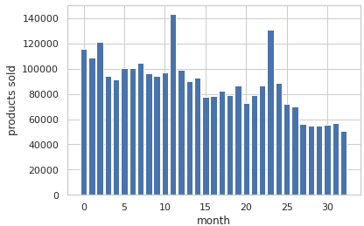
Data exploration
Sales by month

Slide 5
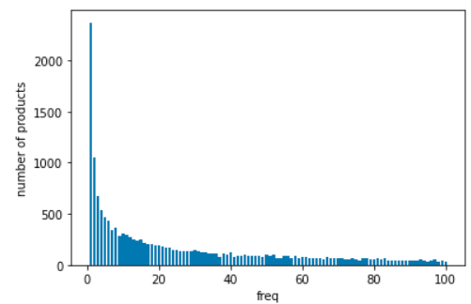
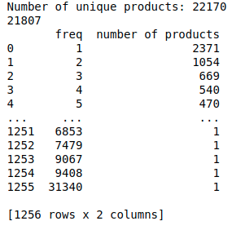
Data exploration
Product marketability
2371 products that have been sold once

Slide 6
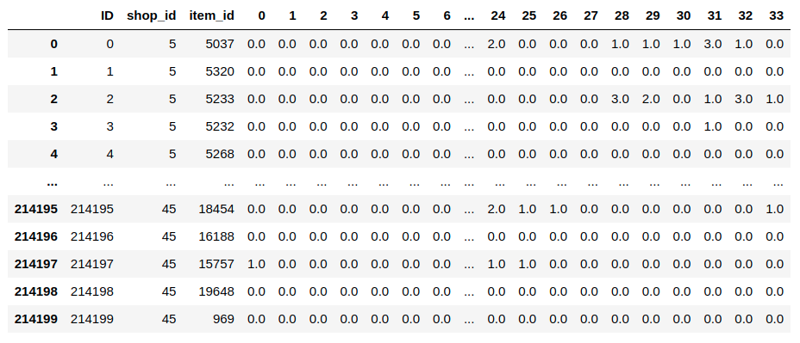
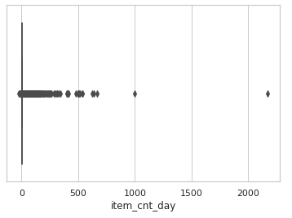
Preprocessing
Daily sale records -> monthly sale records
we are supposed to predict the total number of product sales in next month
Removing outliers
Negative sales (product returns)
Constructing additional features
Validation set

Slide 7
Results
Models
LGBMRegressor
0.88
XGBRegressor
1.02
RNN (PyTorch)
0.83
Score - Root mean squared error

Slide 8
Feature engineering
Lag features
Delta_price_lag

Slide 9
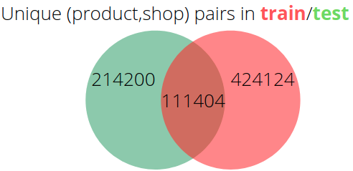
Issue - missing training samples
We have no sale history in the train set for half of the products that we have to predict
We can try to generate some representative values
Cannot validate these values

Slide 10
Solution?
Idea
For every pair <item_id, shop_id> not included in train set, do:
Mean of all pairs <item_id, X>
If there are no pairs <item_id, X> in train set (exactly 15246 cases), do:
Mean of all pairs <Y, shop_id>
In case there are no pairs <Y, shop_id> (0 cases) in train set set the value to zero
Use this value as a prediction
Did it work? - Not really
Worse results

Slide 11
Things worth trying
CatBoost
AutoML
Additional feature extraction
Still plenty of time to submit: Competition ends in Jan 1. 2023

Slide 12
Thanks for your attention

