Slide 1
Introduction
Zdeněk Říha

Slide 2
Why do we need standards in IT Security?
Compatibility/interoperability
Common terminology
Efficiency/costs – no need to reinvent a wheel
Regular updates/follow developments
…
Security

Slide 3
Disadvantages
Paid standards
  To cover the development of standards
Competition among the standardization bodies
Access to standards (and their drafts)
  + difficult to understand
Reduced flexibility
  E.g. for small organizations

Slide 4
Coverage
From high-level management
  ISMS (information security management system)
  E.g. ISO 27000
Up to low level crypto
  E.g. RSA, PKCS#1

Slide 5
Standards vs. norms
Standards are recommendations
Norms are authoritative (mandatory) standards
Normativity depends on:
  Country
  Time
  Field/context
  Type of company, personal use/business use

Slide 6

Standardization bodies
ISO
National SO
  Úřad pro technickou normalizaci, metrologii a státní zkušebnictví, ČSN
  UNMS SR (Slovakia)
  DIN (Germany)
  AFNOR (France)
  ANSI (USA)
CEN – European association
CEN, CENELEC and ETSI - recognized as European Standards (ENs)

Slide 7
Standardization bodies
NIST: National Institute of Standards and Technology (USA)
ETSI European Telecommunications Standards Institute
ITU-T (e.g. X.509)
IETF – RFC
RSA Security (PKCS)

Slide 8
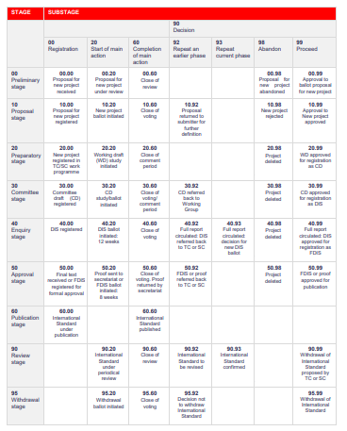
Process
The full list of status codes of ISO standards
Focus on involvement of stakeholders, not on speed
Often public consultations are needed

Slide 9
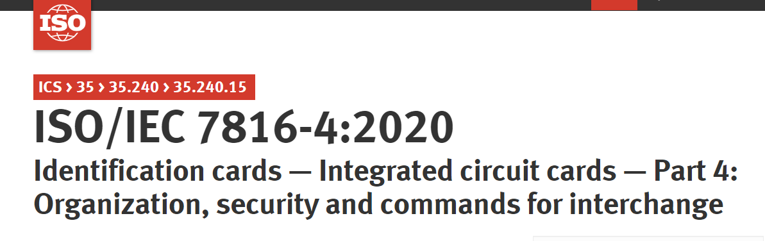
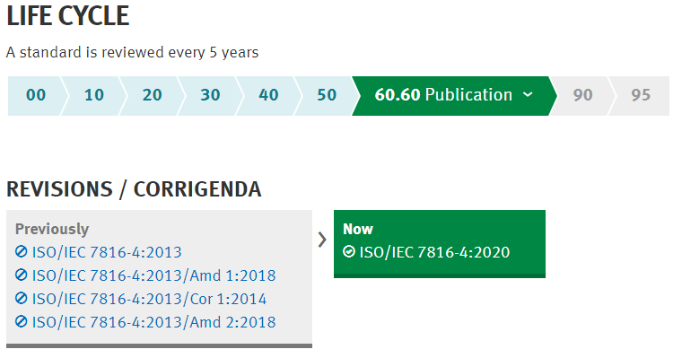
Versioning (ISO)

Slide 10
Versioning (RFCs)
  RSA Encryption
  RFC 2315
  RFC 2437
  RFC 3447
  RFC 8017

Slide 11
Versioning (NIST FIPS)
Digital Signature Standard
  FIPS 186 (published on 19 May 1994)
  FIPS 186-1 (published on 15 Dec 1998)
  FIPS 186-2 (published on 27 Jan 2000)
  FIPS 186-3 (published June 2009)
  FIPS 186-4 (published July 2013)
  FIPS 186-5 (draft available from Oct 2019)

Slide 12
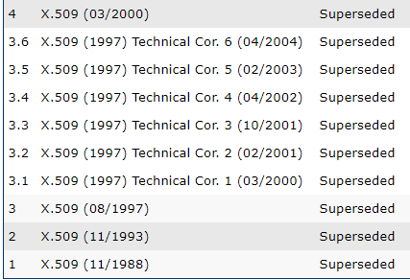
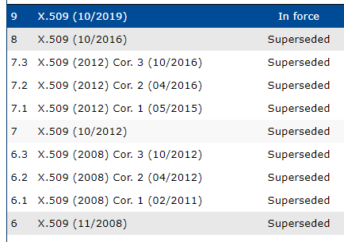
Versioning
PKCS#1 v1.5
ETSI TS 119 312 V1.3.1 (2019-02)
ITU-T X.509 Version/Edition

