Slide 1
Overview of crypto standards
Zdeněk Říha

Slide 2
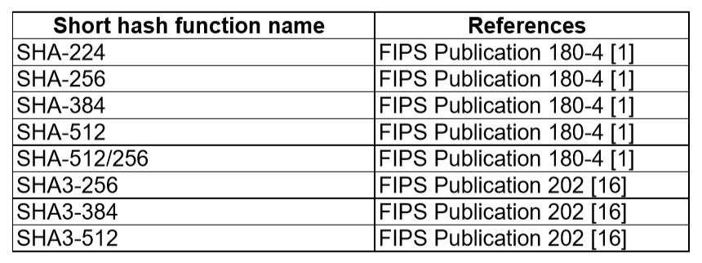
Hash functions
MD5 (128 bit output) – defined v RFC 1321
RIPEMD-128/RIPEMD-160 in ISO/IEC 10118-3
BLAKE2b, BLAKE2s defined in RFC 7693.

Slide 3
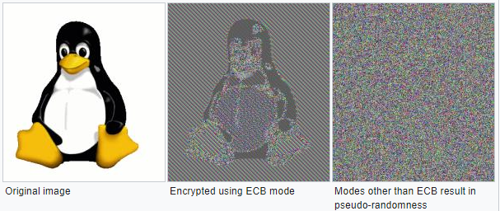
Symmetric crypto
Modes of operation (FIPS 81)
  ECB (Electronic Code Book)
  CBC (Ciper Block Chaining)
  CFB (Cipher Feedback Mode)
  OFB (Output Feedback Mode)
Newer modes of operation
  CTR (Counter Mode) [FIPS SP 800-38A]
  CMAC [FIPS SP 800-38B], CCM [FIPS SP 800-38C], GCM [FIPS SP 800-38D], XTS-AES [FIPS SP 800-38E]
  Other in FIPS SP 800-38F, FIPS SP 800-38G
See:
https://en.wikipedia.org/wiki/Block_cipher_mode_of_operation

Slide 4
Padding
ISO 9797 method 1 padded with values 0x00
  to remove the padding the length of the original message is needed
ISO 9797 method 2 (ISO 7816-4, EMV’96) – first the value 0x80 is added, then bytes of 0x00 are added
  PS = ‘80 00‘, if 2 bytes are needed
  PS = ‘80 00 00 00 00 00 00 00‘, if 0 bytes are needed (full block added)
• PKCS#5 – the padding string is made from value n-(||M|| mod n)
  for (3)DES n=8, AES n=16
  e.g. PS = 02 02 - if 2 bytes are needed
  e.g. PS = 08 08 08 08 08 08 08 08 – if 0 bytes are needed and n=8 (3DES)

Slide 5
Symmetric crypto
DES – defined in FIPS PUB 46 (-1 a -2)
  key 56 bits, block 64 bits
3DES – defined in FIPS PUB 46-3
  key either 112 or 168 bits, block 64 bits
AES – (Rijndael), defined v FIPS PUB 197
  key 128, 192 or 256 bits, block 128 bits

Slide 6
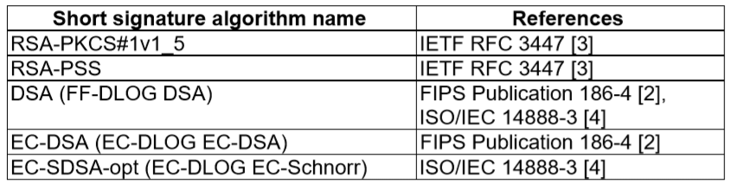
Asymmetric crypto
Certificates X.509
  ITU-T, ISO/IEC, RFC
DER / PEM

Slide 7
PKCS
PKCS#1 – defines RSA encryption
PKCS#3 – defines Diffie-Hellman protocol
PKCS#5 – symmetric encryption based on a password
PKCS#7 – format for digital signatures and asymmetric encryption
PKCS#8 – defines the private key format
PKCS#10 – defines format for certificate requests
PKCS#11 – API for communication with cryptographic tokens
PKCS#12 – format for storing private keys including public key certificates, all protected by a password
PKCS#13 – defines encryption based on elliptic curves
PKCS#15 – defines cryptographic token information format

Slide 8
RSA Padding
E.g. RSA 2048 bits
  Modulus n is 2048 bits, public exponent e usually small
  Message m is 2048 bits in total, usual hash functions provide hashes much shorter. Therefore we need padding.
BTW No padding needed for DSA and ECDSA

Slide 9
RSA Padding algorithms
ANSIX 9.31
  6b bb … bb ba || Hash(M) || 3x cc
  (where x=3 for sha1, x=1 for ripemd160)
PKCS#1 v1.5
  00 01 ff … ff 00 || HashAlgID || Hash(M)
PSS
  00 || H || G(H) ⊕ [salt || 00 … 00] (where H = Hash(salt, M), salt is random, and G is a mask generation function)

Slide 10
Assignments
Write a program (in any programming language) that will prepare a padded block for RSA signature with PKCS#1 v1.5 padding. Input is a file and RSA key size; output is the padded octet string (print it in hex). Use SHA-256 as the hash function. Do not use crypto library for the padding itself [5 points].
Write a program that will generate 2048 bit DH parameters in DER format. Use any cryptolibrary and any programming language (no shell script). Check whether the optional privateValueLength is included (submit a screenshot). Recommendation: Openssl & C & functions DH_new, DH_generate_parameters_ex, i2d_DHparams_bio. [5 points].

Slide 11
Assignment 1
PKCS#1 v1.5 padding
We open the PKCS#1 v2.2 document :-)
  Also available as RFC 8017
We find the relevant section
  9.2 EMSA-PKCS1-v1_5
EMSA-PKCS1-v1_5-ENCODE (M, emLen)
  Input: Message + length of padded result (key size)
  Output: EM (the padded results) to be signed

Slide 12

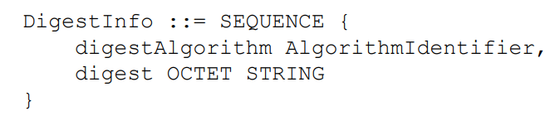
Assignment 1
As we can see in step 5 the result is:
  where PS is composed of 0xff bytes to fit the size
  and T is DER encoded structure containing the hash algorithm and hash itself:

Slide 13
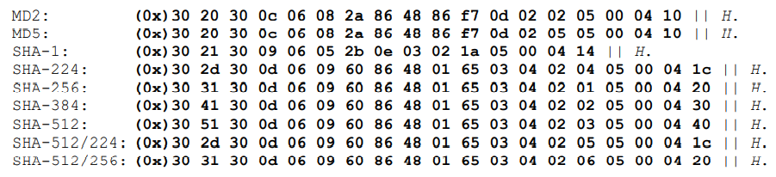
Assignment 1
The authors of PKCS#1 are very nice and provide a help for common hash algorithms
  where H is the hash (32 bytes for SHA-256)
Print the EM in hex

Slide 14

Assignment 2
Read all PKCS#3 standard
8 pages including introduction, history, …
Assignment:
  Write a program that will generate 2048 bit DH parameters in DER format.

Slide 15
Assignment 2
Programming language
    Use any cryptolibrary and any programming language.
    Recommendation: Openssl & C & functions DH_new, DH_generate_parameters_ex, i2d_DHparams_bio
    Try “man dh”
Verify results:
  “openssl asn1parse -inform DER -in yourfile.der”
  “openssl dhparam -inform DER -in yourfile.der -noout -text”

Slide 16
Good luck
Good luck and good fun while reading the standards
Email: zriha@fi.muni.cz

