Slide 1

PV181 Laboratory of security and applied cryptography
Random values and Random Number Generators
Marek Sýs
sysox@mail.muni.cz, A405

Slide 2
You will learn
What types of RNG you can find in libraries.
What RNGs are (in)apropriate for crypto.
bitwise operations (heavily used in crypto).
How to improve randomness of RNG output.
  using hash function and bitwise XOR
How to generate secure random values:
  in python, C, C++
Why standard rand() and others (e.g. Mersenne Twister) are insecure.

Slide 3
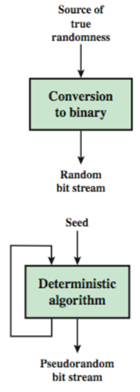
RNG types
True random (TRNG)
  Source: physical device (noise)
  radio decay, thermal noise, …
  non-deterministic, aperiodic, slow
Pseudo random (PRNG)
  Source: software function
  deterministic, periodic, very fast

Slide 4
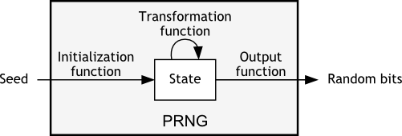
PRNG
defined by 3 functions: Init, Transform, Output
State = Init(Seed)
State = Trans(State)
rnd = Out(State)
Cryptographically secure (CSPRNG) - generated rnd values give no information about next or previous rnd values ⇒ no info about Seed, State

Slide 5
Standard library functions
ANSI C(rand), Java(java.util.random),... - uses fast but very insecure LCG generator
Linear Congruential Generator(LCG)
s_{n+1}=a*s_{n}+b mod m (fixed constants a,b,c)
Out is identity (id) func. i.e., generated rnd=State
⇒ next rnd values easily computed
Trans is linear: f(x) = ax+b mod m
⇒ previous rnd values can be computed easily

Slide 6
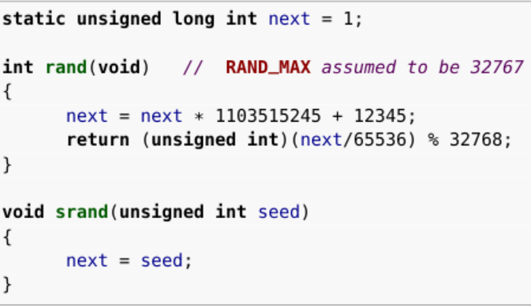
Example
ANSI C portable functions

Slide 7
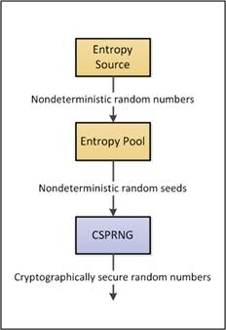
Practice
PRNG values:
CSPRNG seeded by TRNG
TRNG (entropy source):
typically combined internally
with PRNG
output stored in “entropy pool”
  depends on all previous generated
  rnd values (chaining of values,
  not replacement)

Slide 8
TRNG
Linux: two entropy pools (files) dev/(u)random
keyboard timings, mouse movements, IDE timings
Windows: similar to Linux
binary register HKEY_LOCAL_MACHINE\SYSTEM\RNG\Seed
Additional entropy sources (if available):
TPM, RNRAND instruction, hardware system clock (RTC), Interrupt timings, havege daemon

Slide 9
Weak generators
Python random() - “Mersenne Twister(MT) as the core generator. It produces 53-bit precision floats and has a period of 2**19937-1”
C rand(): LCG generators (+ some tweaks)
glibc (used by GCC) rand() - LCG and “linear additive feedback” (r[i] = r[i-31] + r[i-3])
C++: LCG or MT or Lagged fibonacci
minstd_rand(0 or 1), mt19937(_64),

Slide 10
Unix infrastructure
Special files - reading files provides random data
/dev/random
  always produces entropy but,
  blocking - can block the caller until entropy available
  (entropy estimation)
/dev/urandom
  amount of entropy not quaranteed
  always returns quickly (non blocking)
Usage:
/dev/urandom preferred, only shortly after boot use /dev/random (see Myths about dev/urandom)

Slide 11
Linux RNG design
3 entropy pools (store random data)
can be viewed as PRNG - “Init” func mixes (using SHA1) input rnd data to the state ⇒ state depends input data and all previous states!!
input_pool (state of 4096 bits)
accumulate (collects, compress) the entropy from hardware events to the state
feeds exclusively (no access to this pool)
  blocking_pool (state of 1024 bytes)
  non-blocking_pool (ChaCha20 stream cipher)
    only key (256) is fed by true rnd values
  state (“seed” for other pools) is saved at shutdown
See Gauvrit’s blog with nice scheme

Slide 12
Unix infrastructure
Operations on files:
to get entropy just open and read from the file
  use read(2) but always check if returned value == requested number of bytes (reading can be interrupted!!!)
It is also possible to write to /dev/random
  privileged (harmless) user can mix random data into the pool - entropy is increased (but not entropy counter)
information about the pool: proc/sys/random/*

Slide 13
Unix: methods and quality
Good sources(C):
direct read from initialized random/urandom
getrandom() + flags:
  source: random or urandom
  blocking or non-blocking (also blocks until initialised)
get_random_bytes() - kernel space
similar in Python: os.urandom(), os.getrandom(), secrets.token_bytes()
Weak sources:
rand, time(rdtsc instruction, clock func,...), uninitialized urandom

Slide 14
Practice
Go to https://mybinder.org
Copy link https://github.com/sysox/PV181_RNG/ to Github field, press launch
Start with PV181_RNG_python.ipynb
Then PV181_RNG_C.ipynb
Write down the answers to Questions - they will be discussed at the end of seminar.

