Slide 1
ASN.1:
Introduction
Zdeněk Říha

Slide 2
ASN.1
Abstract Syntax Notation 1
notation for describing abstract types and values
Defined in ITU-T X.680 … X.695
Used in many file formats, including crypto
  Public keys, private keys
  Certificate requests, certificates
  Digital signatures, padding, encrypted files

Slide 3
ASN.1
Allows format/storage/transmission of data
  Compatible among many applications
  Not dependent on HW platform
    E.g. little/big endian
  Not dependent on operating system
Simple & Structured types
Multiple encoding rules (methods)

Slide 4
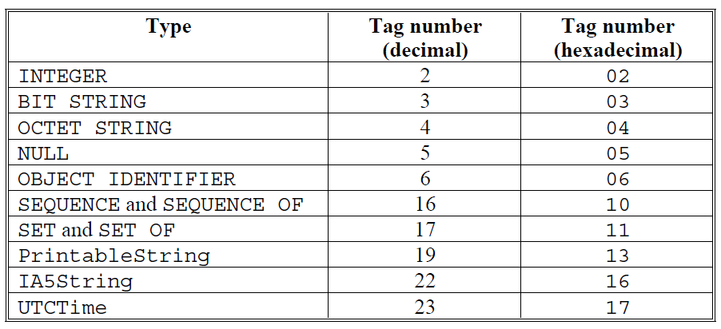
ASN.1 – Types

Slide 5
ASN.1 – simple types
Integer
  signed integer (there’s no unsigned integer)
Bit string
  The number of bits does not have to be a multiple of 8
Octet string
  an arbitrary string of octets
NULL
  No data (used in parameters)
PringtableString, IA5String, UTF8String, …
  Strings – the sets of characters are various
UTCTime
  Time

Slide 6
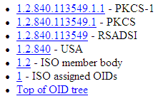
ASN.1 – OID type
Object identifier (OID)
  Sequence of integer components that identify an object
  Assigned in a hierarchical way
Example
  sha-1WithRSAEncryption = 1.2.840.113549.1.1.5
  iso(1) member-body(2)
  us(840) rsadsi(113549)
  pkcs(1) pkcs-1(1) 5

Slide 7
ASN.1 – structured types
SEQUENCE
  an ordered collection of one or more types
SEQUENCE OF
  an ordered collection of zero or more occurrences of a given type
SET
  an unordered collection of one or more types
SET OF
  an unordered collection of zero or more occurrences of a given type

Slide 8
ASN.1 Encoding Rules
XML – oriented formats
  XER (XML Encoding Rules)
Byte-oriented formats
  BER (Basic Encoding Rules)
  CER (Canonical Encoding Rules) – subset of BER
  DER (Distinguished Encoding Rules) – subset of BER
    Used for crypto files
Bit-oriented formats
  PER (Packed Encoding Rules)
Verbose, human readable formats
  GSER (Generic String Encoding Rules)

Slide 9
BER encoding
TLV – Tag Length Value
  All the data is encoded using a simple TLV format
  Tag – what kind of data it is
  Length – the length of the data
  Value – the data itself
Example
  02 01 05 [hexadecimal values]
    Tag – Integer
    Length of data – 1 byte
    Data: (positive integer) 5

Slide 10

Nested data
SEQUENCE is similar to struct/record
30 09 02 01 05 04 02 FF FF 05 00
  30 09 – sequence of length 9 bytes
  02 01 05 – integer 5
  04 02 FF FF – octet string FF FF
  05 00 – NULL (no data)

Slide 11
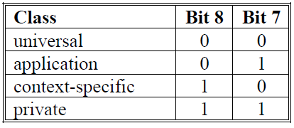
BER tags
Tag encoding
Class
Tag number
  Bits 1-5
  If all bits are 1 then the tag continues in the following byte(s)
Tag #
class | class | Constructed?

Slide 12
BER length
length >=0 && length <= 127
  The length is coded directly
    E.g. ’05’
Otherwise the bit 8 is set, bits 1-7 code the number of bytes that specify the length
  E.g. 255 -> ‘81’ ‘FF’
  E.g. 256 -> ’82’ ‘01’ ‘00’ or also ’83’ ‘00’ ‘01’ ‘00’
    BER x DER
‘80’ is “indefinite” length
  Not allowed in DER

Slide 13
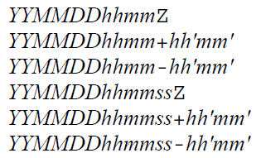
BER value
The data itself
Dependent on data type
  Integer: signed – e.g. 128 -> ’00 80’
  Octet string: directly the data
  Bit string: number of unused bits + padded bit string to a multiple of 8 bits (padding is at the end)
  UTCTime: string of one of the forms

Slide 14
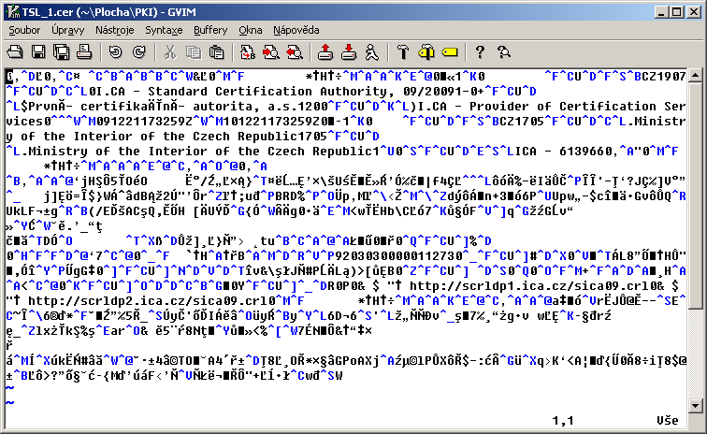
First look at the binary DER file
 CSCA_CZE.crt

Slide 15
DER vs. PEM
PEM
  Privacy Enhanced Mail
PEM as such not used, but formats still used
Textual formats
  Practical for transport channels where full 8bit data can be damaged
PEM is base64 coded DER enveloped with
  -----BEGIN SOMETHING-----
  -----END SOMETHING-----
  Where SOMETHING is CERTIFICATE/PKCS7/KEY…

Slide 16
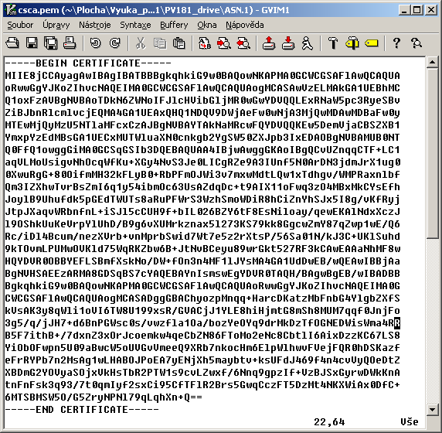
Sample PEM file
 CSCA_CZE.pem

Slide 17
ASN.1 viewers
Unber (part of asn1c)
Openssl asn1parse
ASN.1 Editor
…

Slide 18
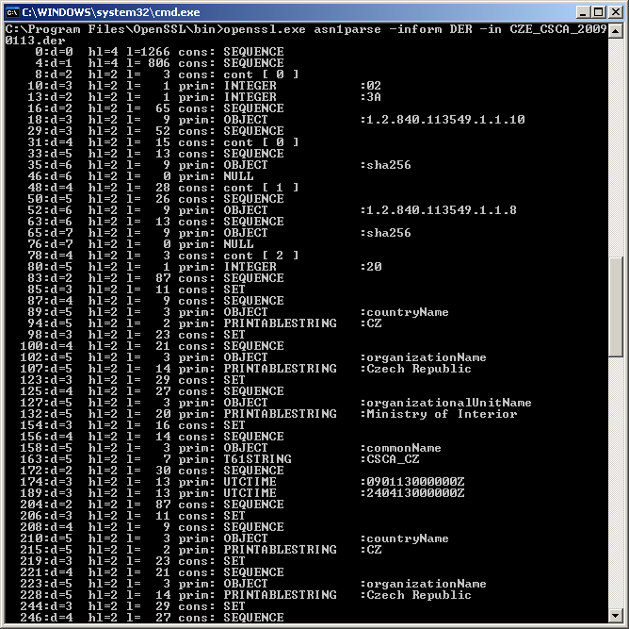
OpenSSL asn1parse
 CSCA_CZE.crt

Slide 19
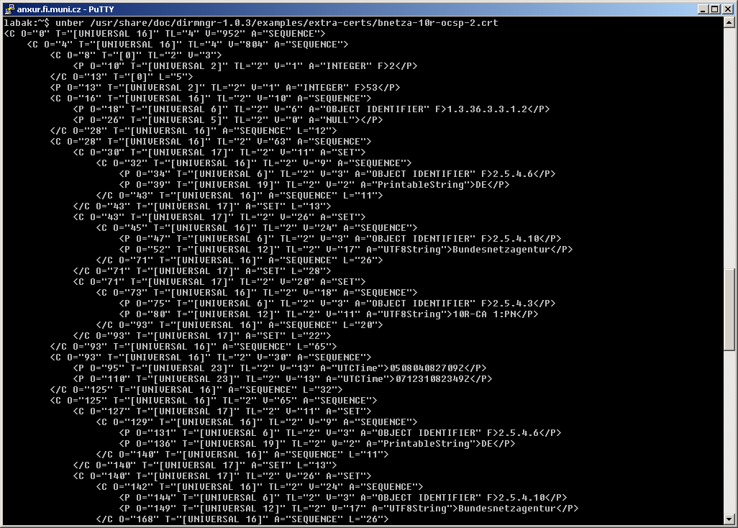
unber
 CSCA_CZE.crt

Slide 20
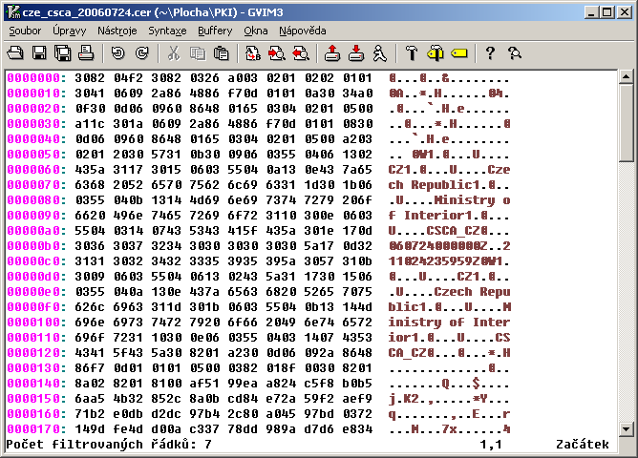
Manual viewing/processing
30 82 04 f2
  SEQUENCE
  length 1266B
30 82 03 26
  SEQUENCE
  length 806B
A0 03
  CONTEXT SPECIFIC 0
  Length 3B
02 01 02
  INTEGER: 2
 CSCA_CZE.crt

Slide 21
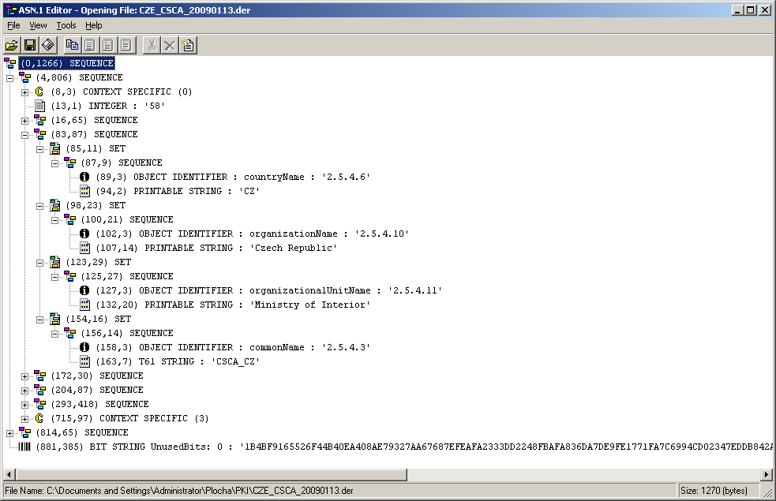
ASN.1 Editor
 CSCA_CZE.crt

Slide 22
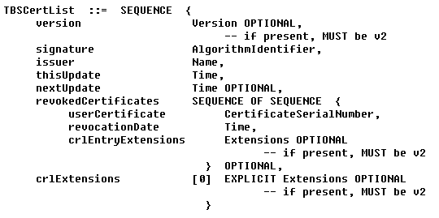

ASN.1 Grammar
To understand the structure (what is the meaning of particular fields) we need ASN.1 grammar

Slide 23
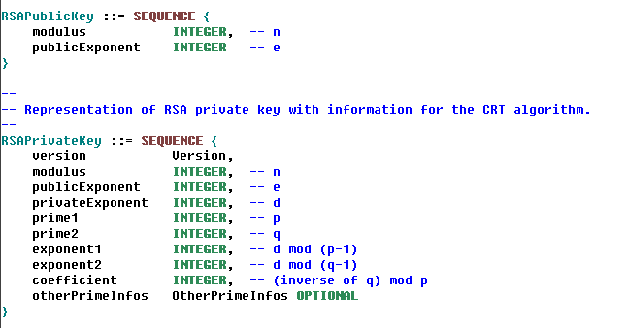
ASN.1 – RSA keys
Source:
PKCS#1
 RSA.key

