Slide 1
PV198 – One-chip Controllers GPIO – LED & Button

Slide 2
Content
What is GPIO
What is it used for
How does it work
Switch debouncing
Application
Output – LED using SDK example
Input – Button using Config Tools

Slide 3
What is GPIO
GPIO – General Purpose Input Output
Direct control of pins of the MCU
Basic interaction with external world
Can be programmed as Input or Output
Has only 2 states (logic 0, logic 1)

Slide 4
Content
What is GPIO
What is it used for
How does it work
Switch debouncing
Application
Output – LED using SDK example
Input – Button using Config Tools

Slide 5
What is it used for
Anything that works with 2 states – on/off
LED
Buttons
Sensors
And used by more sophisticated peripherals

Slide 6
Content
What is GPIO
What is it used for
How does it work
Switch debouncing
Application
Output – LED using SDK example
Input – Button using Config Tools

Slide 7
How buttons on the board work
Connects pit to ground (logic 0) or to voltage (logic 1)

Slide 8
How does it work – Switch debouncing
Bouncing
Looks like button is pressed multiple times
Cause by mechanical contact of the switch

Slide 9
How doeas it work – Switch debouncing
Bouncing
Looks like button is pressed multiple times
Cause by mechanical contact of the switch
Solution
HW debounce(add capacitor)
SW debounce(wait few miliseconds)

Slide 10
Content
What is GPIO
What is it used for
How does it work
Switch debouncing
Application
Output – LED using SDK example
Input – Button using Config Tools

Slide 11
Application
Steps required to create an application:
Initialize( MCUXpresso Configuration Tools help here)
Pin
Clocks
Peripherals
Write application code

Slide 12
Application
Write everything from scratch
❌Error-prone , time demanding, tedious
USE SDK example
✔️Works out-of-box
❌More difficult to modify
USE Config Tools
✔️Easy to use and modify

Slide 13
Content
What is GPIO
What is it used for
How does it work
Switch debouncing
Application
Output – LED using SDK example
Input – Button using Config Tools

Slide 14
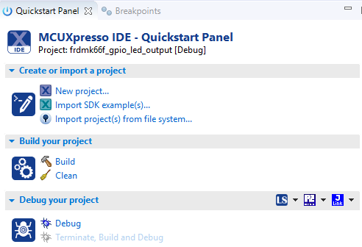
Application – LED using SDK example
Import SDK example “gpio_led_output”
Select import SDK examples(s)…

Slide 15
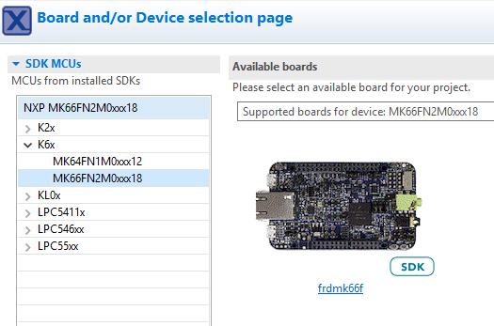
Application – LED using SDK example
In the SDK wizard unfold the K6x, select the MK66FN2… and click on the board image

Slide 16
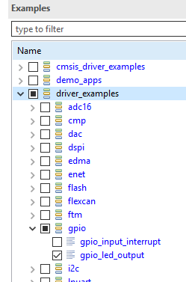
Application – LED using SDK example
Unfold driver_examples -> gpio
Select “gpio_led_output” example
Click Finish

Slide 17
Application – LED using SDK example
Go through code together in detail
Pins, clocks are already configured
GPIO_PinInit
GPIO_PortToggle

Slide 18
Content
What is GPIO
What is it used for
How does it work
Switch debouncing
Application
Output – LED using SDK example
Input – Button using Config Tools

Slide 19
Application – Button using Config Tools
Goal:
Press SW2 button to print text into console

Slide 20
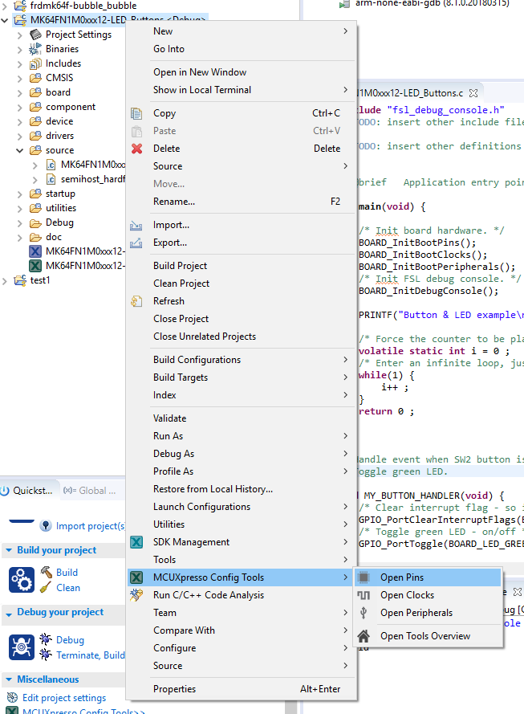
Application – Button using Config Tools
Create new project
Open Config Tools

Slide 21
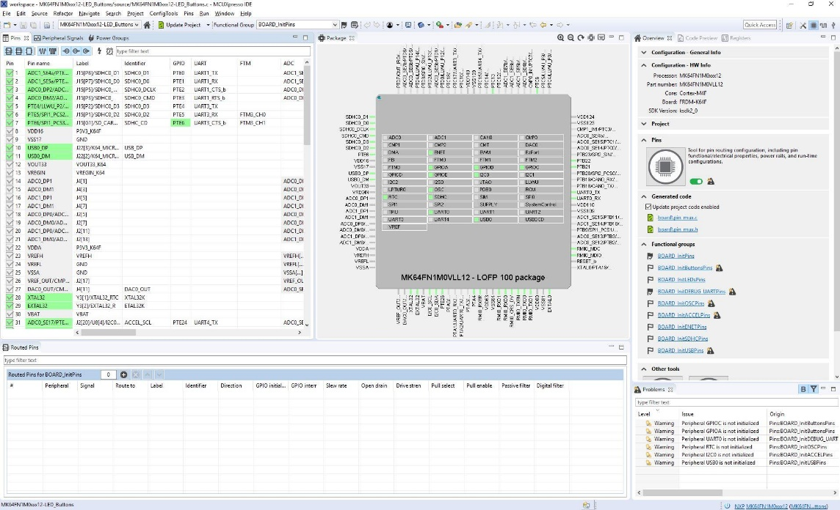
Application – Button using Config Tools
You should see Pin tool now:

Slide 22
Application – Initialization
How configuration tools can help us:
Modify settings easily
Visual representation of a configuration
Great for custom boards (our board already has a lot of useful DEFINEs, which is not a case when new board is created)

Slide 23
Application – Button using Config Tools
Pins tool contains predefined configurations
Open dialog with functional groups by clicking on the icon

Slide 25
Application – Button using Config Tools
Dialog with predefined functional group appears
Set checkbox at the bottom of the dialog for functional group: “BOARD_InitButtonsPins” to call initialization code for the group in default initialization function

Slide 26
Prefix used
in generated code

Slide 27
Application – Button using Config Tools
Code preview is updated
Initialization function now calls 1 more function

Slide 28
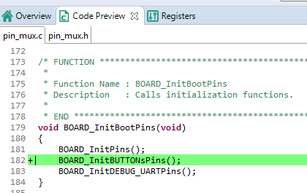

Slide 29
Application – Button using Config Tools
Select “BOARD_InitBUTTONsPins” functional group from a combo-box

Slide 30
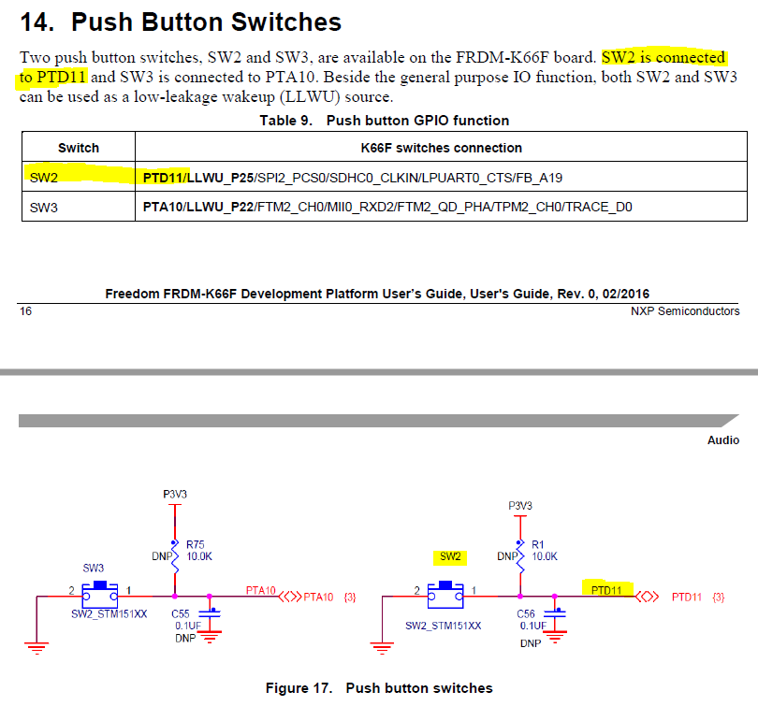
GPIO signal is routed to “PTD11”

Slide 31
User friendly Label – specific for our board
Prefix used in generated code
User-friendly
Label – specific for our board
Identifier used in generated code
Identifier used in generated code

Slide 32
Application – Button using Config Tools
Your project needs to be updated by newly generated code now – this action is done automatically
Whenever generated code does not match the code is your project, it is displayed by changed color of the icon in the toolbar

Slide 33
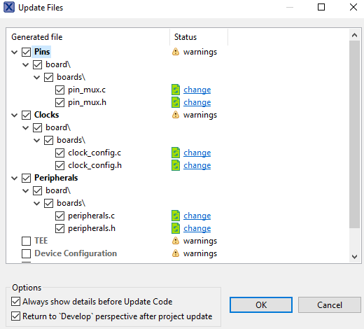
Application – Button using Config Tools
Update Project Files dialog should appear
You can view changes to each file by clicking on the “change” text in the “Status” column
Press “OK” to update your project

Slide 34
Application – Button using Config Tools
Clocks tool – preconfigured, you can view clock settings
Peripherals tool – no need for now

Slide 35
Application – Button using Config Tools
Write application code
Read current state of the GPIO(button)
Detect button press
Print text into console

Slide 36
Application – Button using Config Tools
When you press the button, text is printed more than once
Why?
How to resolve this issue?

Slide 37
Work Progress
Write an applications that toggles GREEN LED when SW3 button is pressed
Fix the issue with button press being registered more than once
Make LED change color every time it is turned on (there are 3 LEDs on the board: Red, Green, Blue)

Slide 38
Homework
Write an applications that reacts to both buttons
SW3 turns on/off selected color
SW2 changes selected color (R -> G -> B -> R …)
At start all colors are turned off, and RED is selected
SW3
SW2
SW3
SW3
All colors
are off
Red
turned on
Red
stays on
Green
Turned on
Green
Turned off

Slide 39
Homework - git
Git Branch- “Week_02”
Git tag – “Submission_02_x”

