Slide 1
PV198 – One-chip Controllers
PWM
PV198 – One-chip Controllers, PWM / Dávid Danaj
<number>

Slide 2
Content
What is PWM
What is it used for
How does it work
PWM on FRDM-K66F
  Timer/PWM Module (TPM)
Code
Application
PV198 – One-chip Controllers, PWM / Dávid Danaj
<number>

Slide 3
What is PWM
PWM – Pulse Width Modulation
A method of reducing the average power delivered by an electrical signal, by effectively chopping it up into discrete parts
PV198 – One-chip Controllers, PWM / Dávid Danaj
<number>

Slide 4
What is it used for
Motor control
Audio amplifiers
Digital lighting
PV198 – One-chip Controllers, PWM / Dávid Danaj
<number>

Slide 5
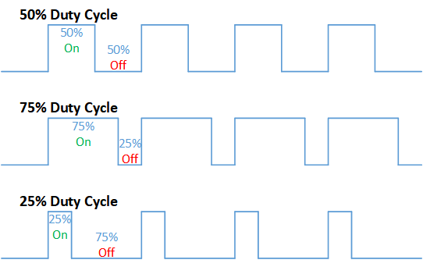
How does it work
Switching fast enough for
the application (low period)
Changing duty cycle
https://en.wikipedia.org/wiki/Pulse-width_modulation#/media/File:Duty_Cycle_Examples.png
CC BY-SA 4.0
PV198 – One-chip Controllers, PWM / Dávid Danaj
<number>

Slide 6
PWM on FRDM-K66F
FlexTimer Module (FTM)
  4 instances
  2 - 8 channels
Timer/PWM Module (TPM)
  2 instances
  2 channels
PV198 – One-chip Controllers, PWM / Dávid Danaj
<number>

Slide 7
Timer/PWM Module (TPM)
Modes of operation:
  Input capture
  Output compare
  Edge-Aligned PWM
  Center-Aligned PWM
  Combine PWM
  Combine Input Capture
PV198 – One-chip Controllers, PWM / Dávid Danaj
<number>

Slide 8
Input capture
Detects edge in the input signal
Configurable rising/falling edge detection
Edge sets interrupt flag
Read precise time from counter
Example: ultrasonic distance sensor demo
PV198 – One-chip Controllers, PWM / Dávid Danaj
<number>

Slide 9
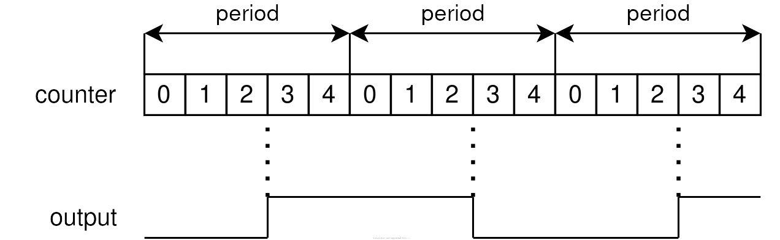
Output compare
Generate timed pulses with programmable
position, polarity, duration, and frequency
PV198 – One-chip Controllers, PWM / Dávid Danaj
<number>

Slide 10
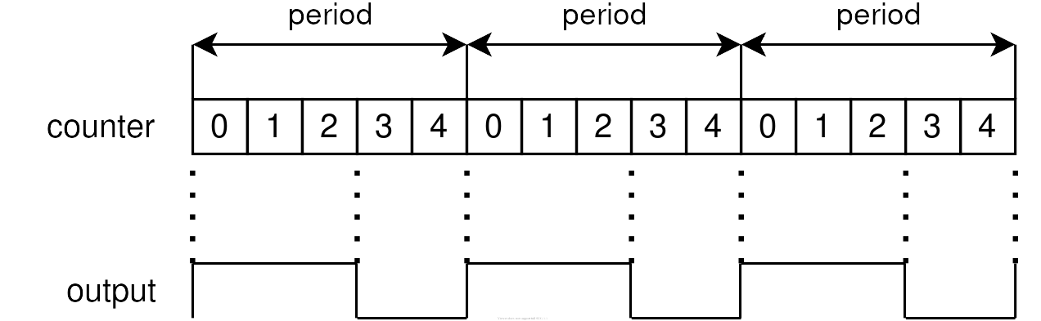
Edge-Aligned PWM
Leading edge is aligned with the beginning of the period
PV198 – One-chip Controllers, PWM / Dávid Danaj
<number>

Slide 11
Center-Aligned PWM
Counts up until it reaches MOD and then counts down until it reaches zero
The pulse width center is when the TPM counter = 0
PV198 – One-chip Controllers, PWM / Dávid Danaj
<number>

Slide 12
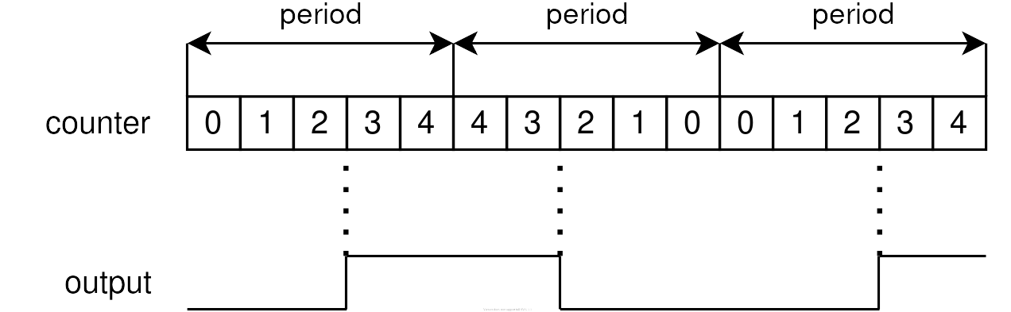
Center-Aligned PWM
PV198 – One-chip Controllers, PWM / Dávid Danaj
<number>

Slide 13
Combine PWM
Even channel (n) and adjacent odd channel (n+1) are combined to generate a PWM signal in the channel (n) output.
PV198 – One-chip Controllers, PWM / Dávid Danaj
<number>

Slide 14
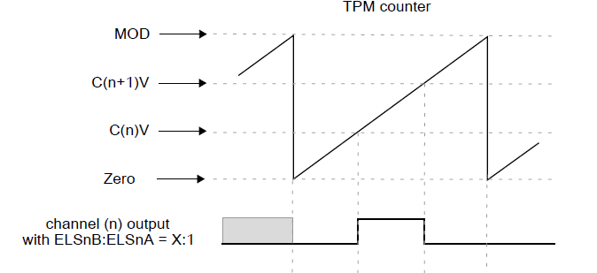
Combine PWM
PV198 – One-chip Controllers, PWM / Dávid Danaj
<number>

Slide 15
Combine Input Capture
Measure a pulse width of the signal
PV198 – One-chip Controllers, PWM / Dávid Danaj
<number>

Slide 16
Application
Create an application that turns on Blue LED with 20% intensity
Use TPM or FTM peripheral
Update your application to turn on Green and Red LED with 20% intensity (use FTM, because TPM is not available)
PV198 – One-chip Controllers, PWM / Dávid Danaj
<number>

Slide 17
Code
const tpm_chnl_pwm_signal_param_t TPM_edge_pwmSignalParams[] = {
{
.chnlNumber = kTPM_Chnl_1,
.level = kTPM_LowTrue,
.dutyCyclePercent = 20
}
};
void TPM_edge_init(void) {
TPM_Init(TPM_EDGE_PERIPHERAL, &TPM_edge_config);
TPM_SetupPwm(TPM_EDGE_PERIPHERAL, TPM_edge_pwmSignalParams, sizeof(TPM_edge_pwmSignalParams) / sizeof(tpm_chnl_pwm_signal_param_t), kTPM_EdgeAlignedPwm, 24000U, TPM_EDGE_CLOCK_SOURCE);
TPM_StartTimer(TPM_EDGE_PERIPHERAL, kTPM_SystemClock);
}
PV198 – One-chip Controllers, PWM / Dávid Danaj
<number>

Slide 18
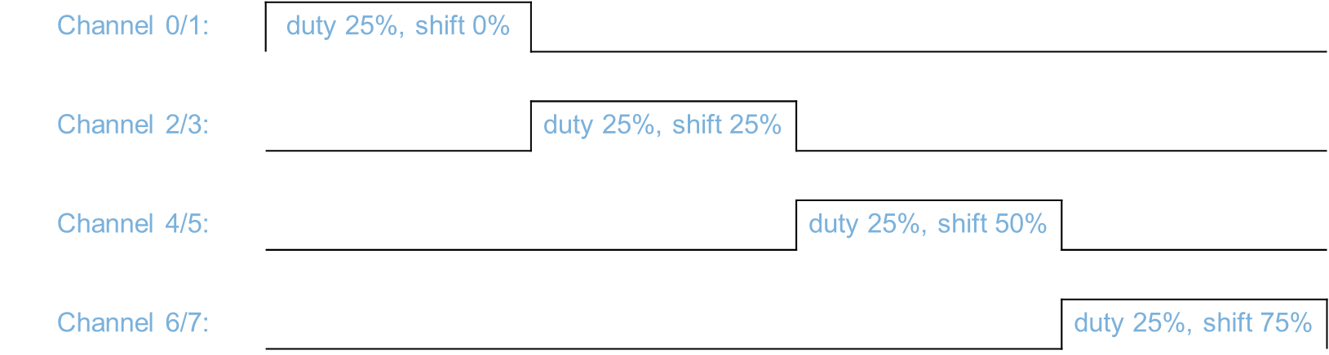
Stepper motor demo
Which mode can we use to get 4 signals as shown in the picture?
PV198 – One-chip Controllers, PWM / Dávid Danaj
<number>

Slide 19
Homework
Write 3 functions, that sets intensity for each color.
Download HSV_RGB.h from study_materials/software
All you have to do is periodically iterate over all colors by updating ‘H = (H + 1) % 360’
PV198 – One-chip Controllers, PWM / Dávid Danaj
<number>

