Slide 1
PV198 – One-chip Controllers
SPI

Slide 2
Content
What is SPI
What is it used for
How does it work
FRDM-K66F SPI
Sensor – BMP 280
Application

Slide 3
What is SPI
SPI – Serial Peripheral Interface
Serial interface bus

Slide 4
What is it used for
Intra-board communication
Peripherals
Sensors

Slide 5
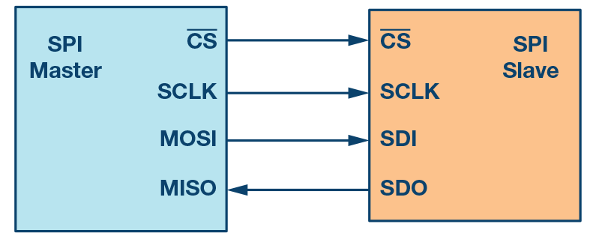
How does it work – Scheme
Figure 1. SPI configuration with master and a slave
https://www.analog.com/en/analog-dialogue/articles/introduction-to-spi-interface.html

Slide 6
How does it work
4 wires (Clock, Chip Select, Master In Slave Out, Master Out Slave In)
Single-master & multi-slave
Chip Select selects slave for communication
Synchronous
Full-duplex
Possibility to use only 3 wires (only 1 data wire)

Slide 7
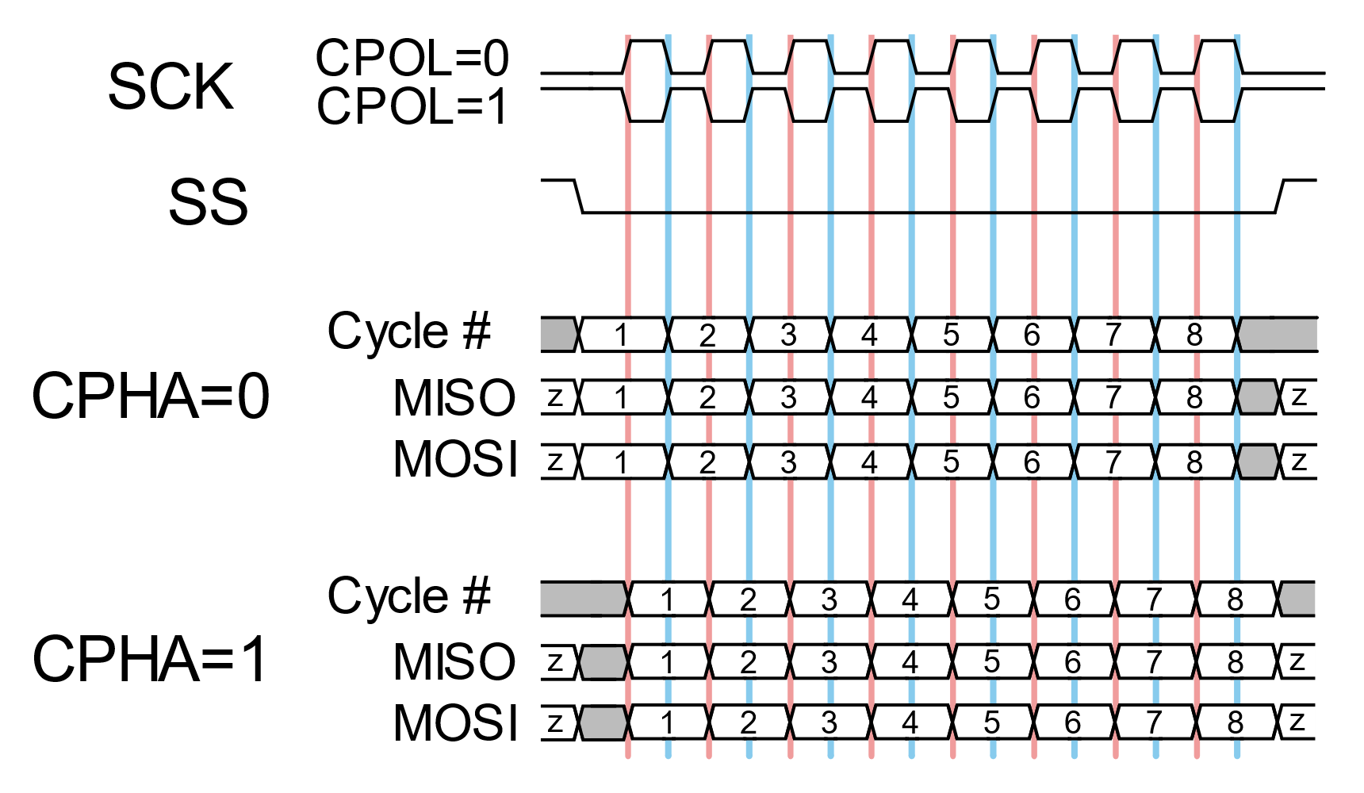
How does it work – Message
By SPI_timing_diagram.svg: en:User:Cburnettderivative work: Jordsan (talk) - SPI_timing_diagram.svg, CC BY-SA 3.0, https://commons.wikimedia.org/w/index.php?curid=11405368

Slide 8
FRDM-K66F SPI
3 SPI modules
Master & Slave support
Interrupts
DMA support
Programmable frame size (4 to 16 bits)
6 peripheral Chip Selects

Slide 9
Temperature & Pressure sensor
Bosch BMP280 Digital Pressure Sensor – link
Digital interfaces I²C (up to 3.4 MHz) SPI (3 and 4 wire, up to 10 MHz)
Pressure resolution 0.16 Pa
Temperature resolution 0.01°C

Slide 10
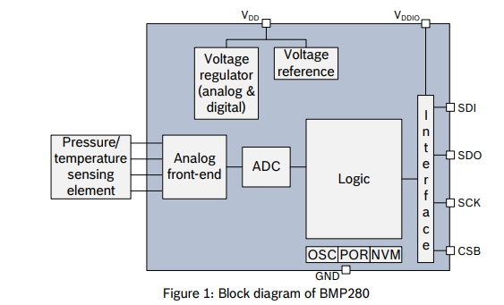
BMP 280

Slide 11
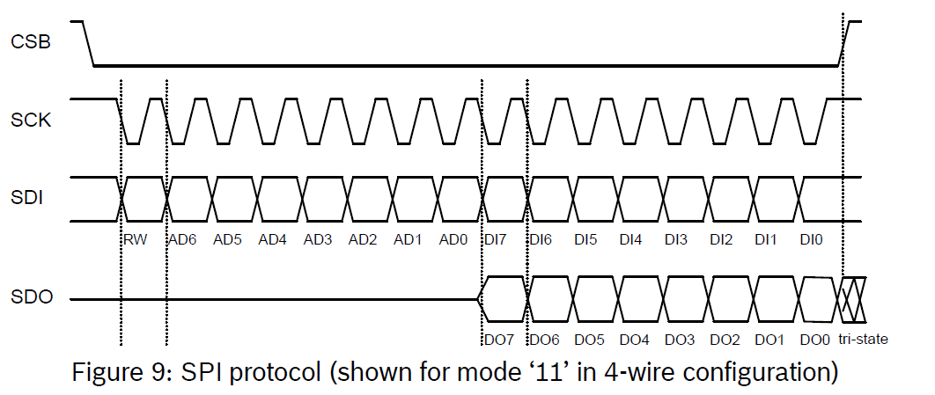
BMP 280 SPI
BST-BMP280-DS001-11

Slide 12
BMP 280 SPI – Write
PV198 – One-chip Controllers, SPI / Dávid Danaj
12

Slide 13
BMP 280 SPI – Read
PV198 – One-chip Controllers, SPI / Dávid Danaj
13

Slide 14
Application
Create an application that reads temperature from BMP280 sensor
Print temperature into console

Slide 15
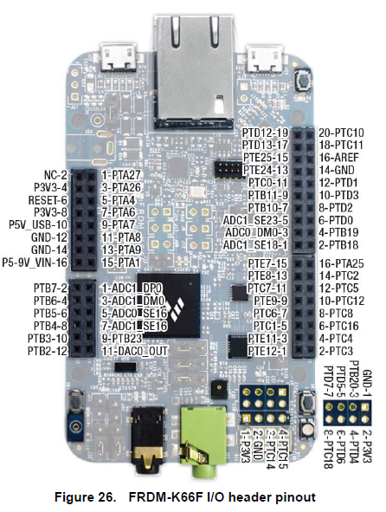
Accelerometer & Magnetometer
VCC
Temp &
Pressure
Sensor
BMP 280
GND
SCL
SDA
CSB
SDO

Slide 16
Application – Step-by-step guide
Study BMP280 Datasheet
Study Serial Peripheral Interface (SPI) chapter in MCU Reference manual
Setup pin routing
Setup DSPI peripheral driver (speed, timing, etc.)
Download BMP280_driver and temperature example
Import driver to the project, use example code
Implement HW specific functions – your main task
Repeat steps 1-7 if necessary

Slide 17

Application – Template
Study BMP280 Datasheet
Study Serial Peripheral Interface (SPI) chapter in MCU Reference manual
Setup pin routing
Setup DSPI peripheral driver (speed, timing, etc.)
Download BMP280_driver and temperature example
Import driver to the project, use example code
Implement HW specific functions – your main task
Repeat steps 1, 2 and 7 if necessary

Slide 18
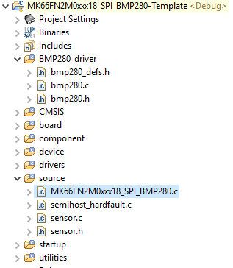
Application – Template
Check pin routing
Check DSPI configuration
  Check timing
Check sensor.c/.h files

Slide 19
Homework
Update the application to print pressure as well as temperature

