Slide 1
PV198 – One-chip Controllers
LCD Display

Slide 2
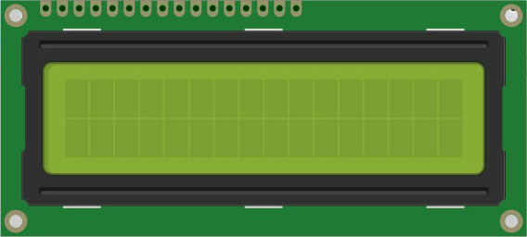
Content
LCD Display usage
LCD 1602A
Driver
Application

Slide 3
LCD Display usage
Printers
Routers
Industrial equipment
…

Slide 4
LCD 1602A – Overview
LCD 1602A display driver
  HD44780U Display Controller – Datasheet
  4 bits connection
  Connection via GPIO pins (7 outputs)

Slide 5
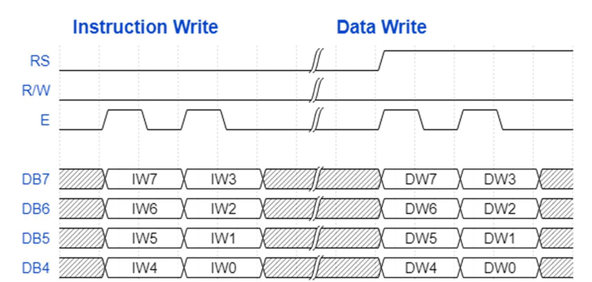
LCD 1602A – Message

Slide 6
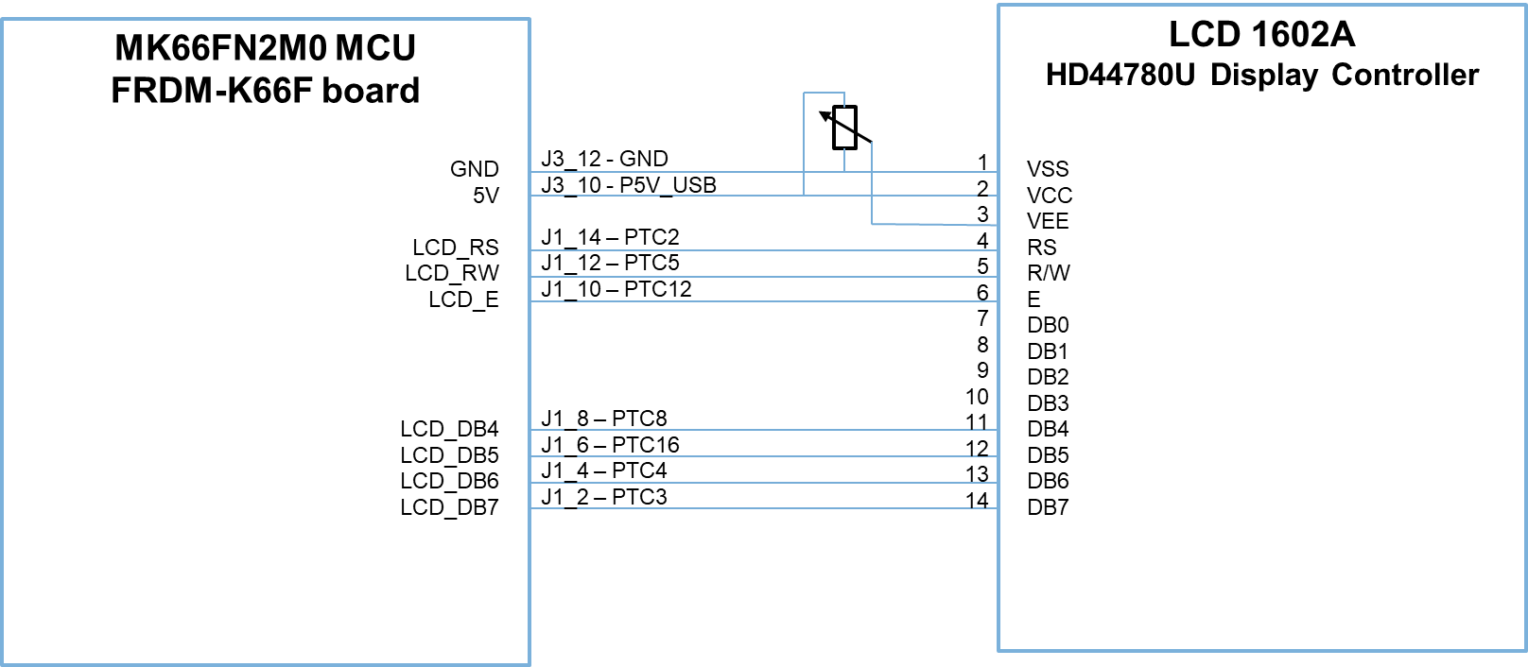
LCD 1602A – Scheme

Slide 7
LCD 1602A – Scheme
We will use DAC output instead of potentiometer
MK66FN2M0 MCU
FRDM-K66F board
LCD 1602A
HD44780U Display Controller
GND
5V
DAC0_OUT
LCD_RS
LCD_RW
LCD_E
LCD_DB4
LCD_DB5
LCD_DB6
LCD_DB7
J3_12 – GND
J3_10 – P5V_USB
J4_11 – DAC0_OUT
J1_14 – PTC2
J1_12 – PTC5
J1_10 – PTC12
J1_8 – PTC8
J1_6 – PTC16
J1_4 – PTC4
J1_2 – PTC3
1
2
3
4
5
6
7
8
9
10
11
12
13
14
VSS
VCC
VEE
RS
R/W
E
DB0
DB1
DB2
DB3
DB4
DB5
DB6
DB7

Slide 8
LCD 1602A – Driver
Support of the 4-bit communication initialization
SysTick timer usage for delays
Basic command and data transfer functions
Does not read busy flag – uses delays instead

Slide 9
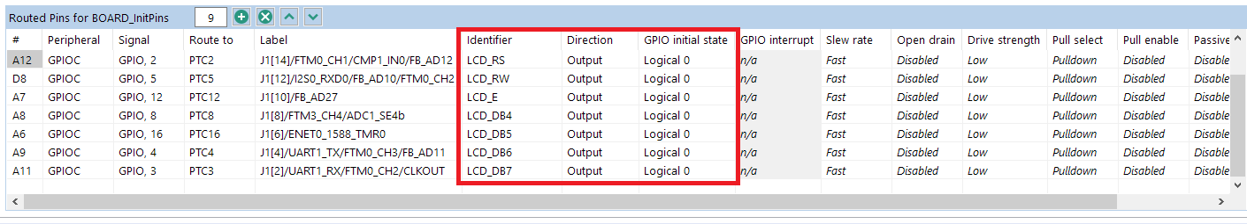
LCD 1602A – Driver Interface
The LCD driver requires to define the following identifiers in the Pins tool for GPIO output pins:
  LCD_DB4
  LCD_DB5
  LCD_DB6
  LCD_DB7
  LCD_RS
  LCD_RW
  LCD_E

Slide 10
LCD 1602A – Driver Interface
The following LCD driver functions are provided:
  void LCD_4BitsInit(uint32_t systick_clk_freq, bool cursor_on, bool cursor_blinking)
  void LCD_Clear()
  void LCD_Home()
  void LCD_SetPosition(uint8_t x, uint8_t y)
  void LCD_PutChar(uint8_t character)
  void LCD_Print(char s[])
  void LCD_SendCommand(uint8_t command)
  void LCD_SendData(uint8_t data, MessageType_t messageType)
SysTick timer is used for implementation of delay
Our task is to implement this function

Slide 11
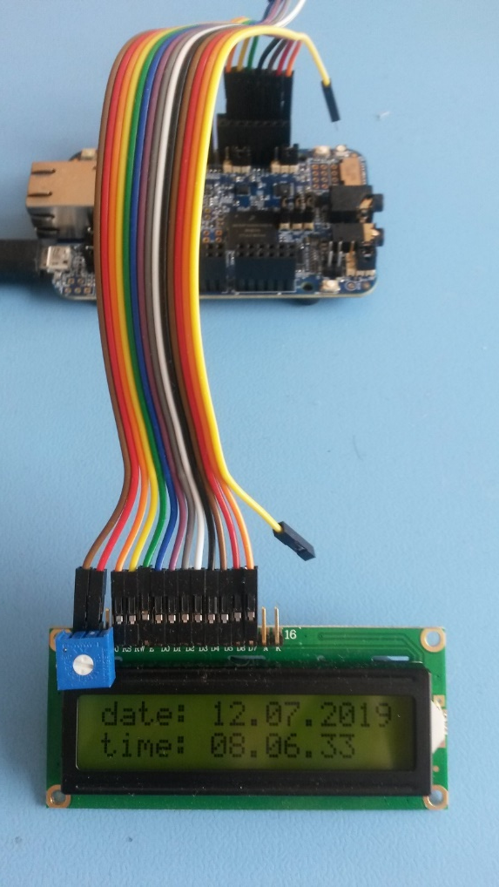
Application
LCD driver initialization
RTC peripheral initialization
Real date and time display demo

Slide 12
Application
Initialization of GPIO pins (wired interface) with the generated code from the Pins tools
Initialization sequence of the LCD driver
  BOARD_InitPins();
  LCD_4BitsInit(BOARD_BOOTCLOCKRUN_CORE_CLOCK, false, false);
Runtime usage of the driver (example):
  LCD_SetPosition(0, 0);
  LCD_Print(“a string”);
Initialization of the LCD driver (using core clock frequency and without cursor)
Displaying “a string” on the LCD screen at position 0,0 (the first column and first line)

Slide 13
Application
Implement function according to message format picture:
  void LCD_SendData(uint8_t data, MessageType_t messageType)
Bonus:
  Display floating text on the display

Slide 14
Homework
Use LCD display with any project created before (accelerometer, temperature sensor, …)

