Slide 1
Pomodoro technique
Albert Sukaný

Slide 2
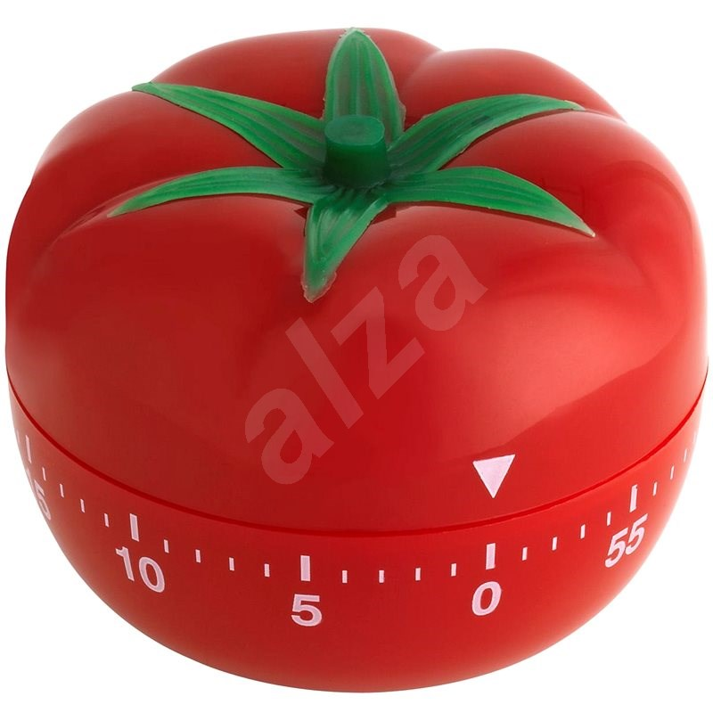
History
Method developer by Francesco Cirilllo in 1980s
He used this method as a university student
Pomodoro = “tomato” in Italian
In 2007 Cirillo published paper about this technique

Slide 3
The Planning
1. Create a TO-DO list
2. Estimate time for each activity
3. Create a time plan for each activity based on the amount of expected pomodoro cycles
4. Start learning based on the plan

Slide 4
Steps
1. Choose a task to work on
2. Set the pomodoro timer
3. Work on the task
4. Take a small break after the timer goes off
5. IF you are about to do the 4. pomodoro take a longer break instead, then go to step 2
ELSE go to step 2

Slide 5
The right amount of time
The length of the high focus and Relax time can be changed
If you are doing a task that is hard, it is recommended to choose 15-minute sessions (5 m. break)
If you are doing a task that is quite easy, it is recommended to choose 50-minute session (10 m. break)
The key is to try what suits the best for you and have experience doing similar tasks

Slide 6
When to use pomodoro
Pomodoro is useful, if you want to:
Control time spent on a task
Improve long term planning
Decrease physical pain and mental fatigue
Stay motivated

Slide 7
When not to use pomodoro
You should not use pomodoro if you:
Fear timers
You prefer long working sessions
Easily lose an idea

Slide 8
Personal experience
I used the pomodoro when preparing for exam period
I rather use it when I am alone
I prefer longer cycles when reading and shorter when calculating or writing code
I would recommend everyone to at least try it

Slide 9
Thank you for your attention

Slide 10
Sources
https://cdn.alza.cz/ImgW.ashx?fd=f16&cd=BIBMI081
http://friend.ucsd.edu/reasonableexpectations/downloads/Cirillo%20--%20Pomodoro%20Technique.pdf
https://c8.alamy.com/comp/2BD46RX/clock-timer-time-passage-icon-15-minutes-2BD46RX.jpg
https://st4.depositphotos.com/28957654/40348/v/380/depositphotos_403487750-stock-illustration-minutes-timer-stopwatch-symbol-flat.jpg
https://en.wikipedia.org/wiki/Pomodoro_Technique

