Slide 1
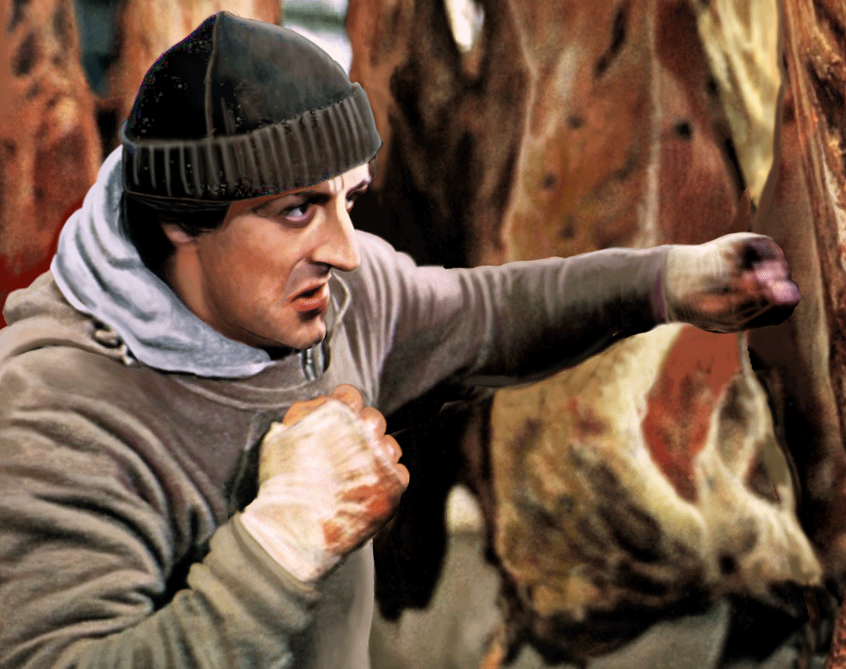
Meal preparation
…in other words, food boxing
Martin Gregorík
500359

Slide 2
Advantages
Planned eating
  Eat what you box
Can help with weight loss
Helps throughout hectic weekday schedule
Saves time, money*
  Time to prepare a box vs. time to travel to/from restaurant
  Cost of ingredients vs. cost of a meal in restaurant
You can box different meal sizes
  Fixes the issue with small meals in restaurants
You can box almost everything

Slide 3
Disadvantages
Not every cuisine can (or should) be boxed
Loses taste and quality
Eating the same for long period of time
You need a box for your boxes – fridge, bag, etc…

Slide 4
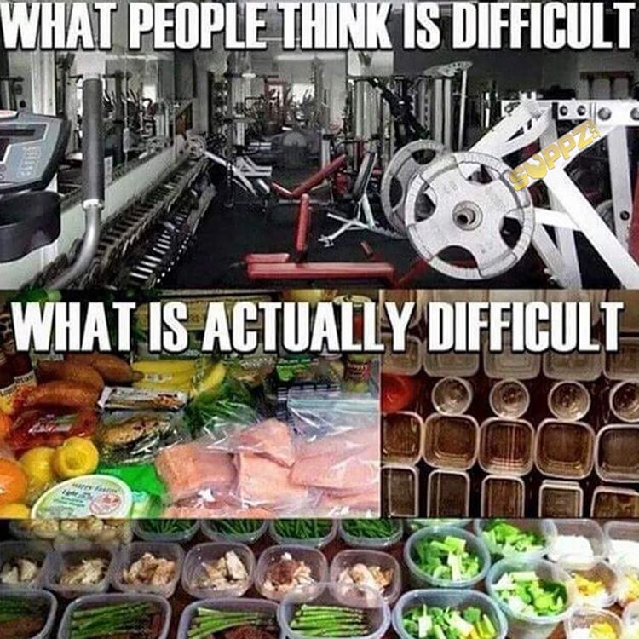
Tips & tricks
Label boxes with dates
Start small – set a prep day and prepare
  E.g., dinners for 2-3 days of the week
Cook in bulk = buy in bulk
  Buying in bulk is cheaper
Marinate proteins and then quickly cook them
  If you don’t like pre-cooked proteins
Meal-prep templates*
Bento boxes

Slide 5
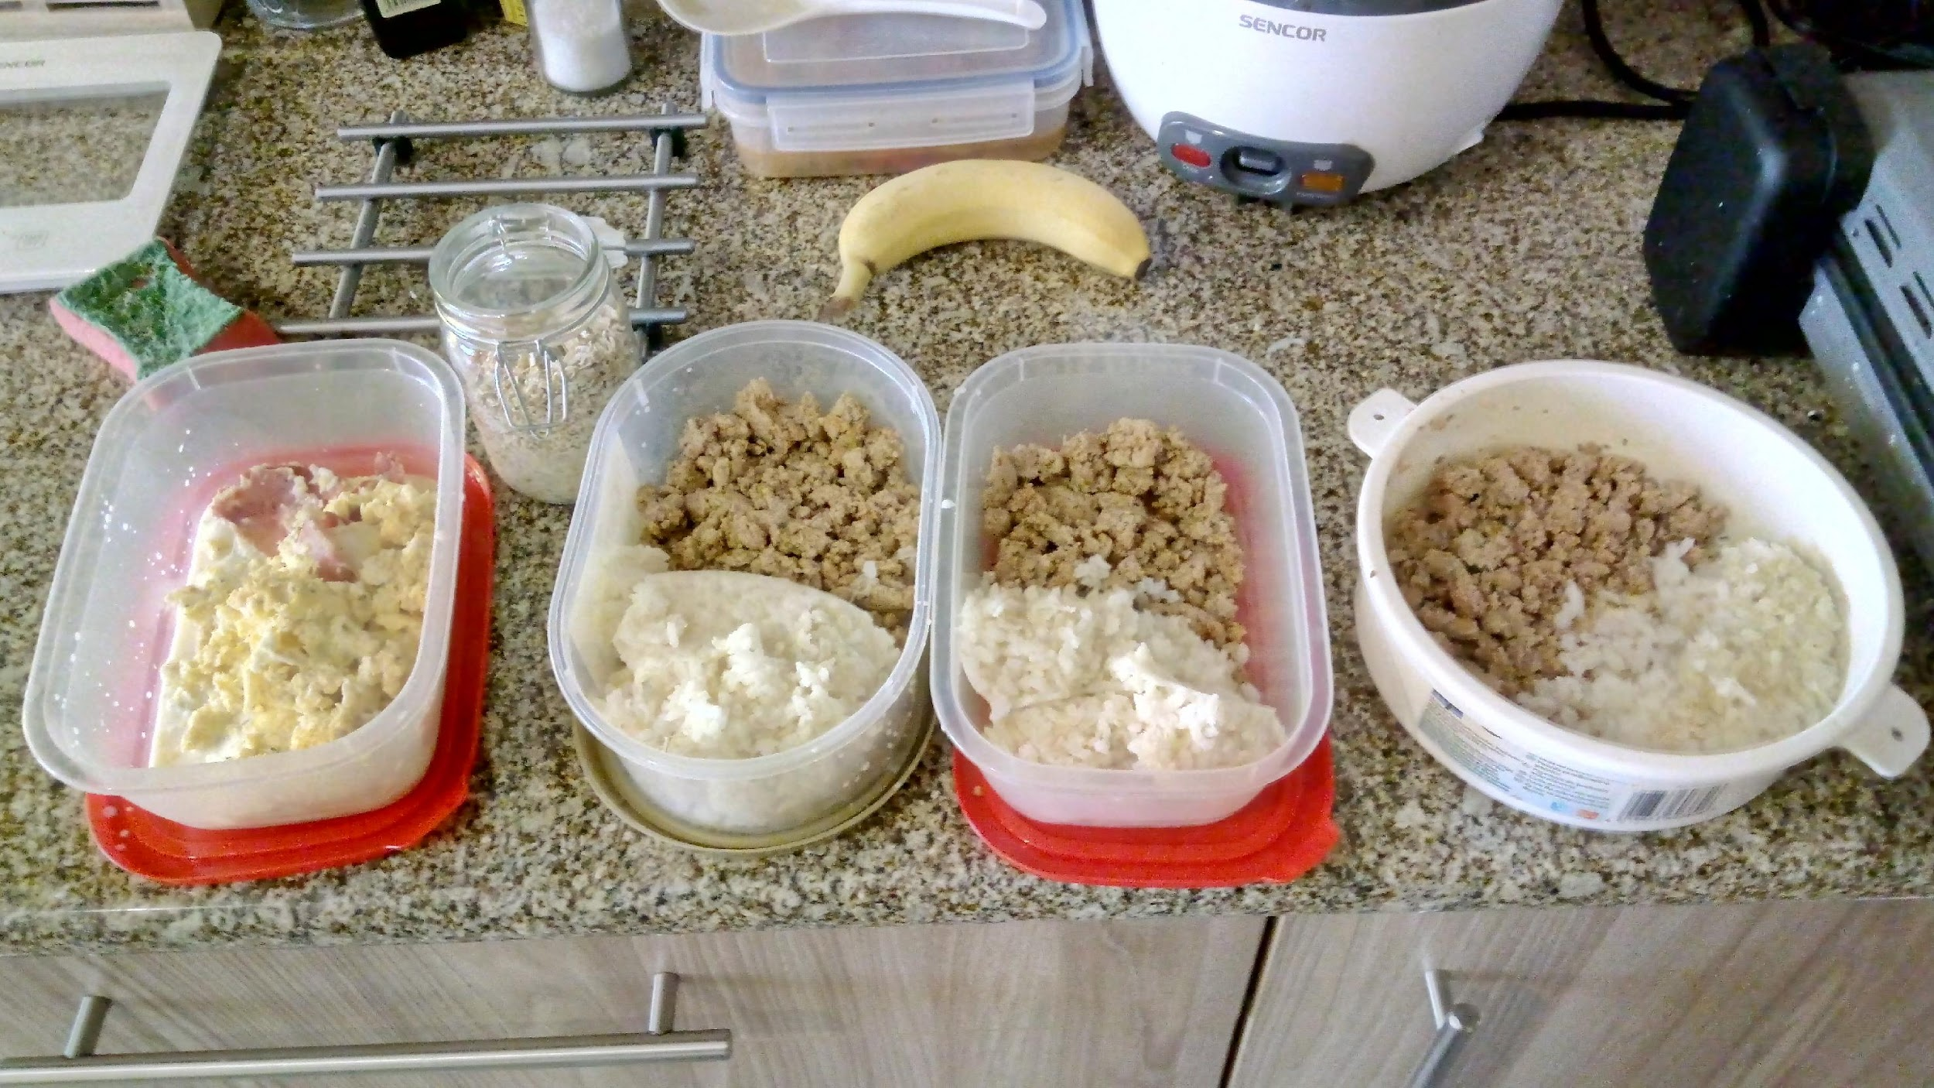
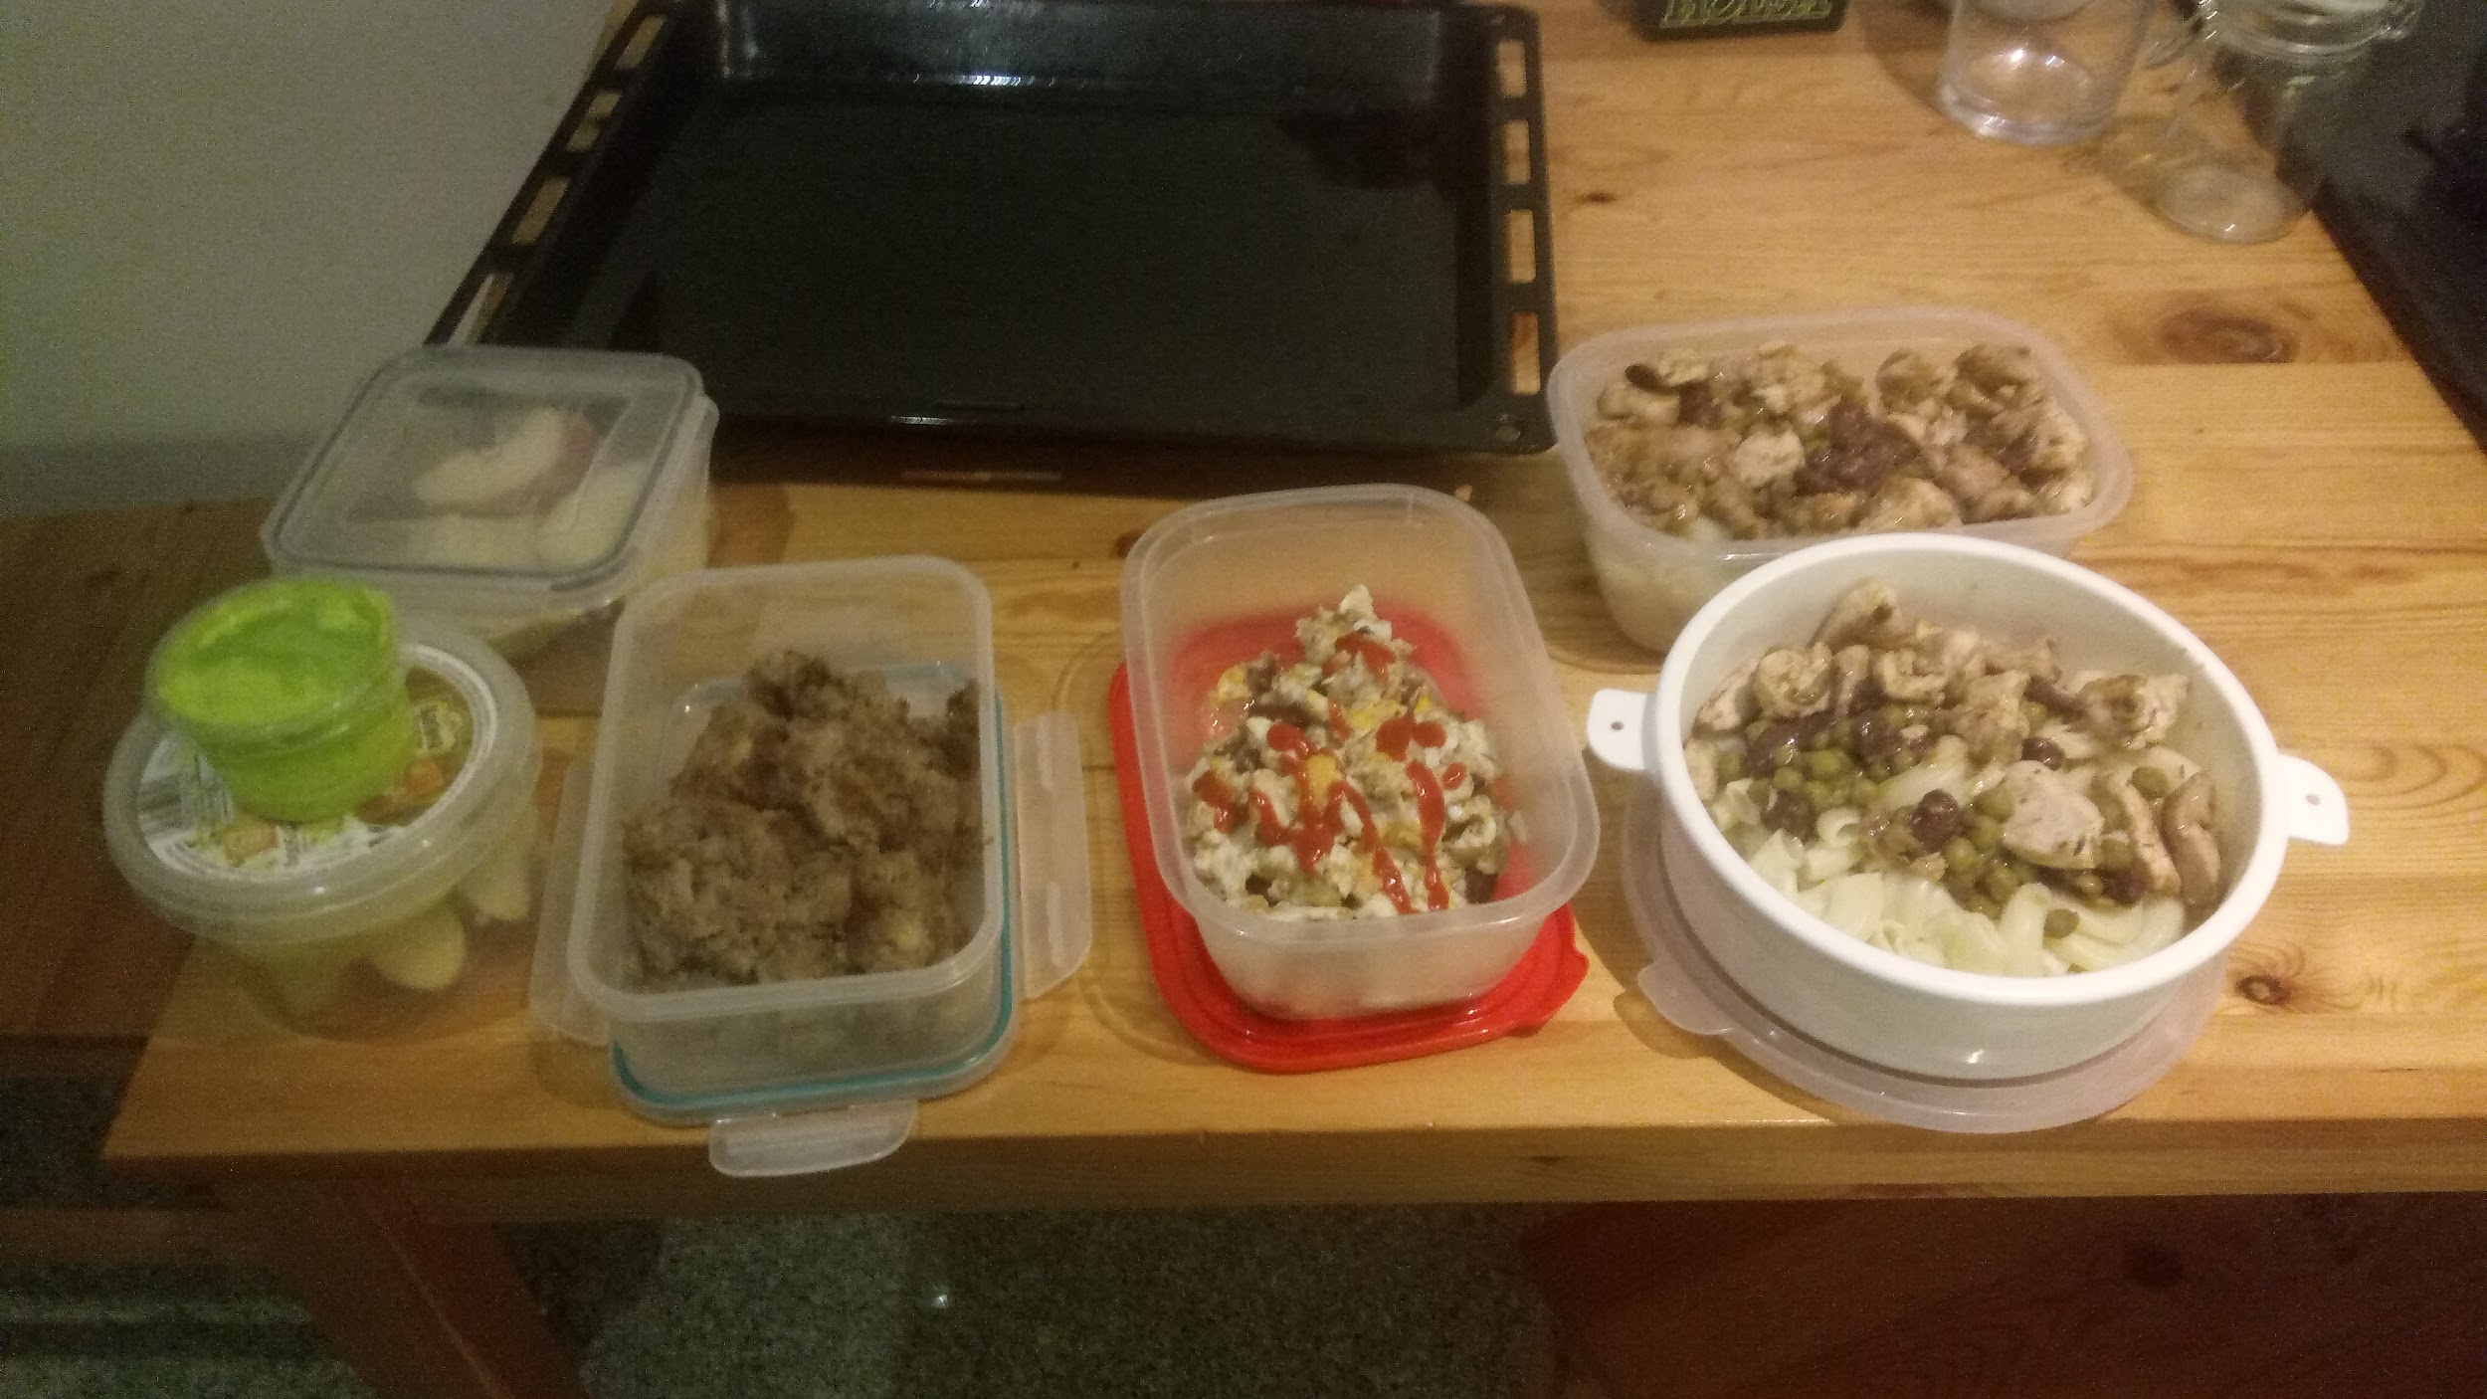

Slide 6
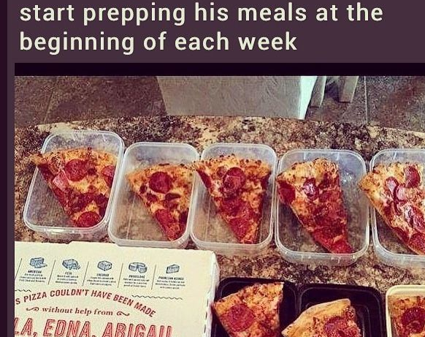
Thank you for your attention.
Any questions?

