Slide 1
Procrastination, Motivation & Imposter syndrome
PV236 – Time management & Effectiveness
1.11. 2021
Josef Spurný

Slide 2
Do you procrastinate globally or locally?
Everyone procrastinates, from time to time
Do I have a problem?
Ongoing, recurrent procrastination
Procrastinating enjoyable activities
Struggling to deliver school/work tasks in time
Subjective feeling that something is wrong, but I can’t help myself

Slide 3
Two aspects of procrastination
Emotional
I must do things that I do not like
→ Do I even know what I enjoy?
Cognitive
I must do vaguely defined tasks
I am not sure how to solve it
Choice paralysis
→ at the end of the day, it is still an emotional problem – uncertainty, lack of self-confidence
= impaired ability to make decisions

Slide 4
It’s in your personality
Do you see your life like a book, or like a collection of stories?

Slide 5
It’s in your personality
Key concept: stability of personality
Attachment theory
“Nature vs Nurture”
Structure of neuronal network
Fragility / Rigidity / Flexibility
Ability to adapt
Ability to integrate experience
Ability to maintain long-term patterns (of relationships, interests…)
Tendency for specific reactions under stress (also psychosomatic – migraines, eczema, irritable bowel syndrome…)
Borderline personality structure

Slide 6
It’s in your personality
What to do about it?
Self-awareness
Self-development (vs personal development)
Therapy / Coaching (aka “guided introspection”)
Seek meaning
Noögenic Neurosis – “The neurosis of the modern man is the inability to give meaning” Viktor Frankl

Slide 7
Know yourself to ride the procrastination horse
Time management paradox
using TM tools and techniques to advocate procrastination
Do you need stress to get to “your” performance level?
Concept of “psychological hardiness”

Slide 8
Narcissistic equilibrium
A balance between “wants” and “musts”
In psychoanalytic terms: ego and superego
Ego = your values, attitudes, desires
Superego = internalized authority (parent, boss, teacher…)
“guilty consciousness”
In order to deliver duties, your ego has to be saturated
Long-term disequilibrium leads to burnout syndrome
Manage your narcissistic equilibrium (resources vs expenses)

Slide 9
Emotional saturation – focus on resources
There is no universal guide – you have to know yourself
Do hobbies
Relax in a way you enjoy
Do anything what would bring you positive emotions
Reward in form of acknowledgement / appreciation
Free time is not a wasted time!

Slide 10
Emotions → Will
Actions require energy levels
Reasoning does not bring energy, emotions does!
Non-living vs living entities
“only dead fish swim with the stream”
Self-feeding cycles
The more efficient cycles, the greater the potential for longer lifespan
Will may be perceived as higher-order emotion, a token of mental metabolism
Burnout / depression → lack of will

Slide 11
Caution: teacher’s subjective opinion!
In the long term, you cannot “solve” procrastination just by pushing yourself to do things you do not want to do (by using tools/techniques)
This way you are only getting more efficient at discharging your battery
Burnout syndrome
Psychosomatic symptoms / diseases
Stress, aggression, easy irritation
These techniques should be combined with maintenance of narcissistic equilibrium, and self-awareness

Slide 12
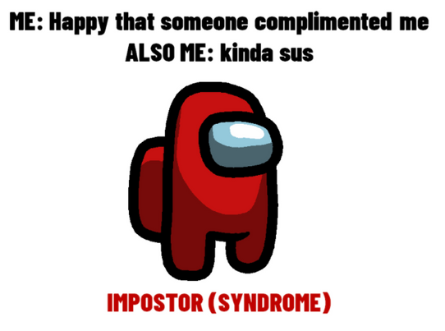
Impostor syndrome
Do you suffer from impostor syndrome?
Objectively, you perform well
Subjectively, you think you underdeliver
You procrastinate because you think you will underdeliver anyway
You tend to doubt appreciation or compliments from others
You fear that one day others will find out
Pic source: https://www.nussocisoc.org/post/a-sociological-take-on-imposter-syndrome

Slide 13
Impostor syndrome – root cause
Psychologist: lack of self-confidence ← attachment
Sociologist: socially constructed problems and/or inequalities (e.g., gender, race) at workplace

Slide 14
Homework assignment
Resources
Expenses
?
?
What charges and discharges your battery?
How much time do you invest in these activities?
Does the greatest expense also take the most time?
Can you recharge the battery without guilty consciousness?

