Slide 1
Evening Drawing
Week 5: Caricatures
Helena Lukášová, Hana Pokojná

Slide 2
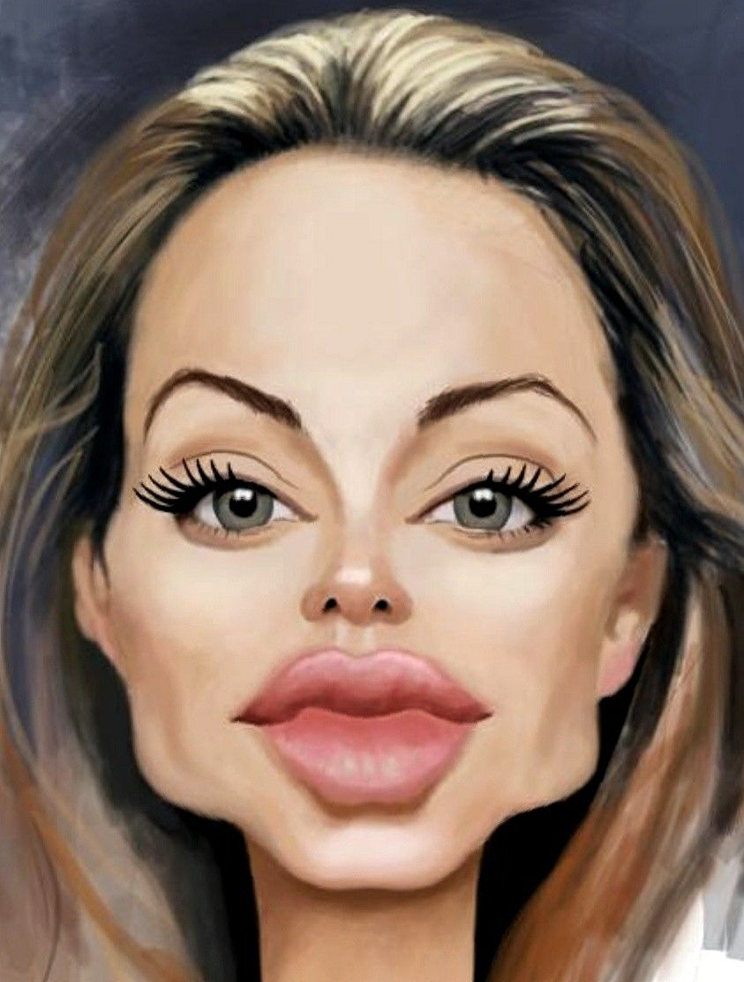
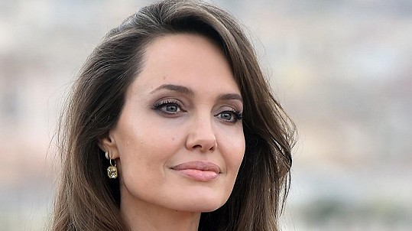
Caricatures
Portraits with exaggerated features that maintain likeness
https://www.super.cz/773841-kam-se-hrabou-influencerky-se-svymi-selficky-angelina-jolie-trhla-rekord-na-instagramu.html
https://www.pinterest.com/pin/672021575643262774/

Slide 3
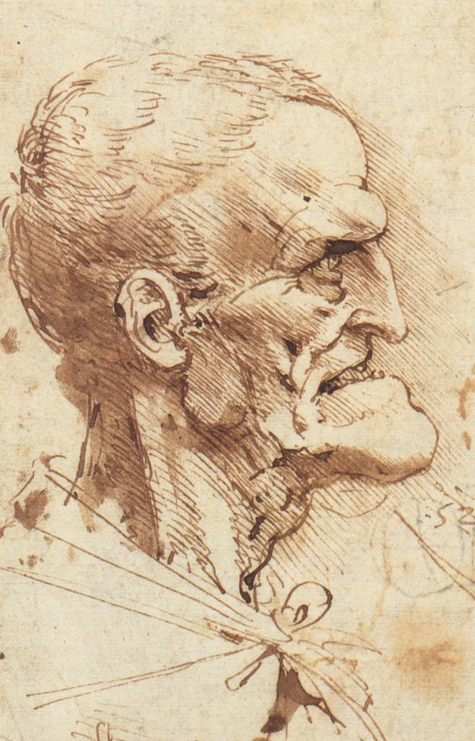
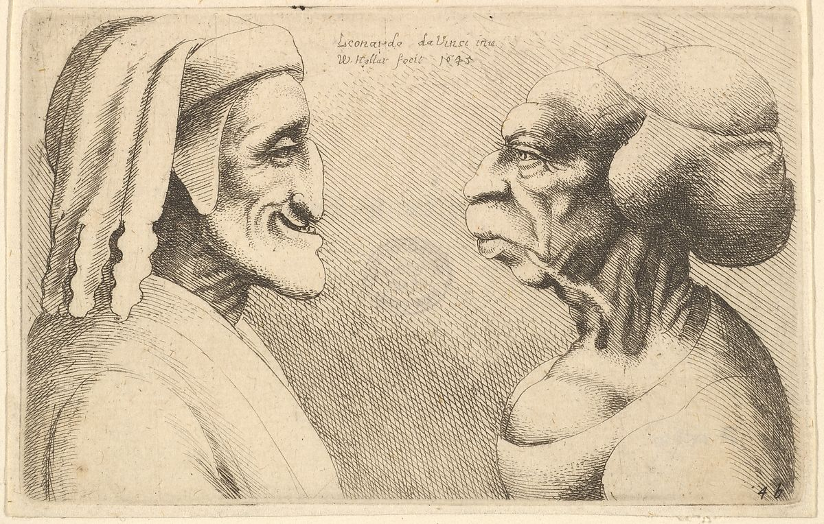
History of caricatures
Leonardo Da Vinci was fascinated by people with differently shaped heads, curious faces and unusual features. He would turn them into tragi-comic figures
“[Leonardo Da Vinci] was so delighted when he saw curious heads, whether bearded or hairy, that he would follow anyone who had thus attracted his attention for a whole day, acquiring such a clear idea of him that when he went home he would draw the head as well as if the man had been present.’ (Giorgio Vassari, 16th century).
https://www.openculture.com/2017/09/leonardo-da-vincis-bizarre-caricatures-monster-drawings.html
https://www.metmuseum.org/art/collection/search/360758

Slide 4
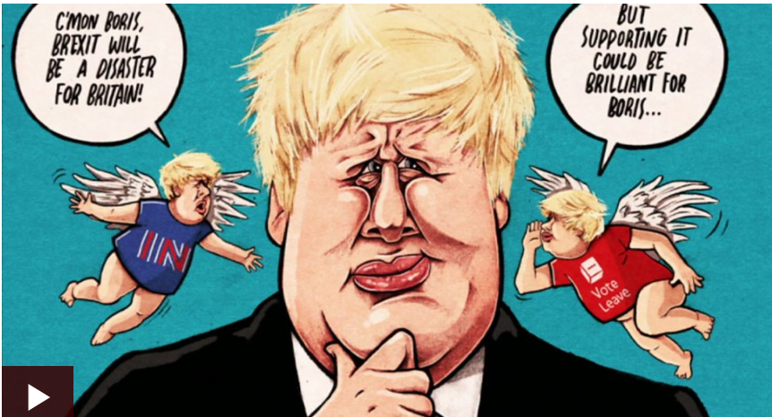
Political Satire
https://www.bbc.com/news/av/uk-politics-41861482

Slide 5
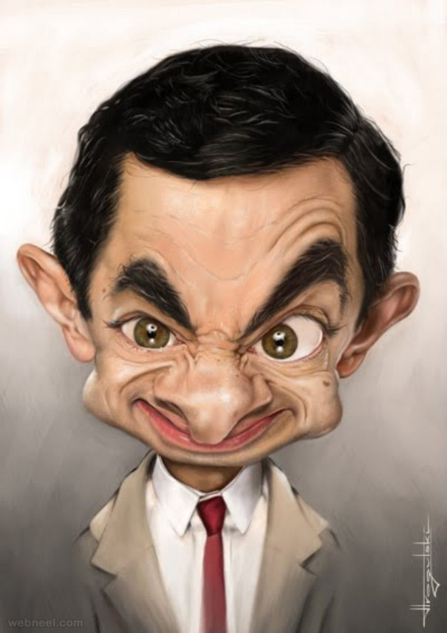
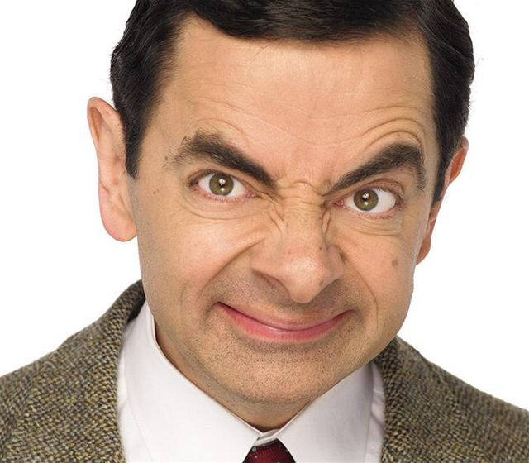
You can base caricature on:
Features
https://www.lidovky.cz/relax/lide/mr-bean-konci-jeho-predstavitel-nechce-aby-zestarl.A111009_132103_lide_spa
https://webneel.com/daily/16-mr-bean-caricature

Slide 6
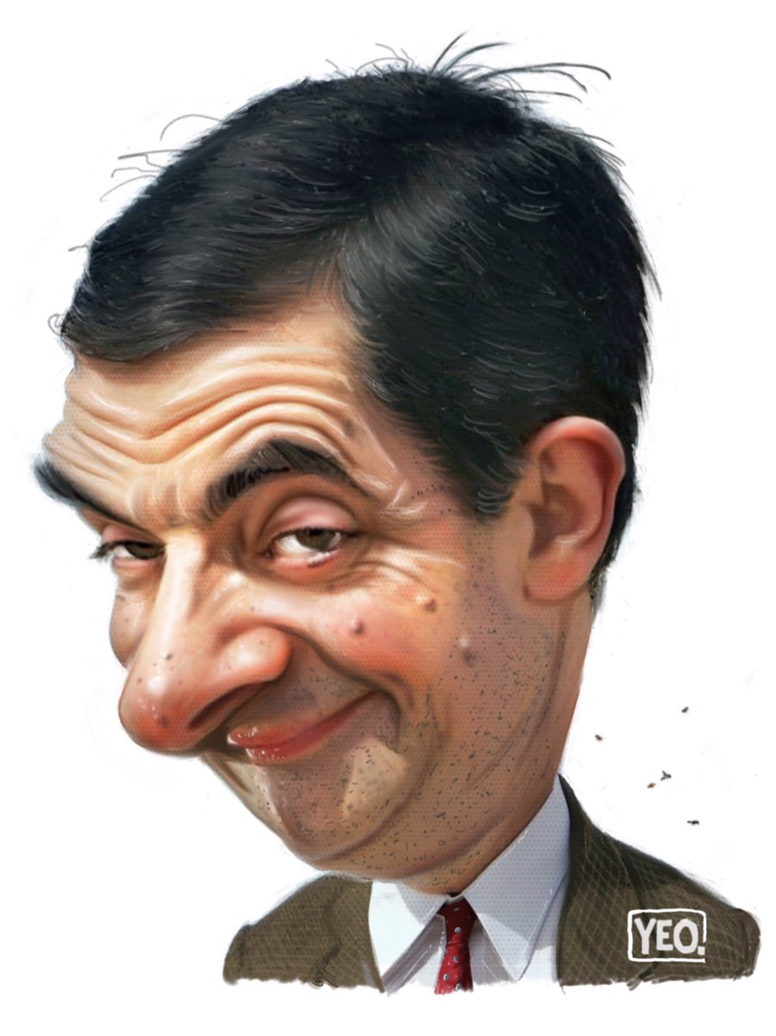
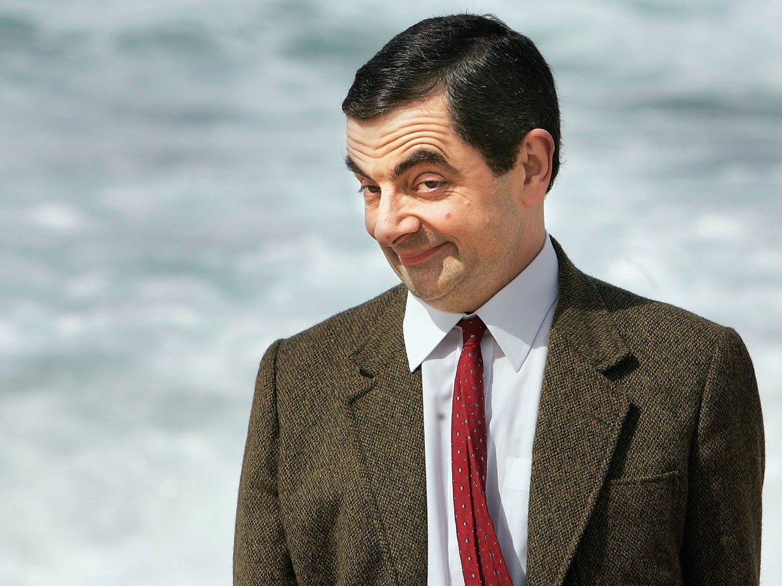
2) Facial expression
https://www.independent.co.uk/arts-entertainment/films/news/rowan-atkinson-mr-bean-b1782513.html
https://twitter.com/yeocartoons/status/875979186577358848

Slide 7
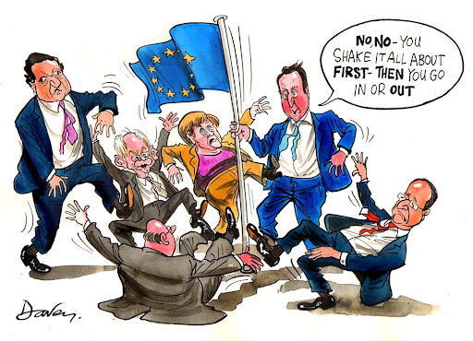
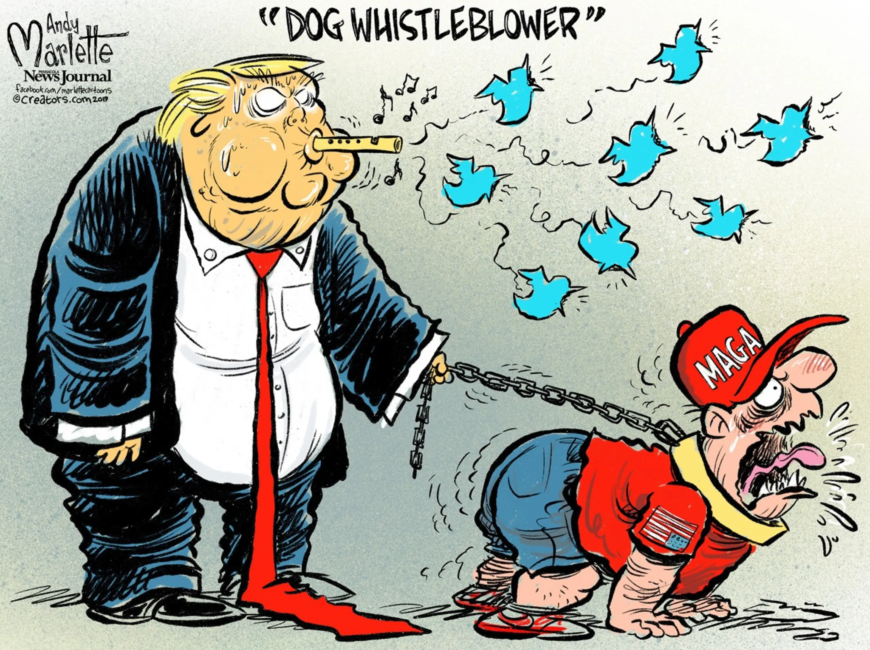
3) Actions
http://clipart-library.com/clipart/yck85jXcE.htm
https://eu.usatoday.com/picture-gallery/opinion/2019/09/02/political-satire-humor-funny-trump/2191836001/

Slide 8
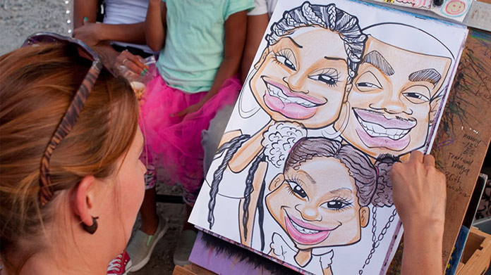
Nowadays, it is also very popular as a souvenir from street artists...
https://howtostartanllc.com/business-ideas/caricature

