Slide 1

Academic Communication Skills in English (DACSE)
Autumn Term 2022

Slide 2
DACSE 2022
course instructor
course administration
course introduction

Slide 3
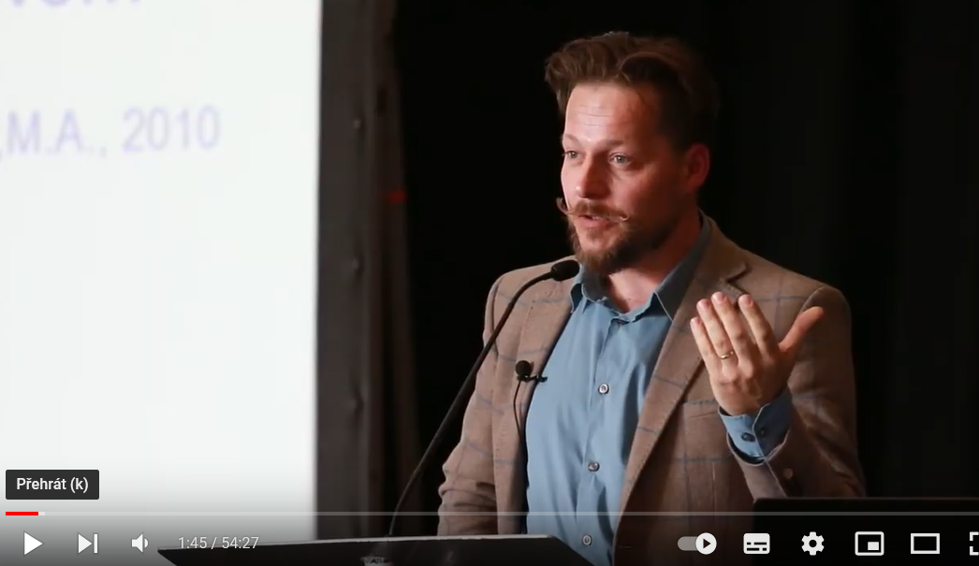
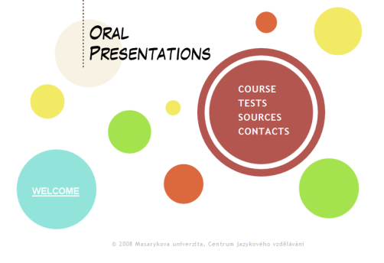
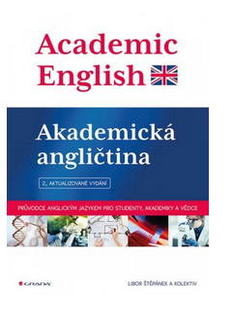
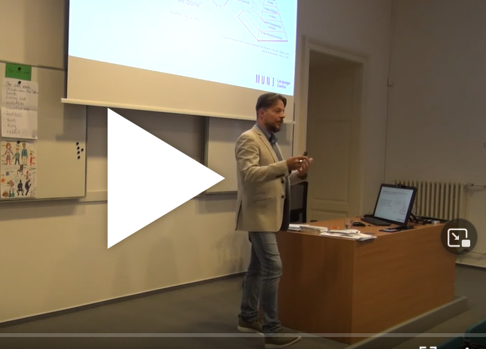

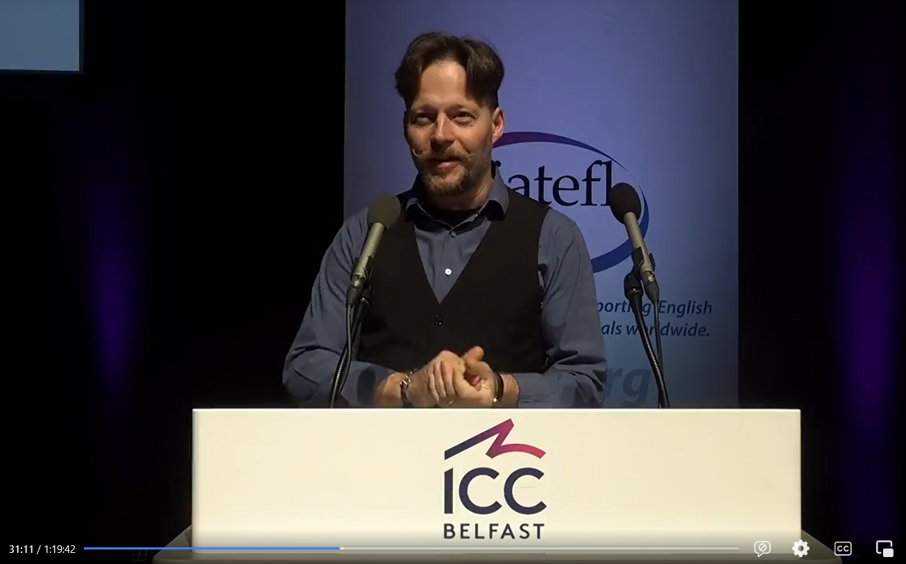
LIBOR ŠTĚPÁNEK (libor.stepanek@cjv.muni.cz)
Masaryk University Language Centre (CJV MU) Komenského nám 2
Education:
  MA in English
  (MA in History & PhD in Political Science)
Specialization and Research:
  Academic Skills in English
  Academic Public Speaking
  Academic Writing
DACSE - since 2009

Slide 4
course objectives
After completing this course you will be able to:
communicate effectively within the international academic community setting;
be a successful participant of an international conference/meeting;
recognize various organizational patterns found in academic speaking;
adjust communication to different tasks;
write short formal academic texts.

Slide 5
course organisation
4 block sessions
Monday 26 September (9:30 - )
Tuesday 27 September
Monday 24 October
Tuesday 25 October
theoretical input combined with diverse practical activities based on individual needs

Slide 6
materials
IS study materials
synchronous classes
IS (or other) discussion forum
  collaborative activities

Slide 7
requirements
Active participation in:
  presentations / talks / teaching sessions giving
  synchronous discussions
  online asynchronous discussions
  writing assignments

Slide 8
introduction

Slide 9
introduction
peer2peer → class

Slide 10
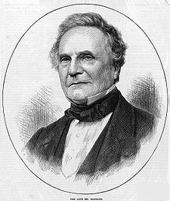
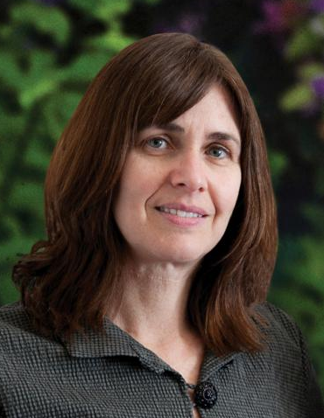
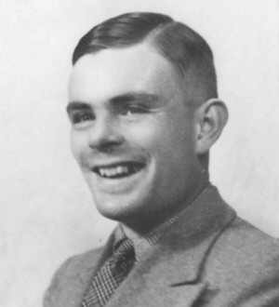
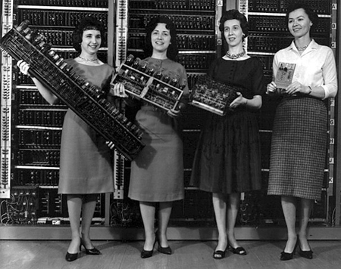
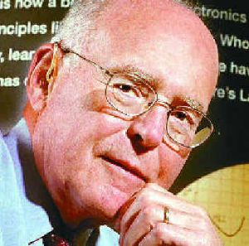

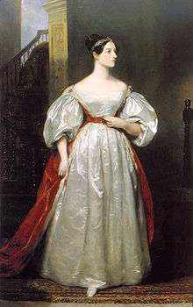
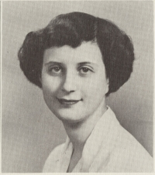
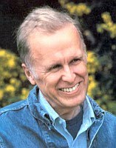
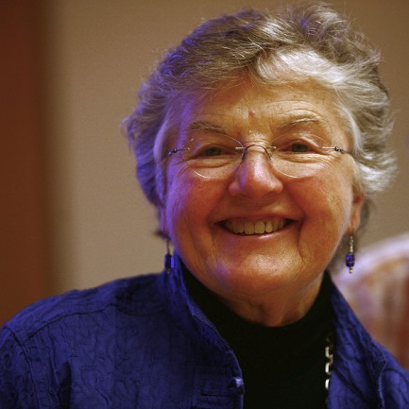
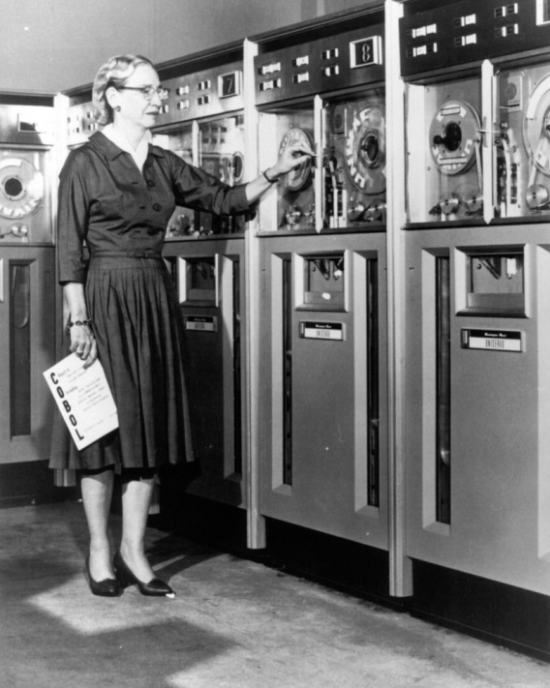
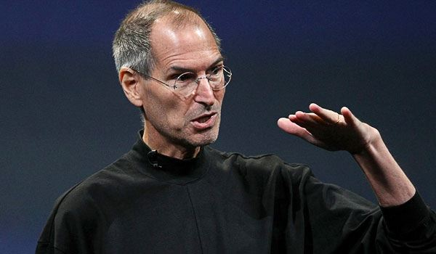
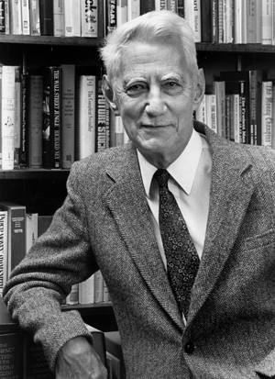
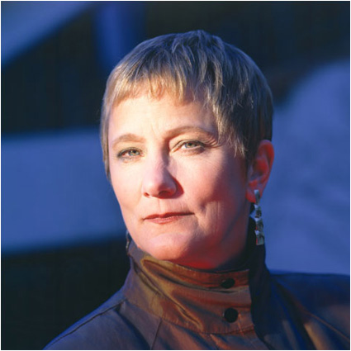
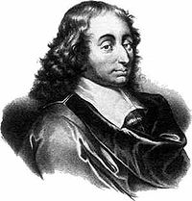

Slide 11
priorities
1.small talk – starting and finishing a conversation a conversation
2. small talk – cultural differences
3. small talk – turn taking
4. academic talks
5.after-presentation discussion
6.conference presentation giving
7.panel discussion – presentations
8.panel discussion – chairing
9.panel discussion – turn taking
10.conference slot chairing
11.toast giving
12.Lecturing / teaching
13.interactive seminar giving
14. adjusting language to your audience
15.peer-to-peer communication
16. authoritative communication
17. “one of the crowd” communication
18. story-telling to present science
19. code switching and code mixing in multilingual communication
20. in-front-of-the-camera-communication
21.abstract writing
22.biography writing
23.academic writing style
24.emails/letters
25. interviews in intercultural setting
26. feedback giving
27. feedback accepting
28. other preferences

