Slide 1
Service Modeling II
© Leonard Walletzký

Slide 2
Why do we need diamonds?
We need to describe things
And their relations
In some given context
Then we need to organize/plan operations
And execute them in some time perspective
Our natural language is
Redundant
Ambiguous

Slide 3
4 diamonds
See
Describing things (objects) and basic relations
Recognize
Adding context to relations
Organize
How agents behave to recognized objects, what kind of operations we can do
Do
Executing planned operations and getting results

Slide 4
See
We are projecting the seen object in our mind
It has
Particular shape or form
There can be some different varies of this object
It can be used for some purposes
Using this object is under some rules
There can be connections to other objects

Slide 5
Diamond See
I am in
syntactic part
I can connect
relationship with
dynamic rule!
Relationship
characteristic
characteristic
R
P
Category
R
Object
R
Rule
I am in
dynamic part
I can connect
operation with
specific
categories!
R
characteristic
characteristic
Operation

Slide 6
Diamond Recognize
One category can exist
in more contexts and
vice versa.
Category
base
R
CI-connection
Item
R
Context
R
R
Manifestation

Slide 7
3rd diamond
Organizing diamond
How is your life / position / work organized
How can be some agent
member of some team
working on projects
educated or taught someone

Slide 8
Diamond of Agent-Team Organization
Goal
follower
establisher
Agent
author
learner
superior
collaborator
Activity

Slide 9
Diamond of Agent-Team Organization
Goal
follower
establisher
Action
Agent
Flow
organizer
organizer
member
member
author
learner
superior
collaborator
Activity

Slide 10
Diamond of Agent-Team Organization
Goal
reaching
reaching
fulfilling
fulfilling
follower
establisher
Action
Agent
Flow
organizer
organizer
member
member
author
learner
covering
superior
collaborator
focusing
Activity

Slide 11
Diamond of Agent-Team Organization
GBS
Goal
reaching
reaching
fulfilling
fulfilling
follower
establisher
composite
Action
Agent
Flow
organizer
organizer
member
member
author
learner
covering
superior
collaborator
focusing
Activity
detail

Slide 12
Diamond of Agent-Team Organization
GBS
R22
Goal
reaching
reaching
fulfilling
fulfilling
follower
establisher
composite
R11
Action
Agent
Flow
organizer
organizer
member
member
author
learner
covering
superior
collaborator
focusing
Activity
detail
R33

Slide 13
Diamond of Agent-Team Organization
GBS
R22
Goal
reaching
reaching
fulfilling
fulfilling
follower
establisher
composite
R11
Action
Agent
Flow
organizer
organizer
member
member
author
learner
covering
superior
collaborator
focusing
R01
R02
Activity
detail
R33

Slide 14
Diamond of Organization - Summary
Matrix-based organization: Action vs. Flow
Activity vs. Action / Flow
R-edges
GBS
R22
Goal
reaching
reaching
fulfilling
follower
fulfilling
establisher
composite
R11
Action
Agent
Flow
organizer
organizer
member
member
author
learner
covering
superior
collaborator
focusing
R01
Activity
R02
detail
R33

Slide 15
4th Diamond - DO
Describing the service environemnt
Illustrating how the service is provided
Adding multicontextual view to service analysis
Helping to compose and decompose the services

Slide 16
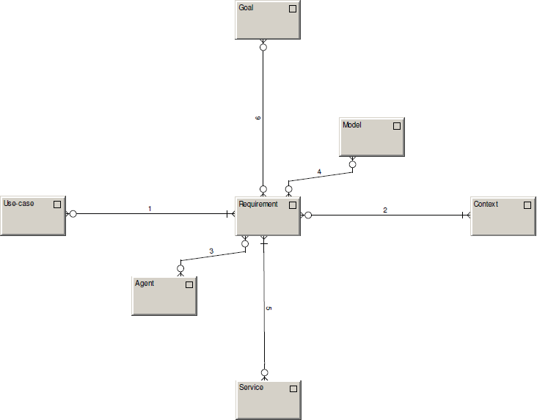
fulfilling
recorded in
forming / formed by
occurring within
addressing
solved by

Slide 17
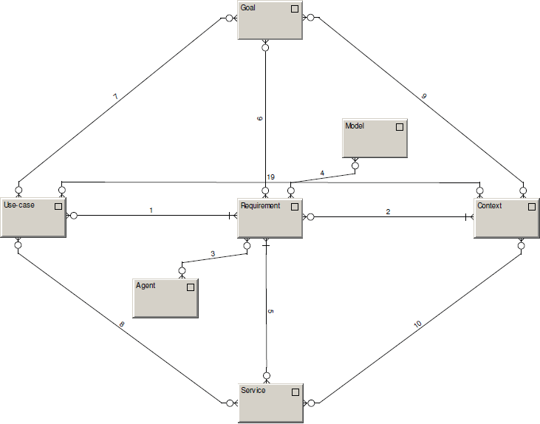
achievable within
achievable by
Identified within
creatable by
creatable within

Slide 18
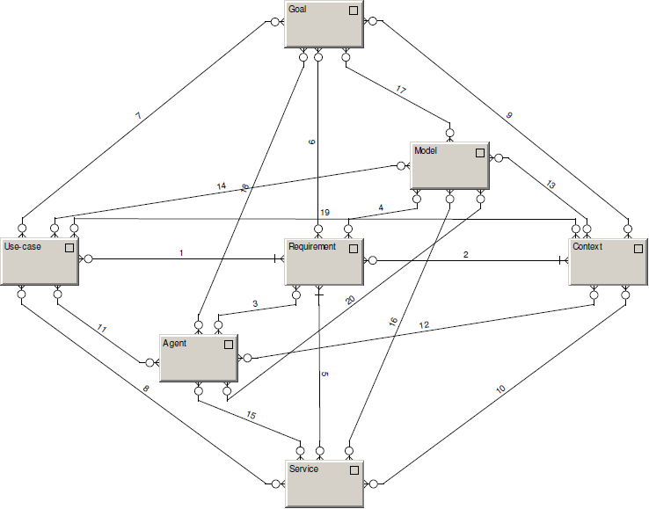
Model records.
Agent wishes, defines, does.

Slide 19
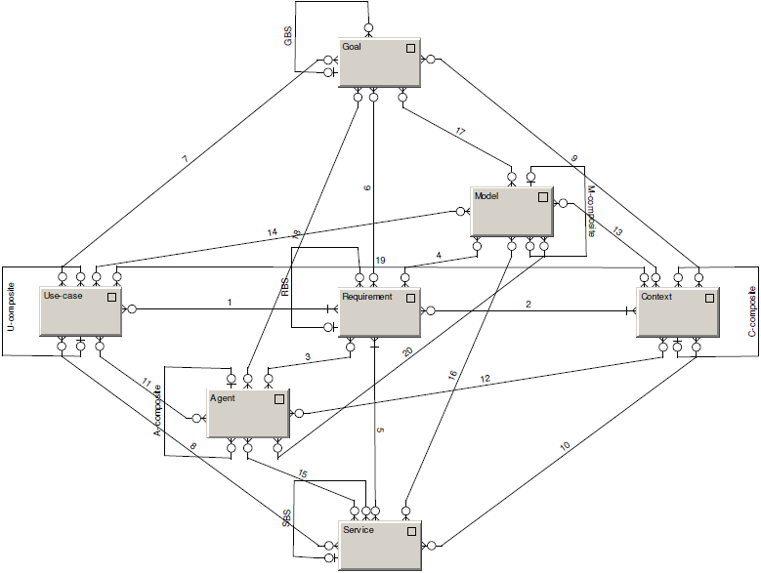
Composites

Slide 20
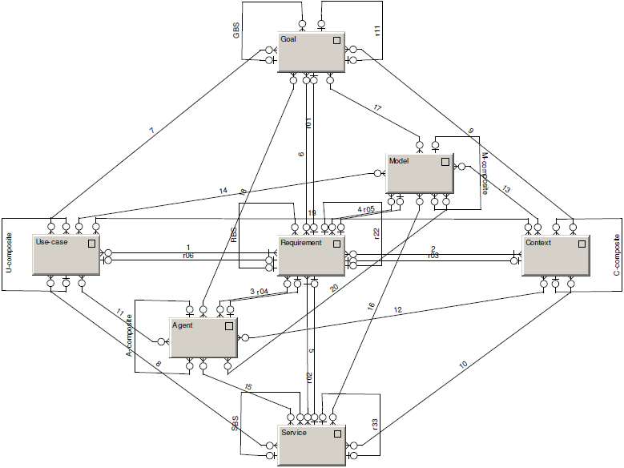
R-edges

Slide 21

Diamond of Predictive Behaviour
Depicts the motivation of agents to DO
Everything can be seen as a requirement
Forming and being formed by behavioral patterns
Models as a system memory

Slide 22
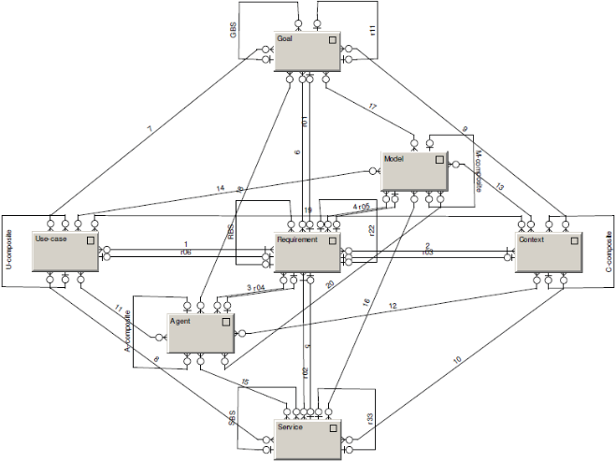
Diamond-Path Framework
Overview
See
Recognize
Organize
Do
Attention
Focussing
Cognitive
Elements
Agent-Team
Organization
Predictive
Behaviour
Category
base
R
GBS
R22
Relationship
CI-connection
R
Item
R
Context
Goal
reaching
reaching
characteristic
characteristic
fulfilling
follower
fulfilling
R
P
R
composite
establisher
R11
Category
R
Object
R
Rule
Manifestation
Action
organizer
Agent
organizer
Flow
member
member
author
learner
R
covering
superior
collaborator
focusing
characteristic
characteristic
R01
R02
Operation
Activity
detail
R33

Slide 23
Smart Service Canvas
Actors
Resources
Institutional arrangement
Co-creation
Goals
What goal is fulfilled by a service?
Are there any sub-goals that need to be taken into the account? Are they part of the main goal GBS ?
Who is the establisher of the goal? Who is the follower?
Requirements
What requirements are important for service design?
What goals are they born from?
Are all requirements in the same context?
Agents
What groups of stakeholders are involved into service?
Are there any special groups of agents that must be mentioned?
What is their role in the GBS/ Actions/ Flows?
Value co-creation
How the value is co-created?
How does each agent contribute on the value co-creation?
How the service is linked to other services?
What is its role in the value co-creation chain?
Contexts
In what contexts is the service able to provide a value? Which context is the main one?
Are there any contexts influenced by the service? How?
Is the service sustainable in all contexts?
Endowment
What resources are necessary to create and maintain the service?
What are the necessary inputs from other services?
Use-cases
Are there any practical applications of the similar service?
How they are designed?
What aspects can we use?
Value proposition
How is the value proposition formulated?
Who are addressing and addressed agents?
How is their response evaluated?
Actions
What necessary actions must be done to create/ maintain/ cooperate on the service?
Are there any actions that take part in other context? And how?
Flows
What flows are affected/newly defined by the service?
In what contexts do they appear and how?
Activities
What activities do the actions and flow contain?
What roles do they play in other contexts?
Measures (KPI)
What are defined indicators to monitor quality and the level of value provided?
How is the innovation level monitored?
Are the effects of the service monitored in all contexts?

Slide 24





Case study
Target 60%
Sources:
(data updated to 2021 Jan)
https://immuni.italia.it
https://erouska.cz
https://coronawarn.de
https://tousanticovid.fr
https://radarcovid.es
https://www.nhs.uk/nhs
QR Check-in,
Local Area Alert,
Contact tracing,
Anonymous
Contact tracing,
Anonymous
Contact tracing,
Anonymous
Contact tracing,
Anonymous
Contact tracing,
Anonymous
Contact tracing,
Anonymous
Main concerns:
25.2M
20.9M
16.1M
12.7M
n. of Downloads:
1,5M
4,6M
27%
33%
19%
31%
% on the total:
15%
9.9%

Slide 25
Case study
The application of immuni (ITALY)
First, the value of current application is analyzed
Second, the design of „an ideal application“ is suggested with the examples of the value

Slide 26


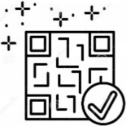

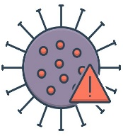









Case study
Public App store
(for free)
1. Few downloads can tackle the final aim
WHERE IS VALUE?
2. Not using the App (even if installed) reduces the solution’s validity
3. Not ‘engaged’ people doesn’t help enough
Local Area Alert (not in Italy)
3
QR check-in (not in Italy)
1
Risky contacts
(tested positive person)
Warning with notifications
2
Data privacy guaranted
Population reached (activated)
Automatic tracking (contact tracing)
Call for competent local support
Anonymous
users
16.1
27%
Infection trends monitoring
(in Millions)
(on the total)

Slide 27
Goals
Requirements
Agents
Value co-creation
To monitor a spread of covid-19.
To prevent covid-19 infection.
To help people to get oriented.
To protect non-infected people​
To enable normal life
To inform about the contacts ​
To provide information about current situation ​
Inhabitants
Medical institutions
Sanitary stations
PARTIALLY-CHECKED
PARTIALLY-CHECKED
MISSED
CHECKED
Contexts
Endowment
Use-cases
Value proposition
Medical – the key is to prevent the congestion of hospitals
Social – people need to understand why the must be isolated
Information about test results
  Are All Covid -19 applications
To be informed about the possible infection
To know what to do
PARTIALLY-CHECKED
PARTIALLY-CHECKED
PARTIALLY-CHECKED
CHECKED
Actions
Flows
Activities
Measures (MPI)
Send warning – this actions happens if the user is infected. The users who were in contact with him/her will be warned. ​
To monitor surrounding ​
To receive positive test information ​
Detect all close devices ​
Send information to sanitary station ​
Receive information about positive contacts​
No of installations ​
No. of informed users ​
PARTIALLY-CHECKED
PARTIALLY-CHECKED
PARTIALLY-CHECKED
PARTIALLY-CHECKED

Slide 28
Goals
Requirements
Agents
Value co-creation
To monitor a spread of covid-19.
To prevent covid-19 infection.
To help people to get oriented.
To protect non-infected people​
To enable normal life
To inform about the contacts ​
To provide information about current situation ​
Inhabitants
Medical institutions
Sanitary stations
The interaction based on information sharing (the confirmation about healthy status)​
The control on the vaccination and testing
To link to register of tests and vaccination​
Business entities – will use the app to confirm the person health status
CHECKED
PARTIALLY-CHECKED
PARTIALLY-CHECKED
MISSED
CHECKED
CHECKED
CHECKED
Contexts
Endowment
Use-cases
Value proposition
Medical – the key is to prevent the congestion of hospitals
Social – people need to understand why the must be isolated
Information about test results
  Are All Covid -19 applications
To be informed about the possible infection
To know what to do
Information about the vaccinations
Control of private data
Economic – to enable economy to run
To get proper date and place for tests and vaccination​
CHECKED
PARTIALLY-CHECKED
PARTIALLY-CHECKED
CHECKED
PARTIALLY-CHECKED
CHECKED
CHECKED
Actions
Flows
Activities
Measures (MPI)
Send warning – this actions happens if the user is infected. The users who were in contact with him/her will be warned. ​
To monitor surrounding ​
To receive positive test information ​
Detect all close devices ​
Send information to sanitary station ​
Receive information about positive contacts​
No of installations ​
No. of informed users ​
To monitor the validity of test and vaccination
No. of tests linked with app​
No of vaccinations linked with app​
No. of questions​
Get the status – get the current health status from register​
Connect to register – connect to the register of test and vaccination​
Get the information about new test or vaccination
PARTIALLY-CHECKED
PARTIALLY-CHECKED
PARTIALLY-CHECKED
PARTIALLY-CHECKED
CHECKED
CHECKED
CHECKED
CHECKED

Slide 29
Reflection
Do you find it interesting?
And useful?
Why has it remained a pure theoretical concept?
Is it too complex?
You will get the possibility to share your opinion!

