Slide 1
Basic application of Service Science
© Leonard Walletzký
2022

Slide 2
Value estimation
How to find proper value proposition

Slide 3
Problem of moral hazard
a tendency to take undue risks because the costs are not borne by the party taking the risk
The customer can affect an event he is insured against, but the seller has no power to monitor or affect this event.
ERP supplier has limited information about customers IT security
Provider has limited information about the basement of the real client´s problem
Double moral hazard
Client does not know if the provider is able to operate on the target

Slide 4
Double moral hazard
Illusion of value proposition
Provider is not able to see the basis of target
Client is not able to see the benefits of the cooperation
Both are motivated to share information and knowledge
Value proposition can not be set up

Slide 5
Example
The company needs information system to support its core business
The company has serious problems with communication with customers
But also hidden problems
processing information
time spent on one particular business case is too long – mostly caused by bad communication inside the company

Slide 6
IT company
Offers a big customised ERP system together with CMS system
CMS system has connection to Social Networks
The problem to solve is the communication
But it is not a part of the problem
IT company needs to find its paths through targets – to analyse the situation if the client

Slide 7
Value
Value proposition is hidden
is hidden by the hill
Hierarchy of barriers hiding the target
have to be overcame step by step
leads to process of value estimation
Value can not be proposed
It can be only estimated
is used to find value proposition
there is not a target, only target area
target area is the space of all sub-targets, corresponding with particular value estimation

Slide 8
Value estimation
modified by the value co-creation process
motivated by the decreasing of the level of information asymmetry of both parties
the process is about particularize of value estimations
till the moment of founding the value proposition

Slide 9
Value proposition
can be found in the moment client and provider can see the target
share the same point of view
both can see the utility level
and share as well
both partners agree with concrete mutual criteria of success
variables to test
no of customers
profitability
target values
number of customers rise of 30%
profitability rises more than 10%

Slide 10
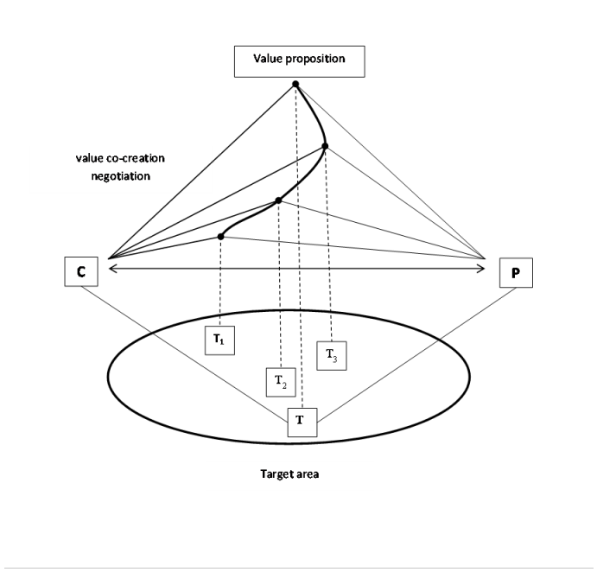
Value proposition

Slide 11
Costs of value estimation
must be shared and paid
problem is complex
must be understood and explored
provider must be paid for using his sources to do it
Client is paying for the analysis of the target area

Slide 12
Software as a Service
How to communicate with normal managers

Slide 13
History
60s
Centralized hosting of business applications
service bureau
company which provides business services for a fee
eg. IBM
time-sharing
sharing of a computing resource among many users by means of multiprogramming and multi-tasking
utility computing
a service provisioning model in which a service provider makes computing resources and infrastructure management available to the customer as needed, and charges them for specific usage rather than a flat rate
mainframes

Slide 14

History
90s
Application Service Provider (ASP)
thanks to expansion of the Internet
class of centralized computing
services of
hosting
managing specialized business applications
reducing costs through
the solution provider's specialization in a particular business application
central administration

Slide 15
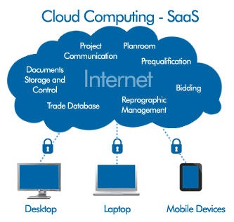
History
2001
Software as a Service
extends the idea of the ASP model
software vendors
first ASPs were focused on managing and hosting of third-party independent software vendors' software
SaaS
typically develop and manage their own software

Slide 16
History
application clients
ASP
Client - Server
initial ASP used thick clients
SaaS
Thin Clients
Web browsers
software architecture
ASP
maintaining a separate instance of the application for each business
SaaS
utilize a multi-tenant architecture
multiple businesses and users

Slide 17
Applications
Well known SaaS
Gmail
Google Drive
Office 365
Messaging
DBMS software
management software

Slide 18
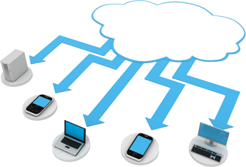
Architecture - provider
Cloud
Cloud Service models
support of scalability
horizontal scaling
the application is installed on multiple machines
tenant

Slide 19
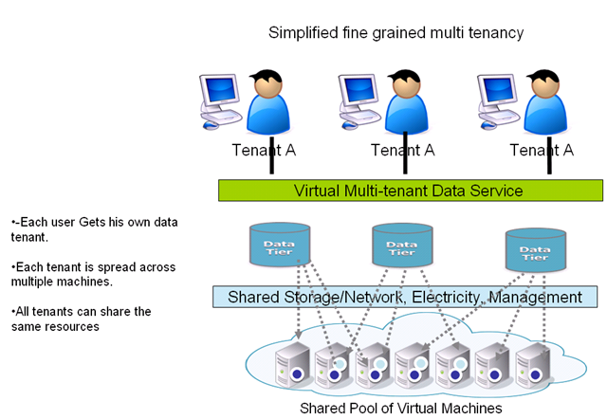
Architecture - provider
multi-tenant services
Vast majority of SaaS solutions
a single
version of the application
configuration
hardware, network, operating system
advantage in comparison with traditional software
multiple physical copies
potentially different versions
different configurations

Slide 20



Architecture - client
Thin Client
Web Browser
Hybrid
Dropbox
For integration with internal systems
Application programming interfaces

Slide 21
Business models
Subscription fee
Freemium
User
Time unit
typically
month
annual
Transaction
Support
Advertising
basic functionality is for free
restrictions in
capacity
functionality
support
users
time
bandwidth
money are charged for
proprietary functions
functionality
...
multi-tenant

Slide 22
How to describe to managers?
Managers are not IT experts
They are focused on core business of the companies
They understand the language of the money
They see IT as the source of problems and non stability
Positive
Strengths
Opportunities
Negative
Weaknesses
Treats

Slide 23
Strengths
Less risky
Immediate
Reduce IT support costs
Initial setup cost for SaaS is typically lower than the equivalent enterprise software
Architecture
Economy of Scale
Enables Mashups

Slide 24
Low risk level
Customer
Lower initial investment
Software and hardware
Even the long time usage price is higher
Compare with better ROI (return of investments)
Avoiding the peaks of cash flow (the highest danger is based on unexpected costs)
Example
CRM or ERP system
Provider has regular income

Slide 25
Immediate
SW deploy
Updates
more often
update is decided and executed by provider, not by customer
single configuration
faster testing
vendor has access to
all customer data
expediting of design
regression testing
analytics of user behaviour

Slide 26
Weaknesses
Migration of data
Integration of clients
Tailored customization
Can't directly access a company's internal systems
Customer might be forced to use a new versions

Slide 27
Opportunities
SaaS Integration Platforms
Complex systems that integrates particular services
CRM
ERP
Growth of SaaS sales on global market
Enables Mashups
integrating content from more than one SaaS
to create a single new service displayed in a single graphical interface

Slide 28
Threats
Unreliable provider of the service
Bankrupt
The physical presence of data
Security and privacy
is common corporate infrastructure more secured than data centres of cloud?
HTTPS
Connection
Latency
Reliability

Slide 29
Sence of SWOT
SaaS is only one from many solution
Task is to give proper service for concrete situation
Managers need to understand
Advantages
Risks
To have real expectations

Slide 30
Conclusion
SaaS is one way to distribute service
In many points of view has positive influence to both parties business
Needs to be described and set properly
Estimation of the value
Process of target understanding

