Slide 1
Seminar Organization
PB007 Software Engineering I
Lukáš Daubner daubner@mail.muni.cz

Slide 2
In this seminar…
Work, work
Introduction
Requirements
Project groups

Slide 3
Why do we do this anyway?

Slide 4
Why do we do this anyway?

Slide 5
Why do we do this anyway?

Slide 6
Why do we do this anyway?

Slide 7
Why do we do this anyway?

Slide 8
Why do we do this anyway?

Slide 9
Why do we do this anyway?

Slide 10
Requirements
Responsibilities, deadlines and bad stuff :/
Attendance
Seminars are mandatory!
Max. one unexcused absence allowed (1st seminar does not count)
More than 1 unexcused absence means -5 points to the final score
Project
Group project (3 students)
Weekly submission of PDF report to homework vault
Deadline is 48h before the next seminar session – midnight Sunday to Monday
Late submission means -5 points to the final score
Bonus points for early project completion
Project completion is required for exam admission

Slide 11
Requirements
Responsibilities, deadlines and bad stuff :/
Questionaries
Graded tests at the beginning of each seminar (starting from 3rd seminar)
You can get 2 points for each tests, and there are 10 tests in total
The test will cover the topic of that week’s seminar
Bonus points
For improving grade – do not help towards E
Max. 5 points
2 points for early successful completion of the final project

Slide 12
Tools
Grab your sword and fight the Horde!
Visual Paradigm
Version 17
https://www.visual-paradigm.com/download/
License key in Seminar syllabus
Academic license for 1 year
For educational purposed only
Checked at each program start

Slide 13
Information sources
Would you like to know more?
Visual Paradigm tutorials
https://www.visual-paradigm.com/tutorials/
UML tips
http://www.agilemodeling.com/style/
Seminar syllabus
Demo seminars
Catalogue of UML mistakes
https://lasaris.fi.muni.cz/students/uml-catalogue

Slide 14
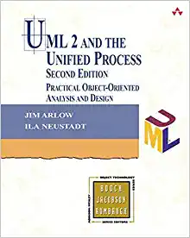
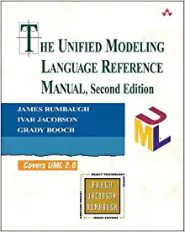
Information sources
Would you like to know more?
UML 2 and the Unified Process
Jim Arlow, Ila Neustadt
detailed explanation of the UML diagrams, tips, examples,. . .
The Unified Modeling Language Reference Manual (2nd Edition)
James Rumbaugh, Ivar Jacobson, Grady Booch
semantics for UML elements

Slide 15
Would you like to know MORE?
PV226 Seminar LaSArIS
Be informed about research activities
Be involved in research activities
See https://is.muni.cz/auth/predmet/fi/podzim2022/PV226

Slide 16
Task for this week
You gotta do what you gotta do
Read the project assignment
Think about the requirements on the system form user roles
Write them down as appropriate
Create a team and figure out a name
Create a VP project
Figure out project sharing (OneDrive, Dropbox, Git, etc.)
Beware! Visual Paradigm is very bad in concurrent access
Work on your local copy. Editing on cloud is fishy.
You don’t have to submit anything this week

Slide 17
Visual Paradigm – report settings

