Slide 1

Requirements Specification,
Use Case Diagram
PB007 Software Engineering I
Lukáš Daubner
daubner@mail.muni.cz

Slide 2
We must do EXACTLY as written!
Let’s brainstorm…

Slide 3
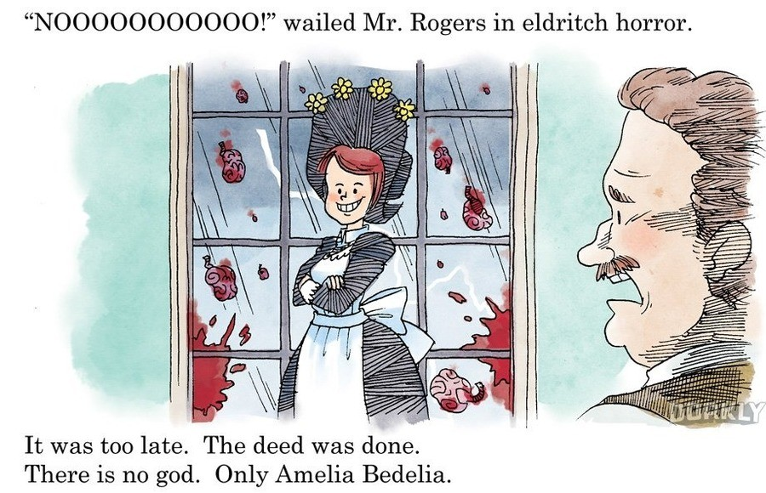
We must do EXACTLY as written!

Slide 4
Functional Requirements
Functional requirement tells WHAT the system should do (or should not do), i.e., describes the system’s functionality.
  Common format: <id><system><function>
Examples:
  1. The ATM verifies the validity of inserted card
  2. The ATM verifies the PIN provided by the customer
  3. The ATM does not allow to withdraw more that 10 000 CZK for a single card
  within 24-hour period

Slide 5
Non-functional Requirements
Non-functional requirement is a constraint imposed on the system. Often related to (quantitative) attributes like performance, security, availability, etc. It also includes environment and regulatory constraints.
  They must be testable!
Příklady:
  1. The ATM will be programmed in Rust
  2. The ATM will use 256-bit AES encryption for communication with bank
  3. The ATM will verify the card validity in less than 3 seconds.

Slide 6
Why do we distinguish between them?
Taxonomy
Functional requirements are modelled in this course
  It is relatively easy to do so
  Easy to have an overview what is done and what needs work
Non-functional requirements are tougher
  Could be hidden
  Could be forgotten
  Could require specialized test cases, or approaches

Slide 7
Use Case Diagram
Use Case Diagram is a method to capture FUNCTIONAL requirements in graphical way.
A.K.A. The most important UML diagram ^{[citation needed]}
It consists of:
  System boundary
  Actors
  Use cases
  Relationships

Slide 8
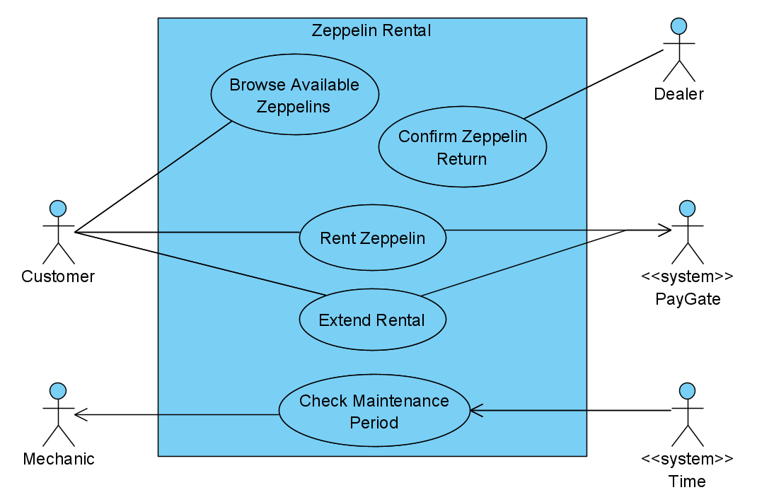
Use Case Diagram
Example

Slide 9
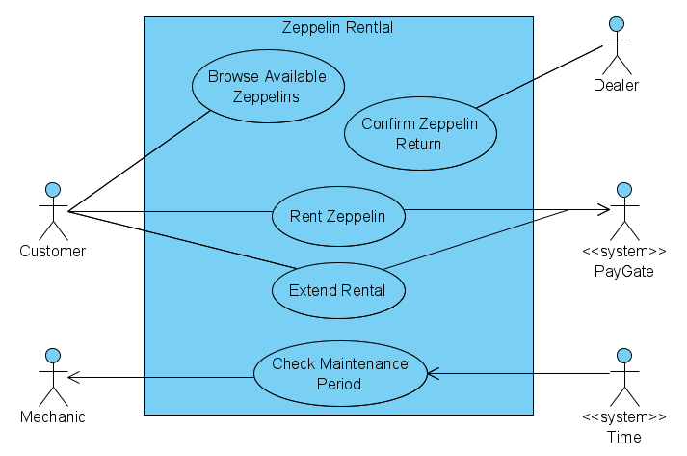
Use Case Diagram
Actors
A role that represents some external entity
  External with respect to system
  Directly communicate with the system
  They are not a single specific person
  On the other hand, a specific person can act as multiple actors, which could change over time
  Actor must have meaningful name
  Actor should have short description

Slide 10
Use Case Diagram
How to identify actors
Who or what uses the system?
What role they have in the interaction with the system?
Are there any other systems involved?
Who/what sends/receives data to/from the system?
Are there any events occurring periodically?

Slide 11
Use Case Diagram
Use Cases
Describes an interaction between the system and external actors. Actions that actors perform in the interaction.
  Use case always begins with some action initiated by actor (primary actor)
  Other actors might join this interaction (secondary actors)
  Use cases are described from actors' point of view
  The name should represent an activity or behaviour

Slide 12
Use Case Diagram
How to identify actors use cases
What systems’ functions in required by a particular actor?
Does the system store or retrieve some data? Who triggers it?
What is happening when a system state changes? Are actors notified about it?
Are there any external events that affect the system? What alerts the system about these events?

Slide 13
Use Case Diagram
How to model it
Recommended steps:
  Define the system boundary
  Find actors
  Find use cases
  Determine relationships between actors and uses cases
  Specify use cases in detail

Slide 14
In this seminar…
Work, work
Activity – Functional & Non-functional requirements
Visual Paradigm demo
Team work on project
  Use case diagram

Slide 15
Task for this week
You gotta do what you gotta do
Create a list of functional and non-functional requirements as a numbered list in the use case diagram specification
  Order the functional requirements according to the user roles
  Formulate 3 non-functional requirements (make them up)
Based on the requirements list, create initial use case diagram
  Meaning actors, use cases and communication associations between them
Look for gaps in the project specification and ask about information you are missing.

