Slide 1

Use Case Diagram II,
Textual Specifications
PB007 Software Engineering I
Lukáš Daubner
daubner@mail.muni.cz

Slide 2
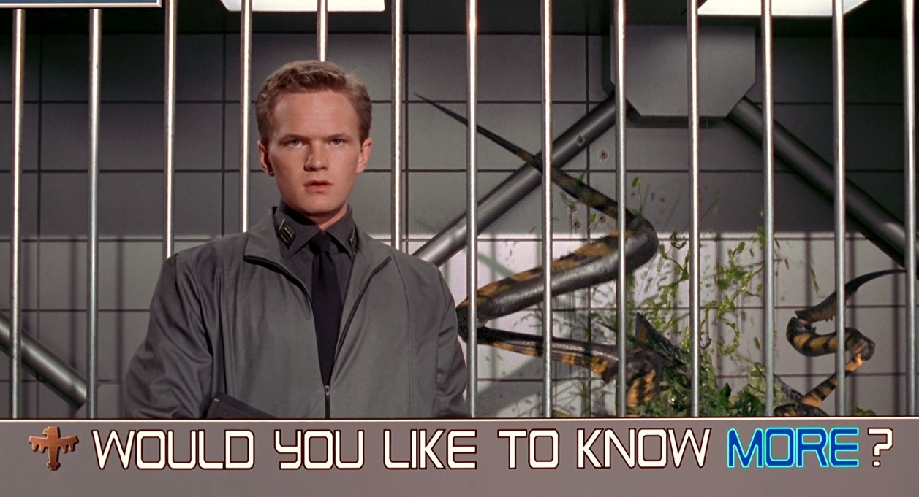
Use Case Diagram – There is more…
Diagram is more expressive
  Inheritance (generalization) of actors
  Inheritance (generalization) of use cases
  “Shared” use case – Include
  “Modular” use case – Extend

Slide 3
Actors Generalization
Relationship between the more general and specialized actors
For simplifying the diagram
General actors are often abstract, i.e., not a real role
A descending actor inherits all roles and parent link. Every time it is expected the use of a parent actor, we can use one of the descendants

Slide 4
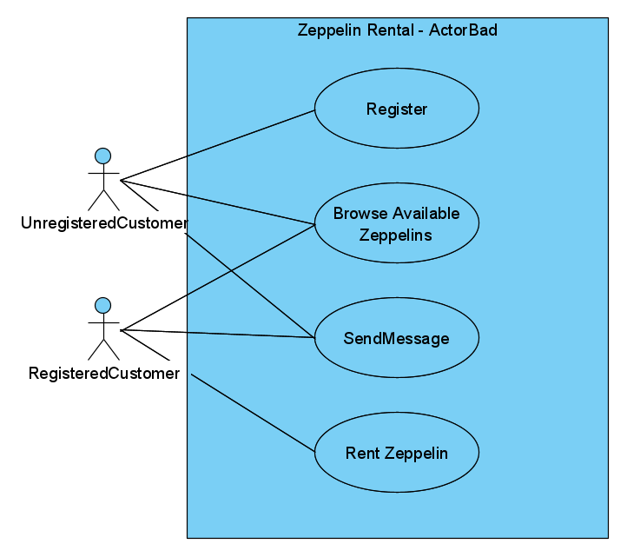
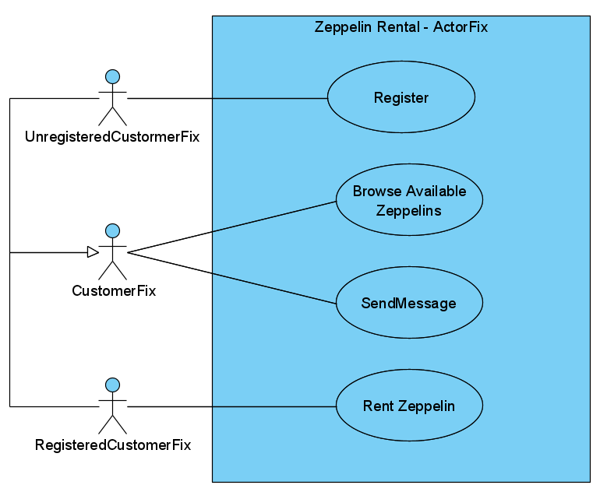
Actors Generalization – Example

Slide 5
Use Case Generalization
relationship between the general and specialized use cases
A specialized use cases inherits the properties, and add new features by overloading (changing) the inherited properties
  It cannot overload the parents’ extension points
The textual specification should reflect those changes
Parental use cases can be abstract (recommended)
  Either no specification or incomplete specification of the flow of events

Slide 6
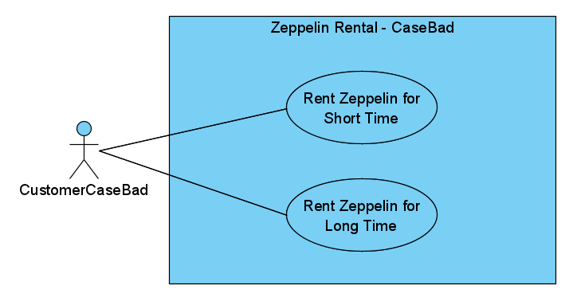
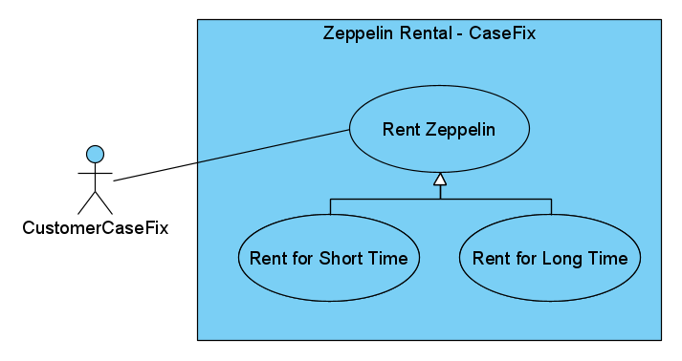
Use Case Generalization – Example

Slide 7
Include
Specialized type of relationship
Allows you to allocate repetitive steps in several use cases in separate use case
The basic use case is incomplete without all the embedded use cases

Slide 8
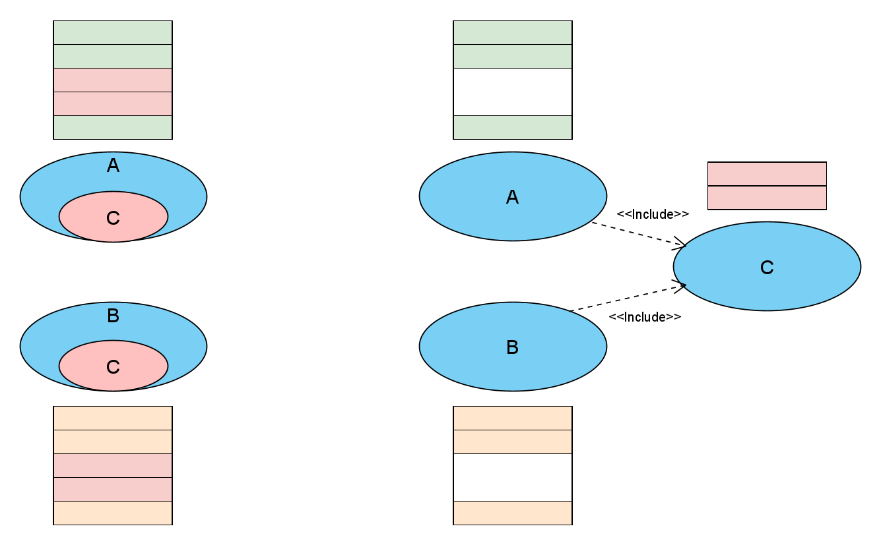
Include

Slide 9
Include

Slide 10
Extend
Specialized type of relationship
Allows insertion of new behaviour into base use case
  The extension is transparent for the use case – the base do not know about extensions
It is inserted at specifically defined points (extension points)
The extending use cases hooks on the extension points
  It is possible to define conditions or hook multiple use cases on one extension point

Slide 11
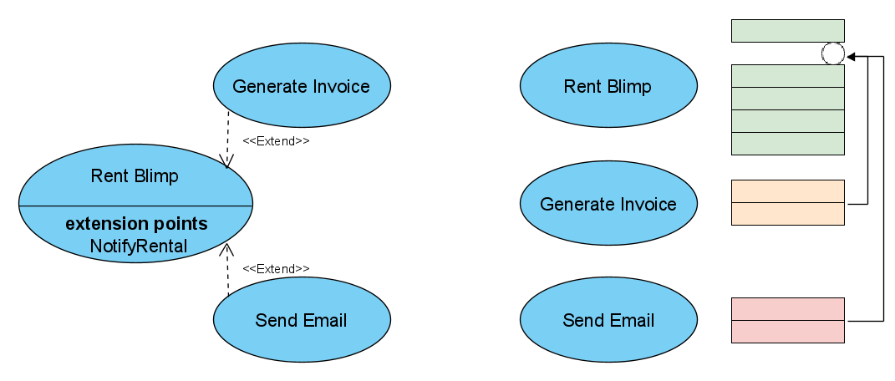
Extend

Slide 12
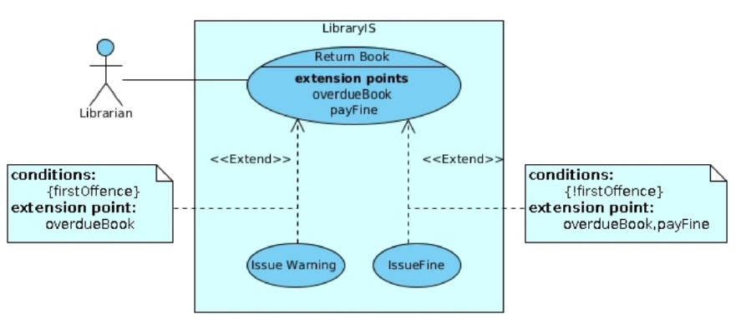
Extend

Slide 13
Textual Specification of Use Cases
Detailed and structured description of a use case
It should include:
  Name and ID
  Brief description
  Primary and secondary actors
  Input and output conditions
  Main flow of events
  Alternative flow of events

Slide 14
Flow of Events – Main Flow
Sequence of steps of interaction with the system in the ideal case
  (free from errors, interruptions, …)
Written as: <step id> <actor/system> <action>
Begins with some action from primary actor
  Recommended form is: 1. The use case begins when <actor> <action>
You can use keywords IF, FOR (FOREACH), WHILE

Slide 15
Flow of Events – Example
1. Use case starts when Customer opens rental form
2. INCLUDE(Find Available Zeppelins)
3. System displays zeppelins available for rental
4. Customer chooses zeppelin to rent
5. WHILE form is not valid
5.1 Customer fills personal information
6. Customer submits the form
EXTENSION POINT(NotifyRental)
7. System saves rental request

Slide 16
Flow of Events – Alternative Flow
The same formatting rules as for the main flow
Represents deviations from the main flow due to errors or interruptions
It can also be used to capture more complex branching, such as situations that are not exactly known if and when they will occur

Slide 17
In this seminar…
Work, work
Visual Paradigm demo
Team work on project
  Use case diagram II

Slide 18
Task for this week
You gotta do what you gotta do
Revise the use case diagram and think using the new constructs
  At least one include/extend should be applicable
(Wire a brief description for all use cases)
  ~2 sentences
Choose 3 use cases and create full textual specification
  Choose the more complex ones to make more sense
  Mark them on diagram (colour)

