Slide 1

Activity Diagram
PB007 Software Engineering I
Lukáš Daubner
daubner@mail.muni.cz

Slide 2
Activity Diagram
What can the activity diagram represent?

Slide 3
Activity Diagram
What can the activity diagram represent?
Activities – Who would have guessed ;)

Slide 4
Activity Diagram
What can the activity diagram represent?
Activities – Who would have guessed ;)
  Use Cases
  Business Processes
  Algorithms
  Operations, methods, ...

Slide 5
Activity Diagram
Flow of events and actions in an activity
It consists of different types of nodes, connected with edges
  Action
  Event (asynchronous behavior)
  Time events
  Parallel flow
  Branching
Typically, it is a sequence of commands (Control Flow), but data can be represented as well (Object Flow)

Slide 6
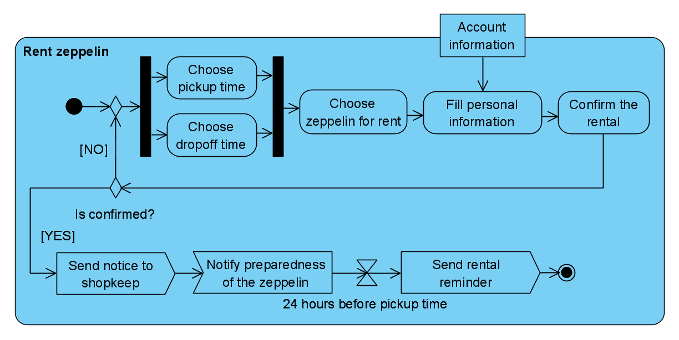
Activity Diagram – Example

Slide 7
Swimlines
Logical grouping of related actions
  Context of actors, use cases, etc..
If use case is modelled, they can be «include» and «extend»
«include»
  Base and included use case have their own swimlanes.
«extend»
  If there is an extension point between two actions, decision node is added in between, from which it is possible to move to the extended use case. Afterwards, the control is returned by merge node.
  Base and extended use case have their own swimlanes.

Slide 8
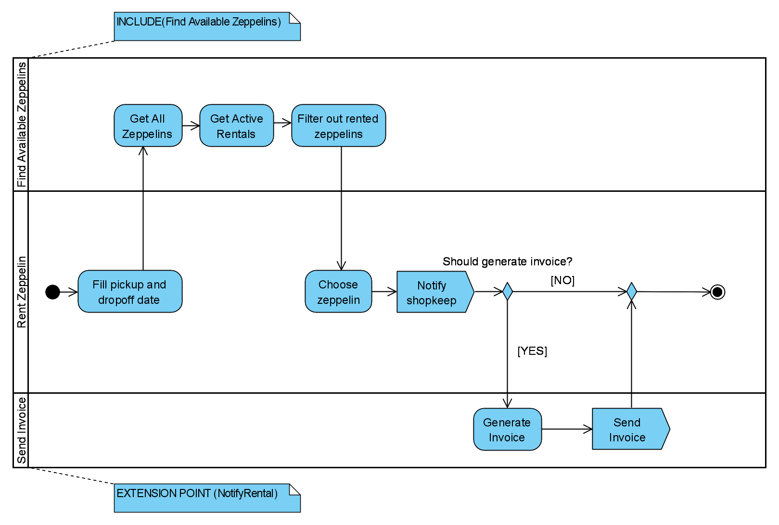
Swimlines – Include & Extend

Slide 9
In this seminar…
Work, work
Visual Paradigm demo
Feedback
Team work on project
  Activity Diagram

Slide 10
Task for this week
You gotta do what you gotta do
Process the feedback
Choose two use cases and create activity diagrams for them
  Adequately™ complex (meaning no three-action diagrams)
  Choose different use cases than those for textual specification
Submit the report
  Don’t forget to include work from previous weeks

