Slide 1

Design Class Diagram
PB007 Software Engineering I
Lukáš Daubner
daubner@mail.muni.cz

Slide 2
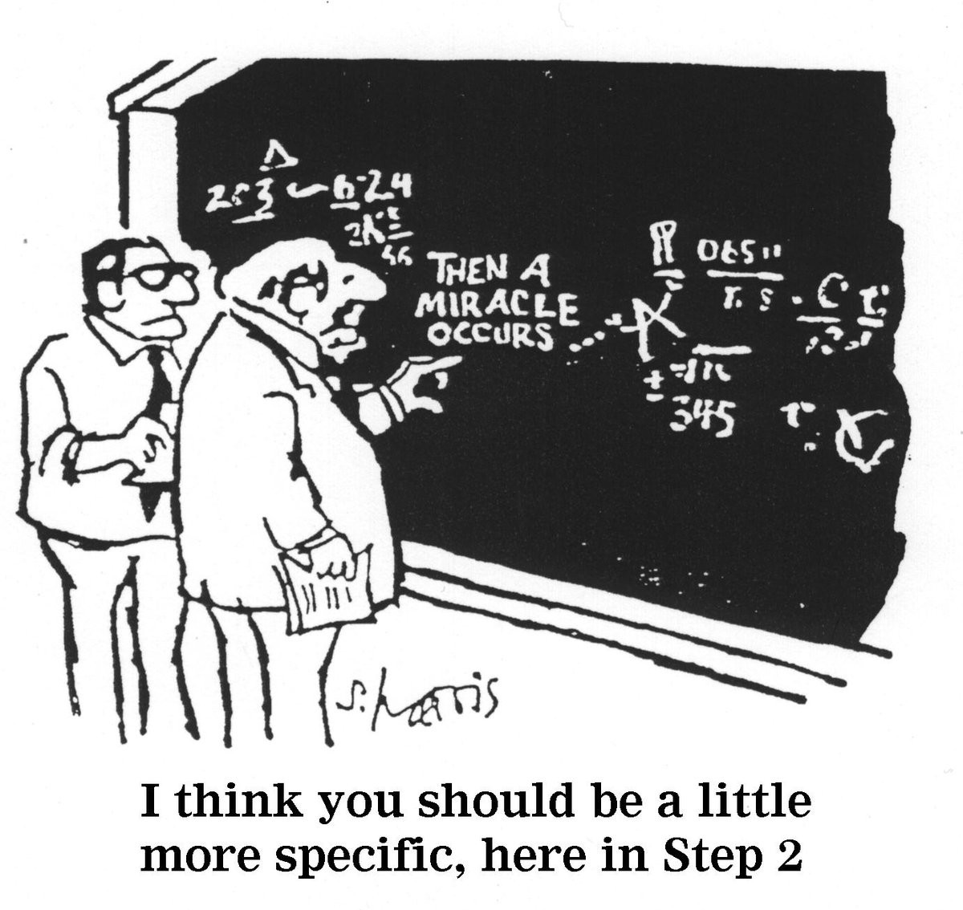
Design Class Diagram
Focus on implementation details
It goes further than capturing domain
  Solutions to more technical problems
Extends and enrich the analytical
class diagram

Slide 3
Design Class Diagram
How should it look like?
All that you need for implementation
  Except method body (we will get to that)
Detailed specification of analytical class
Technology-related class (Service, Controller, DBContext, etc.)
Visibility and types are specified
  Attributes
  Method arguments
  Return values
Constructor
Properties (Getters, Setters)
Methods needed for implementation

Slide 4
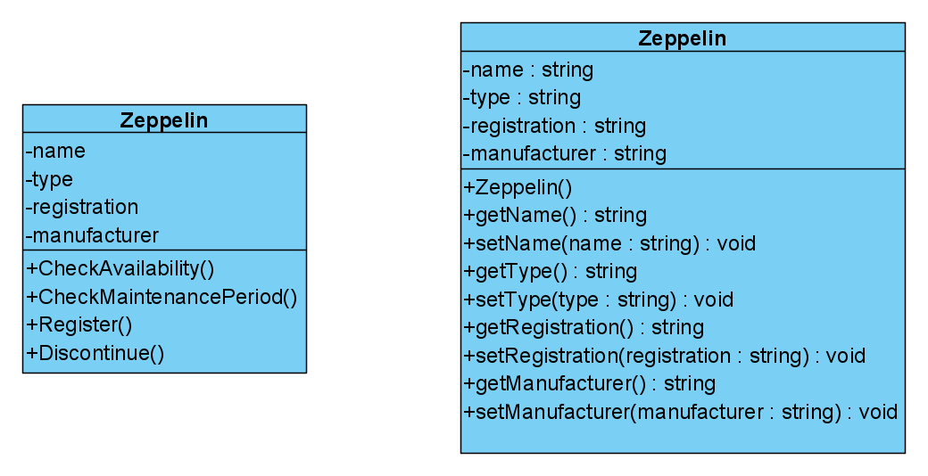
Design Class Diagram
Analytical VS. Design class

Slide 5
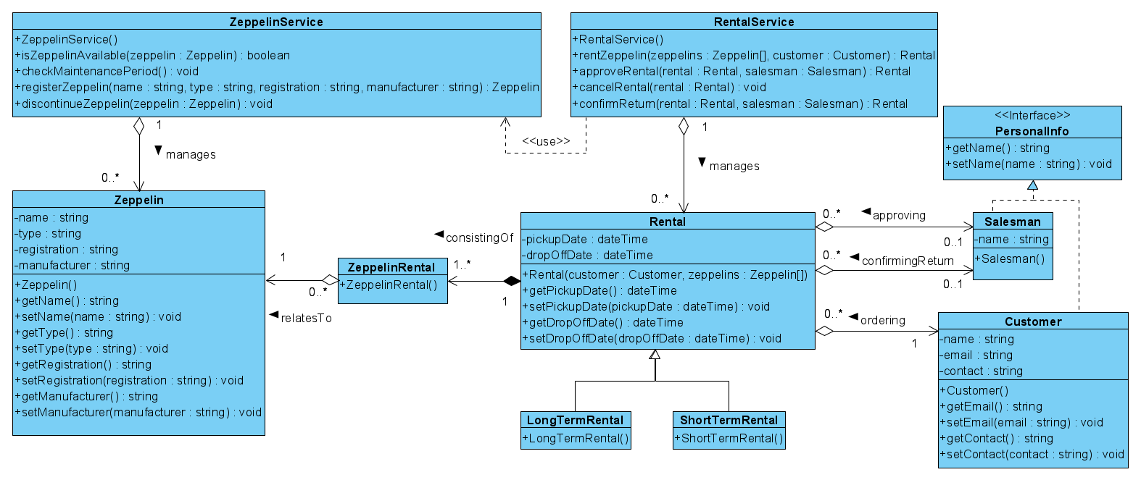
Design Class Diagram – Example

Slide 6
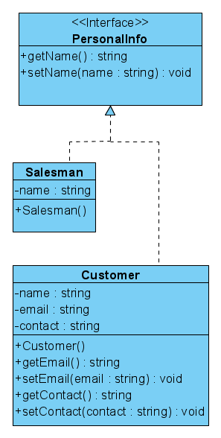
Interface
Defines set of public services
  Methods
  Attributes
  Relationships
Does not contain implementation
Defines so called “Contract”

Slide 7
Specialized Associations
Specification of aggregation and composition (see following slides)
  There is a lot of confusion regarding this topic.
  See https://bellekens.com/2010/12/20/uml-composition-vs-aggregation-vs-association/
Names, navigability, and multiplicities
  Afterall, it is an important part of the specification
Decomposition of bidirectional associations
Decomposition of M:N associations and association classes

Slide 8
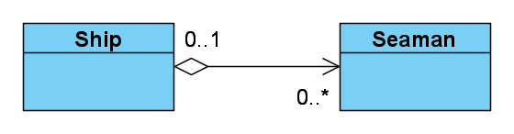
Specialized Associations – Aggregation
Whole-part relationship
  The whole may and may not exit without its parts
  Parts can exist independently from the whole
  The whole is in some sense incomplete if some parts are missing (but still valid)
  Parts can be shared by multiple wholes
Transitive and asymmetrical (without cycles)

Slide 9
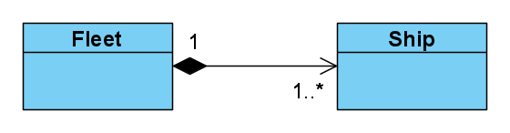
Specialized Associations – Composition
“Stronger” form of aggregation
  The part belong to exactly one whole in the given time
  The part is not valid without the whole
  The whole is responsible for lifecycle of its parts
  When deleting, the whole must take care of its parts (delete or transfer them)
Transitive and asymmetrical (without cycles)

Slide 10
Aggregation vs. Composition
Code comparison
public class Ship
{
private Engine _engine;
public Ship(Engine engine)
{
_engine = engine;
}
}
public class Ship
{
private Engine _engine;
public Ship()
{
_engine = new Engine();
}
}

Slide 11
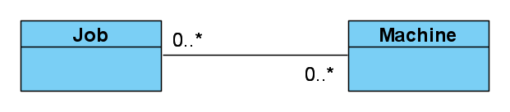
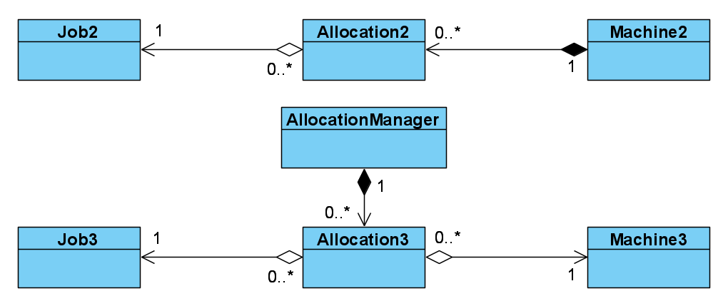
Association Decomposition – M:N
Analytical
Design
  Decompose if there is
  a need for additional attributes
  Someone must “own” it

Slide 12
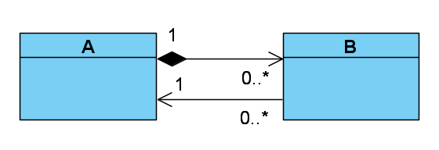
Association Decomposition – Bidirectional
Someone must “own” it
  To ensure consistency

Slide 13
Task for this week
You gotta do what you gotta do
Process the feedback
Copy and extend analytical class diagram to design class diagram
  Add all required methods, properties, constructors, etc.
  Specialize and decompose associations when suitable
  Type everything
  Add technology-related and service classes
NB! Do not delete the original analytical class diagram

