Slide 1

Getting Dynamic,
State Machine Diagram
PB007 Software Engineering I
Lukáš Daubner
daubner@mail.muni.cz

Slide 2
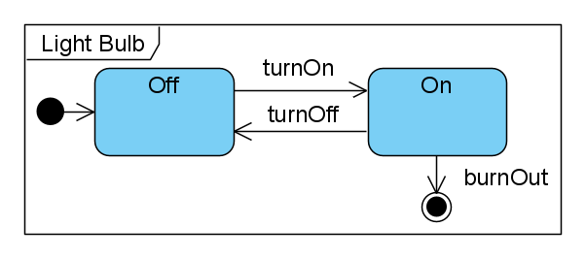
State Machine Diagram
Models the dynamic behavior (life cycle) of one subject
  Class instantiation (Object)
  Use Case
  System
  Subsystem
  Component
  …
Main components are:
  States
  Transitions
  Events
Event
State
Transition

Slide 3
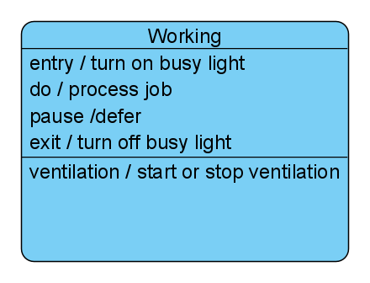
State Machine Diagram
States
Represents semantically important situation
In case of (OOP) object, it is determined by attribute values, relations with others, and performed activity.
Entry action
Performed when entering the state
Deferrable Trigger
Event, which is registered but its
processing is left for other states
Internal activity
Ongoing behavior while
in the state
Exit action
Performed when exiting the state
Internal Transition
Transition, which is processed
without exiting the sate

Slide 4
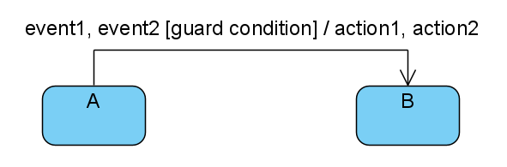
State Machine Diagram
Transitions
Defines how to get from one state to another
Syntax: event [guard condition] / action
Semantics: At the occurrence of event, if the guard condition holds, perform action and go to the new state.
Event
Condition (bool)
Action

Slide 5
State Machine Diagram
Events
Stimulus on which the subject may react by changing the state or performing an operation.
Types of events:
  Call event – Calling operation of the subject.
  Signal event – Asynchronous sending a receiving a signal between subjects
  Change event – Boolean expression. The event occurs when the value is changed from false to true.
  Time event – Event occur at a certain time t (when(t)) or after a certain time t (after(t)).

Slide 6
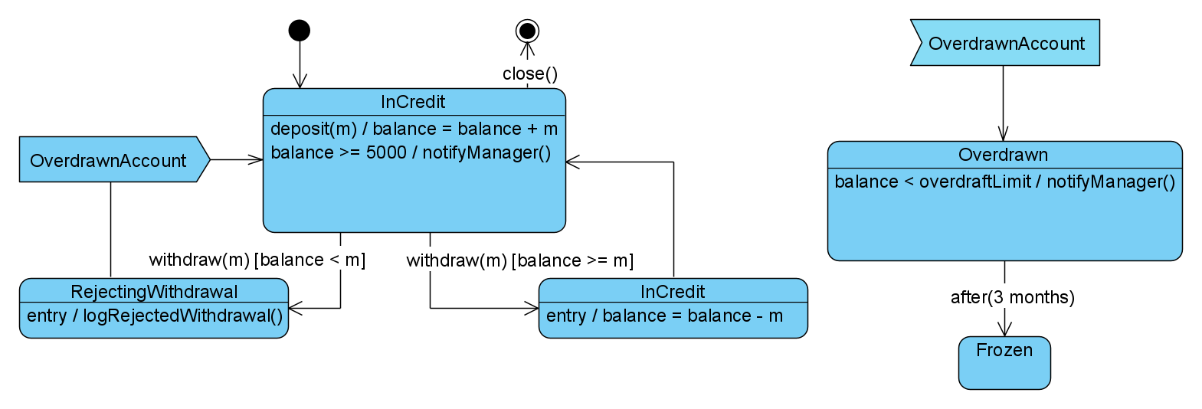
State Machine Diagram
Events
(excerpt from diagram)

Slide 7
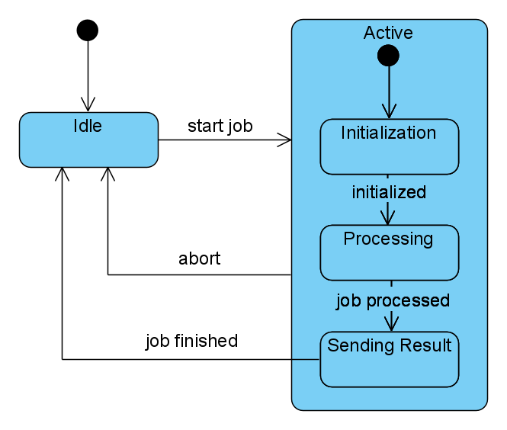
Composite States
Simple composite state
Useful for simplifying the diagram
Capturing inheritance between states
Consist of a single region

Slide 8
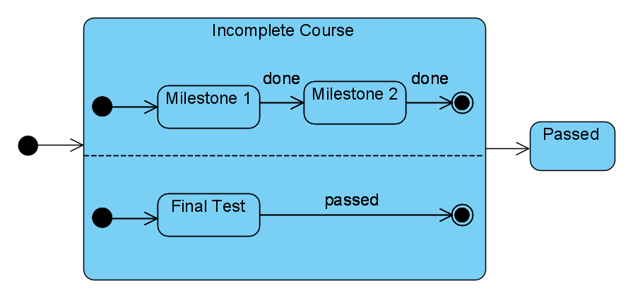
Composite States
Orthogonal composite state
Capturing parallel behavior
Consist of a two and more regions

Slide 9
State Machine Diagram in OOP world
In our case, state machine diagram is used to represent lifecycle of an object
Context of the diagram is only the instance of a class from design class diagram
  All methods and events must be supported by the design class diagram
Initial transition means calling the constructor
Final transition means deleting the object from system
Object saves its state even outside main memory (persistence)

Slide 10
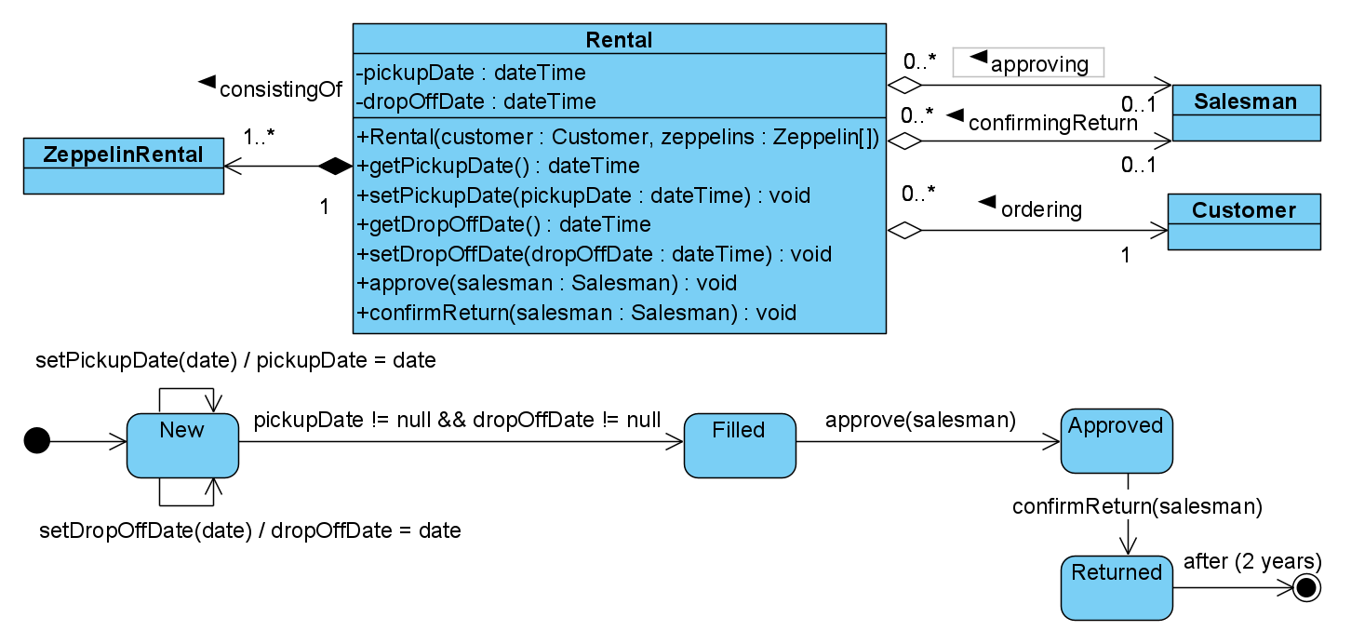
State Machine Diagram in OOP world

Slide 11
Task for this week
You gotta do what you gotta do
Process the feedback
Choose a suitable object for modeling - ride
  Something with non-trivial lifecycle
Create a state machine diagram for this object
  Revise design class diagram if needed

