Slide 1
Object Diagram
PB007 Software Engineering I
Lukáš Daubner daubner@mail.muni.cz

Slide 2
Sequence Diagram
The name of the diagram should ideally be according to the UC we are modelling
The actor is not an object and accesses the system usually through service classes (services / managers)
Objects do not appear out of nothing

Slide 3
Object Diagram
Instance of Class Diagram
Well, duh!
Represents a snapshot of a system state in a given time
Objects with values and their relationships in a particular moment
It is still a static view of the system
The dynamics frozen in time

Slide 4
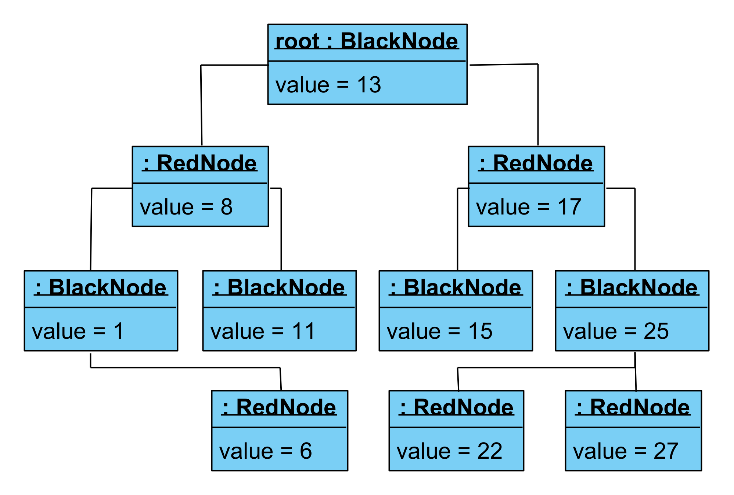
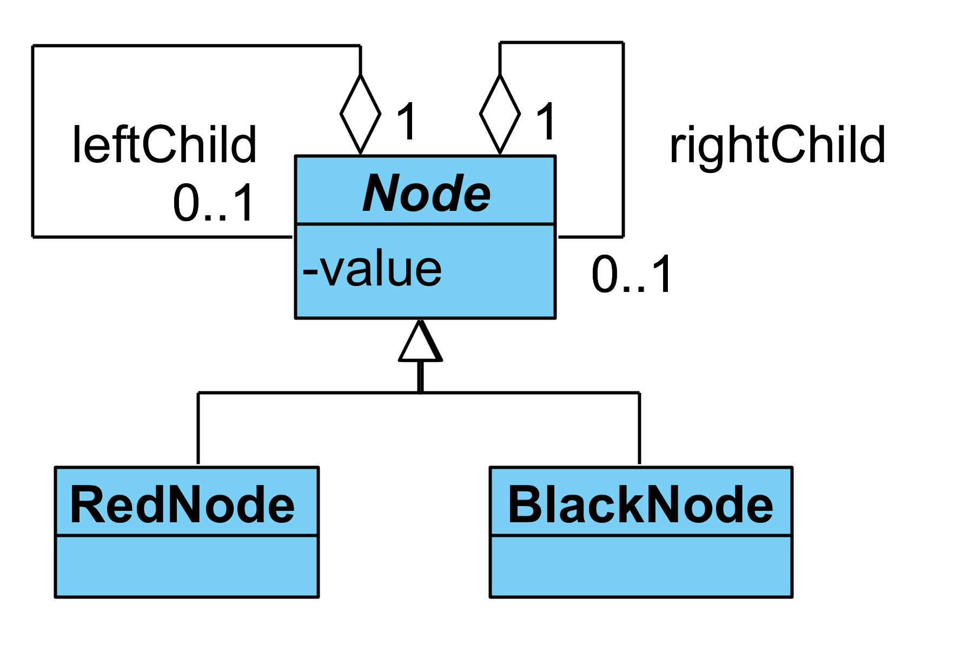
Object Diagram – Example

Slide 5
Object Diagram – Why?
Verify the correctness of a Class Diagram
Especially for some complicated case
Illustrate and highlight some facts
Clarify complex relationships in Class Diagram
Understand behavior in a specific moment
Essentially it is “hitting a breakpoint” in debugger
But in a visual form

Slide 6
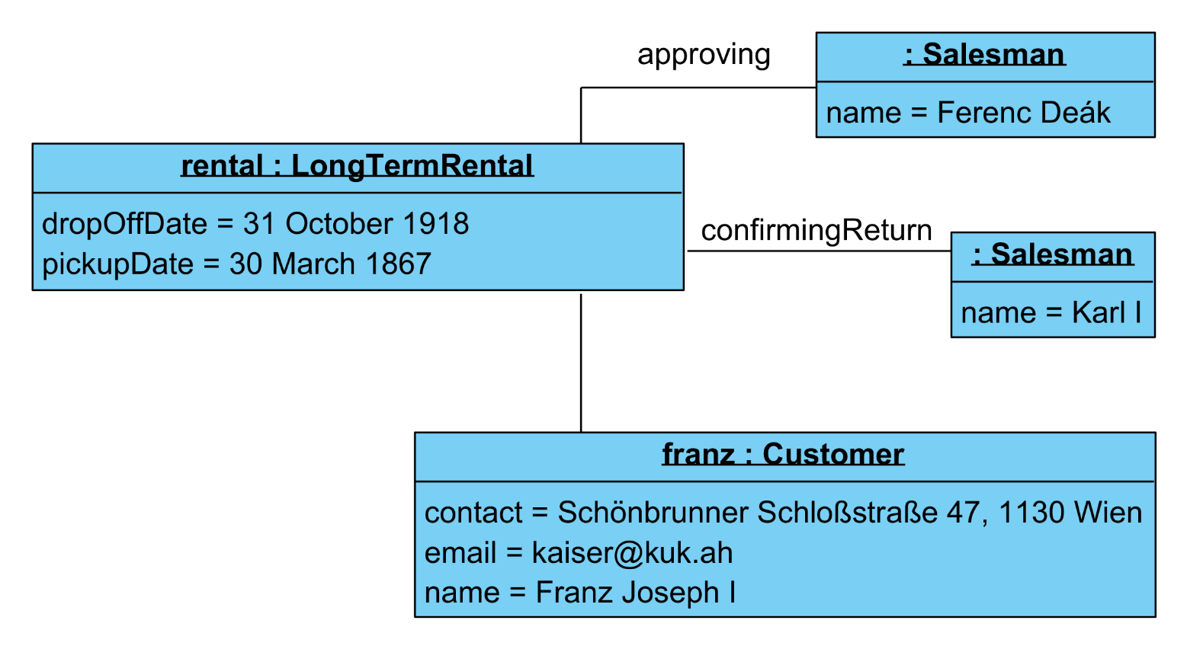
Object Diagram – Components
Anonymous Object
Rather underdefined in UML 2.5.1
Objects
Instances of Classes
Optional name
Mandatory type
Fields with values = slots
Links
Instances of Associations
Sometimes you can see multiplicity, etc., but it is not standard
<Name> : <Type>
Slot
Link
Object

Slide 7
Task for this week
You gotta do what you gotta do
Process the feedback
Based on the Design Class Diagram, think about its interesting and complicated instantiations
Something you want to emphasize
Use Case Diagram and Activity Diagram should help you in finding it
Choose two cases and model them into two Object Diagrams
If you need to change something in Design Class Diagram, just do it, no worries.
Just make sure that the changes are consistent across your project
Write short description explaining which situation they represent

