Slide 1

Package, Component,
Deployment Diagram
PB007 Software Engineering I
Lukáš Daubner
daubner@mail.muni.cz

Slide 2
Package Diagram
Groups related elements and depicts dependencies between them
The elements can be classes, use cases, etc…
It includes:
  Packages – represents logical grouping of elements and define their namespace
  Dependencies – indicates dependency of elements form one package to another
From object point of view, it is package/namespace like it is in OOP programing languages
  Dependencies are then usage of “include/using” keywords

Slide 3
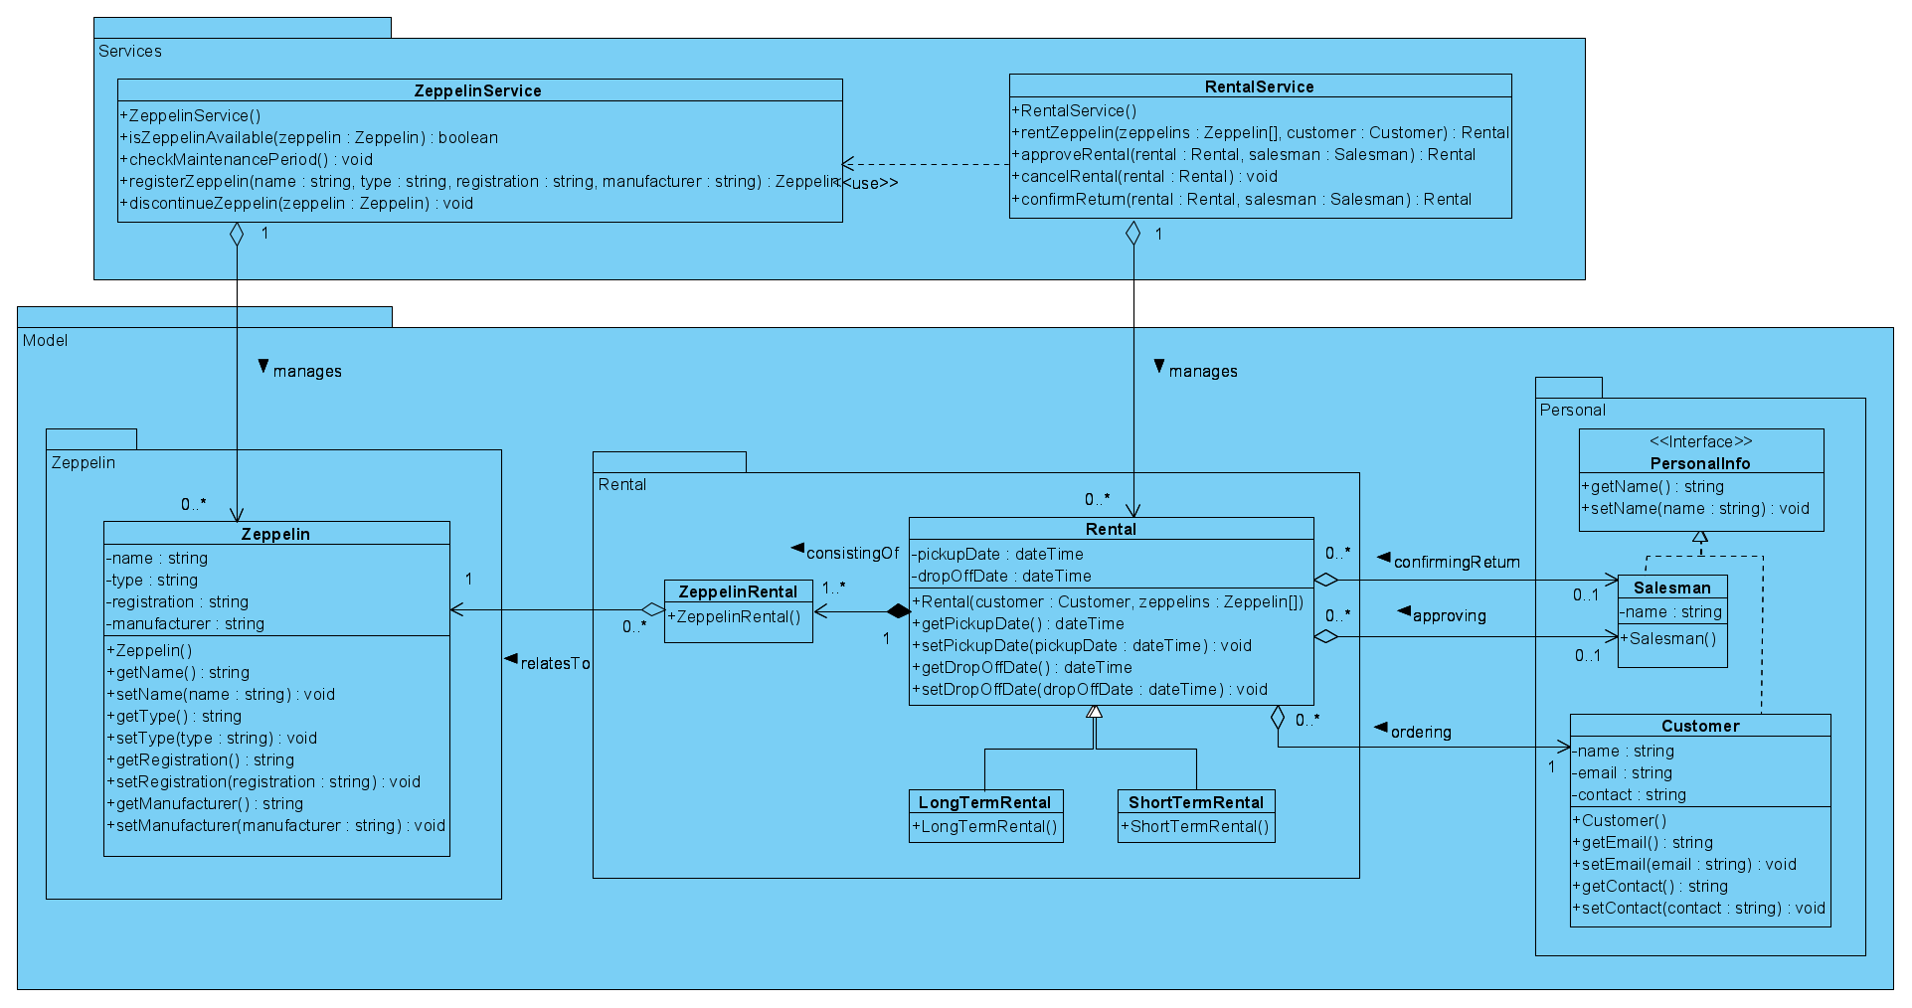
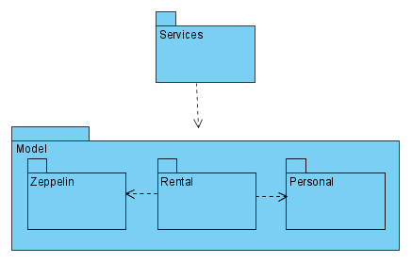
Package Diagram – Example

Slide 4
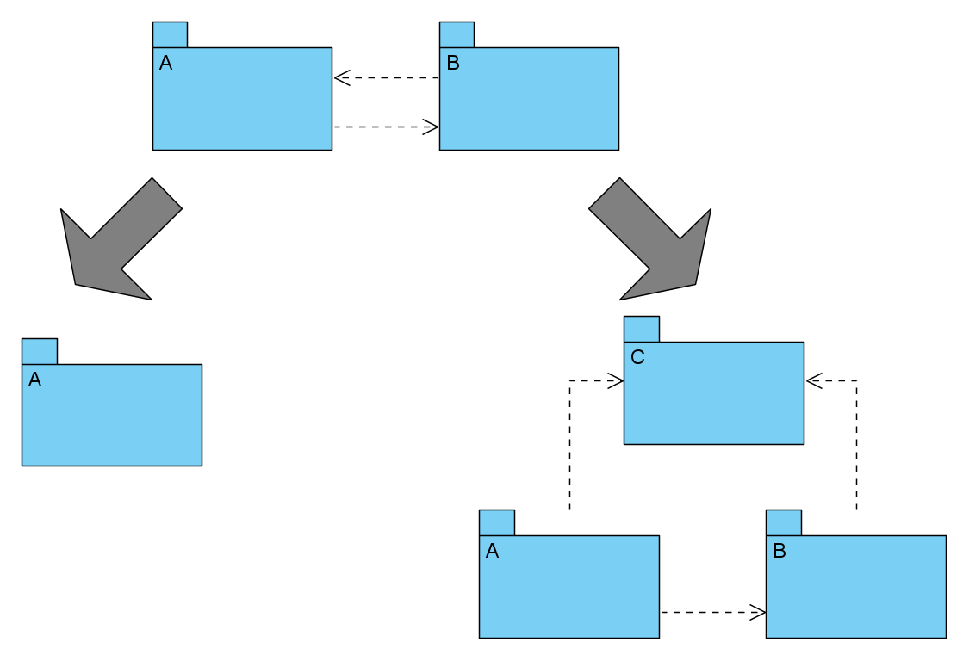
Package Diagram – Circular dependency
All circular dependencies must be resolved
  They can’t be implemented
Either by merge or split

Slide 5
Component Diagram
Captures architecture of the system
Modeled all parts of system
  Executable files
  Libraries
  Static files
  Database schema
  Etc…
Captures dependencies between components, especially interface
Interface is contract used for communication between components
  Provided interface – What the component can do
  Required interface – What the component need

Slide 6
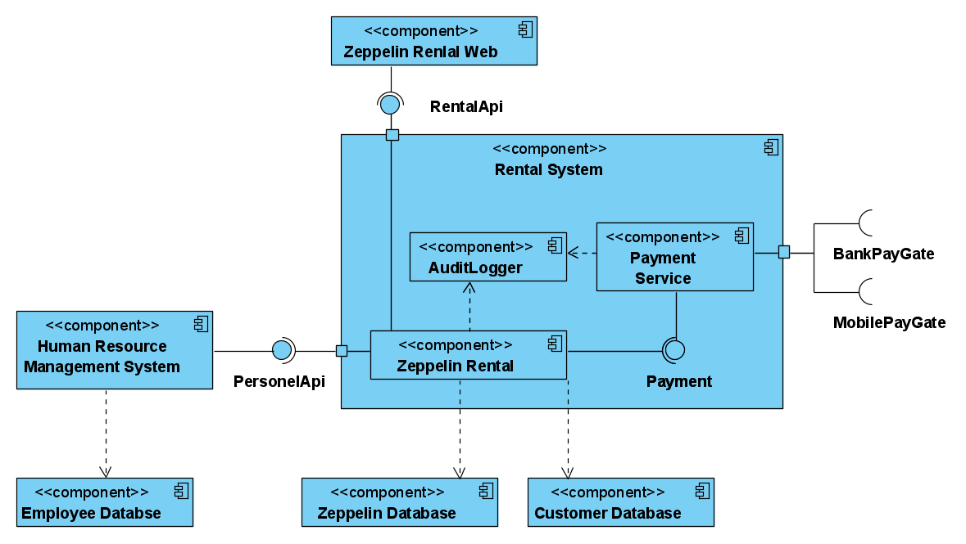
Component Diagram – Example

Slide 7
Deployment Diagram
Depicts mapping of architecture on infrastructure
  Hardware
  Virtual servers
  Containers
You can model elements like backups, load balancing, mapping on cloud services, etc…
It includes:
  Nodes – General computational resources, specified by stereotypes
  Components, Artifacts
  Interfaces
  Links, Dependencies – Connection between the components. They should include information about used communication protocol

Slide 8
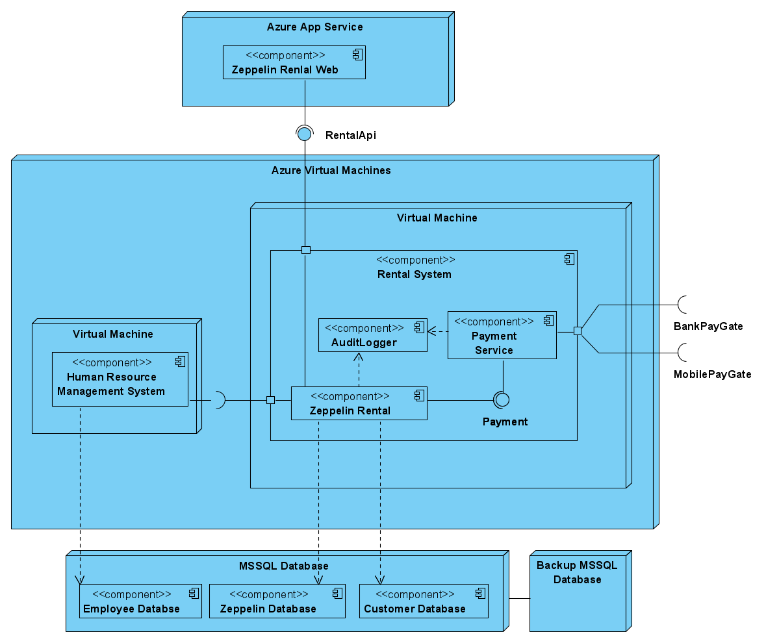
Deployment Diagram – Example

Slide 9
Task for this week
Process the feedback
Copy the Design Class Diagram and add packages (move classes inside them). Next, create separate Package Diagram consisting only of the packages and dependencies (without classes)
  Mind the cycles! Directions of associations/dependencies will tell you
For bonus points - create either Component Diagram or Deployment Diagram
  Component Diagram
    Think about components of your system and how they communicate
    You might need some database schema, caches, web pages, sensors, etc…
    Interfaces are important
  Deployment Diagram of the proposed system
    The system must run/be hosted somewhere

