Slide 1
Overview of crypto standards
Zdeněk Říha

Slide 2
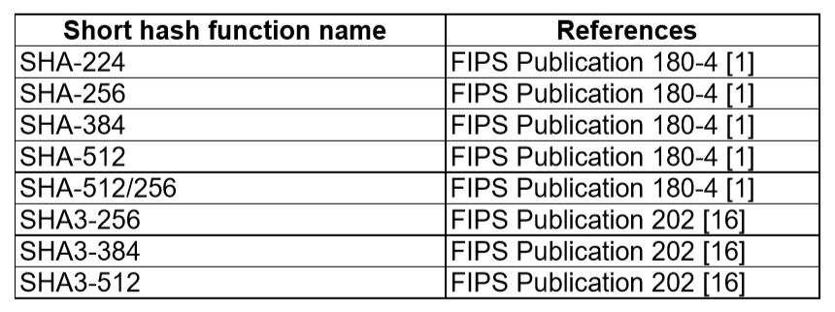
Hash functions
MD5 (128 bit output) – defined v RFC 1321
RIPEMD-128/RIPEMD-160 in ISO/IEC 10118-3
BLAKE2b, BLAKE2s defined in RFC 7693.

Slide 3
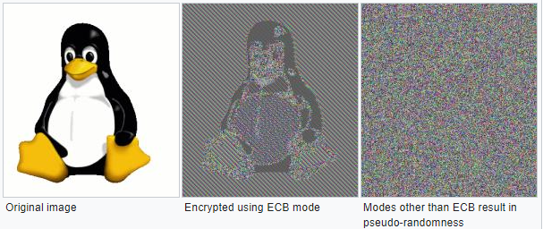
Symmetric crypto
Modes of operation (FIPS 81)
  ECB (Electronic Code Book)
  CBC (Ciper Block Chaining)
  CFB (Cipher Feedback Mode)
  OFB (Output Feedback Mode)
Newer modes of operation
  CTR (Counter Mode) [FIPS SP 800-38A]
  CMAC [FIPS SP 800-38B], CCM [FIPS SP 800-38C], GCM [FIPS SP 800-38D], XTS-AES [FIPS SP 800-38E]
  Other in FIPS SP 800-38F, FIPS SP 800-38G
See:
https://en.wikipedia.org/wiki/Block_cipher_mode_of_operation

Slide 4
Padding
ISO 9797 method 1 padded with values 0x00
  to remove the padding the length of the original message is needed
ISO 9797 method 2 (ISO 7816-4, EMV’96) – first the value 0x80 is added, then bytes of 0x00 are added
  PS = ‘80 00‘, if 2 bytes are needed
  PS = ‘80 00 00 00 00 00 00 00‘, if 0 bytes are needed (full block added)
• PKCS#5 – the padding string is made from value n-(||M|| mod n)
  for (3)DES n=8, AES n=16
  e.g. PS = 02 02 - if 2 bytes are needed
  e.g. PS = 08 08 08 08 08 08 08 08 – if 0 bytes are needed and n=8 (3DES)

Slide 5
Symmetric crypto
DES – defined in FIPS PUB 46 (-1 a -2)
  key 56 bits, block 64 bits
3DES – defined in FIPS PUB 46-3
  key either 112 or 168 bits, block 64 bits
AES – (Rijndael), defined v FIPS PUB 197
  key 128, 192 or 256 bits, block 128 bits

Slide 6
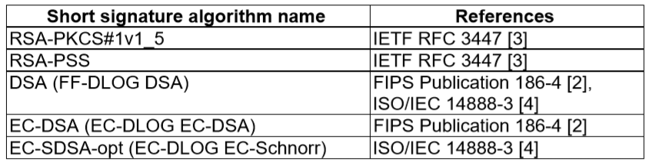
Asymmetric crypto
Certificates X.509
  ITU-T, ISO/IEC, RFC
DER / PEM

Slide 7
PKCS
PKCS#1 – defines RSA encryption
PKCS#3 – defines Diffie-Hellman protocol
PKCS#5 – symmetric encryption based on a password
PKCS#7 – format for digital signatures and asymmetric encryption
PKCS#8 – defines the private key format
PKCS#10 – defines format for certificate requests
PKCS#11 – API for communication with cryptographic tokens
PKCS#12 – format for storing private keys including public key certificates, all protected by a password
PKCS#13 – defines encryption based on elliptic curves
PKCS#15 – defines cryptographic token information format

Slide 8
RSA Padding
E.g. RSA 2048 bits
  Modulus n is 2048 bits, public exponent e usually small
  Message m is 2048 bits in total, usual hash functions provide hashes much shorter. Therefore we need padding.
BTW No padding needed for DSA and ECDSA

Slide 9
RSA Padding algorithms
ANSIX 9.31
  6b bb … bb ba || Hash(M) || 3x cc
  (where x=3 for sha1, x=1 for ripemd160)
PKCS#1 v1.5
  00 01 ff … ff 00 || HashAlgID || Hash(M)
PSS
  00 || H || G(H) ⊕ [salt || 00 … 00] (where H = Hash(salt, M), salt is random, and G is a mask generation function)

Slide 10
Assignments 2022
No assignments = no points
But read PKCS#3 anyway :-)

Slide 11
Good luck
Good luck and good fun while reading the standards
Email: zriha@fi.muni.cz

