Slide 1
PV198 – One-chip Controllers
SPI

Slide 2
Content
What is SPI
What is it used for
How does it work
FRDM-K66F SPI
Sensor – BMP 280
Application

Slide 3
What is SPI
SPI – Serial Peripheral Interface
Serial interface bus

Slide 4
What is it used for
Intra-board communication
External peripherals
Sensors

Slide 5
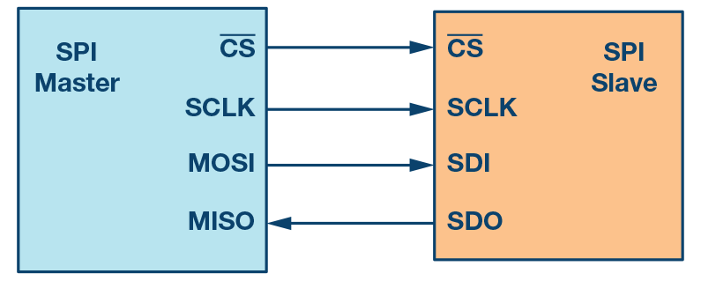
How does it work – Scheme
Figure 1. SPI configuration with master and a slave
https://www.analog.com/en/analog-dialogue/articles/introduction-to-spi-interface.html

Slide 6
How does it work
4 wires (Clock, Chip Select, Master In Slave Out, Master Out Slave In)
Single-master & multi-slave
Chip Select selects slave for communication
Synchronous
Full-duplex
Possibility to use only 3 wires (only 1 data wire)

Slide 7
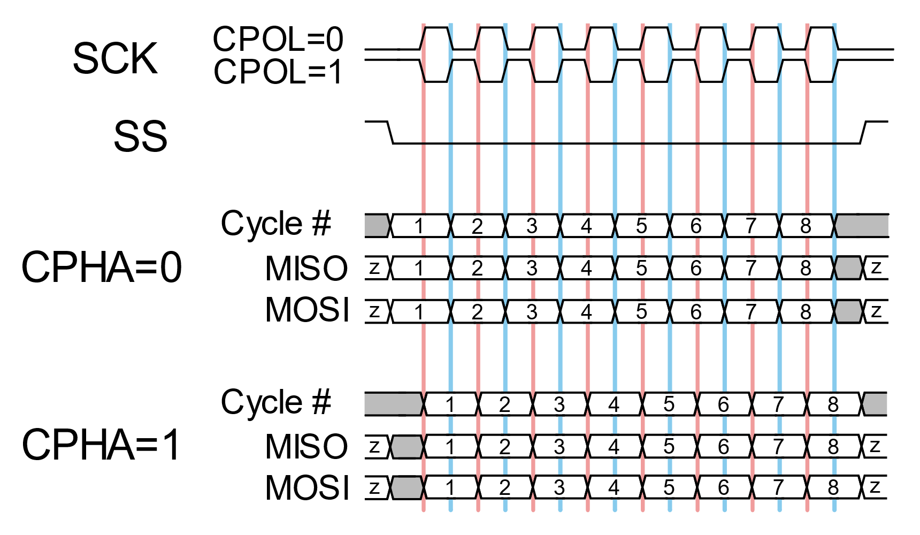
How does it work – Message
By SPI_timing_diagram.svg: en:User:Cburnettderivative work: Jordsan (talk) - SPI_timing_diagram.svg, CC BY-SA 3.0, https://commons.wikimedia.org/w/index.php?curid=11405368

Slide 8
FRDM-K66F SPI
3 SPI modules
Master & Slave support
Interrupts
Programmable frame size (4 to 16 bits)
6 peripheral Chip Selects

Slide 9
Temperature & Pressure sensor
Bosch BMP280 Digital Pressure Sensor – link
Digital interfaces I²C (up to 3.4 MHz) SPI (3 and 4 wire, up to 10 MHz)
Pressure resolution 0.16 Pa
Temperature resolution 0.01°C

Slide 10
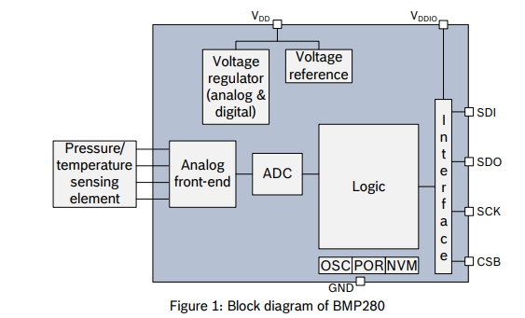
BMP 280

Slide 11
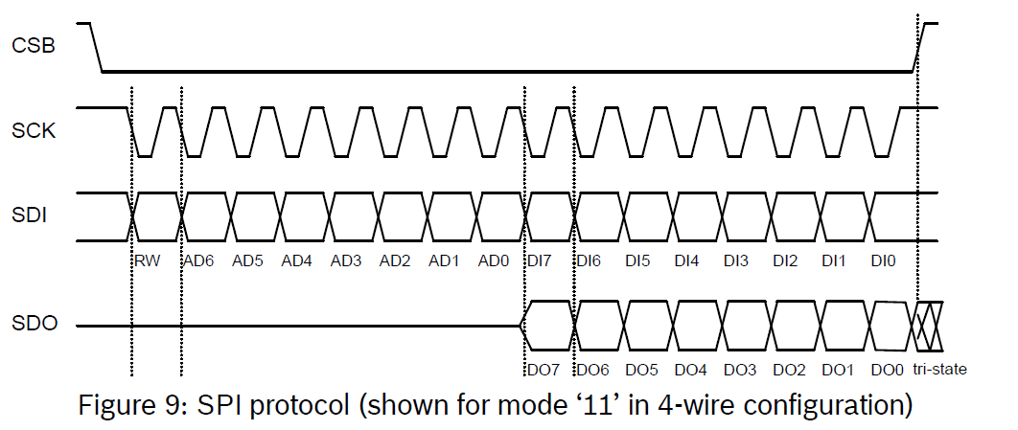
BMP 280 SPI
BST-BMP280-DS001-11

Slide 12
BMP 280 SPI – Write
PV198 – One-chip Controllers, SPI / Dávid Danaj
<number>

Slide 13
BMP 280 SPI – Read
PV198 – One-chip Controllers, SPI / Dávid Danaj
<number>

Slide 14
Application
Create an application that reads temperature from BMP280 sensor
Print temperature into console

Slide 15
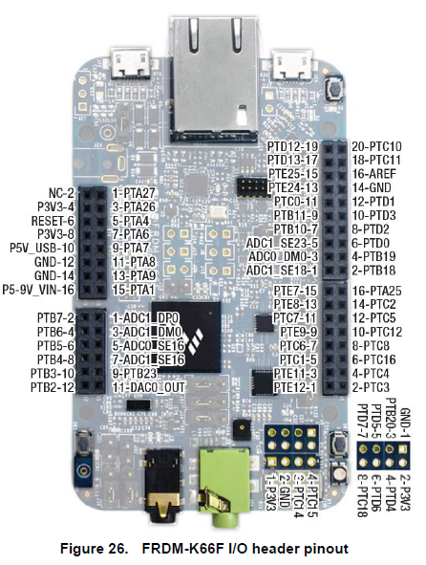
Accelerometer & Magnetometer
VCC
Temp &
Pressure
Sensor
BMP 280
GND
SCL
SDA
CSB
SDO

Slide 16
Application – Step-by-step guide
Study BMP280 Datasheet
Study Serial Peripheral Interface (SPI) chapter in MCU Reference manual
Setup pin routing
Setup DSPI peripheral driver (speed, timing, etc.)
Download BMP280_driver and temperature example
Import driver to the project, use example code
Implement HW specific functions – your main task
Repeat steps 1-7 if necessary

Slide 17

Application – Template
Study BMP280 Datasheet
Study Serial Peripheral Interface (SPI) chapter in MCU Reference manual
Setup pin routing
Setup DSPI peripheral driver (speed, timing, etc.)
Download BMP280_driver and temperature example
Import driver to the project, use example code
Implement HW specific functions – your main task
Repeat steps 1, 2 and 7 if necessary

Slide 18
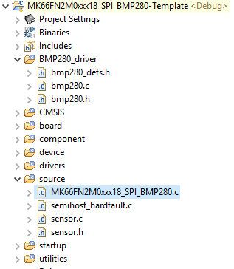
Application – Template
Check pin routing
Check DSPI configuration
  Check timing
Check sensor.c/.h files

Slide 19
Application – Traps
There are multiple traps in the template, here are hints:
  Make sure you do proper error checking for input data (And check that it works)
  You have to enable continuous chip select for the Transfer call

Slide 20
Homework
Update the application to print pressure as well as temperature
Make sure to print the uncompressed pressure (don’t change it)

