Slide 1
PV198 – One-chip Controllers
UART

Slide 2
Content
What is UART
What is it used for
How does it work
FRDM-K66F UART
USB to UART Bridge
Application

Slide 3
What is UART
UART – Universal Asynchronous Receiver-Transmitter
Serial communication

Slide 4
What is it used for
Intra-board communication
Sensors
GPS
Bluetooth
Modems

Slide 5
How does it work – Scheme
UART1
UART2
RX
TX
GND
RX
TX
GND

Slide 6
How does it work
2 wires (Receive – RX, Transmit – TX)
1 to 1 communication
Works without clock signal
Requires same settings for devices (baud rate, parity, etc.)
Asynchronous
Full-duplex

Slide 7

How does it work – Message
K66 Sub-Family Reference Manual

Slide 8
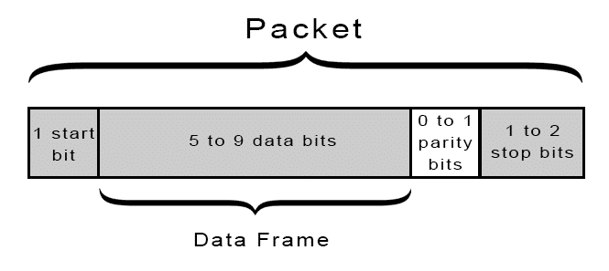
How does it work – Message
http://www.circuitbasics.com/basics-uart-communication/

Slide 9
How does it work – Settings
Baud rate (typical 9600 – 115200)
Number of data bits (8 – 9)
Number of stop bits (1 – 2)
Parity bit (disabled / odd / even)

Slide 10
FRDM-K66F UART
5 UART modules
RS-485 support
Hardware flow control (RTS/CTS)
9-bit UART support
Interrupts
TX/RX FIFO

Slide 11
USB to UART Bridge
Silicon Labs – link
Might be needed to install driver

Slide 12
Application
Create an application that reads data from UART and sends the data back to PC
Update your code to rotate received character +2

Slide 13
Application – Step-by-step guide
Setup pin routing
  PTB11 as UART3_TX, PTB10 as UART3_RX
Setup UART peripheral
  UART3 with 8 bit data, 1 stop bit, no parity, 115200 baudrate
Use API: UART_ReadBlocking,UART_WriteBlocking
Connect “USB to UART bridge” to a board
When “USB to UART bridge” is connected to a PC, it appears in Device Manage in “Ports (COM & LPT)” as “COM” port.
Open terminal application (or Terminal view in MCUXpresso IDE) and connect to correct COM port with your UART settings

Slide 14
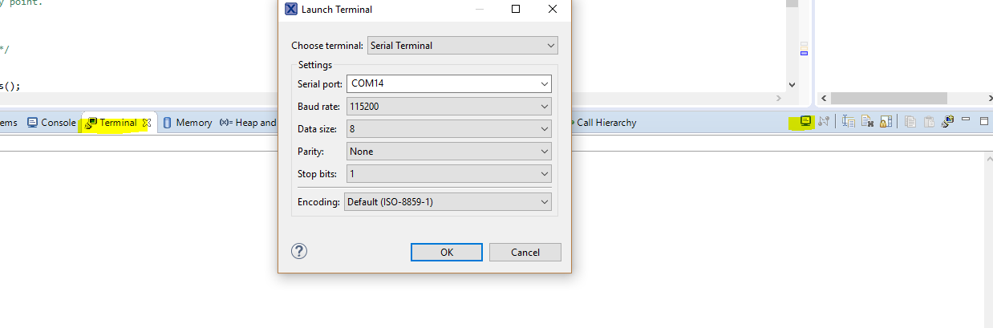
Application – Step-by-step guide

Slide 15
Application 2
Install pyserial:
  powershell: python.exe -m pip install pyserial
Open Python3
Use import Serial
Using Serial send string to device
Check if device correctly encrypted string

Slide 16
Homework
On device side you will receive 3 characters
These 3 characters represent RGB values in order
Your goal is to set LED color correctly according to received values
Due to testing, set the Timer Output Frequency in the FTM peripheral to “262144hz”

