Slide 1
PV198 – One-chip Controllers
Ethernet

Slide 2
Content
What is Ethernet used for
Overview
  ISO/OSI Model
  Headers
FRDM-K66F Ethernet
lwIP
Application

Slide 3
What is Ethernet used for
Connecting embedded devices to a network

Slide 4
Overview – ISO/OSI Model
Application
Physical structure
Physical
Network
HTTP, SMTP, DNS
IP, ICMP
Data
Transport
TCP, UDP
MAC
Session
Presentation
FTP, SSH

Slide 5
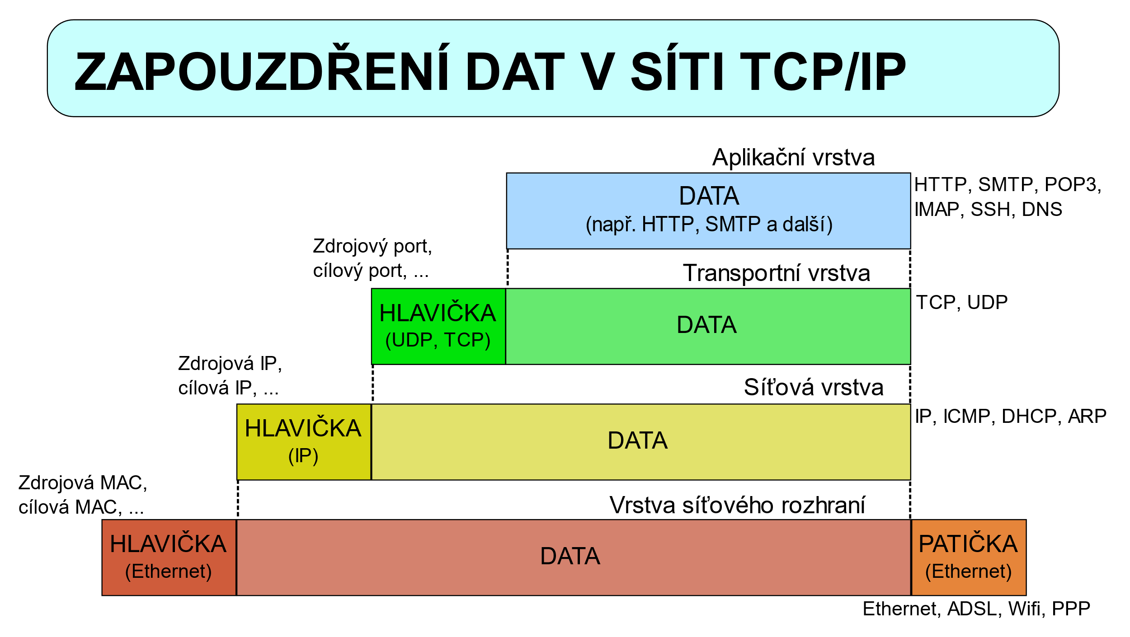
Overview
By David Mudrák (mudrdmz) - Vlastní produkt, CC BY-SA 3.0, https://commons.wikimedia.org/w/index.php?curid=5181616

Slide 6
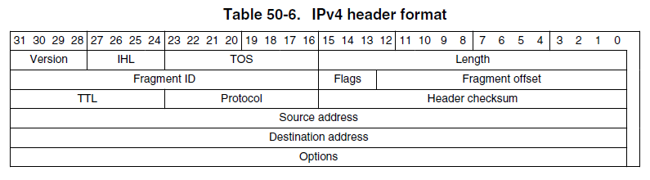
Overview – IPv4 header
K66 Sub-Family Reference Manual, Figure 50-6.

Slide 7
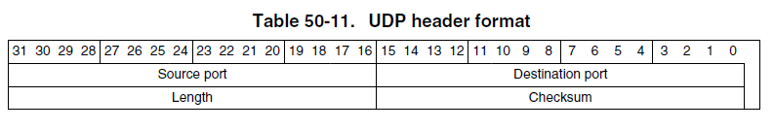
Overview – UDP header
K66 Sub-Family Reference Manual, Figure 50-11.

Slide 8
FRDM-K66F Ethernet
10/100-Mbps Ethernet MAC (ENET)
Compliant with the IEEE802.3-2002 standard
Hardware acceleration block to optimize the performance of network controllers providing TCP/IP, UDP, and ICMP protocol services
CRC-32 checking / CRC-32 generation
Programmable MAC address

Slide 9
FRDM-K66F Ethernet
Application
Micrel 32-pin Ethernet PHY
Physical
Network
Data
Transport
Session
Presentation
10/100-Mbps Ethernet MAC, ENET driver
Lightweight IP stack

Slide 10
lwIP
Lightweight IP stack – link
Small independent implementation of the TCP/IP protocol suite – used in embedded
Features: IP, ICMP, UDP, TCP, DNS, DHCP, and more

Slide 11
Application – Overview
The application sends a message to a Database
Uses UDP packets, InfluxDB and data are shown with Grafana
  Grafana: http://lavinia.fi.muni.cz:3000/
    Credentials: onechip::onechip
    Goto: Student Dashboard
  InfluxDB: udp://lavinia.fi.muni.cz:8089/
When you successfully send a message, it will be visible on a dashboard

Slide 12
Application – Template
Contains initialization of pins, clocks, peripherals and lwIP
Based on UDP echo – when the board receives an UDP packet, it sends the packet back to the sender
Uses predefined static IP address

Slide 13

Application – Source Code
Main:
  Configure (pins, clocks, peripherals, lwIP)
  Send udp packet – your task to implement
  Loop:
    Receive packets
Extra: UDP Callback:
  handle received packet – send the packet back to the sender

Slide 14
Application – Task
Define your unique IP address (192.168.50.x)
Implement method in udpecho_raw.c:
void udp_send_data(const ip4_addr_t dst_addr, uint16_t dst_port, char *msg);

Slide 15
Homework
Send meaningful data to the database.
E.g.:
  Data from sensor (temperature, pressure, accelerometer, … )
  Logging information (button pressed, …)
  You have to use address.h

