Slide 1
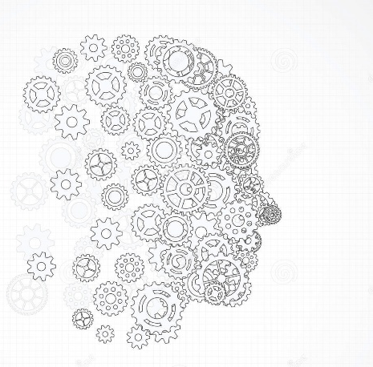
MASARYK Univ. of Brno (CZ) – Faculty of Informatics
Value co-creation ‘gradients’: enabling human-machine interactions through AI-based DSS
Nudges from Heathcare
prof. Luca Carrubbo, Ph.D – lcarrubbo@unisa.it
Brno (CZ), 2022/10/13

Slide 2
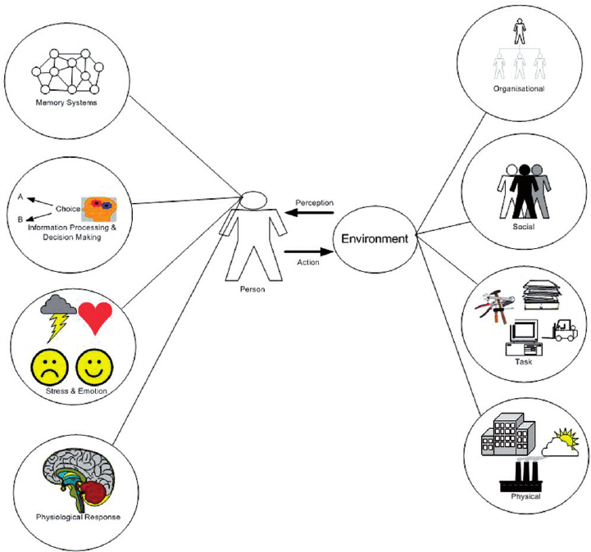
- HMIs… why? -
Artificial Intelligence-based Decision Support Systems (AI-based DSS) are becoming increasingly important in many contexts. There is the need to define a type of human-machine interactions for new value co-creation processes' ranks, to help identify factors that can stimulate value co-creation in human-machine interactions.

Slide 3
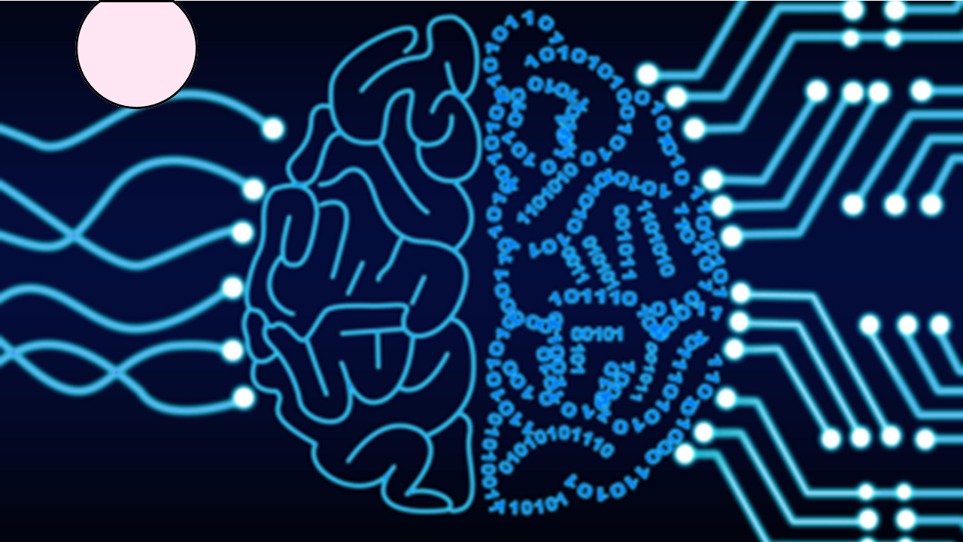
Insight n.1:
  participants really ‘active’,
  resources (every kind) basically ‘available’, ‘expendable’ or ‘usable’ when requested,
  interested entities (individuals, organization or whatever) ready, prepared, educated, motivated.
Insight n.2:
  value co-creation can happen when some conditions are respected,
  everything is personal, experiential, and some doubt that could occur anytime strongly arise,
  the distinction between human and not human appears evident.
Insight n.3:
  technological tools, digital platforms and similar instruments can enable value co-creation,
  interactions are intended as complex and still not well understood,
  HMIs are not deepened at all in the logic of value co-creation.
3

Slide 4
- HMI’s structural pre-condition -
From human side | From not-human side
personal predisposition/tendency | technological instrument sensitivity
people education, experiences and background | machine training
individual learning ability | algorithm elements’ readiness
known language used | instructions’ availability and disposal
finality and cognitive alignment | embeddedness (integration / rooting)
user role (at a stated moment) | variety/variability management through ICT
user acceptance capacity | set up and connectivity appropriateness
contextualization (human side) | context-driven technology (not-human side)

Slide 5
- Gradients of structural preconditions -

Slide 6
- Taxonomy of HMIs -

Slide 7
- HMI’s systems determinants -
From human side | From not-human side
continuity | reliability
relevance | completeness
engagement | speed, real time (timely)
coherence (congruence) | understandability
participation, pro-activity | digital divide avoidance

Slide 8
- Spectrum of HMI in terms of value co-creation -

Slide 9
- Rank of value co-creation in HMI -

Slide 10
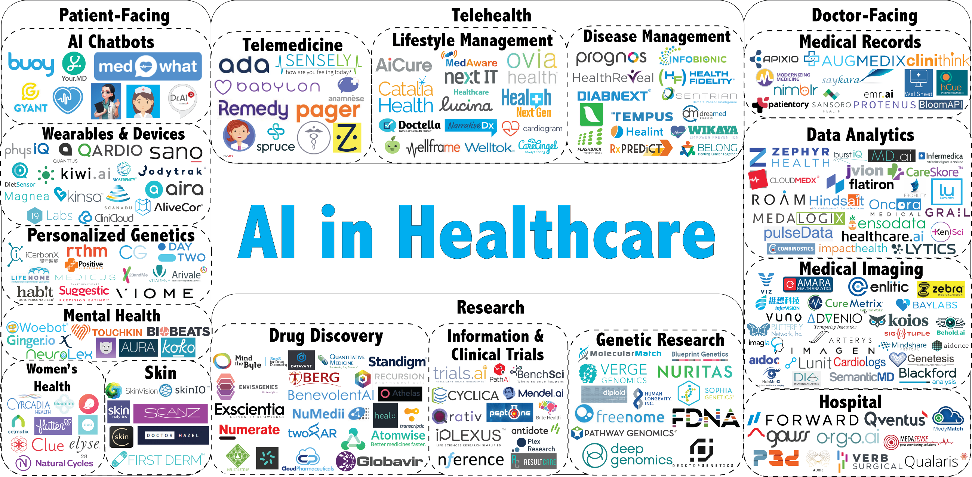
Many actors, many tools…
How many problems in terms of value co-creation? -

Slide 11


Thank You
Luca Carrubbo
lcarrubbo@unisa.it

