Slide 1
Module 7: DHCPv4
Switching, Routing and Wireless Essentials v7.0 (SRWE)
Notes:
Cisco Networking Academy Program
Switching, Routing and Wireless Essentials v7.0 (SRWE)
Module 7 – DHCPv4

Slide 2
Module 7: Activities
What activities are associated with this module?
Page # | Activity Type | Activity Name | Optional?
7.1.5 | Check Your Understanding | DHCPv4 Concepts | Recommended
7.2.6 | Syntax Checker | Configure DHCPv4 | Recommended
7.2.10 | Packet Tracer | Configure DHCPv4 | Recommended
7.3.4 | Syntax Checker | Configure a Cisco Router as DHCP Client | Recommended
7.4.1 | Packet Tracer | Implement DHCPv4 | Recommended
7.4.2 | Lab | Implement DHCPv4 | Recommended
Notes:
2

Slide 3
Module Objectives
Module Title: DHCPv4
Module Objective: Implement DHCPv4 to operate across multiple LANs
Topic Title | Topic Objective
DHCP4 Concepts | Explain how DHCPv4 operates in a small- to medium-sized business network.
Configure a Cisco IOS DHCP4 Server | Configure a router as a DHCPv4 server.
Configure a DHCP4 Client | Configure a router as a DHCPv4 client.
Notes:
3
7.0 – Introduction
7.0.2 – What will I learn to do in this module?

Slide 4
7.1 DHCPv4 Concepts
Notes:
7- DHCPv4
7.1 – DHCPv4 Concepts

Slide 5
DHCPv4 Server and Client
Dynamic Host Configuration Protocol v4 (DHCPv4) assigns IPv4 addresses and other network configuration information dynamically. Because desktop clients typically make up the bulk of network nodes, DHCPv4 is an extremely useful and timesaving tool for network administrators.
A dedicated DHCPv4 server is scalable and relatively easy to manage. However, in a small branch or SOHO location, a Cisco router can be configured to provide DHCPv4 services without the need for a dedicated server. Cisco IOS software supports an optional, full-featured DHCPv4 server.
The DHCPv4 server dynamically assigns, or leases, an IPv4 address from a pool of addresses for a limited period of time chosen by the server, or until the client no longer needs the address.
Clients lease the information from the server for an administratively defined period. Administrators configure DHCPv4 servers to set the leases to time out at different intervals. The lease is typically anywhere from 24 hours to a week or more. When the lease expires, the client must ask for another address, although the client is typically reassigned the same address.
Notes:
7 – DHCPv4
7.1 – DHCPv4 Concepts
7.1.1 – DHCPv4 Server and Client

Slide 6
DHCPv4 Operation
DHCPv4 works in a client/server mode. When a client communicates with a DHCPv4 server, the server assigns or leases (vydá) an IPv4 address to that client.
The client connects to the network with that leased IPv4 address until the lease expires. The client must contact the DHCP server periodically to extend the lease.
This lease mechanism ensures that clients that move or power off do not keep addresses that they no longer need.
When a lease expires, the DHCP server returns the address to the pool where it can be reallocated as necessary.
Notes:
7 – DHCPv4
7.1 – DHCPv4 Concepts
7.1.2 – DHCPv4 Operation

Slide 7
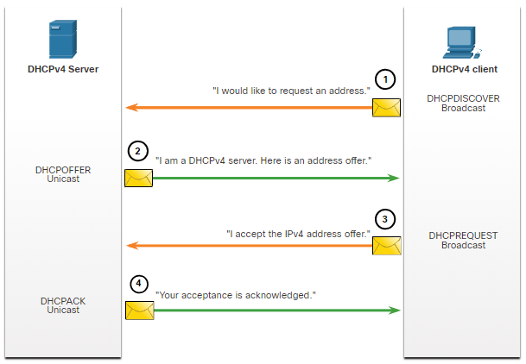
Steps to Obtain a Lease
When the client boots (or otherwise wants to join a network), it begins a four-step process to obtain a lease:
DHCP Discover (DHCPDISCOVER)
DHCP Offer (DHCPOFFER)
DHCP Request (DHCPREQUEST)
DHCP Acknowledgment (DHCPACK)
Notes:
7 – DHCPv4
7.1 – DHCPv4 Concepts
7.1.3 – Steps to Obtain a Lease

Slide 8
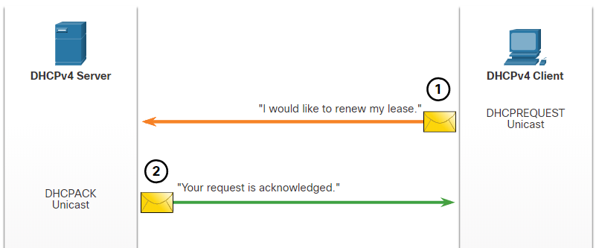
Steps to Renew a Lease
Prior to lease expiration, the client begins a two-step process to renew the lease with the DHCPv4 server, as shown in the figure:
1. DHCP Request (DHCPREQUEST)
Before the lease expires, the client sends a DHCPREQUEST message directly to the DHCPv4 server that originally offered the IPv4 address. If a DHCPACK is not received within a specified amount of time, the client broadcasts another DHCPREQUEST so that one of the other DHCPv4 servers can extend the lease.
2. DHCP Acknowledgment (DHCPACK)
On receiving the DHCPREQUEST message, the server verifies the lease information by returning a DHCPACK.
Note: These messages (primarily the DHCPOFFER and DHCPACK) can be sent as unicast or broadcast according to IETF RFC 2131.
Notes:
7 – DHCPv4
7.1 – DHCPv4 Concepts
7.1.4 – Steps to Renew a Lease
7.1.5 – Check Your Understanding – DHCPv4 Concepts

Slide 9
DHCP display filtry na https://www.wireshark.org/docs/dfref/d/dhcp.html
bootp.option.type == 53
udp port 67 or port 68
tshark -ni eth0 -Y "bootp.option.type == 53" -T fields -e frame.number -e frame.time -e ip.src -e ip.dst -e bootp.option.type -e bootp.ip.client -e xxxx
xxxx lze nahradit jakýmkoli potřebným polem protokolu bootp, protože DHCP používá BOOTP jako svůj transport protokol

Slide 10
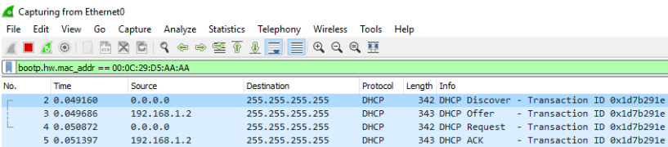
Kontrola, že jsem dostal pro svoji MAC adresu IP adresu od DHCP serveru

Slide 11
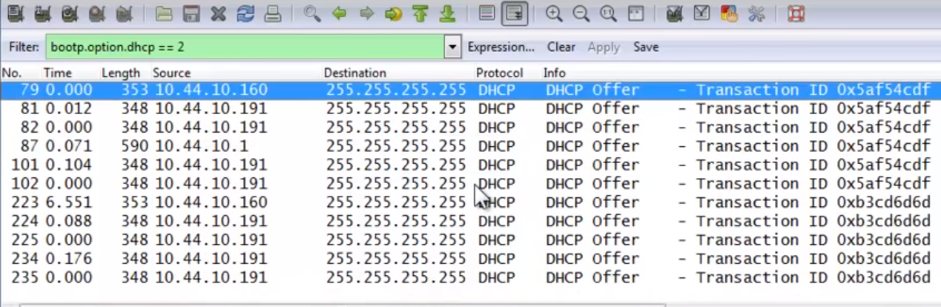
Filtr
https://www.youtube.com/watch?v=BFP20O_qg48

Slide 12
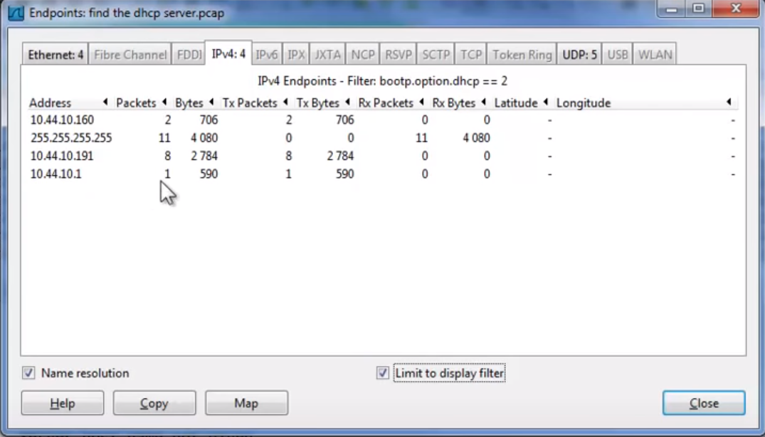
Dva servery, jeden klient

Slide 13
7.2 Configure a Cisco IOS DHCPv4 Server
Notes:
7- DHCPv4
7.2 – Configure a Cisco IOS DHCPv4 Server

Slide 14
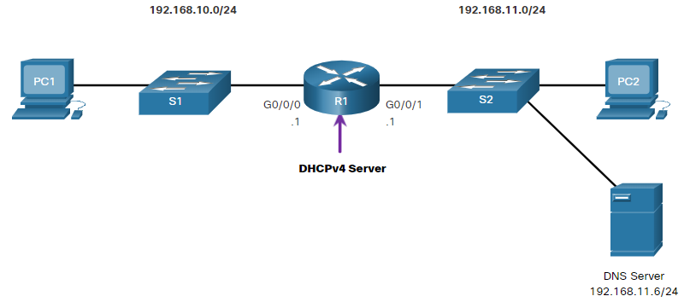
Cisco IOS DHCPv4 Server
Now you have a basic understanding of how DHCPv4 works and how it can make your job a bit easier. A Cisco router running Cisco IOS software can be configured to act as a DHCPv4 server. The Cisco IOS DHCPv4 server assigns and manages IPv4 addresses from specified address pools within the router to DHCPv4 clients.
Notes:
7 – DHCPv4
7.2 – Configure a Cisco IOS DHCPv4 Server
7.2.1 – Cisco IOS DHCPv4 Server

Slide 15
Steps to Configure a Cisco IOS DHCPv4 Server
Use the following steps to configure a Cisco IOS DHCPv4 server:
Step 1. Exclude IPv4 addresses. A single address or a range of addresses can be excluded by specifying the low-address and high-address of the range. Excluded addresses should be those addresses that are assigned to routers, servers, printers, and other devices that have been, or will be, manually configured. You can also enter the command multiple times. The command is ip dhcp excluded-address low-address [high-address]
Step 2. Define a DHCPv4 pool name. The ip dhcp pool pool-name command creates a pool with the specified name and puts the router in DHCPv4 configuration mode, which is identified by the prompt Router(dhcp-config)#.
Notes:
7 – DHCPv4
7.2 – Configure a Cisco IOS DHCPv4 Server
7.2.2 – Steps to Configure a Cisco IOS DHCPv4 Server

Slide 16
Steps to Configure a Cisco IOS DHCPv4 Server (Cont.)
Step 3. Configure the DHCPv4 pool. The address pool and default gateway router must be configured. Use the network statement to define the range of available addresses. Use the default-router command to define the default gateway router. These commands and other optional commands are shown in the table.
Task | IOS Command
Define the address pool. | network network-number [mask | / prefix-length]
Define the default router or gateway. | default-router address [ address2….address8]
Define a DNS server. | dns-server address [ address2…address8]
Define the domain name. | domain-name domain
Define the duration of the DHCP lease. | lease {days [hours [ minutes]] | infinite}
Define the NetBIOS WINS server. | netbios-name-server address [ address2…address8]
Notes:
7 – DHCPv4
7.2 – Configure a Cisco IOS DHCPv4 Server
7.2.2 – Steps to Configure a Cisco IOS DHCPv4 Server (Cont.)

Slide 17
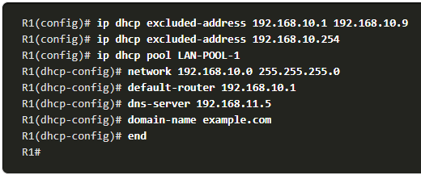
Configuration Example
Notes:
7 – DHCPv4
7.2 – Configure a Cisco IOS DHCPv4 Server
7.2.3 – Configuration Example

Slide 18
DHCPv4 Verification
Use the commands in the table to verify that the Cisco IOS DHCPv4 server is operational.
Command | Description
show running-config | section dhcp | Displays the DHCPv4 commands configured on the router.
show ip dhcp binding | Displays a list of all IPv4 address to MAC address bindings provided by the DHCPv4 service.
show ip dhcp server statistics | Displays count information regarding the number of DHCPv4 messages that have been sent and received
Notes:
7 – DHCPv4
7.2 – Configure a Cisco IOS DHCPv4 Server
7.2.4 – DHCPv4 Verification

Slide 19
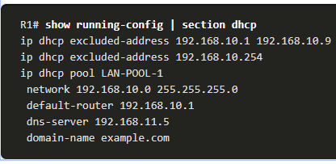
Verify DHCPv4 is Operational
Verify the DHCPv4 Configuration: As shown in the example, the show running-config | section dhcp command output displays the DHCPv4 commands configured on R1. The | section parameter displays only the commands associated with DHCPv4 configuration.
Notes:
7 – DHCPv4
7.2 – Configure a Cisco IOS DHCPv4 Server
7.2.5 – Verify DHCPv4 is Operational

Slide 20
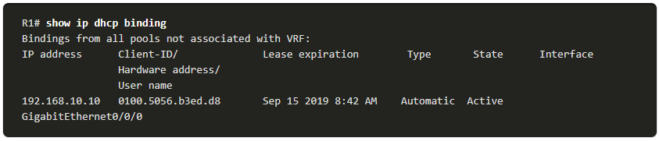
Verify DHCPv4 is Operational (Cont.)
Verify DHCPv4 Bindings: As shown in the example, the operation of DHCPv4 can be verified using the show ip dhcp binding command. This command displays a list of all IPv4 address to MAC address bindings that have been provided by the DHCPv4 service.
Notes:
7 – DHCPv4
7.2 – Configure a Cisco IOS DHCPv4 Server
7.2.5 – Verify DHCPv4 is Operational (Cont.)

Slide 21
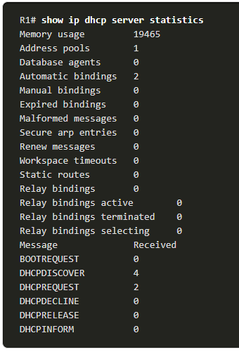
Verify DHCPv4 is Operational (Cont.)
Verify DHCPv4 Statistics: The output of the show ip dhcp server statistics is used to verify that messages are being received or sent by the router. This command displays count information regarding the number of DHCPv4 messages that have been sent and received.
Notes:
7 – DHCPv4
7.2 – Configure a Cisco IOS DHCPv4 Server
7.2.5 – Verify DHCPv4 is Operational (Cont.)

Slide 22
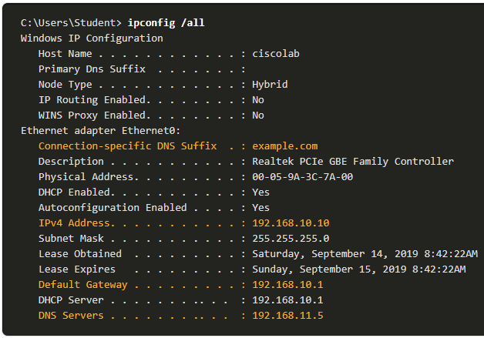
Verify DHCPv4 is Operational (Cont.)
Verify DHCPv4 Client Received IPv4 Addressing: The ipconfig /all command, when issued on PC1, displays the TCP/IP parameters, as shown in the example. Because PC1 was connected to the network segment 192.168.10.0/24, it automatically received a DNS suffix, IPv4 address, subnet mask, default gateway, and DNS server address from that pool. No DHCP-specific router interface configuration is required. If a PC is connected to a network segment that has a DHCPv4 pool available, the PC can obtain an IPv4 address from the appropriate pool automatically.
Notes:
7 – DHCPv4
7.2 – Configure a Cisco IOS DHCPv4 Server
7.2.5 – Verify DHCPv4 is Operational (Cont.)
7.2.6 – Syntax Checker – Configure DHCPv4

Slide 23
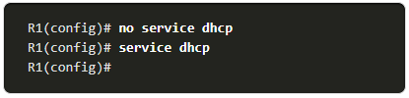
Disable the Cisco IOS DHCPv4 Server
The DHCPv4 service is enabled by default. To disable the service, use the no service dhcp global configuration mode command. Use the service dhcp global configuration mode command to re-enable the DHCPv4 server process, as shown in the example. Enabling the service has no effect if the parameters are not configured.
Note: Clearing the DHCP bindings or stopping and restarting the DHCP service may result in duplicate IP addresses being temporarily assigned on the network.
Notes:
7 – DHCPv4
7.2 – Configure a Cisco IOS DHCPv4 Server
7.2.7 – Disable the Cisco IOS DHCPv4 Server

Slide 24
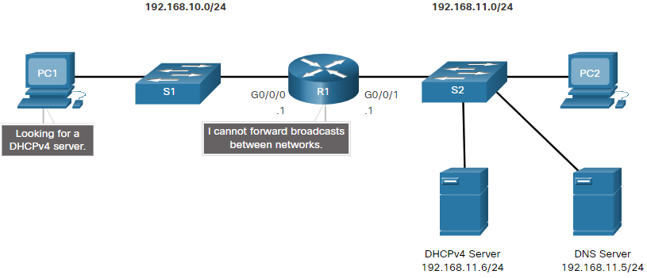
DHCPv4 Relay
In a complex hierarchical network, enterprise servers are usually located centrally. These servers may provide DHCP, DNS, TFTP, and FTP services for the network. Network clients are not typically on the same subnet as those servers. In order to locate the servers and receive services, clients often use broadcast messages.
In the figure, PC1 is attempting to acquire an IPv4 address from a DHCPv4 server using a broadcast message. In this scenario, R1 is not configured as a DHCPv4 server and does not forward the broadcast. Because the DHCPv4 server is located on a different network, PC1 cannot receive an IP address using DHCP. R1 must be configured to relay DHCPv4 messages to the DHCPv4 server.
Notes:
7 – DHCPv4
7.2 – Configure a Cisco IOS DHCPv4 Server
7.2.8 – DHCPv4 Relay

Slide 25
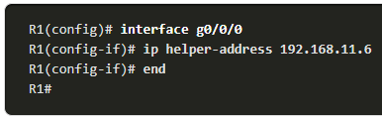
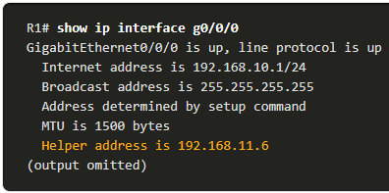
DHCPv4 Relay (Cont.)
Configure R1 with the ip helper-address address interface configuration command. This will cause R1 to relay DHCPv4 broadcasts to the DHCPv4 server. As shown in the example, the interface on R1 receiving the broadcast from PC1 is configured to relay DHCPv4 address to the DHCPv4 server at 192.168.11.6.
When R1 has been configured as a DHCPv4 relay agent, it accepts broadcast requests for the DHCPv4 service and then forwards those requests as a unicast to the IPv4 address 192.168.11.6. The network administrator can use the show ip interface command to verify the configuration.
Notes:
7 – DHCPv4
7.2 – Configure a Cisco IOS DHCPv4 Server
7.2.8 – DHCPv4 Relay (Cont.)

Slide 26
Other Service Broadcasts Relayed
DHCPv4 is not the only service that the router can be configured to relay. By default, the ip helper-address command forwards the following eight UDP services:
Port 37: Time
Port 49: TACACS
Port 53: DNS
Port 67: DHCP/BOOTP server
Port 68: DHCP/BOOTP client
Port 69: TFTP
Port 137: NetBIOS name service
Port 138: NetBIOS datagram service
Notes:
7 – DHCPv4
7.2 – Configure a Cisco IOS DHCPv4 Server
7.2.9 – Other Service Broadcasts Relayed

Slide 27
Packet Tracer – Configure DHCPv4
In this Packet Tracer Activity, you will complete the following objectives:
Part 1: Configure a Router as a DHCP Server
Part 2: Configure DHCP Relay
Part 3: Configure a Router as a DHCP Client
Part 4: Verify DHCP and Connectivity
Notes:
7 – DHCPv4
7.2 – Configure a Cisco IOS DHCPv4 Server
7.2.10 – Packet Tracer – Configure DHCPv4

Slide 28
Parametry ipconfig
Neméně užitečné jsou příkazy ipconfig /release a ipconfig /renew (mají i variantu pro IPv6). To vám umožní si od DHCP serveru vyžádat novou adresu (nebo prostě jenom obnovit rezervaci nebo rezervaci uvolnit). Patří sem i ipconfig /registerdns, které se ještě navíc postará o případnou registraci jmen.
ipconfig /flushdns – umožní vám vyprázdnit paměť DNS Resolveru, tedy to co si Windows pamatují a neptají se znovu. Může se to hodit právě po změně souboru hosts, ale třeba i když nemáte jistotu, jestli IP adresa pro určité doménové jméno je aktuální.
Na to co si Windows pamatují v paměti DNS Resolveru se můžete podívat přes ipconfig /displaydns.
DNS.

Slide 29
7.3 Configure a DHCPv4 Client
Notes:
7- DHCPv4
7.3 – Configure a DHCPv4 Client

Slide 30
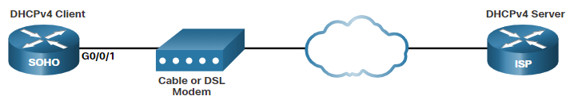
Cisco Router as a DHCPv4 Client
There are scenarios where you might have access to a DHCP server through your ISP. In these instances, you can configure a Cisco IOS router as a DHCPv4 client.
Sometimes, Cisco routers in a small office or home office (SOHO) and branch sites have to be configured as DHCPv4 clients in a similar manner to client computers. The method used depends on the ISP. However, in its simplest configuration, the Ethernet interface is used to connect to a cable or DSL modem.
To configure an Ethernet interface as a DHCP client, use the ip address dhcp interface configuration mode command.
In the figure, assume that an ISP has been configured to provide select customers with IP addresses from the 209.165.201.0/27 network range after the G0/0/1 interface is configured with the ip address dhcp command.
Notes:
7 – DHCPv4
7.3 – Configure a DHCPv4 Client
7.3.1 - Cisco Router as a DHCPv4 Client

Slide 31
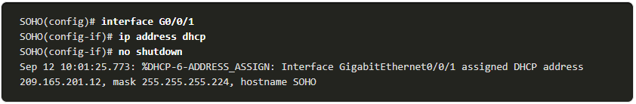
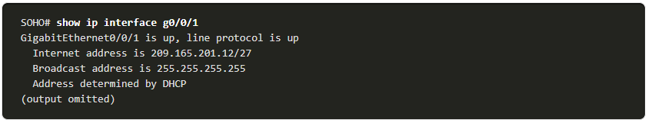
Configuration Example
To configure an Ethernet interface as a DHCP client, use the ip address dhcp interface configuration mode command, as shown in the example. This configuration assumes that the ISP has been configured to provide select customers with IPv4 addressing information.
The show ip interface g0/1 command confirms that the interface is up and that the address was allocated by a DHCPv4 server.
Notes:
7 – DHCPv4
7.3 – Configure a DHCPv4 Client
7.3.2 – Configuration Example

Slide 32
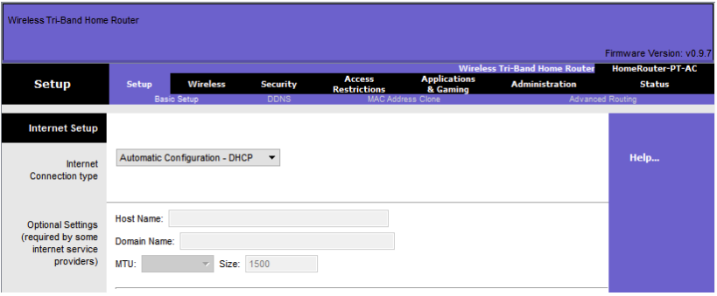
Home Router as a DHCPv4 Client
Home routers are typically already set to receive IPv4 addressing information automatically from the ISP. This is so that customers can easily set up the router and connect to the internet.
For example, the figure shows the default WAN setup page for a Packet Tracer wireless router. Notice that the internet connection type is set to Automatic Configuration - DHCP. This selection is used when the router is connected to a DSL or cable modem and acts as a DHCPv4 client, requesting an IPv4 address from the ISP.
Various manufacturers of home routers will have a similar setup.
Notes:
7 – DHCPv4
7.3 – Configure a DHCPv4 Client
7.3.3 – Home Router as a DHCPv4 Client
7.3.4 – Syntax Checker – Configure a Cisco IOS Router as DHCP Client

Slide 33
7.4 Module Practice and Quiz
Notes:
7- DHCPv4
7.4 – Module Practice and Quiz

Slide 34
Packet Tracer – Implement DHCPv4
In this Packet Tracer, you will complete the following objectives:
Part 1: Configure a Router as a DCHP Server
Part 2: Configure DCHP Relay
Part 3: configure a Router as a DCHP Client
Notes:
7 – DHCPv4
7.4 – Module Practice and Quiz
7.4.1 – Packet Tracer – Implement DHCPv4

Slide 35
Lab – Implement DHCPv4
In this lab, you will complete the following objectives:
Part 1: Build the Network and Configure Basic Device Settings
Part 2: Configure and Verify Two DHCPv4 Servers on R1
Part 3: Configure and Verify a DHCP Relay on R2
Notes:
7 – DHCPv4
7.4 – Module Practice and Quiz
7.4.2 – Lab – Implement DHCPv4

Slide 36
What Did I Learn In This Module?
The DHCPv4 server dynamically assigns, or leases, an IPv4 address to a client from a pool of addresses for a limited period of time chosen by the server, or until the client no longer needs the address.
The DHCPv4 lease process begins with the client sending message requesting the services of a DHCP server. If there is a DHCPv4 server that receives the message it will respond with an IPv4 address and possible other network configuration information.
The client must contact the DHCP server periodically to extend the lease. This lease mechanism ensures that clients that move or power off do not keep addresses that they no longer need.
When the client boots (or otherwise wants to join a network), it begins a four-step process to obtain a lease: DHCPDISCOVER, then DHCPOFFER, then DHCPREQUEST, and finally DHCPACK. Prior to lease expiration, the client begins a two-step process to renew the lease with the DHCPv4 server: DHCPREQUEST then DHCPACK.
A Cisco router running Cisco IOS software can be configured to act as a DHCPv4 server.
Use the following steps to configure a Cisco IOS DHCPv4 server: exclude IPv4 addresses, define a DHCPv4 pool name, and configure the DHCPv4 pool.
Verify your configuration using the show running-config | section dhcp, show ip dhcp binding, and show ip dhcp server statistics commands.
The DHCPv4 service is enabled, by default. To disable the service, use the no service dhcp global configuration mode command.
Notes:
7 – DHCPv4
7.4 – Module Practice and Quiz
7.4.3 – What Did I Learn In This Module

Slide 37
What Did I Learn In This Module? (Cont.)
Network clients are not typically on the same subnet as enterprise servers providing DHCP, DNS, TFTP, and FTP services for the network. In order to locate the servers and receive services, clients often use broadcast messages. The router must be configured to relay DHCPv4 messages to the DHCPv4 server.
The network administrator can configure the router with the ip helper-address address interface configuration command and use the show ip interface command to verify the configuration.
By default, the ip helper-address command forwards the following eight UDP services:
  Port 37: Time
  Port 49: TACACS
  Port 53: DNS
  Port 67: DHCP/BOOTP server
  Port 68: DHCP/BOOTP client
  Port 69: TFTP
  Port 137: NetBIOS name service
  Port 138: NetBIOS datagram service
To configure an Ethernet interface as a DHCP client, use the ip address dhcp interface configuration mode command.
Home routers are typically already set to receive IPv4 addressing information automatically from the ISP. The internet connection type is set to Automatic Configuration - DHCP. This selection is used when the router is connected to a DSL or cable modem and acts as a DHCPv4 client, requesting an IPv4 address from the ISP.
Notes:
7 – DHCPv4
7.4 – Module Practice and Quiz
7.4.3 – What Did I Learn In This Module (Cont.)
7.4.4 – Module Quiz – DHCPv4

Slide 38
New Terms and Commands
Dynamic Host Configuration Protocol (DHCP)
DHCP Discover (DHCPDISCOVER)
DHCP Offer (DHCPOFFER)
DHCP Request (DHCPREQUEST)
DHCP Acknowledgment (DHCPACK)
ip dhcp excluded-address low-address [high-address]
ip dhcp pool name
network network-number [mask | /prefix-length]
default-router address [address2 ... address8]
dns-server address [address2 ... address8]
domain-name domain
lease {days [hours [minutes]] | infinite}
netbios-name-server address [address2 ... address8]
show running-config | section dhcp
show ip dhcp binding
show ip dhcp server statistics
[no] service dhcp
ip helper-address address
ip address dhcp

