Slide 1
Final state exam preparation 10+1 tips
Michael Koudela 2022

Slide 2
1. Do research
PREPARATION PHASE

Slide 3
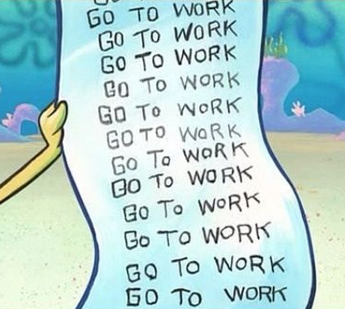
2. Create a schedule
PREPARATION PHASE

Slide 4
3. Prepare materials
PREPARATION PHASE

Slide 5
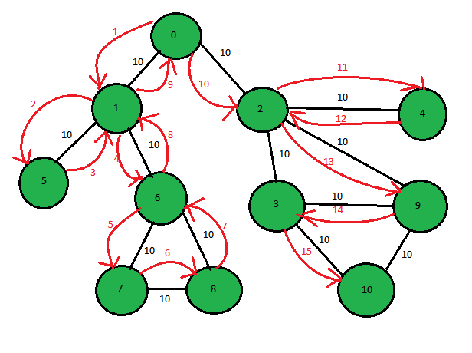
4. Go into depth & width
PREPARATION PHASE

Slide 6
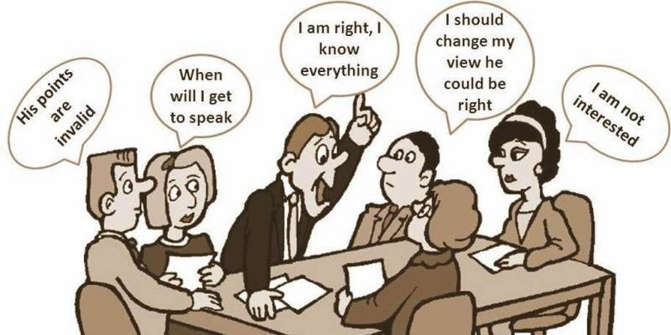
5. Discuss with friends
PREPARATION PHASE

Slide 7
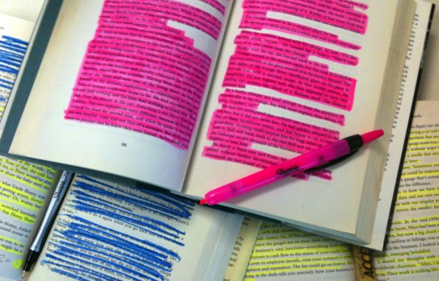
6. Mark easy/hard
STUDY PHASE

Slide 8
7. Revise frequently
STUDY PHASE

Slide 9
8. Explain to someone
STUDY PHASE

Slide 10
9. Prepare for typical questions
He just asked me question 242 , the answer is "primitive function“… or was it for 224?
STUDY PHASE

Slide 11
10. Get to know your committee
STUDY PHASE

Slide 12
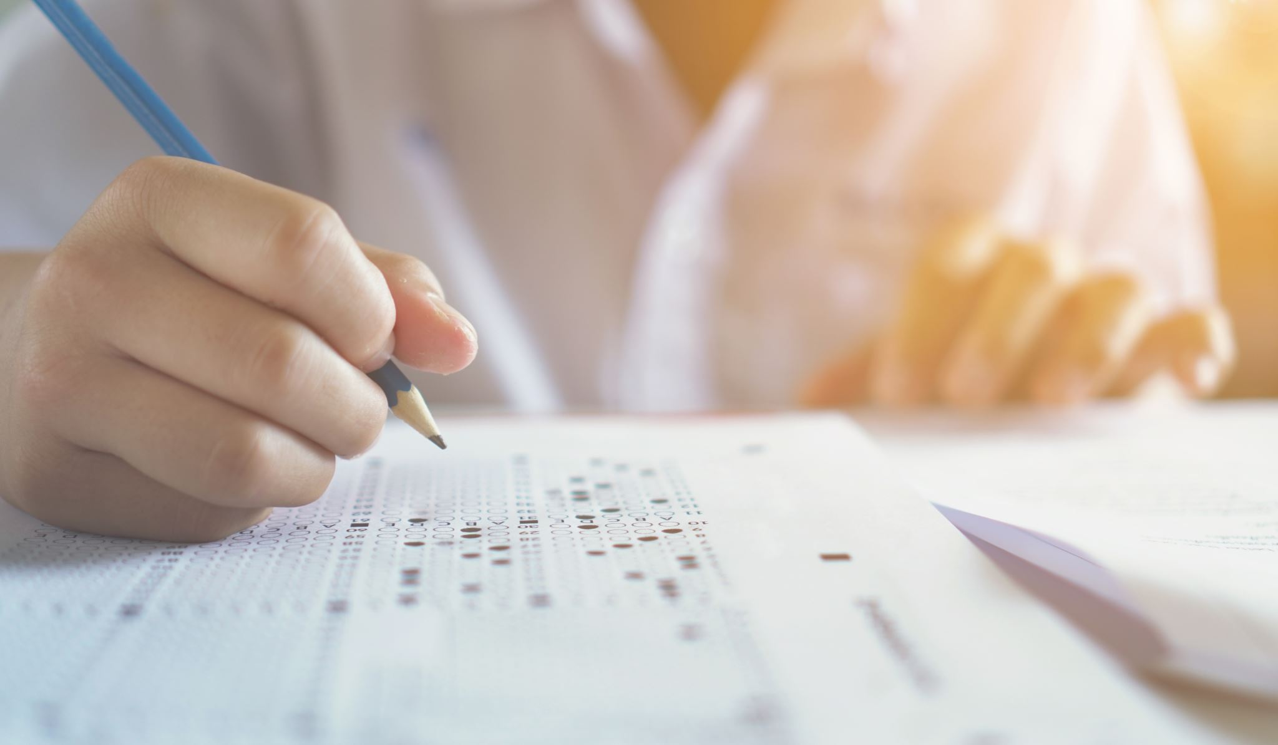
BONUS TIP Talk
EXAM PHASE

