Slide 1
Emotions, Values, Motivation & Procrastination
PV236 – Time Management & Effectiveness
Josef Spurný

Slide 2

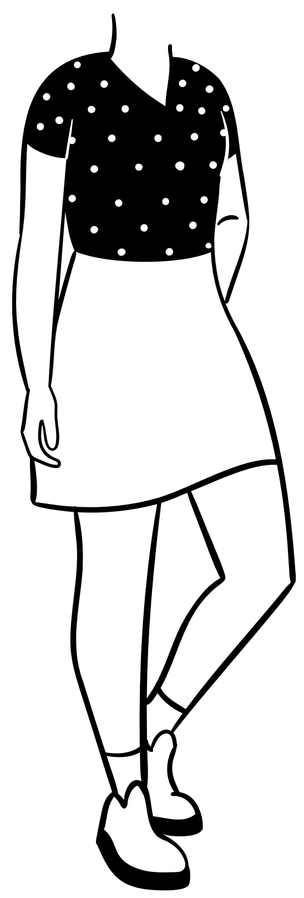
The “Abigail” Group Activity

Slide 3
The “Abigail” Group Activity
Abigail – emotional principle
  Courage, willpower... vs. instability, suggestibility, manipulability…
  Ivan – assertive principle
  Objective, just … vs. uninterested, selfish, buck-passing…
Ahmed – business principle
  Good deal, keeps his word vs. cynical, abusing…
Jeffrey – orthodox principle
  Has believe in good values… vs. selfish, ruthless…
Rambo – aggressive principle
  Protector of weak, knight… vs. aggressor, looking for incentives to fight

Slide 4
Emotions
Emotions have evolutionary value
  To promote beneficial behavior (increase survival)
  To avoid harmful or threatening stimuli
Emotional Brain
  MacLean Triune Brain Hypothesis
  Limbic system (amygdala, hippocampus, hippothalamus…)
Experience
  Neuronal network
  DNA

Slide 5
Attachment Theory
0-4 years
Child needs → parents’ responses
Attachment types
  Secure
  Insecure
    Anxious – Ambivalent
    Anxious – Avoidant
    Fearful – Avoidant (Disorganized)
Structure of Personality
Equifinality

Slide 6
Equifinality
+
Emo. Valence
-
Strength
Emotional responses tend to repeat themselves
Emotional responses are unexpected, irrational…
People do not change (…just like that…)
Different initial setup results in the same outcome

Slide 7
Are humans rational or emotional?

Slide 8
Emotions
Emotions bear energy (stimulation, activation)
Reason does not bear energy
Emotions provide meaning
  “I’m gonna kill you!”
Long-term emotional patterns give rise to (abstract) values

Slide 9
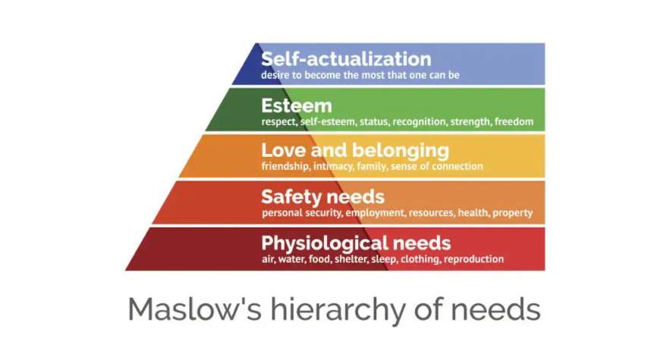
Theory of Human Motivation

Slide 10
Motivation, Will
Actions require energy
Emotions bear energy
“Only dead fish swim with the stream”
Maintaining “emotional metabolism” allows one to swim against the stream
  Will is a higher-order emotion, token of emotional metabolism
  Metabolism has to be provided with resources

Slide 11
Narcissistic Equilibrium
A balance between “wants” and “musts”
In psychoanalytic terms: ego and superego
  Ego = your values, attitudes, desires
  Superego = internalized authority (parent, boss, teacher…)
    “guilty consciousness”
    In order to deliver duties, your ego has to be saturated
    Long-term disequilibrium leads to burnout syndrome
    Manage your narcissistic equilibrium (resources vs expenses)

Slide 12
Emotional saturation – focus on resources
There is no universal guide – you have to know yourself
  Do hobbies
  Relax in a way you enjoy
  Do anything what would bring you positive emotions
  Reward in form of acknowledgement / appreciation
Free time is not a wasted time!

Slide 13

Procrastination

Slide 14
Do you procrastinate globally or locally?
Everyone procrastinates, from time to time
Do I have a problem?
    Ongoing, recurrent procrastination
    Procrastinating enjoyable activities
    Struggling to deliver school/work tasks in time
    Subjective feeling that something is wrong, but I can’t help myself

Slide 15
Two aspects of procrastination
Emotional
  I must do things that I do not like
    → Do I even know what I enjoy?
Cognitive
  I must do vaguely defined tasks
  I am not sure how to solve it
  Choice paralysis
  → at the end of the day, it is still an emotional problem
  – uncertainty, lack of self-confidence
  = impaired ability to make decisions

Slide 16
Know yourself to ride the procrastination horse
It’s in your personality
  Self-awareness
  Self-development (vs personal development)
  Therapy / Coaching (aka “guided introspection”)
  Seek meaning
Do you need stress to get to “your” performance level?
  Concept of “psychological hardiness”

Slide 17
Time management paradoxes
Using TM tools and techniques to advocate procrastination
Applied TM leads to increased pressure instead or reducing it
Investing more willpower to self-motivate instead of changing “the system”
  Forming habits
  Removing distractions

Slide 18
Caution: teacher’s subjective opinion!
In the long term, you cannot “solve” procrastination just by pushing yourself to do things you do not want to do (by using tools/techniques)
  This way you are only getting more efficient at discharging your battery
    Burnout syndrome
    Psychosomatic symptoms / diseases
    Stress, aggression, easy irritation
  These techniques should be combined with maintenance of narcissistic equilibrium, and self-awareness

Slide 19
Homework assignment
Resources
Expenses
?
?
Hints:
What charges and discharges your battery?
Can one activity both charge and discharge you? What prevails?
How much time do you invest in these activities?
Does the greatest expense also take the most time?
Can you recharge the battery without guilty consciousness?

