Slide 1
Crisis communication, Expectations management
PV236 – Time Management & Effectiveness
Josef Spurný

Slide 2
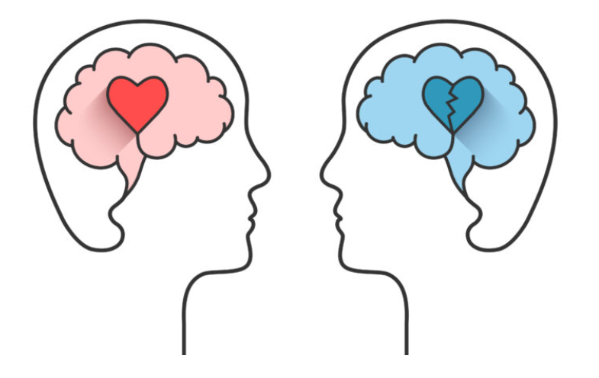
Theoretical framework:
Transactional analysis

Slide 3
Transactional analysis
3 states of our self (Eric Berne, 1950’s)
In the life roles we normally play (child, sibling, student, teacher, employee..), there are three specific internal states which may apply:
Parent
Adult
Child

Slide 4

TA – Parent state
Represents: Parental authority, ethics, morale, tradition
Observed as: setting goals or limits, counseling/coaching/supervision, critique, protective or caring behavior, defending traditional or “normal” values, setting rules and ensuring that they are followed
Variants:
Criticizing parent – command & control, blaming, unwanted advices, “…you should”, “…you must”
Caring parent – support, protection, appreciation, “Well done!”, “I’m so proud of you”

Slide 5

TA – Adult state
Represents: objective, balanced communication, responsibility, bound to reality
Observed as: awareness of pros and cons, realistic expectations, goal seeking, predicting future, working coalition, making and fulfilling agreements

Slide 6

TA – Child state
Represents: Dependency, tendency to be lead, internal wishes, feelings, fantasies
Observed as: emotional episodes (anger, joy, envy…), making fun, playing games, wishful thinking, unrealistic expectations, seeking benefits and overlooking (avoiding) costs, lightheartedness / irresponsibility, manipulation
Variants:
Natural child – behaves spontaneously
Adapted child – as a result of conditional love, it seeks to fulfil parental expectations, own motives may cause guilty consciousness
Negativistic child – rebellious, questioning authority, not willing to cooperate

Slide 7
TA - complementarity
Parent
Parent
Criticizing
Caring
Criticizing
Caring
Adult
Adult
Child
Child
Natural
Adapted
Negativistic
Natural
Adapted
Negativistic

Slide 8
TA - conflicts
Parent
Parent
Criticizing
Caring
Criticizing
Caring
You and your roommate are studying the same studying program. There is a deadline approaching, you suggest that before starting to study, you will both watch an episode of a favorite TV series.
Imagine the conversation to match the portrayed relationships.
Adult
Adult
Child
Child
Natural
Adapted
Negativistic
Natural
Adapted
Negativistic

Slide 9
TA - conflicts
Parent
Parent
Criticizing
Caring
Criticizing
Caring
You and your roommate are studying the same studying program. There is a deadline approaching, you suggest that before starting to study, you will both watch an episode of a favorite TV series.
Imagine the conversation to match the portrayed relationships.
Adult
Adult
Child
Child
Natural
Adapted
Negativistic
Natural
Adapted
Negativistic

Slide 10
TA - conflicts
Parent
Parent
Criticizing
Caring
Criticizing
Caring
You and your roommate are studying the same studying program. There is a deadline approaching, you suggest that before starting to study, you will both watch an episode of a favorite TV series.
Imagine the conversation to match the portrayed relationships.
Adult
Adult
Child
Child
Natural
Adapted
Negativistic
Natural
Adapted
Negativistic

Slide 11
TA – Idealization vs. devaluation
Parent
Parent
Projected, unrealistic, idealized expectations
Confrontation with reality – expectations not met
Devaluation – disappointment, rejection (baby thrown away with the bathwater)
Criticizing
Caring
Criticizing
Caring
Adult
Adult
Child
Child
Natural
Adapted
Negativistic
Natural
Adapted
Negativistic

Slide 12
TA – Good working coalition
Parent
Parent
Criticizing
Caring
Criticizing
Caring
Adult
Adult
Child
Child
Natural
Adapted
Negativistic
Natural
Adapted
Negativistic

Slide 13

Application in crisis communication

Slide 14

What is a crisis?

Slide 15
Crisis communication
time-restricted situation when decisions need to be done
stirred-up emotions of individuals are present
stress or other discomfort is present
the decisions must be done in unexpected or inconvenient time point
small differences in input may lead to significantly different outputs
unexpressed presumptions or expectations may be present

Slide 16
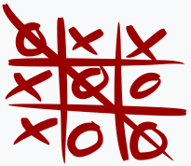
Tic-Tac-Toe Activity

Slide 17
Tic-Tac-Toe Activity - Aftermath
In both formal or informal settings, you might find yourself under pressure to make a decision
Often, people (teams, departments) have their own goals they are interested in and tend to forget about bigger goal they share
This is exaggerated if interested parties slip into child or parent state (willingly or subconsciously)
Take the adult state to evaluate consequences of suboptimal solution

Slide 18

Asiana Airlines Flight 214
Low-speed landing
3 passengers died; another 187 were injured, 49 of them seriously
Co-pilot was aware of captain’s mistake, but was afraid to question him
In Asia, the paternalistic, authoritarian model is culturally embedded
Potentially interesting: Documentary TV series - Seconds from disaster

Slide 19
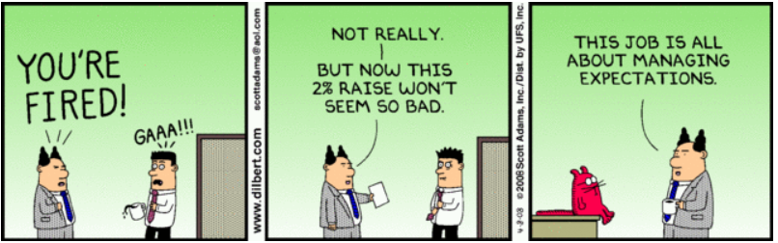
Application in expectation management

Slide 20
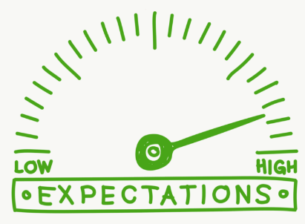
Failed expectations – what went wrong?
Think of a recent situation when your expectations were unmet. What was the cause?

Slide 21
Failed expectations
unrealistic starting point
cultural stereotypes
social stereotypes
cognitive heuristics / biases
  Framing, anchoring, Kruger-Dunning effect, etc.
idealization
…

Slide 22
Expectations managed well
Adult
Adult
formulate the problem in front an as simple as possible
make sure expectations are realistic
do not overcommit your capacity for the delivery
do not hide information, even when it’s not good news – darkness stimulates imagination
try to avoid different interpretations of the same information
it is better to under-promise and over-deliver than vice versa

Slide 23
Homework assignment - TA
Your roommate (or family member) has entered your room without knocking and said:
“Sorry to interrupt you but would you be so kind and take this garbage bag, go outside, and throw it to the garbage can? I am cleaning up and it just gets in the way all the time. ”
You are in the middle of watching an episode of favorite Netflix series episode.
Prepare short responses as a:
Criticizing parent
Caring parent
Adult
Natural child
Adapted child
Negativistic child

