Slide 1
Work-life balance
PV236 – Time Management & Effectiveness
Josef Spurný

Slide 2
Signs of workaholism
You work longer than your colleagues
  Does extra time imply greater productivity?
You can’t stop think about work-related issues in your free time
  It does not matter where you are, but what do you think about
  Your body experiences stress
You do not feel well
  Disrupted sleep, digestion problems, headaches, weight gain/loss, alcohol
Impaired relationships
  Reduced social life, forgetting about important events (b-day), increased irritability
Your self-worth is linked to work success
  Perfectionism, unrealistic expectations, dissatisfaction with sub-stellar performance, micromanaging everything

Slide 3
Signs of workaholism
You do not have hobbies
  Reading work reports is not hobby reading
You feel weird when you do not have any objective
  Does free time make you anxious?
You work when on vacation or when being sick
…
From transactional analysis point, why people slip to workaholism…?

Slide 4
Signs of workaholism
You do not have hobbies
  Reading work reports is not hobby reading
You feel weird when you do not have any objective
  Does free time make you anxious?
You work when on vacation or when being sick
…
From transactional analysis point, why people slip to workaholism…?
… because they live the “adapted child” model

Slide 5
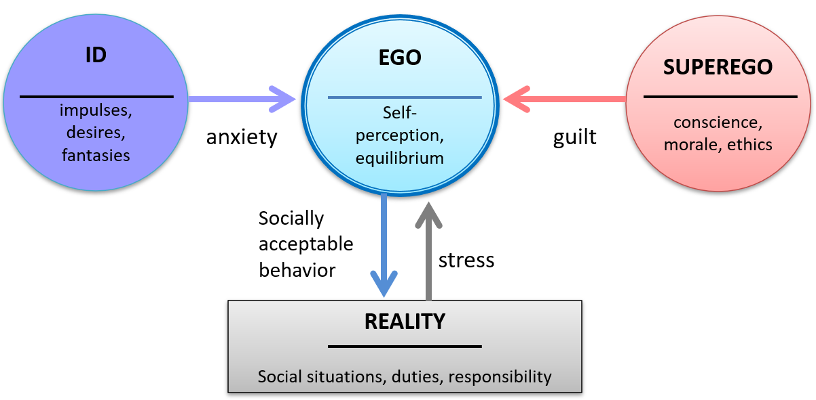
Transactional analysis revisited

Slide 6
What to do with it?
Be aware of the importance of work-life balance
Take control of your time
Actively plan for non-work activities

Slide 7
Tips for work-life balance
First of all, what does work-life balance mean for you?
  There is no universal best-practice, it will change throughout one’s course of life
Question your perfectionism – be “good-enough”, not perfect
Email /phone detox – unplug yourself having doing leisure time
Do some physical activity – get those endorphins
Do not waste time – be efficient, remember Parkinson law
Life changes, maybe your habits should, too?
Find a job that you like – after all, work is part of life
Be social, see old friends, meet new people – “Mark Granovetter: Strength of weak ties”

Slide 8
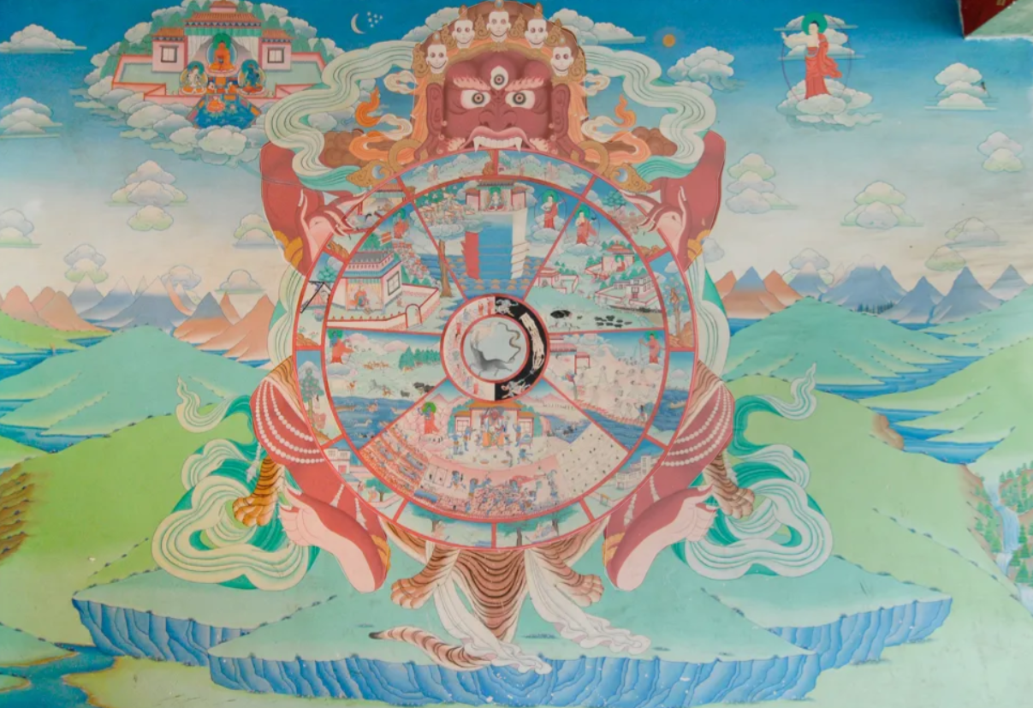
Wheel of Life / Life Balance Wheel

Slide 9
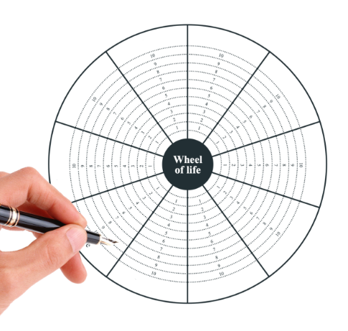
Wheel of Life / Life Balance Wheel
Your homework assignment
Note: Instead of a wheel, you can submit the task in a spreadsheet form, if you would like to.

Slide 10

Wheel of Life / Life Balance Wheel
Brainstorm for 8 different aspects of your life that are important for you
  “Life-role approach“ – me as: student, brother, boyfriend, coworker…
  “Areas of life” – career, financial freedom, physical challenge…

Slide 11

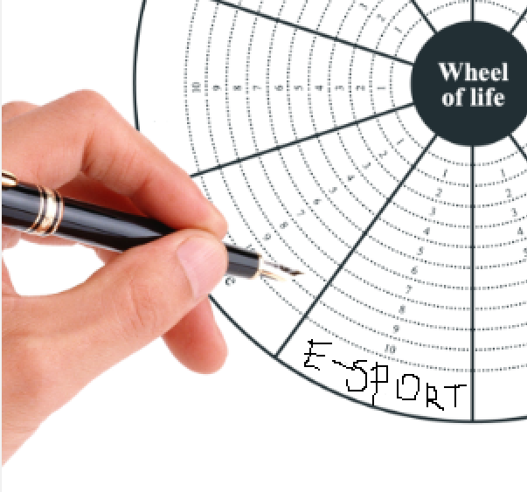
Wheel of Life / Life Balance Wheel
Assign one aspect to one section of the Wheel

Slide 12

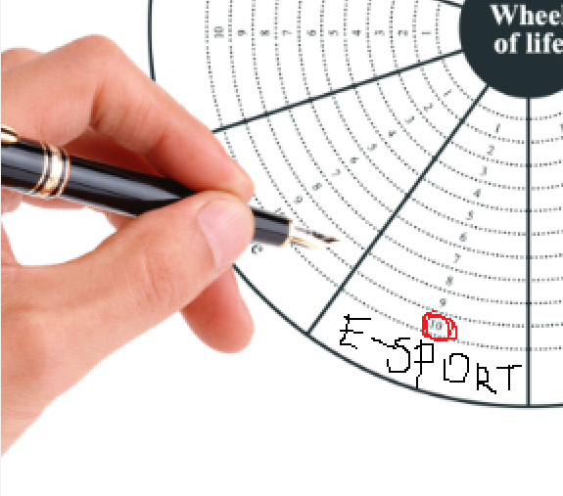
Wheel of Life / Life Balance Wheel
Evaluate each aspect of the Wheel on 0-10 scale based on how much time or attention do you devote to it

Slide 13

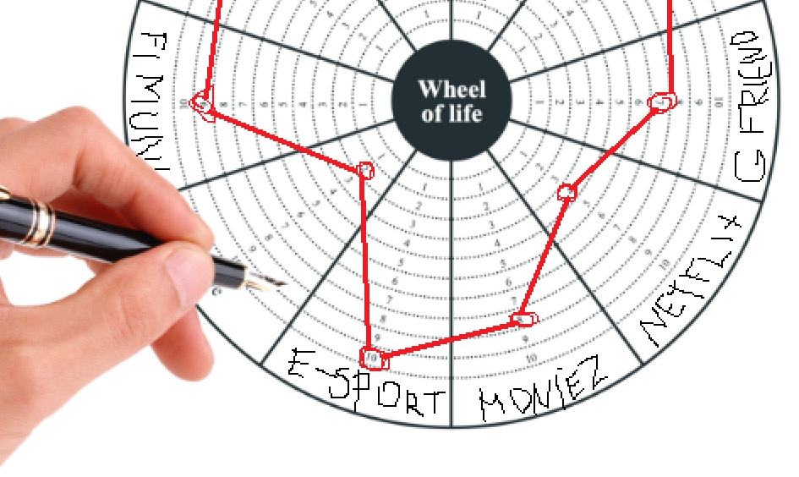
Wheel of Life / Life Balance Wheel
Connect the Wheel – is it balanced?

Slide 14

Wheel of Life / Life Balance Wheel
The “Ideal” – take another look at each of the sections and think about ideal value that would make you happy

Slide 15


Wheel of Life / Life Balance Wheel
If there is a difference between “actual” and “ideal” state, think about actions you can do to move closer to the ideal state

Slide 16
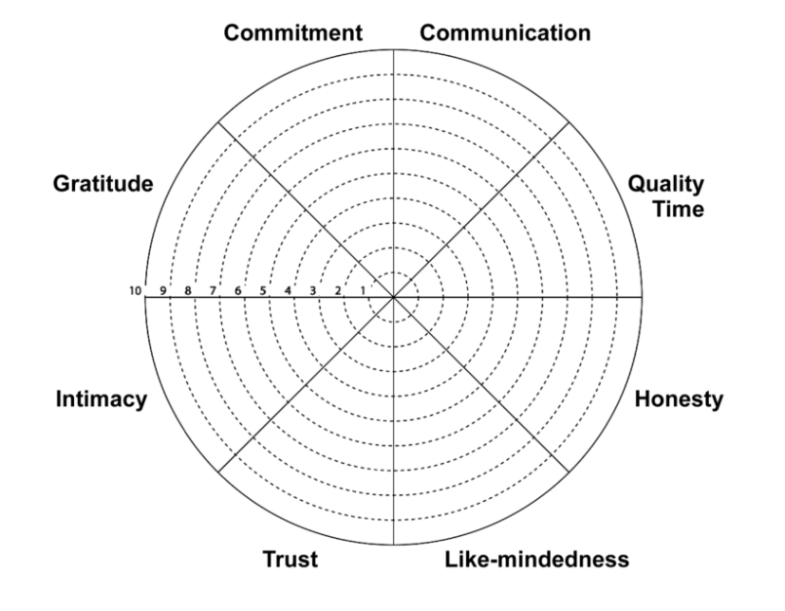
Wheel of Life / Life Balance Wheel
Tip: WoL can be „decomposed“

