Slide 1
Efficient focus, flow experience
Stress
PV236 – Time Management & Effectiveness
Josef Spurný

Slide 2
The Flow experience
Theoretical concept introduced by Hungarian psychologist Mihaly Csikszentmihalyi
A state of high productivity and effortless motivation
No external reward is necessarily present
Positively correlates with motivation level
  Enjoyable activity together with concentration may lead to flow experience more often

Slide 3
How the Flow looks like?
Action-awareness merging
  Involvement in action is automatic and natural
  You become what you do
Full concentration
  Immersion, full engagement in the activity
  Ability to divert distractions
Sense of control
  Rather than consciously trying to remain “in control”, flow experience is about feeling of control without willpower involvement
Loss of Ego
  Normally, we monitor and regulate our behavior to be acceptable by others
  In the flow, people are involved in the activity to such extent that self-monitoring is suppressed
Time distortion
  Subjective feeling of loosing track of time
  Time can be slowed, accelerated or may become irrelevant

Slide 4
How to enter the Flow?
Do you experience flow?
In what situations? Can you repeat it?

Slide 5
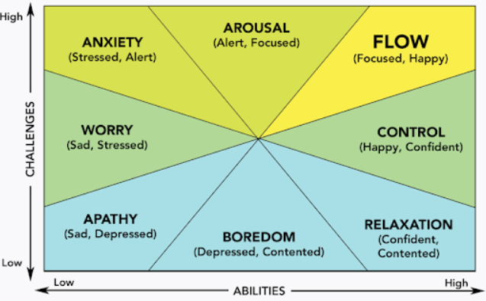
The Flow model

Slide 6
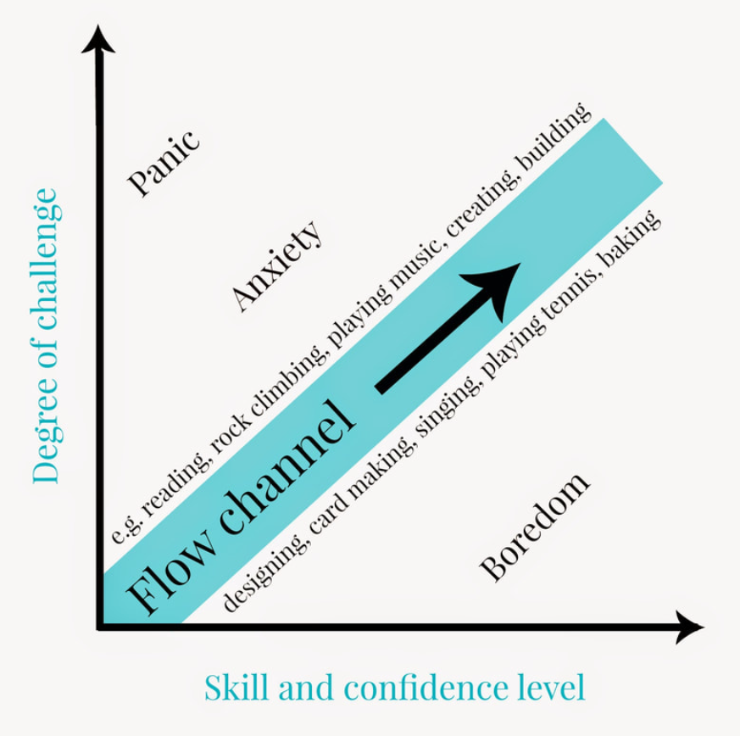
The Flow channel

Slide 7
The Flow preconditions by Csikszentmihalyi
Challenge-skill balance
  Task is not too hard, nor too easy
  “Zone of proximal development”
Well-defined task, consistent feedback
  Both the goal and the path leading to it are clear

Slide 8
Exercises/Tips:
Evaluate your skill level and set appropriate, clearly-defined goals (write them down)
Adjust your daily routine & environment
Create own mission statement – what do you want to achieve?
Focus on internal validation of success instead of external

Slide 9
Stress

Slide 10
Society vs. mind
Acceleration of life pace (Paul Virilio – Dromology)
Fast progress in technology & science
  Boomer: “When I was a little kid, I was curious, I was playing with all kind of technical appliance, a radio for example. Today’s kids don’t do that anymore. How will they become radio-engineers…?”
    Yes, but radios 40 years ago were much simpler than anything nowadays’ kids can play with ☺
  Knowledge grows linearly, but potential combinations grow exponentially → increased specialization of scientist
Increased communication (media/social media, advertising…)
Globalization

Slide 11
Society vs. mind
Our brain is a result of exponential growth, too:
    550 M years of brain evolution
    60 M years of primate brain evolution
    200-400 K years of Homo sapiens brain evolution
    50 K years of cultural development
    10K years since agricultural revolution
    150 years since industrial revolution
    50 years since computer revolution
We live in modern society, but our brain is mostly the same as it was thousands of years ago

Slide 12
What is stress?
Living organisms:
  Intake information from their environment
  Process, accumulate and transform information into internal structure (i.e., they learn → evolution)
    Information initiate reaction (fight vs flight)
  Get rid of excess information
Excess information that cannot be “dissipated” (relaxed) causes damage (stress)
Hans Selye
  Nobel Prize laureate in medicine
  author of stress response (alarm – resistance – exhaustion)
  Origin of “civilization” and psychosomatic diseases

Slide 13
The Stress model - discussion
Coping strategy
Internal structure
intake
excess
Source of stress
Psychosomatic health

Slide 14
Healthy techniques of managing stress
increasing awareness about what happens to me
direct efficient solution
looking for alternative solutions
avoiding stressful situation
seeking emotional & social support
maintaining narcissistic equilibrium (discussed already)

Slide 15
How not to manage stress?

Slide 16
How not to manage stress?
denying reality
not seeking help
refusing offered help
self-destructive behavior (substance abuse, promiscuity…)
social isolation
…

