Slide 1
Relationship marketing
Leonard Walletzký
Faculty of Informatics, Masaryk university

Slide 2
Service and Goods tangibility spectrum

Slide 4
Position the service

Slide 6
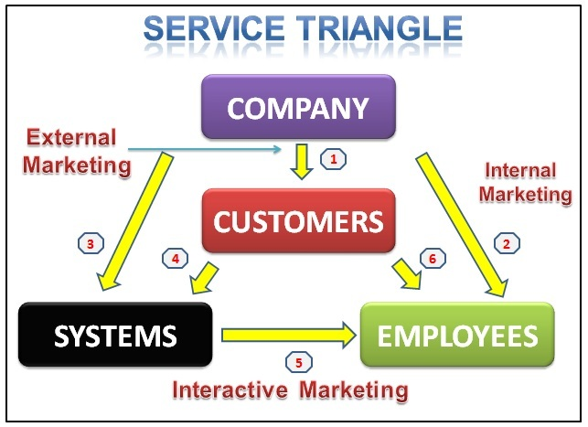
Service Marketing Triangle In IT
IT System
Service Marketing Triangle

Slide 7
Relationship (External) Marketing
Relationships to improve service encounters and retain company’s customers.
Most companies like to build relationships on a long-term basis to retain its customers.
“Relationship marketing” is a step further than the “transactional marketing”
Transactional marketing is a business strategy that focuses on single, "point of sale" transactions. The emphasis is on maximizing the efficiency and volume of individual sales rather than developing a relationship with the buyer.
According to Kotler, the final outcome of a relationship marketing effort is a unique company asset called a marketing network.

Slide 8
Goals of Relationship Marketing
Attracting customers
Retaining customers
Enhancement of relationship
Importance of relationship marketing
Acquiring new customers can be challenging and costly. Relationship marketing helps retain customers over the long term, which results in customer loyalty rather than customers purchase once or infrequently.
Relationship marketing is important for its ability to stay in close contact with customers. By understanding how customers use a brand’s products and services and observing additional unmet needs, brands can create new features and offerings to meet those needs, further strengthening the relationship.

Slide 9
IT vs. Relationship Marketing
https://www.youtube.com/watch?v=r2O5qKZlI50

Slide 10
Benefits of relationship marketing for customers
Confidence Benefits
feelings of trust customers have. They realize they are in safe hands.
Social Benefits
let the customers enjoy a social relationship with their business partners, which bring in more loyalty to the relationship
Special Treatment benefits
Special treatment benefits could range from price to special offers and special solutions based on the intensity of the relationship.

Slide 11
Benefits of relationship marketing for organizations
Lower costs
Committed customers do more business with firms and owing to repeat purchases become the source of larger revenues.
Free advertising
Owing to loyalty with the service brand, positive word-of-mouth generates which is a great benefit accrued over time by the organizations.
Retain staff
Satisfied customers make staff stick to the company.

Slide 12
Case study on customer loyalty
PAYBACK is one of Europe’s leading loyalty programs.
PAYBACK stems from pooling loyalty benefits from many partners: Using one single card, members earn loyalty points when they shop at a wide the range of different merchants and brands.
Source: www.payback.net

Slide 13
Foundations of building relationship
Quality of Service – PA194 and PA181
Segmentation
Relationship Strategies – how do we build and maintain marketing relationship?
Financial Bonds
Social Bonds
Customization Bonds
Structural Bonds

Slide 14
Relationship Strategies

Slide 15
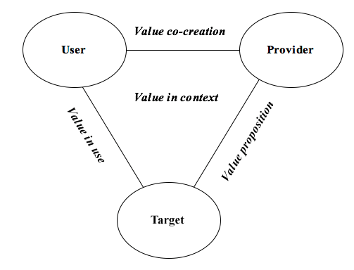
Service Value in Relationship Marketing
You will get to know more about the word VALUE in Service Science and Service Marketing.
Both customers and firms stand to obtain something in this relationship.
Customers like to stay loyal to companies that offer them better value.
Companies like the customers to make more constant purchases.

Slide 16
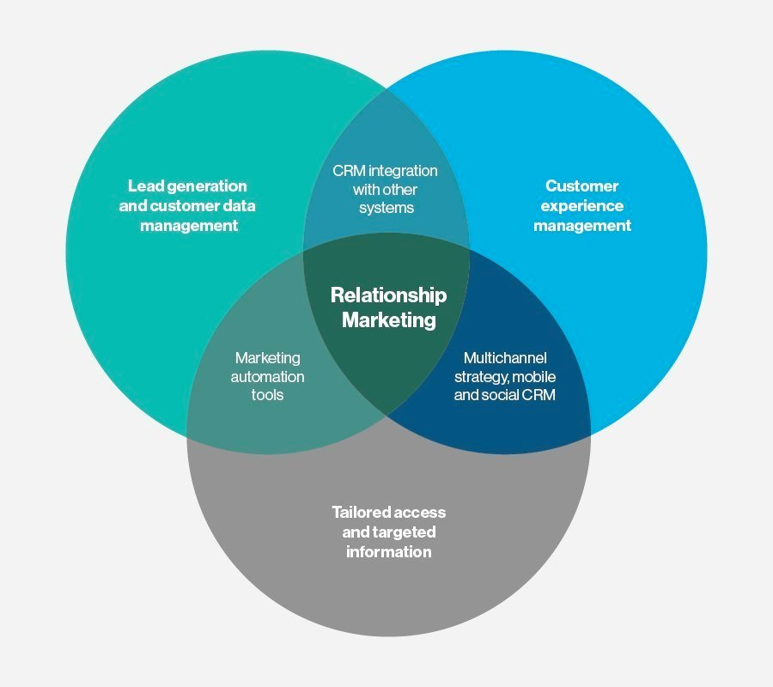
From Relationship marketing to CRM
Relationship marketing is a critical facet of customer relationship management (CRM) that focuses on customer loyalty and long-term customer engagement

Slide 17
Customer Relationship Management (CRM)

Slide 18
CRM
CRM – “Strategy used to learn more about customers’ needs and behaviors in order to develop stronger relationships with them”
CRM – “Any application or initiative designed to help an organization optimize interactions with customers, suppliers, or prospects via one or more touch points – such as a call center, salesperson, distributor, store, branch office, Web, or e-mail – for the purpose of acquiring, retaining, or cross-selling customers.”
CRM introduced in 1993

Slide 19
Look into CRM systems

Slide 20
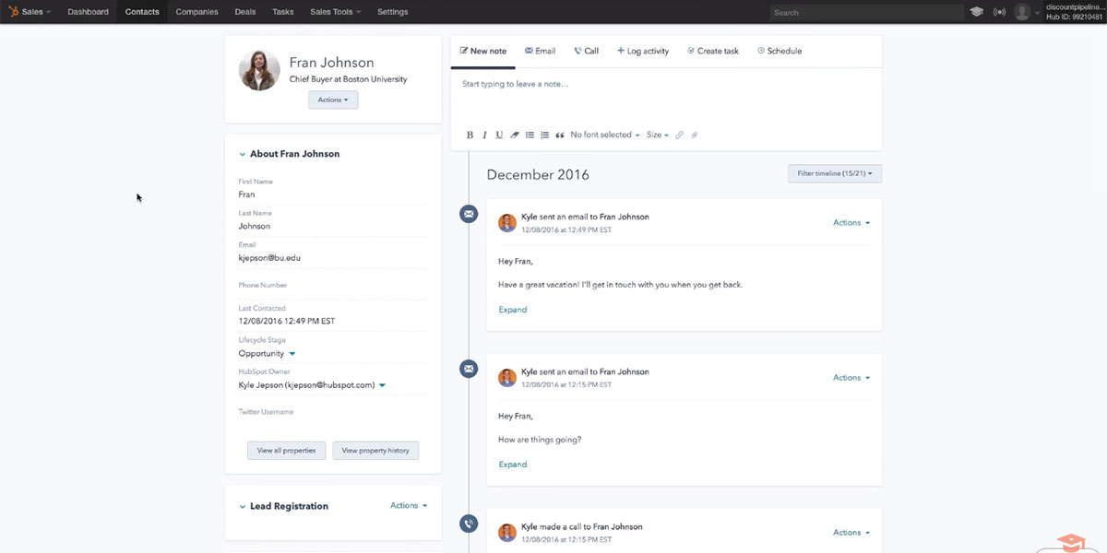
HubSpot CRM
Notes:
https://financesonline.com/what-is-crm-software-analysis-features-types-pricing/#examples

Slide 21
Salesforce Essentials

Slide 22
Freshsales

Slide 23
Types of CRM software
Operational
The CRM’s main goal here is to streamline and automate workflows in sales, marketing, and customer service. Examples: Pipedrive, Zoho CRM, and HubSpot CRM.
Analytical
A good analytical CRM can source tons of data from multiple touch points and consolidate them into insights that are useful to strategic planning. Examples: Salesforce CRM, Oracle CRM, and Microsoft Dynamics CRM
Collaborative
This CRM type promotes teamwork and transparency among sales, marketing, and support by sharing customer information and syncing their activities. It features excellent communication tools including social discussion, chat, and integrated email. Examples: bpm’online CRM, Freshsales, and Base CRM

Slide 24
Why use a CRM software?
Streamline customer profiling
Boost sales opportunities
Leverage data-driven decisions
Forecast sales efficiently
Align marketing and sales
Monitor your customer’s social posts
Accelerate data collection

Slide 25
CRM for Marketing
Campaign management
Retain loyal customers
Cross-selling other products and services
Designing targeted marketing communications
Reinforcing customer purchase decisions
Inducing product trial by new customers
Increasing effectiveness of distribution channel marketing
Improving customer service
Notes:
Notes:
Exhibit 21.3 shows some common CRM marketing database applications.

Slide 26
Potential issues with CRM software?
Security
Data that lives online face the potential dangers of malware attacks, phishing, and hacking. This can compromise your customer’s confidential data.
Privacy
Some customers may feel cautious when their personal information can be accessed and saved in your company’s system.
Weak utilization
Teams may not utilize the software to its optimum capability as they may find it complex or confusing.
Expense
Some users view who view the software as nothing more than a spreadsheet or address book thinks the software is not a valuable investment.

Slide 27
Q & A
Mouzhi.Ge@muni.cz

