Slide 1
Decision making methodology and algorithm : AHP (Analytical Hierarchical Process)
Creation of Information Systems on the Basis of Team Work
Dalia Krikščiūnienė, VU, 2022

Slide 2
Analytical Hierarchical process AHP
Author: Saaty 1980.
Based on expert evaluation
Allows expert groups
Application of quantitative and qualitative criteria
Process of pairwise evaluation (instead of overall assignment of values)
Consistency check
Result – ranking by importance, weights

Slide 3
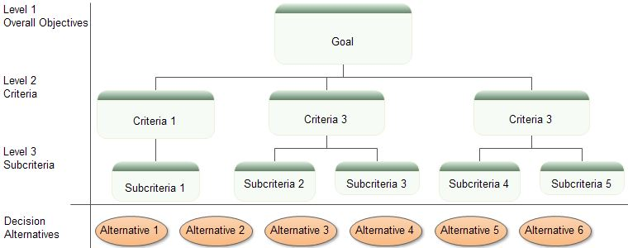
AHP algorithm
Two stage algorithm, where evaluation is done by pairwise comparison of all possible pairs of items:
Stage 1: Criteria assessment -weight assignment to the criteria, arranged as a hierarchical tree
Stage 2: Assessment of decision alternatives (a list of selected objects- weight assignment by each criterion and globally

Slide 4
Example – car selection
Goal- car
Criteria – style, reliability, fuel, price
Alternatives (list of items)
Civic Coupe, Saturn Coupe, Ford Escort, Mazda Miata
Notes:
2

Slide 5
Stage 1- Criteria hierarchy
Car selection
Style
Reliability
Fuel efficiency
STAGE 1
STAGE 2
Civic Saturn Escort Miata
Notes:
3

Slide 6
Ranking criteria and alternatives
Expert ranking: scale 1-9 : symetric relation
Intensyvumas, rangas | Apibrėžimas
1 | Equal
3 | Slightly more important
5 | Definitely More important
7 | Much more important
9 | Absolutely more important
2,4,6,8 | Intermediate values

Slide 7
Evaluation of Criteria: experts assign importance value by analysis of pairs. Is the criterion i (row) more important to criterion j (column) ?
Style
Reliability
Fuel efficiency
Style
1 1/2 3
Reliability
2 1 4
Fuel efficiency
1/3 1/4 1
Automatic recalculation of symmetric relation
Is Reliability (row) more important than Style (column)
Notes:
4

Slide 8
Calculating weights
We analyse the matric [Ax = λ_{max}x] where:
A – matrix of citeria ranks n×n. (n- matrix rank equal to the number of items/criteria)
x eigenvalue vector n×1 – vector of output weights.
λ_{max} eigenvalue, λ_{max} ∈ℜ > n.
The output weights are estimated by calculating eigenvalue vector X:
1) Matrix A comlumns are normalized (the sum columns should become equal to 1) .
2) Calculate average values by rows.
1 0.5 3
2 1 4
0.33 0.25 1.0
Normalization
0.30 0.29 0.38
0.60 0.57 0.50
0.10 0.14 0.13
Row average
0.30
0.60
0.10
A=
X=
Weight vector X
Sums of columns 3.33 1.75 8.00 1.00 1.00 1.00
Notes:
5

Slide 9
STAGE 1 output: Criteria weights
Style 0.30
Reliability 0.60
Fuel efficiency 0.10
Car selection
1.00
Style
0.30
Reliability
0.60
Fuel efficiency
0.10
Notes:
7

Slide 10
Consistency check, evaluation of CR (Consistency ratio)
Consistency Ratio (CR) shows if the expert evaluations were logical, without self-contradiction or random guess.
AHP relies on the common logics of expert evaluations – if A is more important than B, and criterion B is more important than C, then A should be more important than C.
If CR is bigger that 0.1 (>10%) the evaluation matrix is not reliable and has high extent of random guess

Slide 11
CR calculation
In order to find eigenvalue λ_{max}
we analyse the matric expression [Ax = λ_{max} x] where x is the weight vector (eigenvector), and A is the primary (not normalized) expert evaluation matrix, n is matrix rank (number of rows, columns):
A x Ax x
1 0.5 3
2 1 4
0.333 0.25 1.0
0.30
0.60
0.10
0.90
1.60
0.35
0.30
0.60
0.10
=
= λ_{max}
λmax=average of divided values: {0.90/0.30, 1.60/0.6, 0.35/0.10}=3.06
Consistency index is calculated : CI=(λmax-n)/(n-1)=(3.06-3)/(3-1)= 0.03
Consistancy ratio CR=CI/RI=0.03/0.58=0.05. If CR<0.1 evaluations a logical and not random. If CR > 10% (0,1) , the experts should revise evaluation or be excluded
Matrix rank
RI-random index

Slide 12
STAGE 2: Assessment of decision alternatives by EACH criterion
Style
Priority vector
Civic
Saturn
Escort
Miata
Civic
1 1/4 4 1/6
0.13
0.24
0.07
0.56
Saturn
4 1 4 1/4
Escort
1/4 1/4 1 1/5
Miata
Miata
6 4 5 1
Reliability
Civic
Saturn
Escort
Miata
Civic
1 2 5 1
0.38
0.29
0.07
0.26
Saturn
1/2 1 3 2
Escort
1/5 1/3 1 1/4
Miata
1 1/2 4 1
Notes:
8

Slide 13
Ranking values for including quantitative (not expert) evaluation
KM/L
Normalized
Fuel efficiency
Civic
34
.30
Saturn
27
.24
Escort
24
.21
Miata
Miata
28
113
.25
1.0
The indicators of fuel consumption for 100km is recalculated to the indicator “How many km we can drive with 1 liter” (the bigger value is the better should be used for all evaluations – both quantitative and expert)
If we’d like to reflect difference of fuel efficiency depending on seasons (winter/summer or surroundings (city/highway), the expert ranking can be used again
Notes:
9

Slide 14
The result of two-stage evaluation: criteria weights and evaluation of alternatives by all criteria
Car selection
1.00
Style
0.30
Reliability
0.60
Fuel efficiency
0.10
Civic 0.13
Saturn 0.24
Escort 0.07
Miata 0.56
Civic 0.38
Saturn 0.29
Escort 0.07
Miata 0.26
Civic 0.30
Saturn 0.24
Escort 0.21
Miata 0.25
Notes:
10

Slide 15
Global evaluation- weights are calculated by matrix multiplication
Style
Reliability
Fuel efficiency
Civic
.13 .38 .30
.24 .29 .24
.07 .07 .21
.56 .26 .25
.30
.60
.10
.30
.27
.08
.35
Saturn
x
=
Escort
Miata
Miata
Weight matrix
Stage 2
Criteria weights
Stage 1
Global evaluations
Notes:
11

Slide 16
Cost criterion for decision making
Cost can be included to the lost of all criteria for expert pairwise evaluation/ However, it tends to dominate and can hide importance of some criteria.
Instead, it be can use it for COST/BENEFIT analysis . The normalized price is used to estimate COST (price) and is divided by BENEFIT (global evaluation). The smaller value, the more attractive is alternative, as the benefit exceeds cost (CIVIC is most attractive for smallest ratio 0.73, ESCORT is overpriced comparing to its overall benefit – ratio 2.13))
Normalized
price
Benefit
(global weights)
Cost/Benefit
ratio
Price
CIVIC 12K 0.22 0.30 0.73
SATURN 15K 0.28 0.27 1.03
ESCORT 9K 0.17 0.08 2.13
MIATA 18K 0.33 0.35 0.92
Notes:
13

Slide 17
Regression analysis: Graphical visualization of result
Regression analysis is applied
Benefit exceeds the cost (beneficial for us) for all cases above the trendline
Miata
Civic
Saturn
Escort

Slide 18
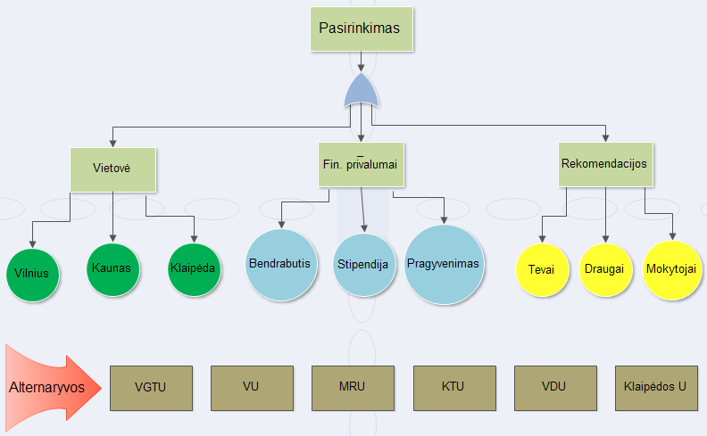
Choosing place to study. Criteria (Location, budget, recommendations). Alternatives (universities)

Slide 19
Complex decisions
Many levels of criteria and sub-criteria exists for complex problems.

Slide 20
Group Decision Making
The AHP allows group decision making, where group members can use their experience, values and knowledge to break down a problem into a hierarchy and solve. Doing so provides:
Understand the conflicting ideas in the organization and try to reach a consensus.
Minimize dominance by a strong member of the group.
Members of the group may vote for the criteria to form the AHP tree. (Overall priorities are determined by the weighted averages of the priorities obtained from members of the group.)
However;
The GDSS does not replace all the requirements for group decision making. Open meetings with the involvement of all members are still an asset.

Slide 21
More about AHP: Pros and Cons
It allows multi criteria decision making.
It is applicable when it is difficult to formulate criteria evaluations, i.e., it allows qualitative evaluation as well as quantitative evaluation.
It is applicable for group decision making environments
Pros
There are hidden assumptions like consistency. Repeating evaluations is cumbersome.
Difficult to use when the number of criteria or alternatives is high, i.e., more than 7.
Difficult to add a new criterion or alternative
Difficult to take out an existing criterion or alternative, since the best alternative might differ if the worst one is excluded.
Users should be trained to use AHP methodology.
Use GDSS
Use constraints to eliminate some alternatives
Cons
Use cost/benefit ratio if applicable

Slide 22
Example 1: : Evaluation of Job Offers
Ex: Peter is offered 4 jobs from Acme Manufacturing (A), Bankers Bank (B), Creative Consulting (C), and Dynamic Decision Making (D).
He bases his evaluation on the criteria such as location, salary, job content, and long-term prospects.
Step 1: Decide upon the relative importance of the selection criteria:
Location Salary Content Long-term
Location
1 1/5 1/3 1/2
5 1 2 4
3 1/2 1 3
2 1/2 1/3 1
Salary
Content
Long-term

Slide 23
Example 1: Priority Vectors:
1) Normalize the column entries by dividing each entry by the sum of the column.
2) Take the overall row averages
Location Salary Content Long-term Average
Location
0.091 0.102 0.091 0.059
0.455 0.513 0.545 0.471
0.273 0.256 0.273 0.353
0.182 0.128 0.091 0.118
0.086
0.496
0.289
0.130
Salary
Content
Long-term
+ +
1 1 1 1 1

Slide 24
Example 1: Evaluation of Job Offers
Step 2: Evaluate alternatives w.r.t. each criteria
Location Scores
Relative Location Scores
A B C D
A B C D Avg.
A
B
C
D
1 1/2 1/3 5
2 1 1/2 7
3 2 1 9
1/5 1/7 1/9 1
A
B
C
D
0.161 0.137 0.171 0.227
0.322 0.275 0.257 0.312
0.484 0.549 0.514 0.409
0.032 0.040 0.057 0.045
0.174
0.293
0.489
0.044

Slide 25
Example 1: Calculation of Relative Scores
Relative weights for each criteria
Relative scores for each alternative
Relative Scores for Each Criteria
Location Salary Content Long-Term
A
B
C
D
0.174 0.050 0.210 0.510
0.293 0.444 0.038 0.012
0.489 0.312 0.354 0.290
0.044 0.194 0.398 0.188
0.086 0.496 0.289 0.130
0.164 0.256 0.335 0.238
x
=

Slide 26
Example 2: AHP in project management
Prequalification of contractors aims at the elimination of incompetent contractors from the bidding process.
It is the choice of the decision maker to eliminate contractor E from the AHP evalution since it is not “feasible” at all !!
 | Contractor A | Contractor B | Contractor C | Contractor D | Contractor E
Experience | 5 years experience | 7 years experience | 8 years experience | 10 years experience | 15 years experience
 | Two similar projects | One similar project | No similar project | Two similar projects | No similar project
 |  | Special procurement experience | 1 international project
Financial stability | $7 M assets | $10 M assets | $14 M assets | $11 M assets | $6 M assets
 | High growth rate | $5.5 M liabilities | $6 M liabilities | $4 M liabilities | $1.5 M liabilities
 | No liability | Part of a group of companies |  | Good relation with banks
Quality performance | Good organization | Average organization | Good organization | Good organization | Bad organization
 | C.M. personnel | C.M. personnel | C.M. team | Good reputation | Unethical techniques
 | Good reputation | Two delayed projects | Government award | Many certi®cates | One project terminated
 | Many certi®cates | Safety program | Good reputation | Cost raised in some projects | Average quality
 | Safety program |  | QA/QC program
Manpower resources | 150 labourers | 100 labourers | 120 labourers | 90 labourers | 40 labourers
 | 10 special skilled labourers | 200 by subcontract | Good skilled labors | 130 by subcontract | 260 by subcontract
 |  | Availability in peaks | 25 special skilled labourers

Slide 27
Example 2 (cont.’d)
 | Contractor A | Contractor B | Contractor C | Contractor D | Contractor E
Equipment resources | 4 mixer machines | 6 mixer machines | 1 batching plant | 4 mixer machines | 2 mixer machines
 | 1 excavator | 1 excavator | 2 concrete transferring trucks | 1 excavator | 10 others
 | 15 others | 1 bulldozer | 2 mixer machines | 9 others | 2000 sf steel formwork
 |  | 20 others | 1 excavator |  | 6000 sf wooden formwork
 |  | 15,000 sf steel formwork | 1 bulldozer
 |  |  | 16 others
 |  |  | 17,000 sf steel formwork
Current works load | 1 big project ending | 2 projects ending (1 big+ 1 medium) | 1 medium project started | 2 big projects ending | 2 small projects started
 | 2 projects in mid (1 medium +1 small) |  | 2 projects ending (1 big + 1 medium) | 1 medium project in mid | 3 projects ending (2 small + 1 medium)

Slide 28
Example 2: Hierarchy Tree
Selecting the most suitable contractor
Experience
Financial Stability
Quality Performence
Manpower Resources
Equipment Resources
Current workload
Contractor A
Contractor B
Contractor C
Contractor D
Contractor E

Slide 29
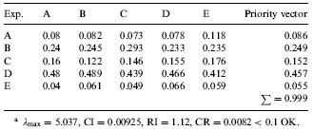
Example 2: AHP in project management
Step 1: Evaluation of the weights of the criteria
Step 2: a) Pairwise comparison matrix for experience

Slide 30
Example 2: AHP in project management
Calculation of priority vector:
x
=
Probably Contractor-E should have been eliminated. It appears to be the worst.
Note that a DSS supports the decision maker, it can not replace him/her. Thus,
an AHP Based DSS should allow the decision maker to make sensitivity analysis of his judgements on the overall priorities !

Slide 31
Multi Criteria Decision Making Models: PROMETHEE
One of the most efficient and easiest MCDM methodologies.
Developed by Jean-Pierre Brans and Bertrand Mareschal at the ULB and VUB universities since 1982
Considers a set of criteria and alternatives. Criteria weights are determined that indicate the relative importance
Utilizes a function reflecting the degree of advantage of one alternative over the other, along with the degree of disadvantage that the same alternative has with respect to the other alternative.
In scaling, there are six options allowing the user to express meaningful differences by minimum gaps between observations. When type I is used, only relative advantage matters; type 6 is based on standardization with respect to normal distribution.

Slide 32
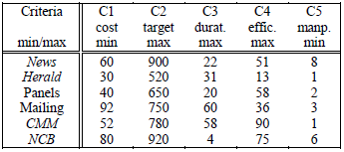
Example 3: Media Selection for a Bicycle Co.
A bicycle manufacturing company is intending to advertise its products.
Six marketing actions are considered: Advertising in the international newspaper, News; in the newspaper Herald; by mean of advertising boards in large cities; of a personal mailing; by TV spots on channels CMM or NCB.
Units: Cost ($ 1,000), Target (10,000 people), Duration (days), Efficiency (0-100)
Manpower (# people involved in the company)

Slide 33
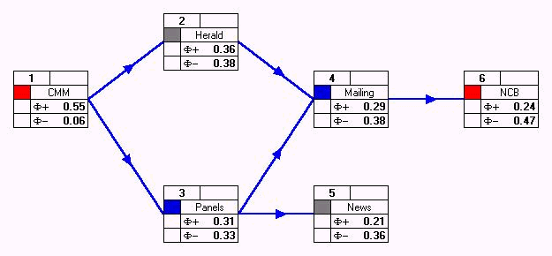
Partial anf full rankings with Promethee I and II

Slide 34
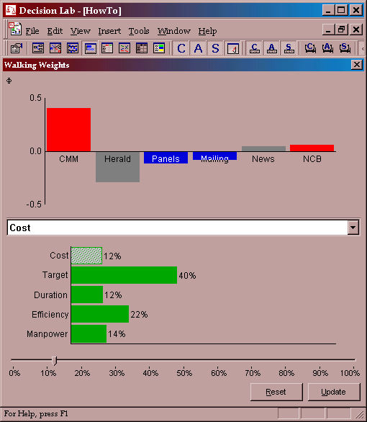
Ranking of the alternatives can be obtained for the selected weights

Slide 35
Including optimization: Additional constraints
It is often necessary that several alternatives have to be selected subject to a set of goals.
In this case an LP can be constructed with binary decision variables, which gives the selection of r actions, among n alternatives.
Let xi=1 if media i is selected and 0 otherwise, i=1,2,...,6.
φ(Ai) are the relative weight of media i, i=1,2,...,6.
Max φ(A1) x1 + … + φ(A6) x6
Subject to
x1 + x2 + x3 + x4 + x5 + x6 ≥ 2 (at least 2 media should be selected)
x1 + x2 + x3 + x4 + x5 + x6 ≤ 4 (at most 4 media should be selected.)
x1 + x2 = 1 (choose exactly one newspaper)
x5 + x6 = 1 ((choose exactly 1 TV channel)
625 x1 + 550 x2 + 250 x3 + 150 x4 + 175 x5 + 750 x6 ≥ 1200 (min. expected return)
- 60 x1 - 30 x2 + 40 x3 + 92 x4 + 52 x5 + 80 x6 ≥ 0 (cost of advertising in newspapers should be less than 50% of total costs)

Slide 36
AHP web tool
https://bpmsg.com/ahp/
Top link- Register (for the leader of AHP evaluation)
After registration an Sign in- use - My AHP Projects
For New project press “New hierarchy”. It will consist of two stages: 1 stage: criteria hierarchy is created and evaluated and saved (project type in My projects is “H”.
2 stage project will be generated automatically by listing alternatives after stage 1 evaluation phase. This will be shown in the My project list as project type A, same title as H.
For creating project for stage 1, press “New hierarchy” and edit it (keeping the syntax signs- column, semicolumn. E.g.
ATOSTOGOS:Saule,Gamta,Pramogos,Lankytini objektai;
Hierarchy is extended by explaining criteria – e.g. „Pramogos“ has to be explained, so the new line is written in the same format:
Pramogos: Jaunimui, Vaikams, Sportas;
After creating (save, submit) hierarchy, copy the link for expert evaluation to all members (they must not be registered or signed to the system)

Slide 37
AHP web tool
After receiving the link (or the session code), the experts can do evaluation. If they have a session code, they use AHP Group Session meniu. Each place where they see AHP, they have to do evaluation. They evaluate pairs of criteria : chose a dot for the more important criterion, assign value, how much more it is important.
After submitting evaluation, the „consistency ratio“ is computed by system, and , if CR value > 10%, the suggestions for changing evaluation are highlighted. The experts are allowed to revise to reach CR<10 % (if this is not achieved, the evaluation will be excluded forom the decision).
For initiating STAGE 2, project leader reviews the Stage 1 group results, selects "View results" press "Define alternatives" and writes the number of alternatives for discussion in the stage 2 etapui. Then the window opens for writing down the list of alternatives. After Save, the new code for voting is assigned. The new link with the new code is sent out to all experts.
The same procedure for evaluation (following each AHP in red square) and adjusting CR is done.
The team report will include the visualizations and tables about voting : criteria weights, alternative weights, table of voting by group members and their results . If some experts have CR>10, their results have to be excluded.

Slide 38
Decision making method: mindmapping
Mind maps
https://www.mindmeister.com/
It is an idea organization and visualization tool for grouping the ideas, summarizing them for further applying other (quantitative) decision making methods.

Slide 39
Decision alternatives – evaluation by “6 hats” method
Present evaluation of alternatives by taking a role, expressed by the hat color:
White hat – relies on information and facts;
Yellow – positive support, discuss pros, potential;
Red – based on emotional argumentation, convincing, taking perspective of market response;
Black – reserved, critical, cautious thinking and argumentation;
Green – creativity aspect, comparative evaluation of innovation and creativity influence for development;
Blue- management aspects, control and summarizing all pros and cons

Slide 40
Delphi method
Delphi is based on the principle that forecasts (or decisions) from a structured group of individuals are more accurate than those from unstructured groups.
The experts answer questionnaires in two or more rounds. After each round, a facilitator or change agent provides an anonymised summary of the experts' forecasts from the previous round as well as the reasons they provided for their judgments.
Thus, experts are encouraged to revise their earlier answers in light of the replies of other members of their panel.
Finally, the process is stopped after a predefined stop criterion (e.g., number of rounds, achievement of consensus, stability of results), and the mean or median scores of the final rounds determine the results

Slide 41
References
Al Harbi K.M.A.S. (1999), Application of AHP in Project Management, International Journal of Project Management, 19, 19-27.
Haas R., Meixner, O., (2009) An Illustrated Guide to the Analytic Hierarchy Process, Lecture Notes, Institute of Marketing & Innovation, University of Natural Resources, retrieved from http://www.boku.ac.at/mi/ on October 2009.
Saaty, T.L., Vargas, L.G., (2001), Models, Methods, Concepts & Applications of the Analytic Hierarchy Process, Kluwer’s Academic Publishers, Boston, USA.
Brans, J.P., Mareschal, B., (2010) “How to Decide with Promethee, retrieved from http://www.visualdecision.com on October 2010.

