Slide 1
Marketing information systems
Prof. dr. Dalia Krikščiūnienė
Vilnius University
Lithuania
Brno, Czech 2022 muni.cz

Slide 2
Course assignments
1 Marketing information management in the web, internet analytics. Tools Google Blogger / Google Analytics
2 Customer relationship marketing, customer capital, marketing decisions. Tools: Excel (pivot),AHP
3 Computerization of marketing processes, problems and solutions. Tools: Power BI
4 Digital transformation of marketing technologies. Tools Google Big Query
Each task carries 50% assignments nd 50% theoretical course (embedded in assignment and class discussion

Slide 3
Marketingo disciplinos įtaka ir raida
Marketingo koncepciniai pagrindai
Marketingo teorinė raida
Mainų pagrindai
Marketingo vadyba, jos vieta įmonėje
Marketingo vadybos procesai
Marketingo specialistų atsakomybės sritys
Marketingo dedamųjų transformacija technologijų įtakoje

Slide 4
Concepts
Market
Marketing as a domain area
Marketing Concepts
Marketing management, role in a company
Marketing theories
MARTECH development. Influence of technologies: from computerization to digital transformation
Marketing dynamics approach
Marketing efforts continuum towards the financial results

Slide 5
Marketing as a domain area
Many definitions of marketing- different accents (AMA-American marketing association defines)
Marketing is a social process by which individuals an groups obtain what they need and want through creating and exchanging products and value with others (Kotler, Turner, 1985)
Keywords:
Needs, wants, demands
Products
Values and satisfaction
Exchange and transactions
Markets

Slide 6
Needs, wants, demands
Need is a state of felt deprivation of some basic satisfaction
E.g. food, clothing –things of survival. These needs are not created by society or marketers, they exist n human biology
Wants are desires for specific satisfiers of deeper needs.
They are different is various societies: a person needs food and wants oyster, needs clothing and wants a Chanel outfit, needs esteem and wants fancy necklace. Wants are continuously reshaped by social forces and communities (families, schools, church, etc.) Marketing can create wants for the customers

Slide 7
Needs, wants, demands
Demands are wants for specific products that are backed up by an ability and willingness to obtain them by exchange.
Wants become demands when backed up by purchasing power.
Companies have to measure not only how many people want their product but how many would actually be willing and able to buy it.

Slide 8
Needs, wants, demands
These distinctions answer frequent critics for marketing “marketers create needs” or “marketers get people to buy things they don’t want”.
Marketers do not create needs- they preexist marketers. E.g. marketers do not create need for social status.
Along with other influential forces marketers influence wants. They suggest to consumers or try to point out how particular product would satisfy need (e.g. BMW car or Parker pen for satisfying need for social status)
Marketers try to influence demand by making product attractive, affordable, available. The demand is highly affected by competition: the want of the customer can be created by one firm and converted to the satisfied demand by the other (e.g. due to discount)

Slide 9
Products
Broad understanding of product : anything that can be offered to someone to satisfy a need or want.
Product as a physical object serves as a vehicle for getting service (e.g. car for riding it).
Services are carried by other vehicles such as persons, places, activities, organizations, ideas. Product covers all vehicles that are capable of delivering satisfaction of a want or need
Tangible and intangible products. Inangible products cover information and knowledge (which is often not documented) and patents, technologies, brands (which can have certificates and can be sold-obtained (exchanged in the market)
Other terms for product: offer, satisfier, resource.

Slide 10
Values and satisfaction
How do consumers choose among the products that might satisfy a given need ?
E.g. how can we travel ? By foot, roller skates, bicycle, car, plane or cruise ship.
The list makes a choice set.
According it we make a product set
The goal set which we want to satisfy in need for traveling, e.g. speed, cost, ease. Each product has difference capacity to satisfy goals.
What is the ideal product ?
Product space is the rating of products by customer perception how far is is from ideal. Value (or utility) is greater if product is nearer to ideal

Slide 11
Exchange and transactions
Marketing exists when people decide to satisfy needs and wants in way we call exchange.
Four ways of exchange:
Self production (e.g. relieve hunger by fishing) - no marketing, as there is no interaction
Coercion (e.g. wrest food from other) – no benefit is offered to other party
Begging (e.g. approach other)- no tangible to offer, except gratitude
Exchange (offer resource in exchange for good: money, another good, service)- marketing arises from this approach
However even in the situations where there is no marketing, the marketing specialists can introduce it (e.g. computer games created for deeating enemies or robbing resources fulfil the needs of customer to experience situation of coercion

Slide 12
Exchange and transactions
Exchange is the defining concept underlying marketing- the act of obtaining desired product from someone offering something in return
Terms for exchange: leave them both better or not worse, that’s why exchange is a value creating process
Exchange has to be seen as a process not event (two partied finding each other, negotiating, moving towards agreement)
If the agreement is reached, transaction occurs.

Slide 13
Markets
Economist view: market is the place where buyers and sellers gather
Marketers view: market consists of all potential customers sharing a particular need or want, able for exchange to satisfy it.
Market are seen as buyers (their groupings), the sellers-as industry. They are connected with flows:
Communication
Products (goods/services)
Money
Information

Slide 14
Summary of marketing concepts
Marketing means human activity that takes place in relation to markets.
Marketer seeks for resource form someone and willing to offer something of value in exchange.
Marketer is seeking response from other party, and can take a role of seller or buyer.

Slide 15
Marketing Concepts
Marketing orientation | Focus | Means | Ends
Production concept | Mass production lowering costs and price | High production efficiency and wide distribution coverage | Sell what is produced. Leads to impersonality of consumer
Product concept | Consumer favors only products that offer most quality, performance and features | Make good products and improve them over time | Sell what producers “love” cause marketing “myopia” losing sight what customer wants
Selling concept | Product | Selling and promotion | Profits through sales volume
Marketing concept | Meet customer needs | Integrated marketing | Profits through customer satisfaction.
Societal marketing concept | Determine customer needs | Deliver needs fulfillment better than competitors | Preserve and ensure long-run society welfare

Slide 16
Marketing’s role in a company
Equal function or primary four: marketing, production, finance, personnel
More important function
Central major function
Customer –central function for controlling 4 primary functions
Customer as controlling, marketing and integrative function in the center

Slide 17
Marketing’s role in a company
Production
Finance
Marketing
Personnel
Marketing
Production
Finance
Personnel
Production, Finance, Personnel
Marketing
Customer

Slide 18
Marketing management
It is the analysis, planning, implementation and control of programs
designed to create, build, and maintain beneficial exchanges and relationships with target markets
for the purpose of achieving organizational objectives
The organization forms the idea of a desired level of transactions with the target market. It has a task of influencing the level, timing, composition of demand according to goals.
States of demand to cope: negative absent, latent, falling, irregular, full, overfull, unwholesome demand

Slide 19
Marketing and management processes (functions)
5 Key Functions of Management
Plan
Organise
Make decisions (Command)
Co-ordinate
Control
If the specialist does not perform any of these functions, he cannot be considered as manager.

Slide 20
Marketing theories
Most prevailing theory is 4P (McCarthy, 1968)- marketing mix (customer, markets, etc. missing here).
Extensions of the 4P theory:
Kotler (megamarketing) 4+2P
Booms&Bitner (Service marketing) 4+3P
Baumgartner (1991) – 15P
The mix concept was initially developed by Neil Burden (1964) derived from Culliton (1948) : marketing is a mix of ingredients (12 elements +4 forces) (Product planning, pricing, branding, channels of distribution, personal selling, advertising, promotions, packaging, display, servicing, physical handling, fact finding and analysis) + (behavior of : consumers buying, trades’ (ret.wh), competitors and their position, governmental
and search for suitable set of ingredients for each transaction with customer.

Slide 21
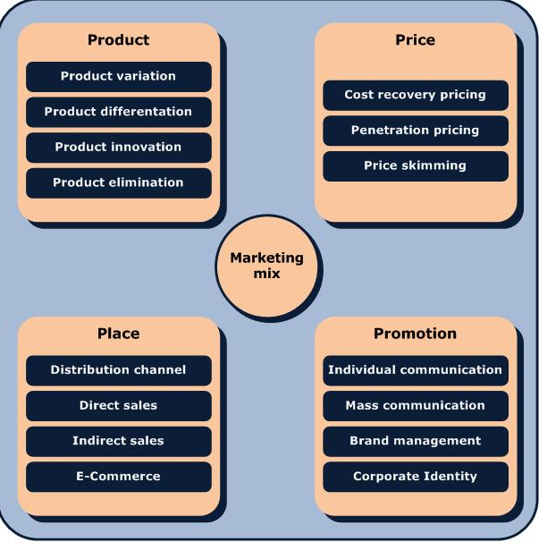
4P – marketing mix component system is too brief for its real implementation. Its real content covers various problem areas:

Slide 22
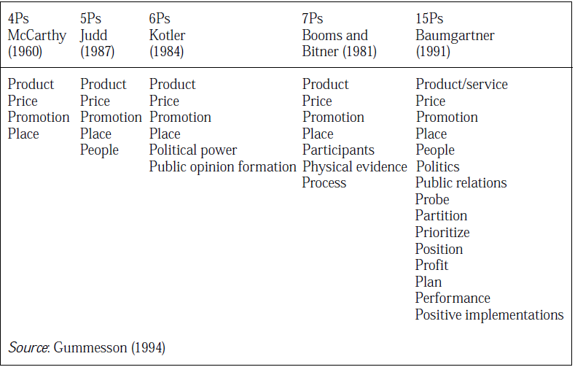
Marketing theories- summary

Slide 23
Development of marketing theories: from mix to relationships
Relationship marketing theory (Gronroos1996, Gummesson,1999 and USA “school”.
Christopher, Payne, Ballantyne (1991) Six markets
Kotler (1992) Ten players
Morgan, Hunt (1994) Ten partnerships
Gummesson 30R :classical relationships (3), special (14), mega (6), nano (7)
Relationship history of communication with customer leads to future activities including transactions.
Relationship processes can be considered as tangible, as they use resources and can be measured by quantitative indicators. They have life cycle. (Gronroos, 1996).
4P marketing is implemented by special department, and in RM all employees ar considered as “part-time marketers” (Gummesson, 1999)

Slide 24
Marketing work and careers
Sales manager
Sale representative
Advertising and promotion manager
Marketing researcher
Customer service manager
Product manager
Market manager
Marketing vice-president
Extensive career specifications exist in enterprises

Slide 25
Marketing work and careers (e.g. certification)
Identify information and research requirements for business and marketing decisions.
Manage the acquisition of information and the Marketing Information System (MkIS).
Contribute information and ideas for business and marketing decisions.
Create a competitive operational marketing plan appropriate to the organization's context.
Integrate appropriate marketing mix tools and manage them to achieve the effective implementation of plans

Slide 26
Marketing work and careers (e.g.certification)
Define and use appropriate measures to evaluate the effectiveness of marketing plans and activities.
Create an effective communications plan for a specific campaign.
Manage marketing communications activities.
Develop and manage support to customers and members of marketing channels.
Plan a marketing project.
Manage a team for marketing project or tasks.
Make recommendations for changes and innovations to the marketing process for value enhancement

Slide 27
Web technologies. Web x.0

Slide 28
MARTECH development. Influence of technologies: from computerization to digital transformation

Slide 29
Marketing dynamics appproach

Slide 30
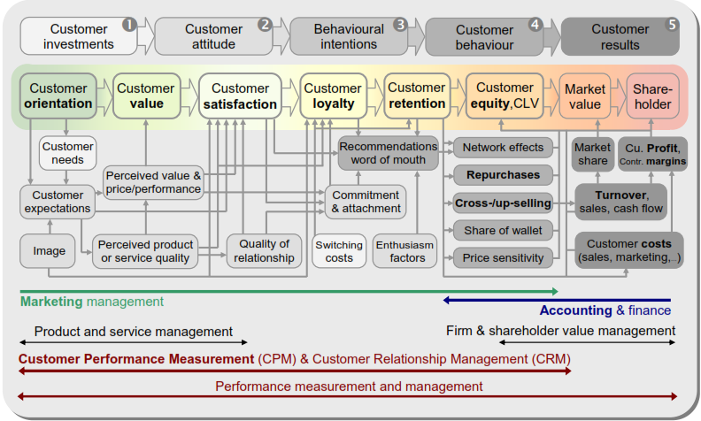
Marketing efforts continuum towards the financial results
Source: Zumstein, D.

Slide 31
Internet marketing
Content marketing
Paid advertising
SEO (search engine optimization)
Soial netowrks, media
CRO (Conversion optimization)
Analytics
cxl.com, https://conversion-rate-experts.com/

