Slide 1
VAMPIRE SURVIVORS

Slide 2
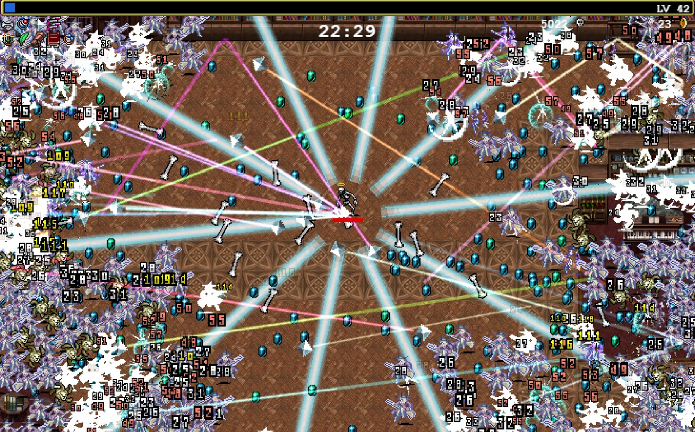
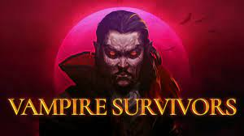
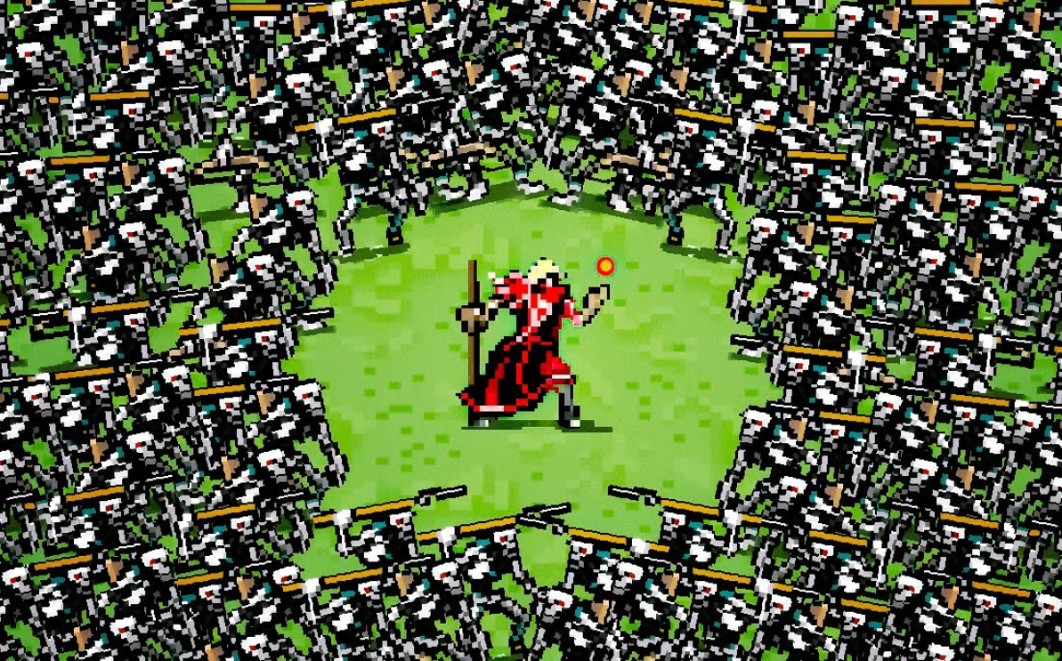
Rozložení nadpisu a obsahu se seznamem
Vampire Survivors is a time survival game with roguelite elements, bullet hell and bullet heaven aspects.

Slide 3
Vampire Survivors
Time survival
Time limited levels
Rogue-lite elements
Getting stronger throught deaths(meta-proggresion)
Unlocking new characters
Bullet hell
Overhelming number of projectiles you need to dodge
Bullet heaven
You generate a lot of projectiles (very fun)

Slide 4
My playtime in Vampire survivors is roughly 40 hours. I observed the captivating effects of the game through the intense gameplay that required split second decision making and precise maneuvers to navigate throught chaos.
Playing the game was a wild ride. At first it was easy, later the number of enemies skyrocketed that made it way harder but i also experinced snowballing effects of power-ups and different weapons. It was a delicate balance between challenge and reward that makes Vampire Survivors both challenging and immensely satisfying.
The game was great at making me feel strong due its numerous ways of snowballing but it also kept me from feeling way too strong due its way of progression.
I would consider myself targeted audience, the game feels very addictive, is very fast paced, easy to learn. There is no point in me deleting it, unfortunately it is availiable online.

