Slide 1
História ezoterických programovacích jazykov
Erik Kočamba

Slide 2
Ezoterický programovací jazyk
Esolang
Experimentovanie s divnými nápadmi
Zložité programovanie
Vtip

Slide 3
INTERCAL
Donald R. Woods a James M. Lyon
1972
Prvý ezoterický programovací jazyk
Compiler Language With No Pronounceable Acronym

Slide 4
DO ,1 <- #13
PLEASE DO ,1 SUB #1 <- #238
DO ,1 SUB #2 <- #108
DO ,1 SUB #3 <- #112
DO ,1 SUB #4 <- #0
DO ,1 SUB #5 <- #64
DO ,1 SUB #6 <- #194
DO ,1 SUB #7 <- #48
PLEASE DO ,1 SUB #8 <- #22
DO ,1 SUB #9 <- #248
DO ,1 SUB #10 <- #168
DO ,1 SUB #11 <- #24
DO ,1 SUB #12 <- #16
DO ,1 SUB #13 <- #162
PLEASE READ OUT ,1
PLEASE GIVE UP

Slide 5
BRAINF*CK
Urban Müler
1993
Najznámejší esolang
Cieľom bolo vytvoriť čo najmenší kompilátor pre Amiga OS 2.0 (240B)
8 príkazov: <>+-[].,

Slide 6
BRAINF*CK
Príkaz | Popis
> | Posun ukazateľa doprava
< | Posun ukazateľa doľava
+ | Inkrement pamäťovej bunky
- | Dekrement pamäťovej bunky
. | Výpis znaku pamäťovej bunky
, | Načítanie znaku pamäťovej bunky
[ | Skok za párovú ] ak pamäťová bunka má hodnotu 0
] | Skok späť na párovú ] ak pamäťová bunka má hodnotu rôznu od 0

Slide 7
BRAINF*CK
++++++++[>++++[>++>+++>+++>+<<<<-]>+>+>->>+[<]<-]>>.>---.+++++++..+++.>>.<-.<.+++.------.--------.>>+.>++.

Slide 8
SMETANA
Chris Pressey
1994
Self-Modifying Extremely Tiny AutomatoN Application
2 typy inštrukcií
  Swap step x with step y.
  Go to step x.

Slide 9
SMETANA
Step 1. Go to step 4.
Step 2. Swap step 3 with step 5.
Step 3. Go to step 6.
Step 4. Swap step 1 with step 6.
Step 5. Go to step 2.
Step 6. Swap step 1 with step 2.

Slide 10
Malbolge
Ben Olmstead
1998
Pomenovaný po ôsmom kruhu pekla v dráme Dante Alighieriho
Navrhnutý aby bol takmer nepoužiteľný

Slide 11
Malbolge
(=<`#9]~6ZY32Vx/4Rs+0No-&Jk)"Fh}|Bcy?`=*z]Kw%oG4UUS0/@-ejc(:'8dc

Slide 12
Shakespeare
Karl Hasselström a Jon Åslund
2001
Cieľom bolo vytvoriť jazyk ktorý by pripomínal Shakespearove hry

Slide 13
Shakespeare
The Infamous Hello World Program.
Romeo, a young man with a remarkable patience. Juliet, a likewise young woman of remarkable grace. Ophelia, a remarkable woman much in dispute with Hamlet. Hamlet, the flatterer of Andersen Insulting A/S.
Act I: Hamlet's insults and flattery.
Scene I: The insulting of Romeo.
[Enter Hamlet and Romeo] Hamlet: You lying stupid fatherless big smelly half-witted coward! You are as stupid as the difference between a handsome rich brave hero and thyself! Speak your mind! You are as brave as the sum of your fat little stuffed misused dusty old rotten codpiece and a beautiful fair warm peaceful sunny summer's day. You are as healthy as the difference between the sum of the sweetest reddest rose and my father and yourself! Speak your mind! You are as cowardly as the sum of yourself and the difference between a big mighty proud kingdom and a horse. Speak your mind. Speak your mind! [Exit Romeo]

Slide 14
WHITESPACE
Edwin Brady a Chris Morris
2003
Pozostáva iba z bielych znakov
Môže byť obsiahnutý v kóde iného jazyka

Slide 15
Whitespace

Slide 16
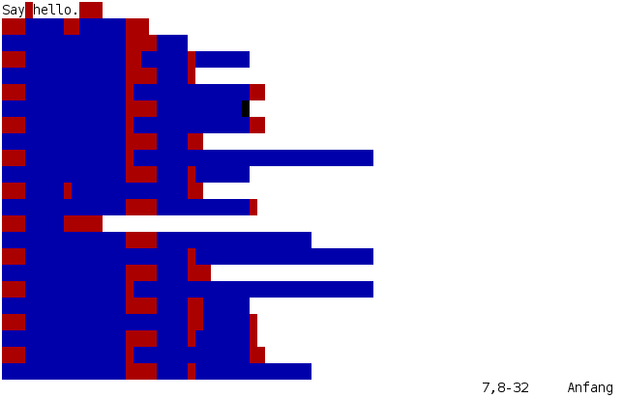
Whitespace

Slide 17
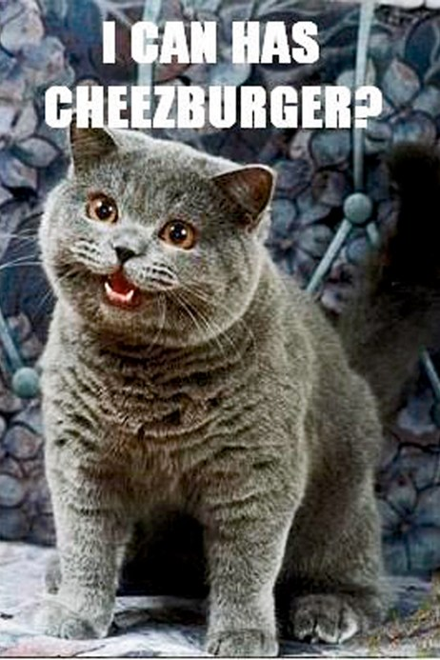
LOLCODE
Adam Lindsay
2007
Príkazy inšpirované LOLCATS meme

Slide 18
LOLCODE
HAI 1.2
CAN HAS STDIO?
VISIBLE "HAI WORLD!!!1!"
KTHXBYE

Slide 19
Piet
David Morgan-Mar
Výstup je podobný abstraktnému obrazu
Je tvorený 20 farbami
Každá farba reprezentuje integer

Slide 20



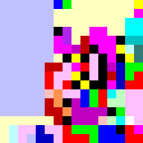
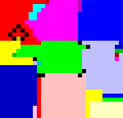
Piet

Slide 21
Velato
Daniel Temkin
2009
Používa MIDI súbory ako zdrojový kód
Program sa dá zapísať do nôt

Slide 22
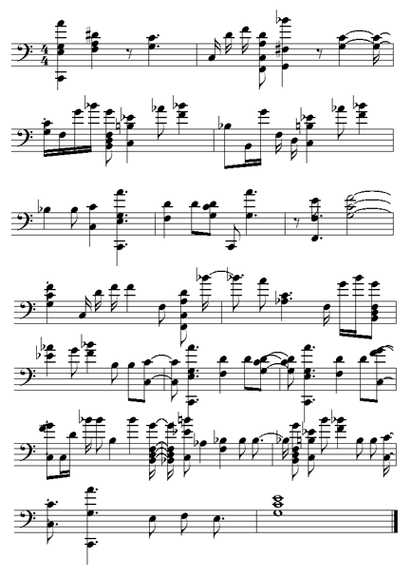
Velato

Slide 23
JSF*ck
Yosuke Hasegawa
2010
Validný JS kód
6 príkazov: +!()[]

Slide 24
JSF*ck
[][(![]+[])[+[]]+(![]+[])[!+[]+!+[]]+(![]+[])[+!+[]]+(!![]+[])[+[]]][([][(![]+[])[+[]]+(![]+[])[!+[]+!+[]]+(![]+[])[+!+[]]+(!![]+[])[+[]]]+[])[!+[]+!+[]+!+[]]+(!![]+[][(![]+[])[+[]]+(![]+[])[!+[]+!+[]]+(![]+[])[+!+[]]+(!![]+[])[+[]]])[+!+[]+[+[]]]+([][[]]+[])[+!+[]]+(![]+[])[!+[]+!+[]+!+[]]+(!![]+[])[+[]]+(!![]+[])[+!+[]]+([][[]]+[])[+[]]+([][(![]+[])[+[]]+(![]+[])[!+[]+!+[]]+(![]+[])[+!+[]]+(!![]+[])[+[]]]+[])[!+[]+!+[]+!+[]]+(!![]+[])[+[]]+(!![]+[][(![]+[])[+[]]+(![]+[])[!+[]+!+[]]+(![]+[])[+!+[]]+(!![]+[])[+[]]])[+!+[]+[+[]]]+(!![]+[])[+!+[]]]((!![]+[])[+!+[]]+(!![]+[])[!+[]+!+[]+!+[]]+(!![]+[])[+[]]+([][[]]+[])[+[]]+(!![]+[])[+!+[]]+([][[]]+[])[+!+[]]+(+[![]]+[][(![]+[])[+[]]+(![]+[])[!+[]+!+[]]+(![]+[])[+!+[]]+(!![]+[])[+[]]])[+!+[]+[+!+[]]]+(!![]+[])[!+[]+!+[]+!+[]]+(+(!+[]+!+[]+!+[]+[+!+[]]))[(!![]+[])[+[]]+(!![]+[][(![]+[])[+[]]+(![]+[])[!+[]+!+[]]+(![]+[])[+!+[]]+(!![]+[])[+[]]])[+!+[]+[+[]]]+([]+[])[([][(![]+[])[+[]]+(![]+[])[!+[]+!+[]]+(![]+[])[+!+[]]+(!![]+[])[+[]]]+[])[!+[]+!+[]+!+[]]+(!![]+[][(![]+[])[+[]]+(![]+[])[!+[]+!+[]]+(![]+[])[+!+[]]+(!![]+[])[+[]]])[+!+[]+[+[]]]+([][[]]+[])[+!+[]]+(![]+[])[!+[]+!+[]+!+[]]+(!![]+[])[+[]]+(!![]+[])[+!+[]]+([][[]]+[])[+[]]+([][(![]+[])[+[]]+(![]+[])[!+[]+!+[]]+(![]+[])[+!+[]]+(!![]+[])[+[]]]+[])[!+[]+!+[]+!+[]]+(!![]+[])[+[]]+(!![]+[][(![]+[])[+[]]+(![]+[])[!+[]+!+[]]+(![]+[])[+!+[]]+(!![]+[])[+[]]])[+!+[]+[+[]]]+(!![]+[])[+!+[]]][([][[]]+[])[+!+[]]+(![]+[])[+!+[]]+((+[])[([][(![]+[])[+[]]+(![]+[])[!+[]+!+[]]+(![]+[])[+!+[]]+(!![]+[])[+[]]]+[])[!+[]+!+[]+!+[]]+(!![]+[][(![]+[])[+[]]+(![]+[])[!+[]+!+[]]+(![]+[])[+!+[]]+(!![]+[])[+[]]])[+!+[]+[+[]]]+([][[]]+[])[+!+[]]+(![]+[])[!+[]+!+[]+!+[]]+(!![]+[])[+[]]+(!![]+[])[+!+[]]+([][[]]+[])[+[]]+([][(![]+[])[+[]]+(![]+[])[!+[]+!+[]]+(![]+[])[+!+[]]+(!![]+[])[+[]]]+[])[!+[]+!+[]+!+[]]+(!![]+[])[+[]]+(!![]+[][(![]+[])[+[]]+(![]+[])[!+[]+!+[]]+(![]+[])[+!+[]]+(!![]+[])[+[]]])[+!+[]+[+[]]]+(!![]+[])[+!+[]]]+[])[+!+[]+[+!+[]]]+(!![]+[])[!+[]+!+[]+!+[]]]](!+[]+!+[]+!+[]+[!+[]+!+[]])+(![]+[])[+!+[]]+(![]+[])[!+[]+!+[]])()([][(![]+[])[+[]]+(![]+[])[!+[]+!+[]]+(![]+[])[+!+[]]+(!![]+[])[+[]]][([][(![]+[])[+[]]+(![]+[])[!+[]+!+[]]+(![]+[])[+!+[]]+(!![]+[])[+[]]]+[])[!+[]+!+[]+!+[]]+(!![]+[][(![]+[])[+[]]+(![]+[])[!+[]+!+[]]+(![]+[])[+!+[]]+(!![]+[])[+[]]])[+!+[]+[+[]]]+([][[]]+[])[+!+[]]+(![]+[])[!+[]+!+[]+!+[]]+(!![]+[])[+[]]+(!![]+[])[+!+[]]+([][[]]+[])[+[]]+([][(![]+[])[+[]]+(![]+[])[!+[]+!+[]]+(![]+[])[+!+[]]+(!![]+[])[+[]]]+[])[!+[]+!+[]+!+[]]+(!![]+[])[+[]]+(!![]+[][(![]+[])[+[]]+(![]+[])[!+[]+!+[]]+(![]+[])[+!+[]]+(!![]+[])[+[]]])[+!+[]+[+[]]]+(!![]+[])[+!+[]]]((!![]+[])[+!+[]]+(!![]+[])[!+[]+!+[]+!+[]]+(!![]+[])[+[]]+([][[]]+[])[+[]]+(!![]+[])[+!+[]]+([][[]]+[])[+!+[]]+([]+[])[(![]+[])[+[]]+(!![]+[][(![]+[])[+[]]+(![]+[])[!+[]+!+[]]+(![]+[])[+!+[]]+(!![]+[])[+[]]])[+!+[]+[+[]]]+([][[]]+[])[+!+[]]+(!![]+[])[+[]]+([][(![]+[])[+[]]+(![]+[])[!+[]+!+[]]+(![]+[])[+!+[]]+(!![]+[])[+[]]]+[])[!+[]+!+[]+!+[]]+(!![]+[][(![]+[])[+[]]+(![]+[])[!+[]+!+[]]+(![]+[])[+!+[]]+(!![]+[])[+[]]])[+!+[]+[+[]]]+(![]+[])[!+[]+!+[]]+(!![]+[][(![]+[])[+[]]+(![]+[])[!+[]+!+[]]+(![]+[])[+!+[]]+(!![]+[])[+[]]])[+!+[]+[+[]]]+(!![]+[])[+!+[]]]()[+!+[]+[!+[]+!+[]]]+((![]+[])[+!+[]]+(![]+[])[!+[]+!+[]]+(!![]+[])[!+[]+!+[]+!+[]]+(!![]+[])[+!+[]]+(!![]+[])[+[]]+[+!+[]]+[!+[]+!+[]+!+[]+!+[]+!+[]+!+[]]+[!+[]+!+[]+!+[]+!+[]]+(!![]+[])[+[]]+[!+[]+!+[]+!+[]+!+[]+!+[]]+[+[]]+(!![]+[])[+[]]+[!+[]+!+[]+!+[]+!+[]]+[!+[]+!+[]+!+[]+!+[]+!+[]+!+[]+!+[]]+(!![]+[])[+[]]+[+!+[]]+[+!+[]]+[+[]]+(!![]+[])[!+[]+!+[]+!+[]]+(![]+[])[!+[]+!+[]]+(![]+[])[!+[]+!+[]]+(!![]+[])[+[]]+[+!+[]]+[!+[]+!+[]+!+[]+!+[]+!+[]]+[!+[]+!+[]+!+[]+!+[]+!+[]+!+[]+!+[]]+(!![]+[])[+[]]+[!+[]+!+[]+!+[]+!+[]]+[+[]]+(!![]+[])[+[]]+[+!+[]]+[!+[]+!+[]]+[!+[]+!+[]+!+[]+!+[]+!+[]+!+[]+!+[]]+(!![]+[])[+[]]+[+!+[]]+[!+[]+!+[]+!+[]+!+[]+!+[]]+[!+[]+!+[]+!+[]+!+[]+!+[]+!+[]+!+[]]+(!![]+[])[+!+[]]+(![]+[])[!+[]+!+[]]+([][[]]+[])[!+[]+!+[]]+(!![]+[])[+[]]+[!+[]+!+[]+!+[]+!+[]]+[+!+[]]+(!![]+[])[+[]]+[!+[]+!+[]+!+[]+!+[]]+[!+[]+!+[]+!+[]+!+[]+!+[]+!+[]+!+[]]+(!![]+[])[+[]]+[!+[]+!+[]+!+[]+!+[]+!+[]]+[+!+[]])[(![]+[])[!+[]+!+[]+!+[]]+(+(!+[]+!+[]+[+!+[]]+[+!+[]]))[(!![]+[])[+[]]+(!![]+[][(![]+[])[+[]]+(![]+[])[!+[]+!+[]]+(![]+[])[+!+[]]+(!![]+[])[+[]]])[+!+[]+[+[]]]+([]+[])[([][(![]+[])[+[]]+(![]+[])[!+[]+!+[]]+(![]+[])[+!+[]]+(!![]+[])[+[]]]+[])[!+[]+!+[]+!+[]]+(!![]+[][(![]+[])[+[]]+(![]+[])[!+[]+!+[]]+(![]+[])[+!+[]]+(!![]+[])[+[]]])[+!+[]+[+[]]]+([][[]]+[])[+!+[]]+(![]+[])[!+[]+!+[]+!+[]]+(!![]+[])[+[]]+(!![]+[])[+!+[]]+([][[]]+[])[+[]]+([][(![]+[])[+[]]+(![]+[])[!+[]+!+[]]+(![]+[])[+!+[]]+(!![]+[])[+[]]]+[])[!+[]+!+[]+!+[]]+(!![]+[])[+[]]+(!![]+[][(![]+[])[+[]]+(![]+[])[!+[]+!+[]]+(![]+[])[+!+[]]+(!![]+[])[+[]]])[+!+[]+[+[]]]+(!![]+[])[+!+[]]][([][[]]+[])[+!+[]]+(![]+[])[+!+[]]+((+[])[([][(![]+[])[+[]]+(![]+[])[!+[]+!+[]]+(![]+[])[+!+[]]+(!![]+[])[+[]]]+[])[!+[]+!+[]+!+[]]+(!![]+[][(![]+[])[+[]]+(![]+[])[!+[]+!+[]]+(![]+[])[+!+[]]+(!![]+[])[+[]]])[+!+[]+[+[]]]+([][[]]+[])[+!+[]]+(![]+[])[!+[]+!+[]+!+[]]+(!![]+[])[+[]]+(!![]+[])[+!+[]]+([][[]]+[])[+[]]+([][(![]+[])[+[]]+(![]+[])[!+[]+!+[]]+(![]+[])[+!+[]]+(!![]+[])[+[]]]+[])[!+[]+!+[]+!+[]]+(!![]+[])[+[]]+(!![]+[][(![]+[])[+[]]+(![]+[])[!+[]+!+[]]+(![]+[])[+!+[]]+(!![]+[])[+[]]])[+!+[]+[+[]]]+(!![]+[])[+!+[]]]+[])[+!+[]+[+!+[]]]+(!![]+[])[!+[]+!+[]+!+[]]]](!+[]+!+[]+!+[]+[+!+[]])[+!+[]]+(![]+[])[!+[]+!+[]]+([![]]+[][[]])[+!+[]+[+[]]]+(!![]+[])[+[]]]((!![]+[])[+[]])[([][(!![]+[])[!+[]+!+[]+!+[]]+([][[]]+[])[+!+[]]+(!![]+[])[+[]]+(!![]+[])[+!+[]]+([![]]+[][[]])[+!+[]+[+[]]]+(!![]+[])[!+[]+!+[]+!+[]]+(![]+[])[!+[]+!+[]+!+[]]]()+[])[!+[]+!+[]+!+[]]+(!![]+[][(![]+[])[+[]]+(![]+[])[!+[]+!+[]]+(![]+[])[+!+[]]+(!![]+[])[+[]]])[+!+[]+[+[]]]+([![]]+[][[]])[+!+[]+[+[]]]+([][[]]+[])[+!+[]]](([][(![]+[])[+[]]+(![]+[])[!+[]+!+[]]+(![]+[])[+!+[]]+(!![]+[])[+[]]][([][(![]+[])[+[]]+(![]+[])[!+[]+!+[]]+(![]+[])[+!+[]]+(!![]+[])[+[]]]+[])[!+[]+!+[]+!+[]]+(!![]+[][(![]+[])[+[]]+(![]+[])[!+[]+!+[]]+(![]+[])[+!+[]]+(!![]+[])[+[]]])[+!+[]+[+[]]]+([][[]]+[])[+!+[]]+(![]+[])[!+[]+!+[]+!+[]]+(!![]+[])[+[]]+(!![]+[])[+!+[]]+([][[]]+[])[+[]]+([][(![]+[])[+[]]+(![]+[])[!+[]+!+[]]+(![]+[])[+!+[]]+(!![]+[])[+[]]]+[])[!+[]+!+[]+!+[]]+(!![]+[])[+[]]+(!![]+[][(![]+[])[+[]]+(![]+[])[!+[]+!+[]]+(![]+[])[+!+[]]+(!![]+[])[+[]]])[+!+[]+[+[]]]+(!![]+[])[+!+[]]]((!![]+[])[+!+[]]+(!![]+[])[!+[]+!+[]+!+[]]+(!![]+[])[+[]]+([][[]]+[])[+[]]+(!![]+[])[+!+[]]+([][[]]+[])[+!+[]]+(![]+[+[]])[([![]]+[][[]])[+!+[]+[+[]]]+(!![]+[])[+[]]+(![]+[])[+!+[]]+(![]+[])[!+[]+!+[]]+([![]]+[][[]])[+!+[]+[+[]]]+([][(![]+[])[+[]]+(![]+[])[!+[]+!+[]]+(![]+[])[+!+[]]+(!![]+[])[+[]]]+[])[!+[]+!+[]+!+[]]+(![]+[])[!+[]+!+[]+!+[]]]()[+!+[]+[+[]]]+![]+(![]+[+[]])[([![]]+[][[]])[+!+[]+[+[]]]+(!![]+[])[+[]]+(![]+[])[+!+[]]+(![]+[])[!+[]+!+[]]+([![]]+[][[]])[+!+[]+[+[]]]+([][(![]+[])[+[]]+(![]+[])[!+[]+!+[]]+(![]+[])[+!+[]]+(!![]+[])[+[]]]+[])[!+[]+!+[]+!+[]]+(![]+[])[!+[]+!+[]+!+[]]]()[+!+[]+[+[]]])()[([][(![]+[])[+[]]+(![]+[])[!+[]+!+[]]+(![]+[])[+!+[]]+(!![]+[])[+[]]]+[])[!+[]+!+[]+!+[]]+(!![]+[][(![]+[])[+[]]+(![]+[])[!+[]+!+[]]+(![]+[])[+!+[]]+(!![]+[])[+[]]])[+!+[]+[+[]]]+([][[]]+[])[+!+[]]+(![]+[])[!+[]+!+[]+!+[]]+(!![]+[])[+[]]+(!![]+[])[+!+[]]+([][[]]+[])[+[]]+([][(![]+[])[+[]]+(![]+[])[!+[]+!+[]]+(![]+[])[+!+[]]+(!![]+[])[+[]]]+[])[!+[]+!+[]+!+[]]+(!![]+[])[+[]]+(!![]+[][(![]+[])[+[]]+(![]+[])[!+[]+!+[]]+(![]+[])[+!+[]]+(!![]+[])[+[]]])[+!+[]+[+[]]]+(!![]+[])[+!+[]]]((![]+[+[]])[([![]]+[][[]])[+!+[]+[+[]]]+(!![]+[])[+[]]+(![]+[])[+!+[]]+(![]+[])[!+[]+!+[]]+([![]]+[][[]])[+!+[]+[+[]]]+([][(![]+[])[+[]]+(![]+[])[!+[]+!+[]]+(![]+[])[+!+[]]+(!![]+[])[+[]]]+[])[!+[]+!+[]+!+[]]+(![]+[])[!+[]+!+[]+!+[]]]()[+!+[]+[+[]]])+[])[+!+[]])+([]+[])[(![]+[])[+[]]+(!![]+[][(![]+[])[+[]]+(![]+[])[!+[]+!+[]]+(![]+[])[+!+[]]+(!![]+[])[+[]]])[+!+[]+[+[]]]+([][[]]+[])[+!+[]]+(!![]+[])[+[]]+([][(![]+[])[+[]]+(![]+[])[!+[]+!+[]]+(![]+[])[+!+[]]+(!![]+[])[+[]]]+[])[!+[]+!+[]+!+[]]+(!![]+[][(![]+[])[+[]]+(![]+[])[!+[]+!+[]]+(![]+[])[+!+[]]+(!![]+[])[+[]]])[+!+[]+[+[]]]+(![]+[])[!+[]+!+[]]+(!![]+[][(![]+[])[+[]]+(![]+[])[!+[]+!+[]]+(![]+[])[+!+[]]+(!![]+[])[+[]]])[+!+[]+[+[]]]+(!![]+[])[+!+[]]]()[+!+[]+[!+[]+!+[]]])())

Slide 25
ArnoldC
Lauri Hartikka
2013
Jazyk založený na hláškach Arnolda Schwarzeneggra

Slide 26
ArnoldC
IT'S SHOWTIME
TALK TO THE HAND "hello world"
YOU HAVE BEEN TERMINATED

Slide 27
OSTRAJava
Tomáš Kohout
2015
Má za cieľ pozdvihnúť kvalitu (nie len ostravského) programovania.

Slide 28
OSTRAJava
banik pyco
tryda Ostrava{
rynek(){
Konzola.pravit("Toz vitaj") pyco
}
}
fajront pyco

