Slide 1
Deep Forest
Katarína Nocarová

Slide 2
My thesis
Deep forest and reactions
Results from article, newer results and new implementation
Compare DF to other classifiesrs
Experiments with different hyperparameter settings
AutoML
Improvements, future work

Slide 3
Article
All based on article named Deep Forest by Zhi-Hua Zhou, Ji Feng from Nanjing University
https://arxiv.org/pdf/1702.08835.pdf
(2017/2020)

Slide 4
The ideas
Success of deep neural networks
Disadvantages of neural networks (hyperparameters, time and data consuming, blackbox, predetermined model complexity...)
Success of ensemble methods and Random Forest
Deepness rather than neurons – layer by layer processing, model complexity and in-model feature transformation as means to representation learning ability

Slide 5
gcForest
Random Forest implementation
Cascade Forest Structure
Multi-grained scanning

Slide 6
Cascade Forest Structure
Each level processes information and outputs results to a new layer
Each layer as an ensemble of different decision tree forests – ensemble of ensembles
Different forests for diversity (such as random forest and completely-random tree forest)
Each forest will produce an estimate of class distribution, by counting the percentage of different classes of training examples at the leaf node where the concerned instance falls, and then averaging across all trees in the same forest

Slide 7
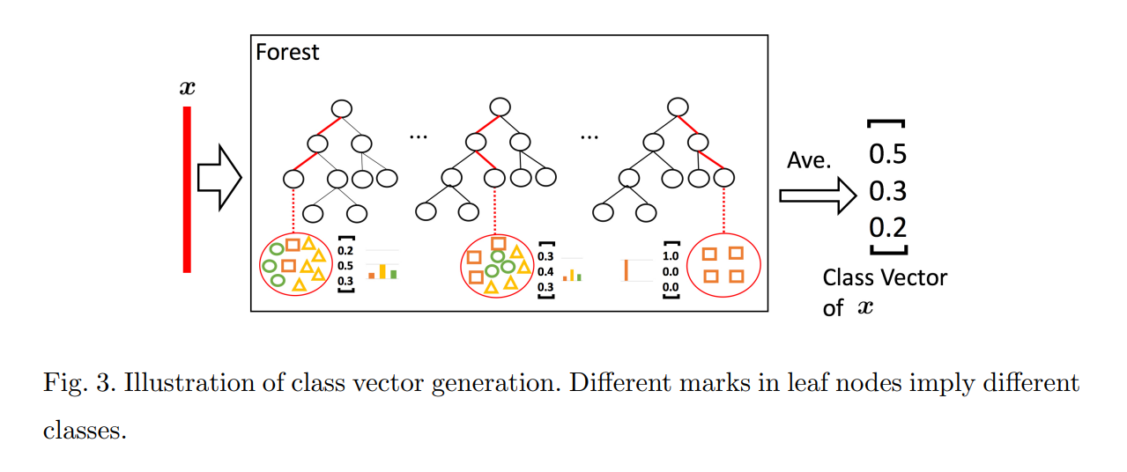
Class vector generation

Slide 8
Example

Slide 9
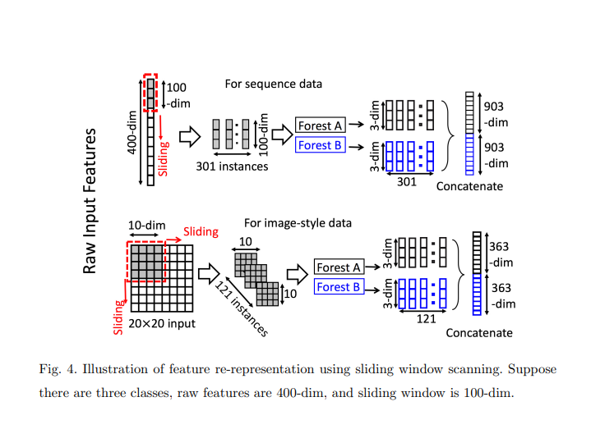
Multi-Grained Scanning
Using sliding windows to scan the raw features

Slide 10
Overall procedure
Multi-grained scanning
Cascade forests
Adding layers untill convergence of validation performance
Final prediction will be obtained by aggregating the class vectors at the last level

Slide 11
Overall procedure

Slide 12
DF21
Newer implementation – improvement on efficiency
https://github.com/LAMDA-NJU/Deep-Forest
Documentation: https://deep-forest.readthedocs.io/en/stable/

Slide 13
How to use
Classification

Slide 14
Results
From article promising – comparable to neural networks
Several models in different fields (examples)
Anti-cancer drug response https://www.sciencedirect.com/science/article/abs/pii/S1046202318303232
E-commerce consumers’ repurchase behavior https://journals.plos.org/plosone/article?id=10.1371/journal.pone.0255906
Detection of Cash-Out Fraud https://dl.acm.org/doi/abs/10.1145/3342241
Classification of cancer subtypes https://bmcbioinformatics.biomedcentral.com/articles/10.1186/s12859-018-2095-4

Slide 15
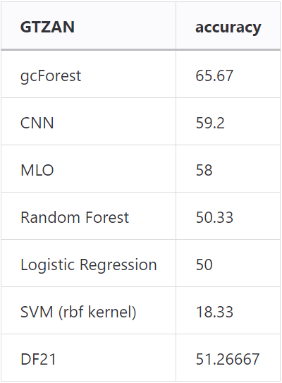
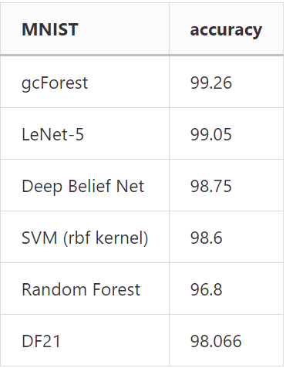
Their results

Slide 16
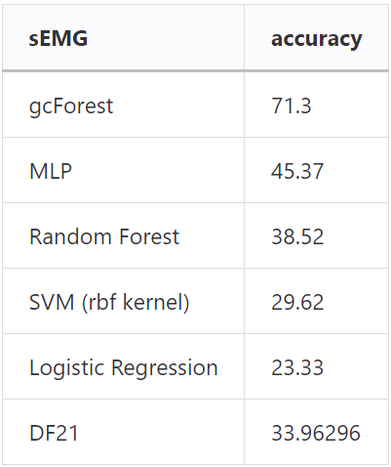
Their results

Slide 17
Their results

Slide 18
Their results

Slide 19
Layers

Slide 20
Compared to other classifiers
10 other classifiers, 55 datasets
Better than average in 85% cases
Average gain 5.5%
47% best accuracy
Better than Random Forest in 72%, average difference 0.019 Comparable runtime* (on average 3 times slower)

Slide 21
Compared to Random Forest

Slide 22
Parameter tuning
https://deep-forest.readthedocs.io/en/stable/parameters_tunning.html#
For accuracy (n_estimators, n_trees, max_layers, use_predictor)
Faster speed (n_jobs, n_bins, max_deapth, n_estimators, n_trees, min_samples_leaf, n_tolerant_rounds)
Lower memory (partial_mode)

Slide 23
Parameters
class deepforest.CascadeForestClassifier(n_bins=255, bin_subsample=200000, bin_type='percentile', max_layers=20, criterion='gini', n_estimators=2, n_trees=100, max_depth=None, min_samples_split=2, min_samples_leaf=1, use_predictor=False, predictor='forest', predictor_kwargs={}, backend='custom', n_tolerant_rounds=2, delta=1e-05, partial_mode=False, n_jobs=None, random_state=None, verbose=1)

Slide 24
Experiments with parameters
2*2*3*4*4*4 = 768 parameter settings with grid search
57 datasets -> 43 776 runs
5-fold cross validation -> 218 880 runs

Slide 25
Bin_type and criterion

Slide 26
Max_layers and n_estimators

Slide 27
N_trees

Slide 28
Predictor and use_predictor

Slide 29
Metalearning
To create a model able to recommend parameters for a selected dataset based on its metadata
To reduce the amount of parameter combinations needed

Slide 30
Thank you for attention
Main source: https://arxiv.org/pdf/1702.08835.pdf

