Slide 1
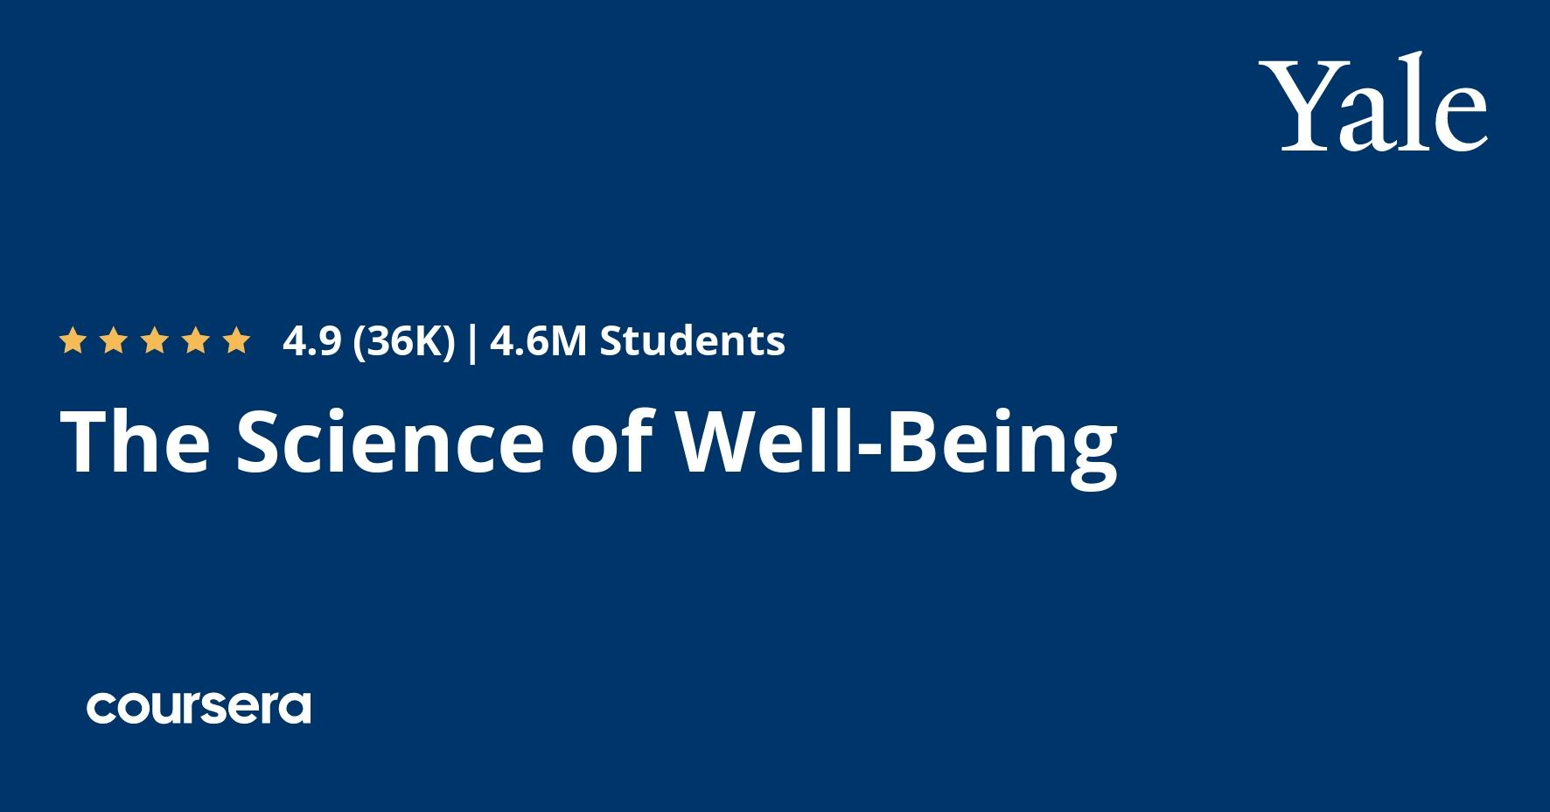
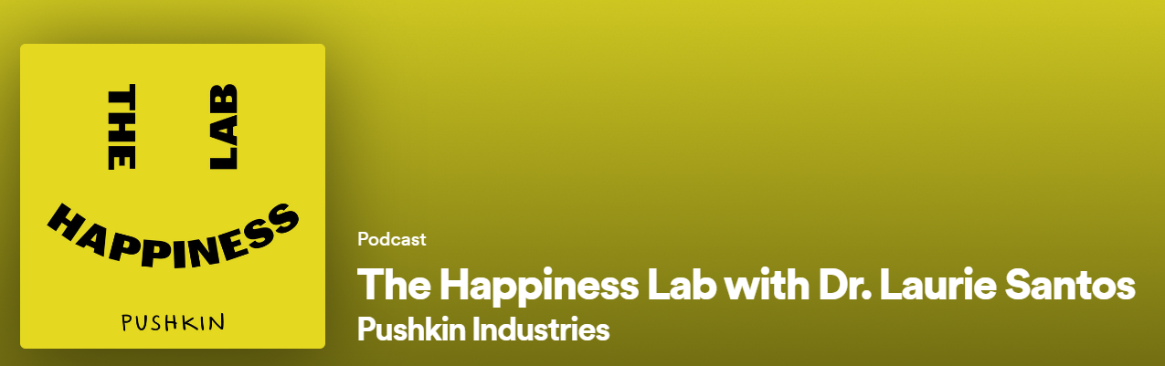
PV236 – Time management & effectiveness
Lucia Baginová

Slide 2
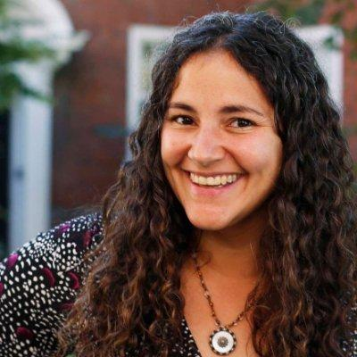



Dr. Lorie Santos
Professor of psychology at Yale
Master’s and Ph.D from Harvard Psychology Department
Popular Science magazine –
“The Brilliant 10: The top up-and-coming minds in science”

Slide 4
The Science of Well-Being
- started as a class “Psychology and the Good Life” at Yale university in 2018
- it became the most popular class in the history of Yale. Then the online course was created to be available for everyone.
- the aim of this course is to explore what new results in psychological science teach us about how to be happier, how to feel less stressed and how to enhance our well-being
- just knowing is not enough, we have to put things into practice

Slide 5




Structure of the course
10 weeks
5 theoretical lectures (Weeks 2-6)
Measuring your happiness before and after
PERMA Profiler , Authentic Hapiness Inventory
Practical assignments

Slide 6
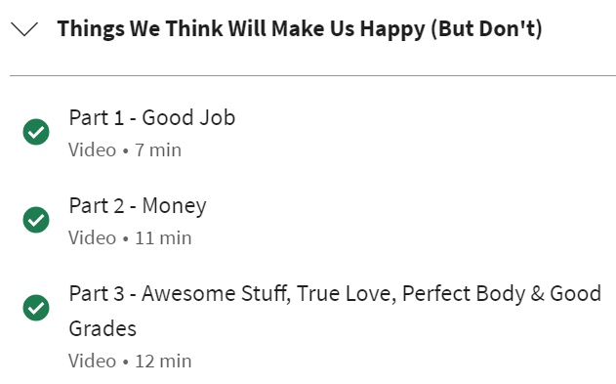
Week 2

Slide 7

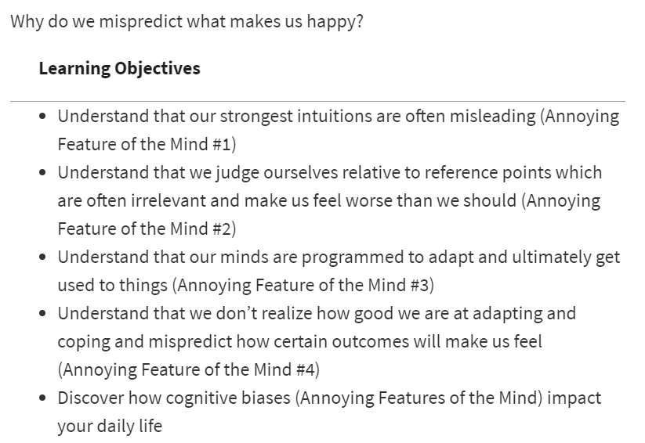
Week 3

Slide 8
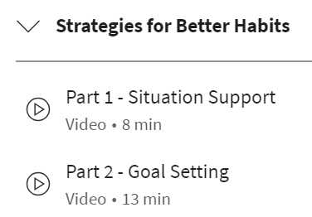
Weeks 4-6
4 - How can we overcome our biases
5 - Stuff that really makes us happy
6 - Putting strategies into practice

Slide 9
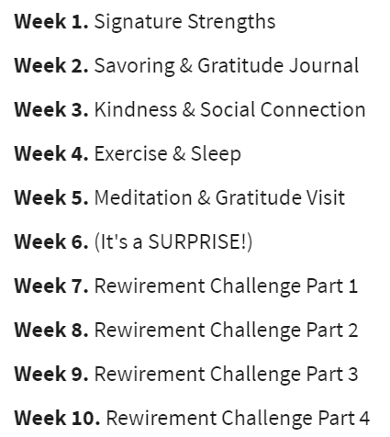
Course Rewirements

Slide 10
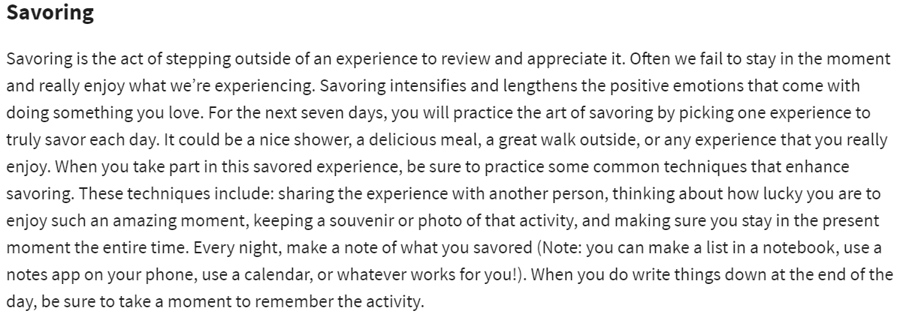
Week 2 rewirements

Slide 11
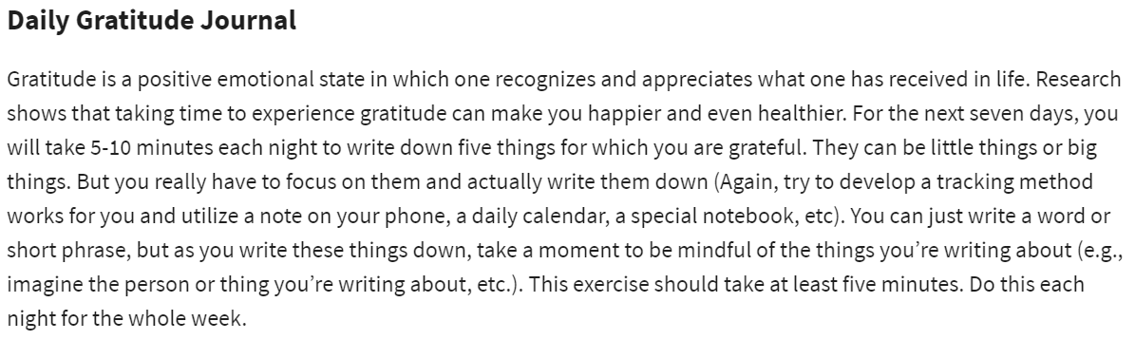
Week 2 rewirements

Slide 12
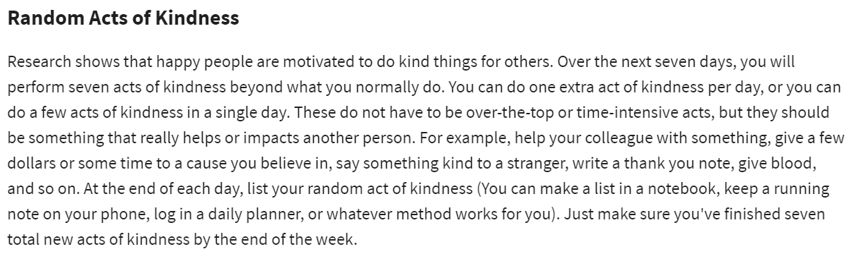
Week 3 rewirements

Slide 13
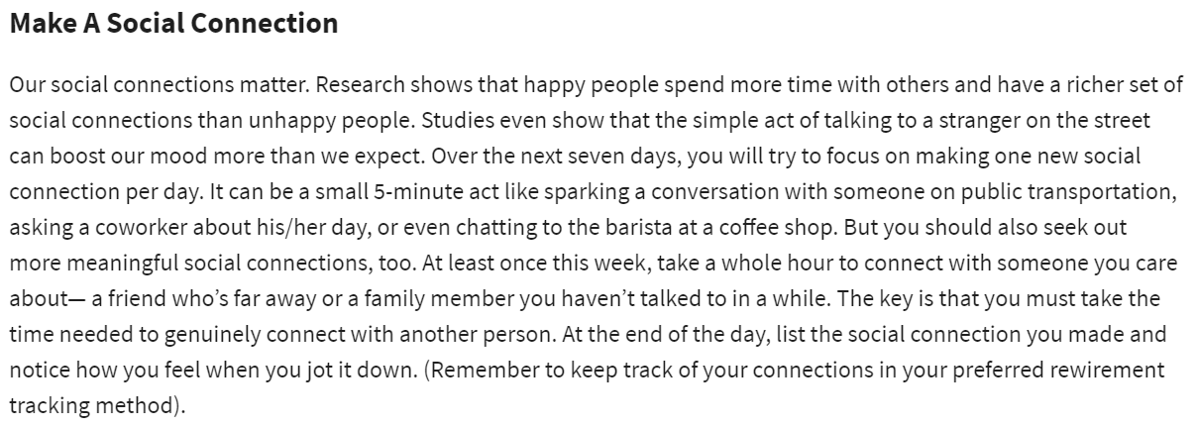
Week 3 rewirements

Slide 14
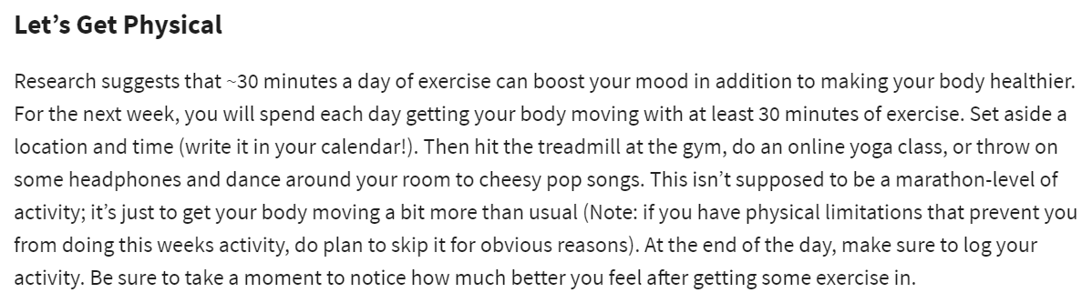
Week 4 rewirements

Slide 15
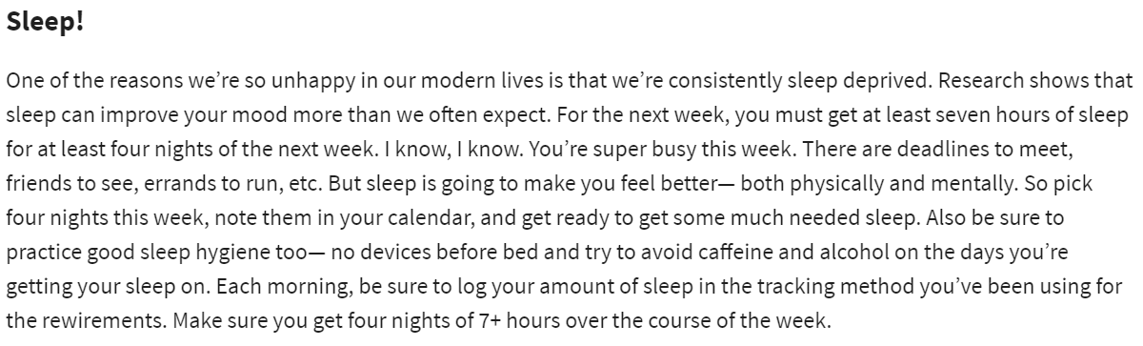
Week 4 rewirements

Slide 16
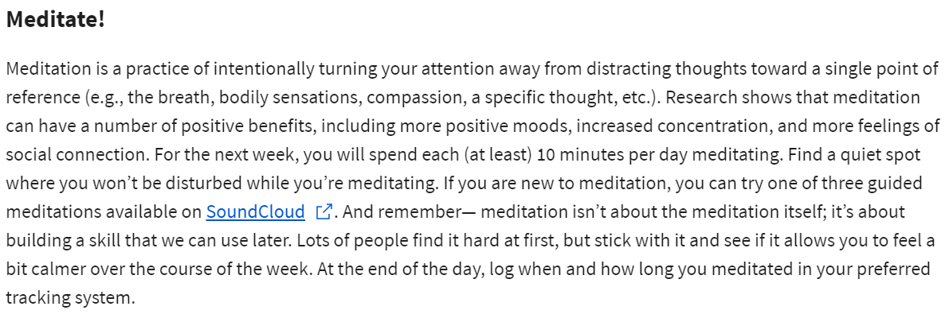
Week 5 rewirements
SoundCloud
Balance app

Slide 17
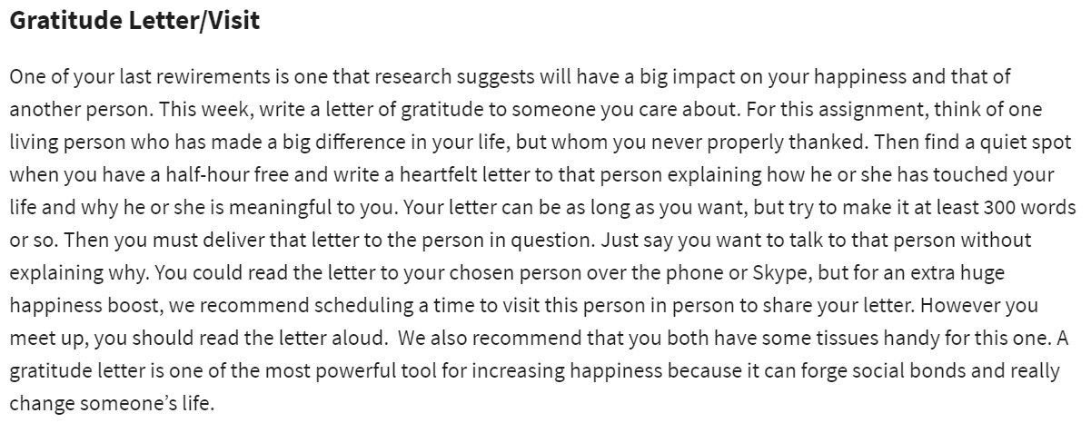
Week 5 rewirements

Slide 18
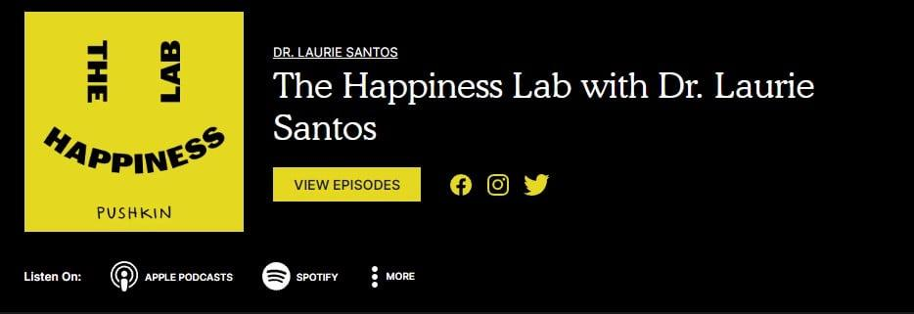
LINK (season 1)

Slide 19

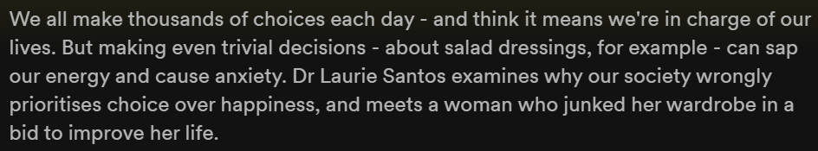

Slide 20
Experiment with jam tasting
in front of a store
2 Saturdays in a row
Discount promised for trying the samples
6 jams vs. 24 jams
How did the number of choices effect peoples’ behaviour?
The day with 24 jams -> attracted 20% more customers
-> we think more choices = better
The day with 6 jams -> 30 % of customers made a purchase
The day with 24 jams -> only 3 % of customers made a purchase
-> making choices is exhausting, overwhelming

Slide 21
From the episode:
“There’s a study that shows that when you have people make a hundred hypothetical decisions, all trivial, and then you give them a task that challenges their self-control, they give up easily.”

Slide 22

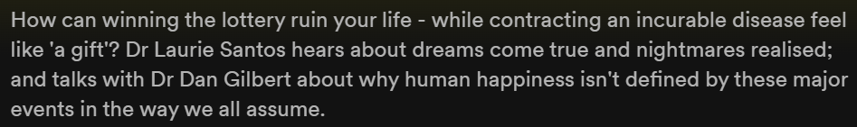
TedTalk: The surprising science of happiness
  synthetic happiness - the kind of happiness we make when we do not get what we wanted

Slide 23
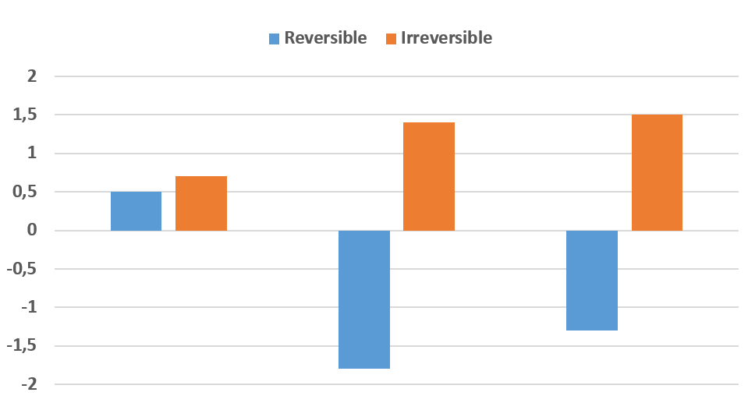
Experiment with students taking a photography class
They can take only one of 2 pictures home
  One group had to keep that picture they chose
  The other group was given the opportunity to rethink their decision. On the 4th day they could come back and make a swap
Change in satisfaction with choice
Prediction for day before swap expires
Day before swap expires
5 days after swap expired

Slide 24
What can we do in our day-to-day life
Limit the number of choices you have
  Limit your wardrobe only to the things you actually wear
    Get rid of unworn clothes
    Hide winter clothes during summers
  Choose your meal at the restaurant only from the food your friends are ordering, not from the whole menu
  Have the same breakfast the whole week
  ….
Before spending too much time on a decision:
  Is it really important? Is it worth your energy?
  Will the different outcomes really make a difference for you?

Slide 25

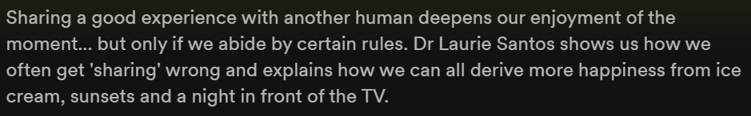
Experiment with chocolate tasting
People were supposed to taste and rate chocolate
Tasting alone vs. tasting with another person
Subjects did not know they are tasting the same samples twice
-> When sharing the experience with someone else,
people rated the same chocolate as better

Slide 26
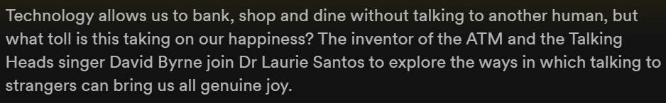
“The sheer amount of time we spend around other people actually predicts how happy we are. Take one famous study by positive psychologists Ed Diener and Marty Seligman. They looked at people who scored in the highest 10 percentile on happiness surveys and tried to figure out, what makes them so much happier than the rest of us. The researchers discovered that these happy people didn’t spend any more time exercising or doing religious activities. What did these happy folks do differently? They were more social. They spend more time around other humans, than people with average levels of happiness. The results were so strong, that these researchers deemed being around other people as a necessary condition for very high happiness.”
“Another study by nobel prize winning psychologist Danny Kahneman confirmed this. He and his colleagues tested, which daily activities make us feel best. The winner? Socializing with others. It’s better than eating, shopping, relaxing, or even watching tv. Just being with other people makes us feel good. Even if those people are strangers.”

Slide 27

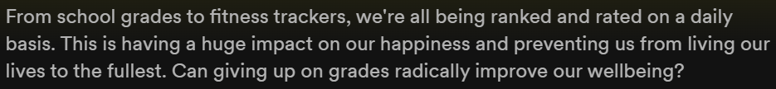

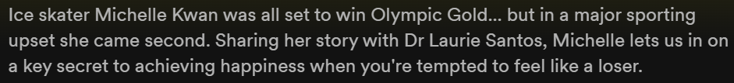
Some other episodes

Slide 28

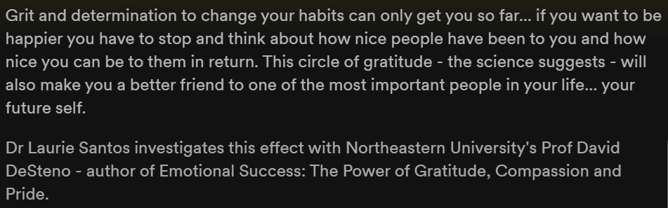

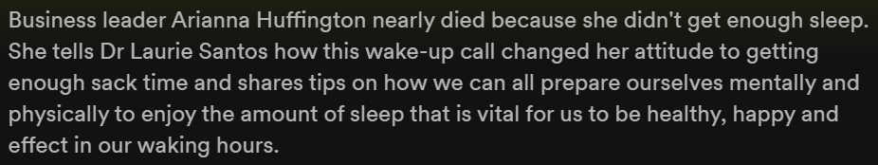

Slide 29
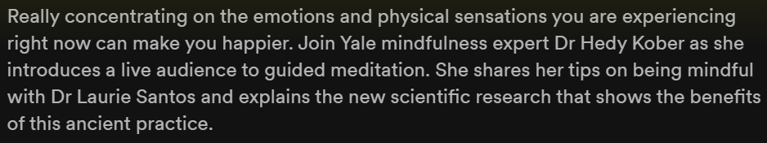
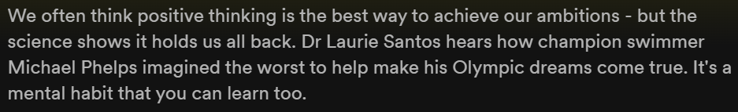

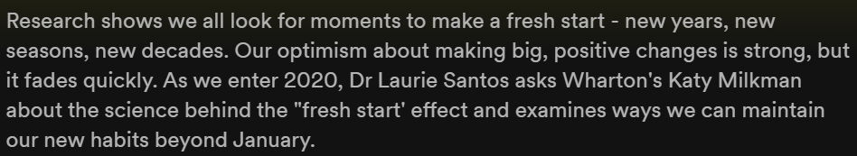

Slide 30
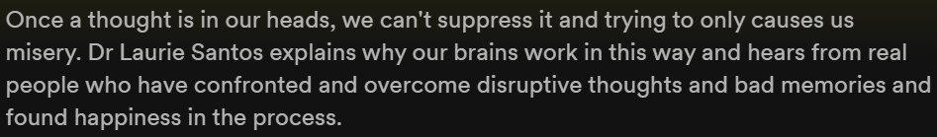

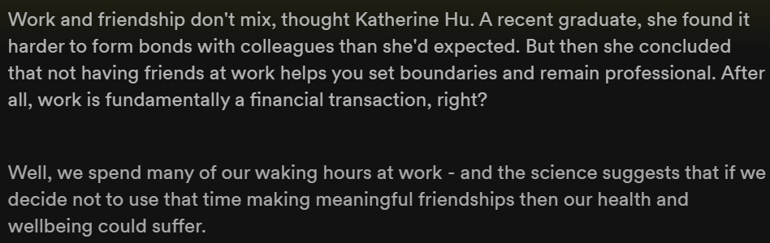

Slide 31
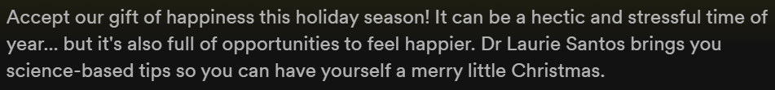

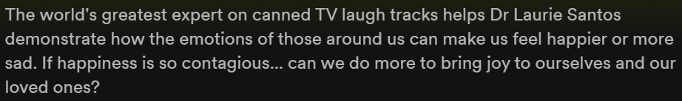

Slide 32
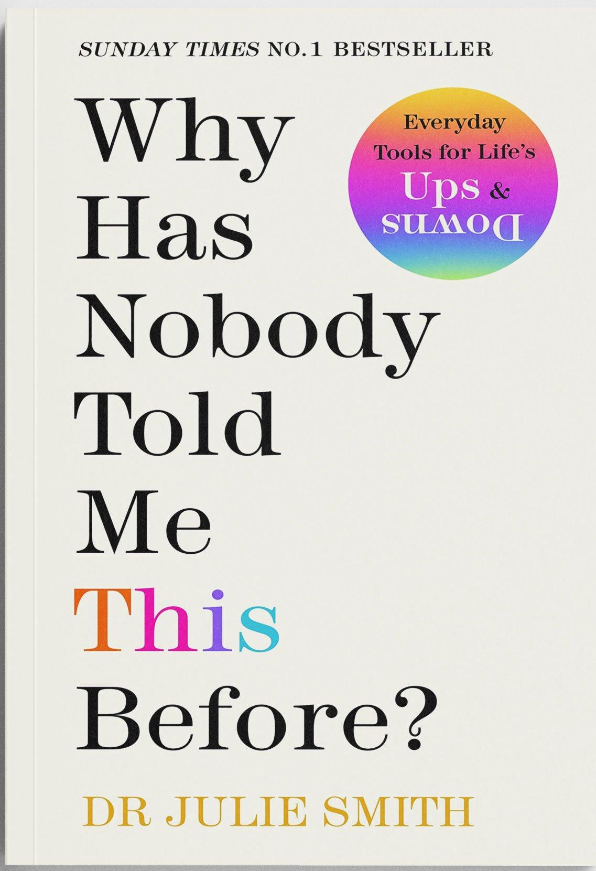
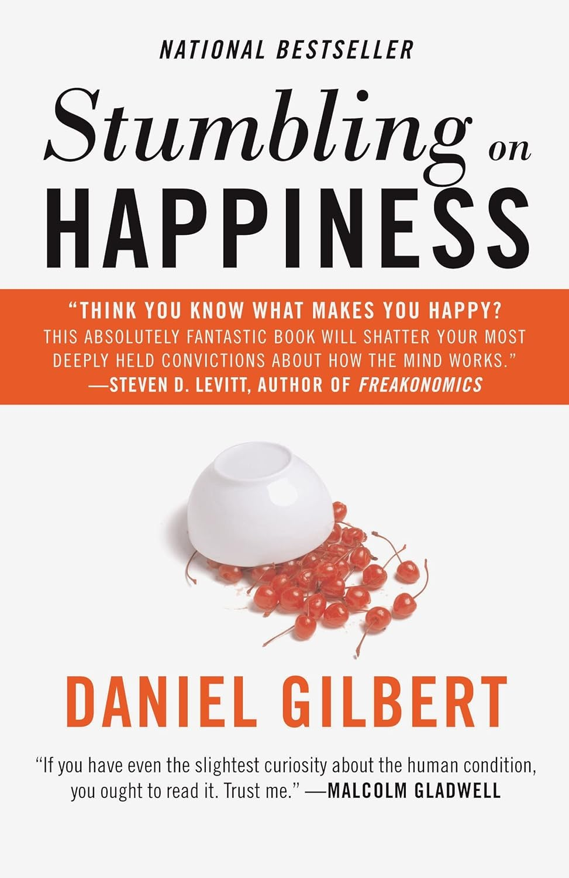
Links
Website of Dr. Santos: https://www.drlauriesantos.com/
The happiness lab (contains other links to articles/sources that were mentioned during the episodes)
  Spotify
  Apple podcasts
Measuring Hapiness
  PERMA Profiler
  Authentic Hapiness Inventory
Free (hopefully still) yearly subscription on guided-meditation app Balance
TedTalk: The surprising science of happiness
My other book recommendations:
“Why has nobody told me this before” by Dr. Julie Smith – during a Mental health related session at my workplace, somebody asked the psychologist: “If you had to pick only one book that you would recommend to everybody”. This book was his recommendation.
“Stumbling on Happiness” by Daniel Gilbert

