Slide 1
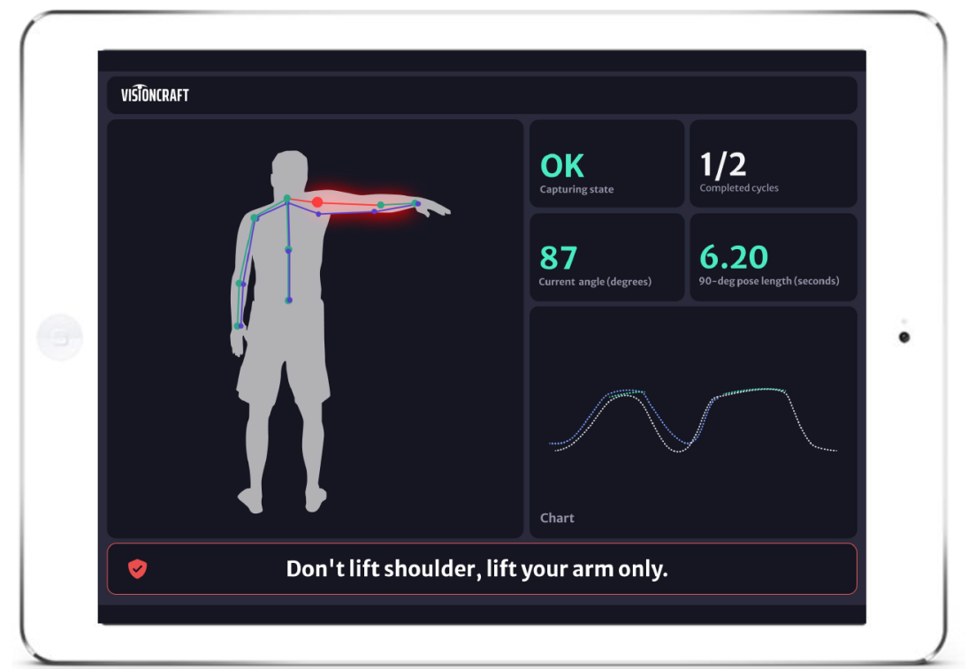
VisioTherapy AI-powered remote physical therapy
Petra Budíková

Slide 2
About me
2013: Ph.D. at FI MUNI (Large-Scale Multi-Modal Image Search)
2013-2021: postdoc at DISA lab, FI MUNI
Image retrieval and annotation
Human motion retrieval
Since 2022: R&D in VisionCraft + little research at FI
Summer 2023: joined forces with DISA lab within TACR grant
Objective: develop VisioTherapy software for remote monitoring of rehabiliation exercising

Slide 3
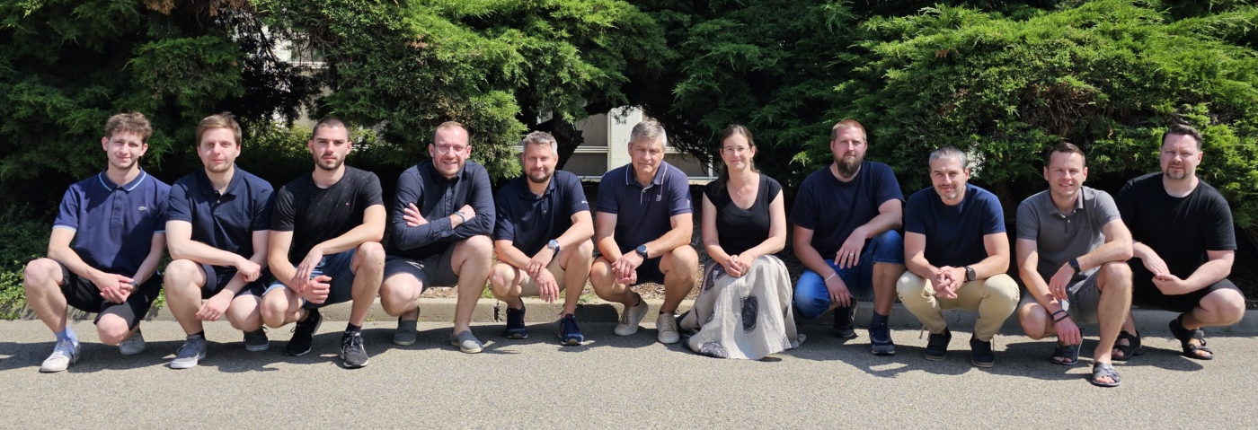
About VisionCraft
Startup from Brno, founded in 2018
At first, focus on Intelligent Transportation Systems
Object detection and tracking using NNs
Edge computing, privacy-safe
Since 2022, another area of interest: applications of human motion analysis for healthcare

Slide 4
Human motion analysis for dummies
What is the man doing?
Is his movement similar to some example?
Is he dangerous?
…
motion data extraction
motion data analysis
Video taken by standard camera/webcam/
smartphone
3D model of human skeleton

Slide 5
Why physical therapy?

Slide 6
Why physical therapy? (II)
Home exercising issues
50-70% of patients do not adhere to home exercise plans
Patients often exercise incorrectly or do not even remember the exercise
Poor accessibility
Waiting times about 9-15 weeks to see a physical therapist is US and UK
In USA, it is estimated that 50 000 therapists will be missing by 2050
Enormous demand
A third of people globally are currently living with a health condition that would benefit from rehabilitation
The number is expected to grow in future

Slide 7
VisioTherapy concept
Basic idea: Assist patients during home exercising
Guide them during exercising
Detect errors, provide feedback
Provide motivation, measure progress
Report to therapists
Patient’s journey:
Initial appointment & individual- isation
Exercising at home guided by VisioTherapy app
(Ir)regular checks with therapist

Slide 8
VisioTherapy concept: UI
+ acoustic feedback (sound signals or synthetic voice)
+ acoustic feedback (sound signals or synthetic voice)

Slide 9
VisioTherapy concept: Benefits
For patients
For therapists
reminders to exercise
motivating elements
control of correct exercising
frequent and correct exercising
faster
recovery
motivated patients
feedback from patient’s home exercising
more efficient patient treatment
more
money

Slide 10
VisioTherapy concept: What makes us special
Wide availability: runs on smartphone, no special hardware needed
Absolute privacy: edge computing, no video shared anywhere
Fast and precise feedback: real-time motion analysis, high-precision motion detection
Personalized solution: takes into account the individual needs and abilities of each patient
Therapist in the loop: therapist remains in charge, guarantees the medical quality of the rehabilitation

Slide 11
VisioTherapy: first steps
Autumn 2022: first experiments and consultations with therapists
Very rough prototype presented at WebSummit conference, positive feedback
January 2023: submission of TACR TREND grant proposal
Scope: in cooperation with FI, develop more precise algorithms for skeleton detection and motion analysis, create working desktop application
May 2023: submission of TACR SIGMA grant proposal
Scope: develop of mobile application, gamification, business strategy
Summer 2023: received both grants, can build a reasonable team and start serious work on VisioTherapy!!
Developers and business people: VisionCraft
Physiotherapy expert: Mgr. Lukáš Katzer
Research team: Honza Sedmidubský, Mima Jánošová, Andrej Černek, Dávid Rusnák (DP)

Slide 12
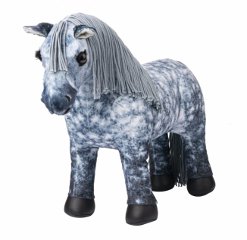
VisioTherapy: from idea to product
Extraction of high-quality motion data from video
Precise and fast evaluation of exercise correctness
Analysis of patient’s progress, problematic parts, …
Gamification elements
Design and implementation of desktop and mobile app

Slide 13
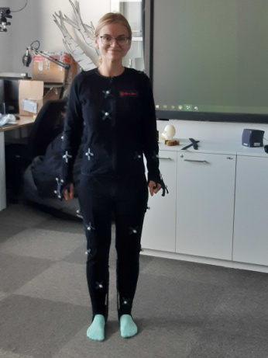
Extraction of high-quality motion data from video
On one hand, there are many NNs that perform human pose extraction from ordinary video
On the other hand, the results are often far from perfect
What can we do to extract high-quality motion data?
Search for NN models suitable for rehabilitation exercises
Create dataset of rehabilitation exercises with GT of precise motion data
HCI lab at FI
Fine-tune existing NN models using our data
Preprocess video before applying NNs
Apply cleaning algorithms to extracted motion data

Slide 14
Motion analysis
Basic functionality
Checking static constraints on patient’s position
Measurement of joint movement angles
Advanced processing of motion data
Definition of suitable similarity model
Online detection of erroneous exercising
Offline comparison of motion sequences using both positive and negative examples
Exercise repetition counting
Detection and explanation of differences between model and actual exercise
Patient progress monitoring
Data mining over exercising data of patient groups

Slide 15
Gamification
Many apps use gamification
Language learning
Fitness training
…
However, not all gamification principles are suitable for physiotherapy
The more the better is not true here!
We need to consult with therapists to come up with suitable motivation elements
Could be a nice bachelor/diploma theses… anybody interested?

Slide 16
Design and implementation of VisioTherapy app
Both desktop and mobile interfaces
Mobile for patients
Mobile and desktop for therapists
Challenge: Feedback on exercise correctness
During exercising, after exercising
Visual and audio
This could also be a very nice bachelor/diploma thesis!
Implementation
Edge computing – emphasis on efficiency
Only derived data (MoCap + statistics) sent to server

Slide 17
Timeline
7/2023
Very rough prototype
Basic motion analysis
7/2024
Full prototype for desktop
Enhanced quality of motion data
Evaluation of exercise correctness
Exercise repetition counting
Ready to test with first users
7/2025
Working mobile app
High-quality motion data
Full scope of motion analysis

Slide 18
The End… Questions? Comments?

