Slide 1
Estimation of vegetation parameters from hyperspectral data
T. Slanináková, 15.9.2023, SitSem

Slide 2
Context
EnviLab: Platform for providing data, visualizations and analyses of ecosystems in CZ
Why?
Features:
Aggregating and providing geo data from remote sensing via Web, API
Hosting visualizations, analyses, and results of various research groups
Providing data analyses
Analysis/visualization of bark beetle’s reproduction/spread over Czech forests
Vegetation parameters

Slide 3
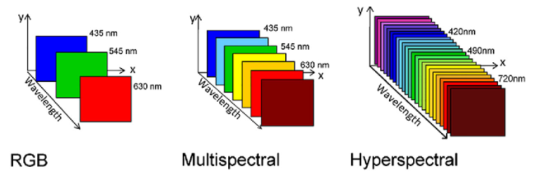
Context
Lots of multi/hyperspectral data from remote sensing
Source: Single-Cell Analysis Using Hyperspectral Imaging Modalities.

Slide 4
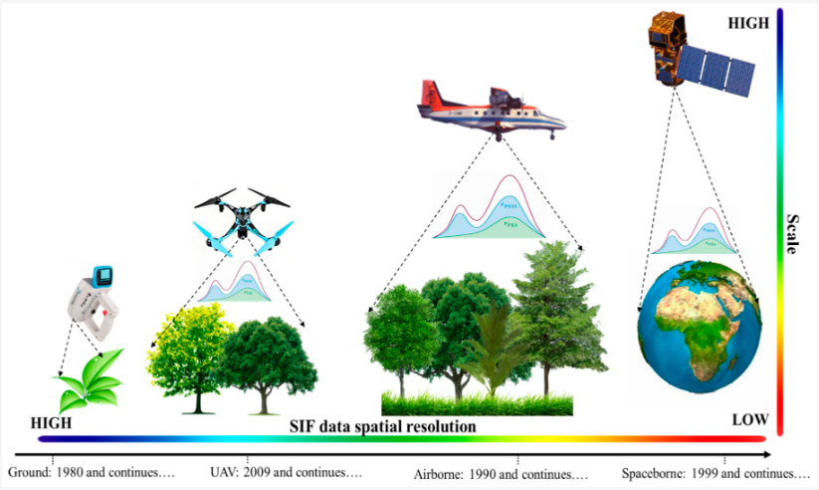
Context
Lots of multi/hyperspectral data from remote sensing
ESA – Sentinel 1,2,3,5P missions (program COPERNICUS)
Many more data sources in the future (FLEX ‘25, CHIME ‘28)
CzechGlobe (CAS) – Airborne missions
Use of such data:
Mining/geology
Urban land-use mapping
Agriculture: health of the crops
Vegetation analysis
Review of Top-of-Canopy Sun-Induced Fluorescence (SIF) Studies from Ground, UAV, Airborne to Spaceborne Observations

Slide 5
Context
Monitoring the health of forests through assessing vegetation parameters
Why:
Interesting for CzechGlobe, foresters
Attractive for us as a nice use case for EnviLab
Interesting research problem with active scientific community

Slide 6
Outline
Context
Problem definition
Approach
Results
Next steps

Slide 7
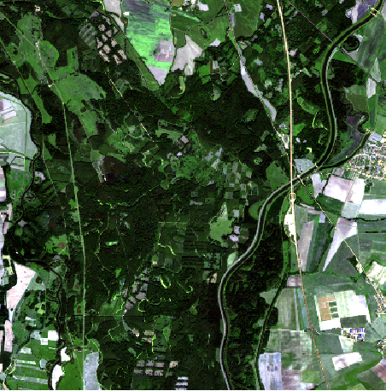
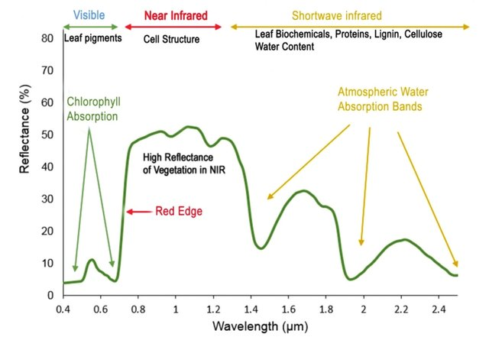
Problem definition
Given data from remote sensing (satellite, airborne) train a model to predict vegetation parameters
Data

Slide 8
Problem definition
Given data from remote sensing (satellite, airborne) and simulated spectra, train a model to predict vegetation parameters
Simulated spectra
Data
Vegetation parameters
Spectra

Slide 9
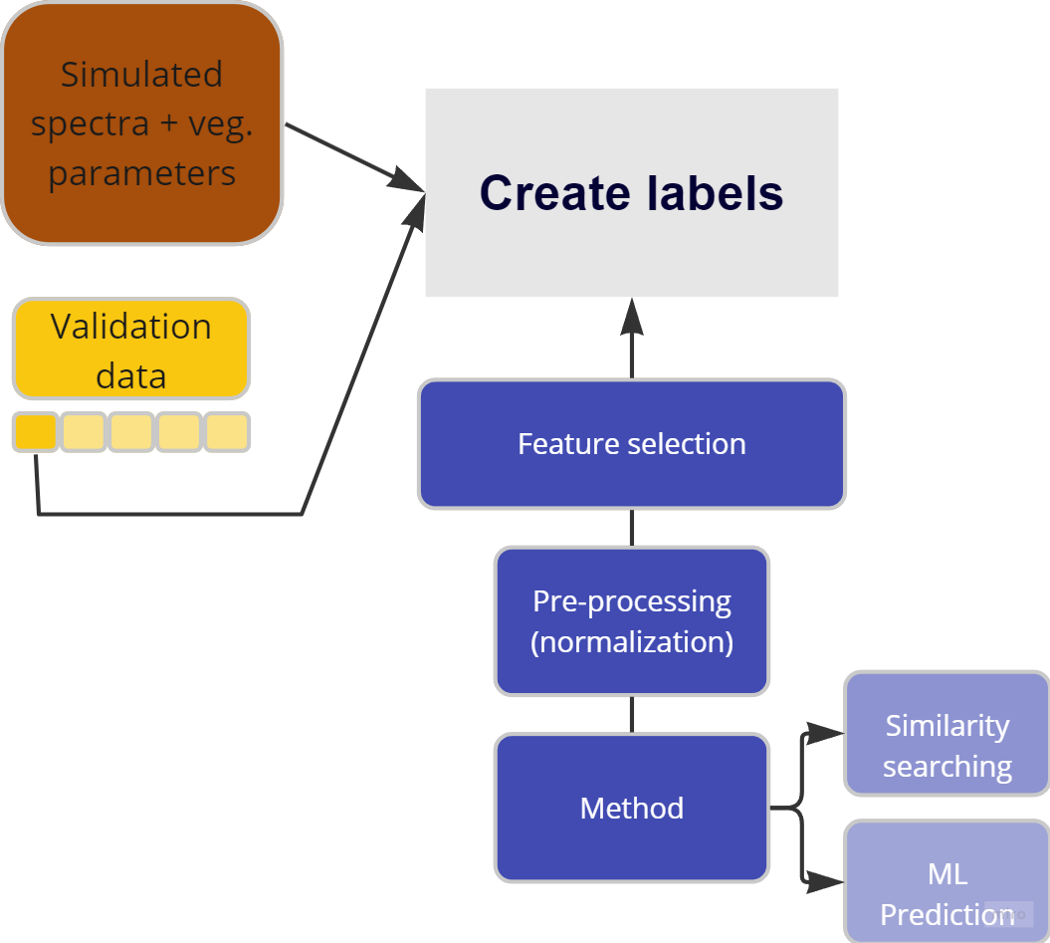
Approach
Our approach

Slide 10
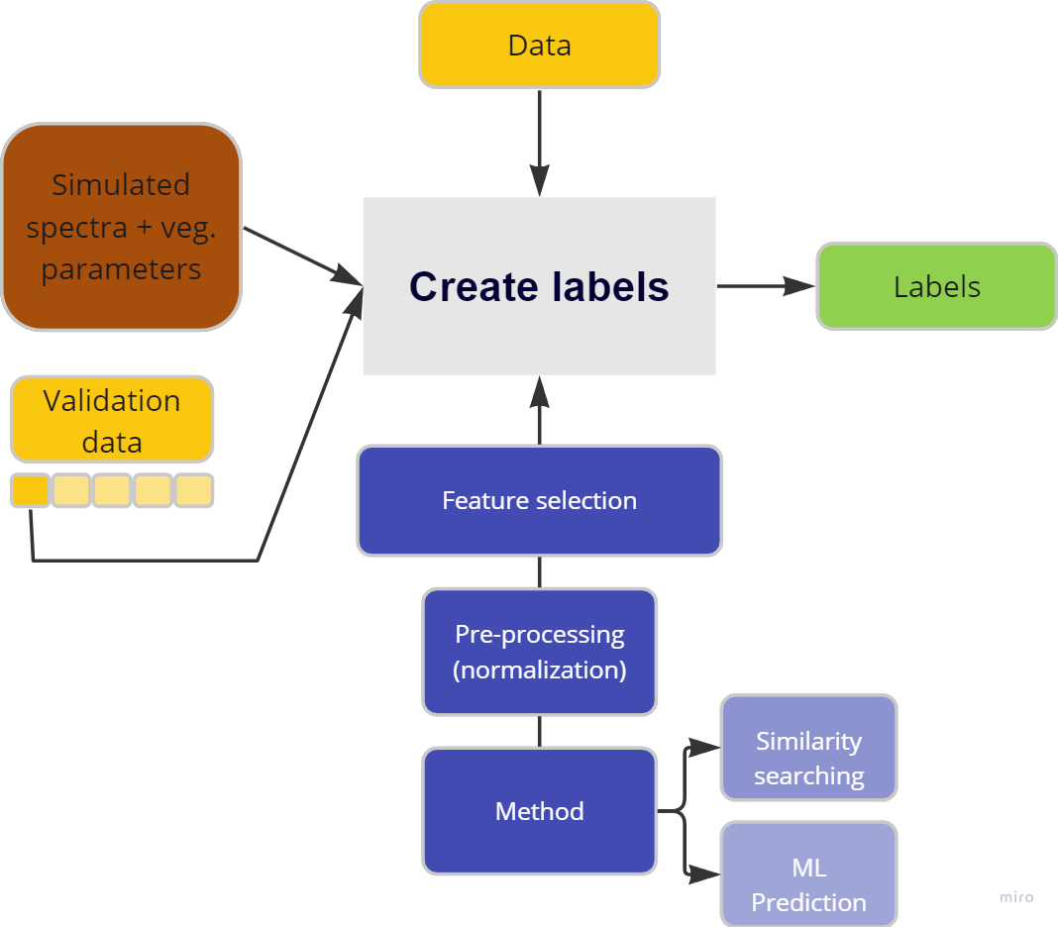
Approach
Our approach

Slide 11
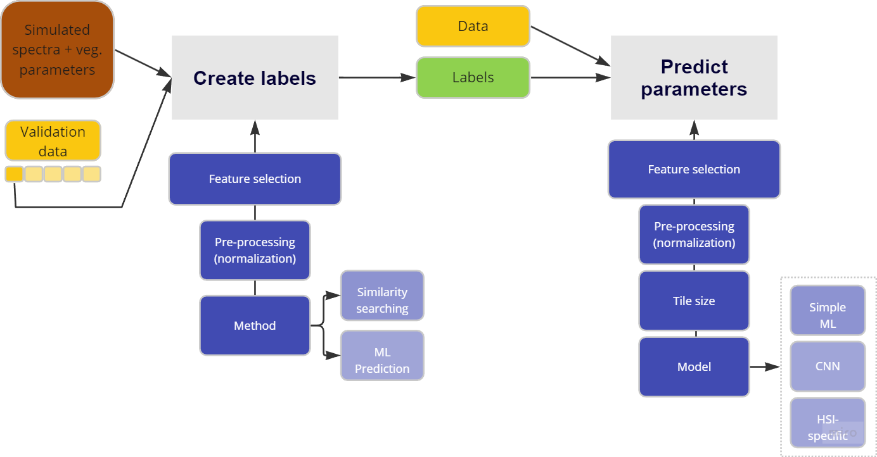
Approach
Our approach

Slide 12
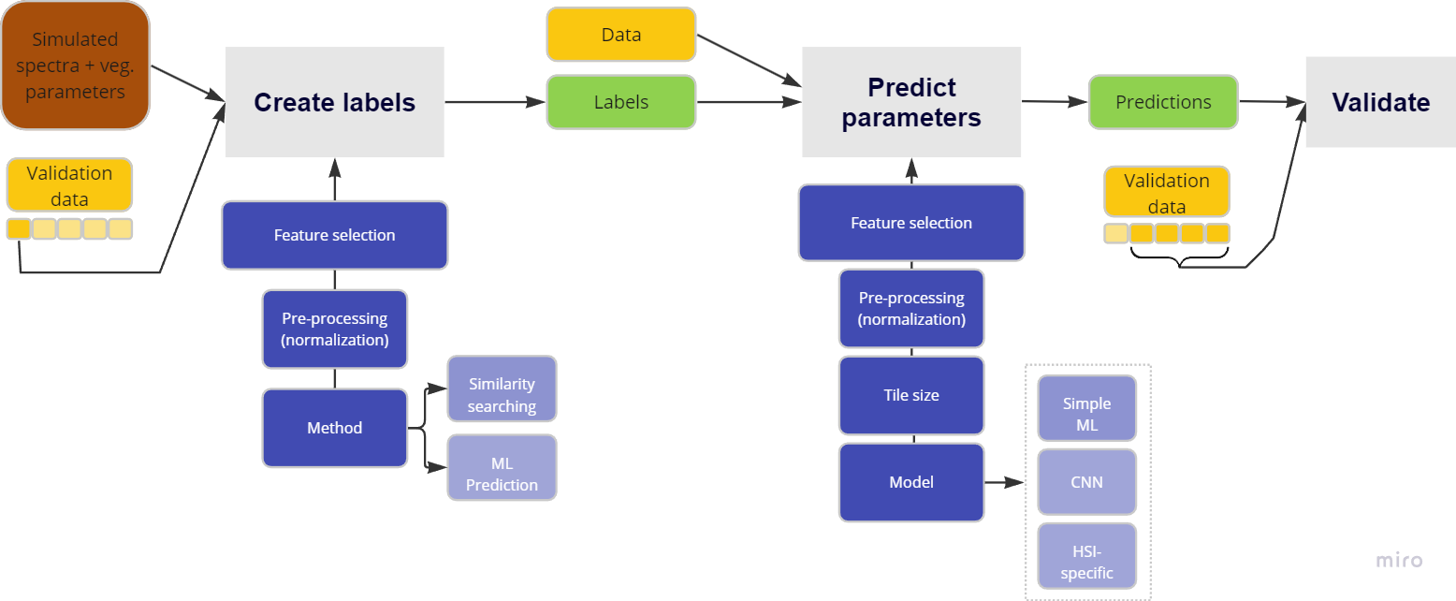
Approach
Our approach

Slide 13
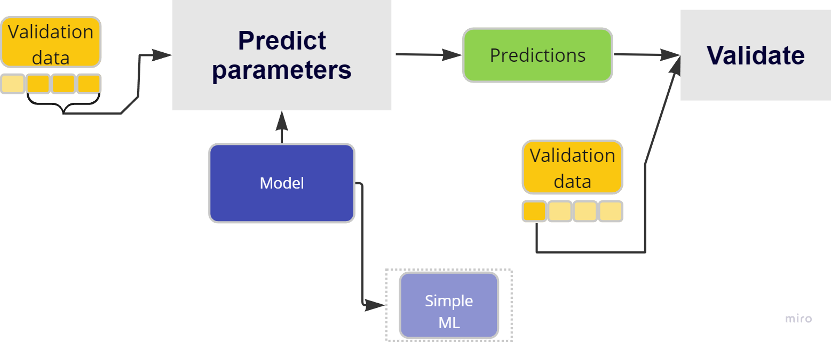
Approach
CzechGlobe’s approach

Slide 14
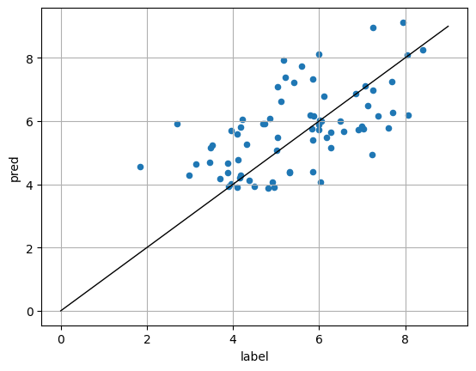
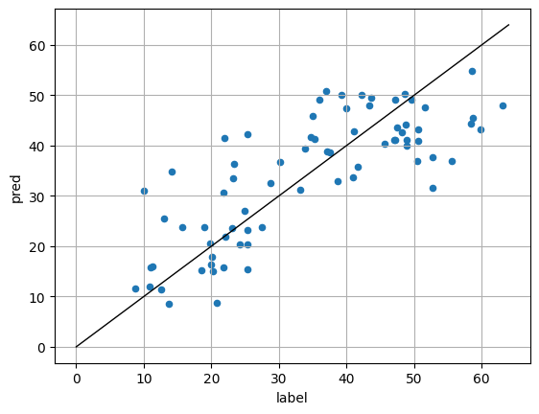
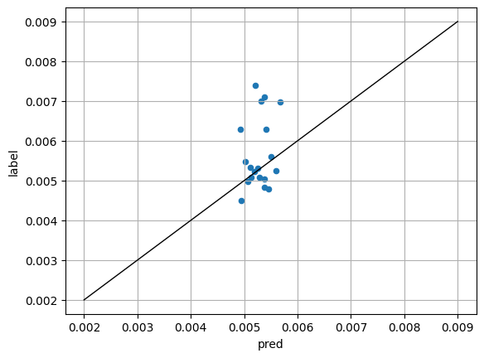
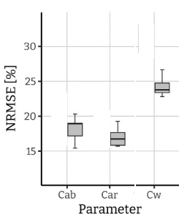
Results
On hand-collected validation data (different locations, different times)
Best model based on (n)rmse
Carotenoids
Chlorophyll
Water content
8.63
0.00087
Rmse nrmse
1.27
0.2
0.184
0.301

Slide 15
Next steps
Improve the quality of labels
More detailed simulated spectra
Involve more validation data into the process
Include more data
Extend with data from different time segments (unclouded)
Extend with airborne data
Try more robust models
Prithvi-100M-multi-temporal-crop-classification

