Slide 1
Final summary
Introduction to Service Science

Slide 2
Main topics to remember
Service economy
Service Dominant Logic
Service system modelling
Service environment and service cooperation
Asymmetric information and its role in IT
Software as a Service
Basic of Diamond Path (4 diamonds)

Slide 3
Service economy
Product economy and basic consequences
Development of service economy, why it is important
Role of service in global economy
Why everything is a service?

Slide 4
What is the Service Science?
Service Science means curricula, training, and research programs that are designed to teach individuals to apply scientific, engineering, and management disciplines that integrate elements of computer science, operation research, industrial engineering, business strategy, management sciences, and social and legal sciences, in order to encourage innovation in how organizations create value for customers and shareholders that could not be achieved through such disciplines working in isolation. (U.S. National Innovation Investment Act, 2007)
Notes:
Začít od konce
Definice SeS, důležitost poznala i vláda USA – je to podstatné pro společnost
Použít slovo multidisciplinární
Pozor – Jim Spohrer definuje Knowledge intensive and customized service

Slide 5
Multidisciplinarity
I – shape
Dash – shape
T – shape
Deeply focused
Expert only in one branch
Interdisciplinary approach
Not expert, but is able to communicate with I-shapes
Multidisciplinary approach
Expert in one field, interdisciplinary in the others

Slide 6
T – shape professionals
Economics and finance
Soft and Other Skills
Management and marketing
Soft skills
Core disciplines
IT knowledges
Service Science

Slide 7
Service dominant logic
Product dominant logic and its paradigms
Service dominant logic basic paradigms
SDL advanced paradigms
What is value proposition?
Difference in the role of customer in PDL and SDL

Slide 8
Basic Service Economy Paradigms
Service is the fundamental basis of exchange
The customer is always a co-creator of the value
All social and economics actors are the resource integrators
Value is always uniquely and phenomenologically determined by the beneficiary

Slide 9
Advanced SDL Paradigms
Indirect exchange masks the fundamental basis of exchange
Goods are distribution mechanism for service provision
Operant resources are the fundamental source of competitive advantage
All economies are service economies
The enterprise cannot deliver value, but only value proposition
A service-centered view is inherently customer oriented and relational

Slide 10
Value proposition
The offer done by provider to the client
What the provider is able to do to increase beneficiary of the client
Based on
Knowledge
Information
Similarities on the market
What we can do for what price
Must be formulated in the form understandable for the rervice receiver

Slide 11
Service system modelling
Basic entities and their roles
Provider
Client (Customer)
Target
Relation among them
Mention and use principle
Role of time

Slide 12
Mention - Use
Forms of relationship
value co-creation
value proposition
information sharing
Provider
Client
Mention
Forms of ownership
C is owner of T or
C needs an added
value on T
Forms of responsibility
P is responsible for
the actions with T
Mention/Use
Use
Target

Slide 13
Service environment
How we build service environment
Basic features of the environment
Special cases of cooperation between service systems
Cooperating service systems
Dual service system

Slide 14
Cooperation of service systems
Lets have some service system (S1) with provider, client and target defined
We say the system S1 cooperates with system S2 if
Agent who plays the role of client in S1, plays role of provider in S2
Agent who plays the role of provider in S1, plays role of client in S2
Benefits for the client in S2 depends on benefits for the client in S1 (or vice-versa)
The target is not same

Slide 15
Dual service system
Lets have the prime service system S1
Lets have a second service system S2, where
Agent who plays the role of client in S1, plays role of provider in S2
Agent who plays the role of provider in S1, plays role of client in S2
Benefits for the client in S2 depends on benefits for the client in S1 (or vice versa)
Target is the same in S1 and S2 with the bidirectional value proposition

Slide 16
Service system environment
P
P
C
P
C
C
P
T
T
T

Slide 17
Asymmetric information
Definition and differences
Basic concepts and models
Information about the price
Information about the quality
Auction models
Moral hazard
Role of IT in the Framework of Asymmetric information

Slide 18
Stigler's model
Seniors game
Where to buy a particular good for the cheapest price
Assumptions
The buyer knows all shops, where he can buy this product
The buyer does not know the prices in the shops
The buyer is willing to invest some costs to find the information about the cheapest price
The amounts of those costs are limited
What do we do now to solve this problem?

Slide 19
The searching costs
The valuation of the time, needed for the finding of the information
The costs for the searching must be same or less than expected profit
Conclusions
The costs for the searching are individual
The reduction of the problem to the price difference is wrong
The value is also important
The analysis of the problem is too simple
IT rapidly decline the searching costs

Slide 20
Quality of information
If you are buying some product or services, how you can be sure about its quality?
Guarantee
Insurance for the product failure
Impulse for the producer to improve the quality
Has information value – indicator of the product quality
Direct influence to the producer reputation
Selecting (extended) guarantee can be used for the customer discrimination

Slide 21
Moral hazard
a tendency to take undue risks because the costs are not borne by the party taking the risk
The customer is able to affect an event he is insured against, but the seller has no power to monitor or affect this event.
Insurance company do not know how you use your car
ERP supplier has limited information about customers IT security
Double moral hazard
Supplier gives only limited or minimal guarantee
Customers information about product quality is limited

Slide 22
Auctions with independent value
Closed auctions
The offers are given before
the first price auction
The highest or the lowest price wins
The second price auction
The highest and lowest offer are excluded
The second highest or lowest offer wins

Slide 23
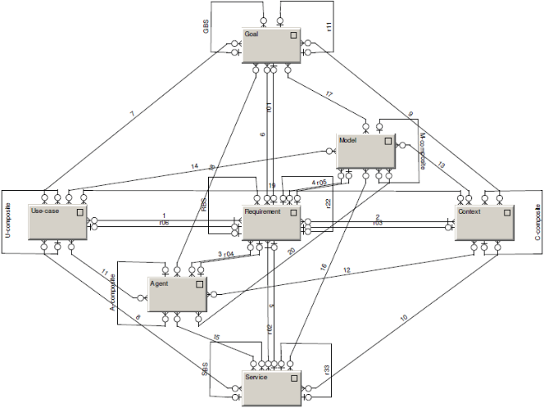
Diamond-Path Framework
Overview
See
Recognize
Organize
Do
Attention
Focussing
Cognitive
Elements
Agent-Team
Organization
Predictive
Behaviour
Category
GBS
R22
base
Goal
reaching
reaching
R
fulfilling
follower
fulfilling
Relationship
composite
establisher
R11
CI-connection
R
Item
R
Context
Action
Agent
Flow
characteristic
R
P
characteristic
organizer
organizer
member
member
R
author
learner
Category
R
Object
R
Rule
covering
superior
collaborator
focusing
Manifestation
R01
Activity
R02
characteristic
R
characteristic
detail
R33
Operation

Slide 24
Diamond See
Relationship
characteristic
characteristic
R
P
Category
R
Object
R
Rule
characteristic
R
characteristic
Operation

Slide 25
Road (street) - Objects and relationships
Name | Relationship | Name
Car | Is on | Road
Bus | Is on | Road
Bicycle | Is on | Road
Pedestrian way | Is on | Road
Driving lines | Are dividing | Road
All vehicles | Are using | Driving lines
Trafic on the road | contains | All vehicles
Trafic lights | Are managing | Trafic on the road

Slide 26
Diamond Recognize
Category
base
R
CI-connection
Item
R
Context
R
R
Manifestation

Slide 27
Example – bus manifestation
Public trasport
How it is organized
Road
Traffic problems
Travel agency
How fast can they go?
What services they can provide?
Lines reserved for buses
How fast they are
How they are equipped?

Slide 28
Diamond Organize
GBS
R22
Goal
reaching
reaching
fulfilling
fulfilling
follower
establisher
composite
R11
Action
Agent
Flow
organizer
organizer
member
member
author
learner
covering
superior
collaborator
focusing
R01
R02
Activity
detail
R33

Slide 29
Agents
Agent | Public transport | Road
Citizen | Customer | Pedestrian Driver Biker
Emplyee | Driver of public transport Inspector | Policeman Fire man Emergency

Slide 30
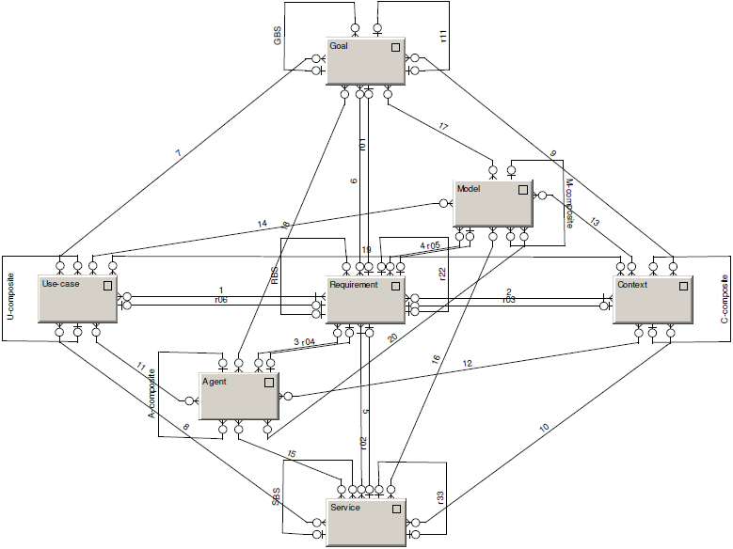
Diamond Do

Slide 31
Realization
Context | Requirement | Service | Agent | Goal | Model | Use Case
Healthy run of the citizen | To find optimal road | Road planner | Citizen | To be healthy | Relaxing roads | Current status of weather and air pollution
Race of the moto bikers | To find optimal road | Road planner | Moto driver | To win the race | Race maps | Weather (rain / sunny), position of other participants
Emergency service | To find optimal road | Road planner | Driver of emergency vehicle | To get to the place of accident | City street map | Current situation of traffic

Slide 32
Simple case studies
Smart City
Contextual analysis of a Smart City
Data

